Slide 1

My VA: Payment Info + Onsite Notifications
Discovery Readout
Liz Lantz
liz.lantz@adhocteam.us
January 28, 2022

Slide 2
Background & Goals

Slide 3
Background
Background & Goals
Throughout My VA 2.0 research and discovery, the recurring theme mentioned by Veterans is that seeing payment info on their My VA dashboard is a high priority. The importance of payment information is also reflected in analytics, as viewing payments is a top interaction on VA.gov overall and is a top search term from the My VA dashboard.
This effort aims to add payment information to the My VA dashboard to be elevated for logged-in Veteran's awareness and attention, as the MVP.
Link to product brief.

Slide 4
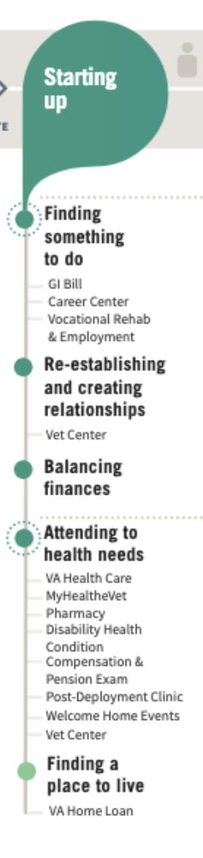
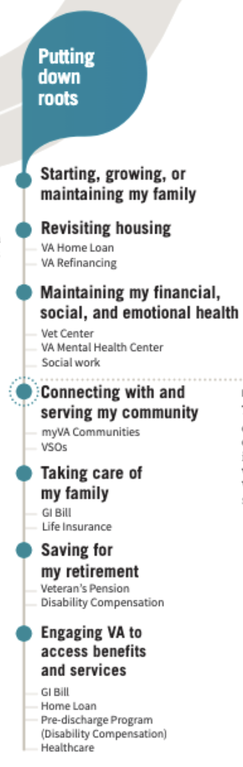
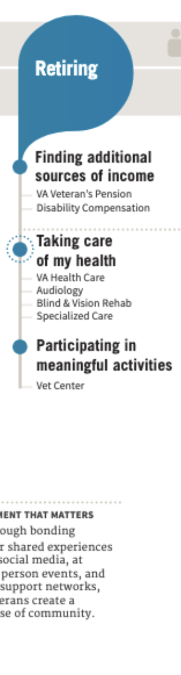
Research goals
Background & Goals
The MVP we tested in this research focused on surfacing payment and debt information to Veterans. Though this is relevant at all stages of the Veteran journey (review complete journey map), it’s particularly important when Veterans are Starting up, Putting down roots, and Retiring and actively managing finances at those stages.

Slide 5
Research goals
Background & Goals
The purpose of this research was to:
1. Validate that our proposed payment information IA matches the Veteran mental model.
2. Understand the financial information that is most important to Veterans.
3. Validate that our onsite notification MVP meets Veterans' needs.

Slide 6
Hypotheses to be tested
Background & Goals
Veterans will be able to more easily manage their debts and view payment history using the links in My VA.
Veterans will not need to use site search to find their payment or debt information from My VA.
Veterans will want to see more details about the financial information than we're surfacing on My VA, and that providing a link will be a sufficient way for them to get those details.
The design for action items and alerts will be effective at drawing attention to important information.
There may be some confusion about why some alerts are at the top of the page, and others are within distinct sections of My VA.

Slide 7
Methodology

Slide 8
Method
Methodology
We conducted remote usability testing over Zoom using a prototype on production. That's right! On production! Testing on production allowed us to use a code-based prototype and be more inclusive with our recruiting approach.
Our onsite notifications only displayed for participants who had debt with VA, so we had a UX Pin prototype as a back-up. We use the prototype to get feedback on the onsite notifications from participants who didn't have debt.

Slide 9
Participant demographics
Methodology
We spoke with a diverse group of 12 Veterans:
8 male, 4 female
8 participants over 55, 1 aged 45-54, and 2 aged 35-44
Education ranged from "some college, no degree" to "master's degree"
2 identified as other than cisgender or heterosexual
8 identified as White, 3 identified as Black and 1 identified as Bi-racial
Read more in-depth information about our participant in the complete findings summary.

Slide 10
Participant demographics
Methodology
Findings may not include the perspectives of the following underserved Veteran groups:
Veterans with cognitive disabilities
Mobile users
Veterans with other than honorable discharge
Veterans who have an immigrant origin
Expat Veterans (living abroad)
Veterans who identify as Hispanic, Asian, or Native
Transgender Veterans
Beginning and experienced AT users
Users of the following assistive technologies: mobile screen readers, keyboards attached to mobile devices or tablets, switch devices and braille readers.

Slide 11
Research questions
Methodology
We grouped our research questions into 3 categories.
1. Proposed payment information IA
Where do users expect to see new information about their payments and debts on VA.gov?
Can users find the payment information that they're looking for?
Do users expect to see a travel reimbursement link under health care or payment information
What is the order of importance of the existing sections on My VA + payment information?
How do users expect their action items to be structured in relation to non-action item information?

Slide 12
Research questions
Methodology
2. Financial information
What information do users want to know about new debts, existing debts, and payments from the VA?
Is it important for them to know how many new debts have been added, or only that they have new debt?
Are we missing any additional links?
How long do users expect to have access to historical financial information (debts + payments) on My VA?
Does providing a link allow users to sufficiently take action on their payments and debts, and manage direct deposit?

Slide 13
Research questions
Methodology
3. Onsite notifications
Does the proposed MVP solution (a single dismissible debt notification displayed at the top of the page) help Veterans to more easily take action on their payments or debts?
Why would a user want to dismiss this alert?
What do users expect to happen after an alert has been dismissed? How and when would they see that information again?
Are there any areas where the design does not meet Veteran needs?
When does a user expect to see an alert about new debt?

Slide 14
Research Findings

Slide 15
Key Findings
Research Findings
1. Proposed payment information IA
1.1 Participants intuitively found recent information about payments under “View payment history” links on the homepage, and My VA.
1.2 Participants weren’t confident about where to find debt information from the homepage, but clearly understood where to find that information on My VA.
1.3 Participant expectations about where to find the travel reimbursement information were varied.
1.4 Participants preferred My VA sections to be ordered by on their VA benefits and services.
1.5 Displaying important information at the top of the page was effective at getting participants’ attention.

Slide 16
Key Findings
Research Findings
2. Financial information
2.1 Amount is the most critical piece of information to participants for both payment and debts.
2.2 Some participants found it helpful to know the number of outstanding debts.
2.3 Two pieces of information were repeatedly named as being missing from the Benefit payments and debts section: remaining education benefits, and debt status.
2.4 Seeing the most recent payment on My VA was sufficient for participants, since the information is accompanied by the View Payment History link.
2.5 The majority of participants intuitively used the View payment history and Manage your direct deposit links; the exception was a participant using screen magnification software.

Slide 17
Key Findings
Research Findings
3. Onsite notifications
3.1 Participants could intuitively take action on a notification via a link.
3.2 Participants expected that if they dismissed an alert, it would display on My VA until they had completed the action they were being alerted about.
3.3 Multiple participants commented that the light yellow color for the alert did not stand out to them, and one participant stated it made the text very difficult to read.

Slide 18
1. Proposed payment information IA

Slide 19
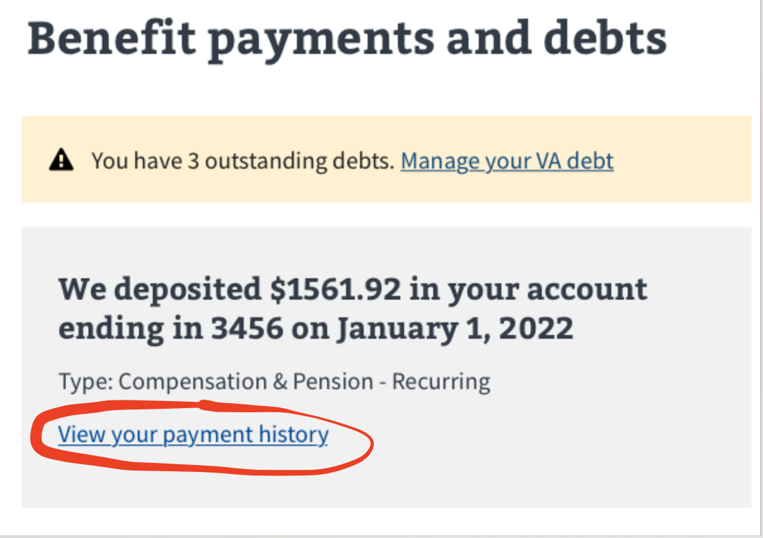
1.1 Participants intuitively found recent information about payments under “View payment history” links on the homepage, and My VA.
Research Findings
11 of 12 participants went to the view payment history link under the relevant benefit from the homepage.
All participants noticed the view payment history link on My VA as soon as they scrolled down to the Benefit payment and debt section of the page.

Slide 20
1.2 Participants weren’t confident about where to find debt information from the homepage, but clearly understood where to find that information on My VA.
Research Findings
All but one participant in this group were unfamiliar with VA debt, so they had no context around looking for such information.
Some participants, including the one participant with debt, guessed they might find debt information under payment history. This aligns with what other VA.gov team’s have noted in research.
Once they visited My VA, it was clear to them that they would see information about any debts under the “Benefit payments and debts section”.

Slide 21
1.3 Participant expectations about where to find the travel reimbursement information were varied.
Research Findings
Many participants stated an initial answer, but then talked about it making sense in two places (usually Benefit payments and debts and Health care).
Their initial responses were:
Benefit payments and debts - 4 participants
Health care - 3 participants
Claims & appeals - 2 participants
Note: We didn’t get to discuss this with each person due to time constraints.

Slide 22
1.4 Participants preferred My VA sections to be ordered by on their VA benefits and services.
Research Findings
Each participant had different feedback about which section of My VA mattered most to them. They each stated the highest priority section was the one containing information about the benefit they used most.
For participants who used VA health care, that section was highest priority for them.
Others stated Benefit payment and debts.
Others stated Claims and appeals.
One participant said the Applying for benefits section would be the most important.

Slide 23
1.5 Displaying important information at the top of the page was effective at getting participants’ attention.
Research Findings
Many participants immediately commented on the onsite notification as soon as they landed on My VA.
The top of the page was a logical placement. This was especially true for time sensitive information, and users on mobile devices.
“If it's at the top, it’s the first thing that grabs your eyes and attention.” - P12
Repeating alerts on the page served as an effective reminder for most people.
However, 3 participants thought the alerts were identical because they had the same link.
2 different participants explicitly stated they were confused by the repetition (they understood the difference in content), commenting that the alerts meant essentially the same thing.

Slide 24
2. Financial information

Slide 25
2.1 Amount is the most critical piece of information to participants for both payment and debts.
Research Findings
This was true whether it was an amount being paid or an amount owed.
Participants mentioned secondary information as also being important, and talked about hoping to find this information if they clicked on the “View payment history” or “Manage your VA debt links” from My VA:
The date a payment was deposited into their account
The due date for a debt
The reason for a debt
How to pay a debt
Someone to contact if they had questions about their debt
Participants who had been long-time recipients of steady compensation payments weren’t overly concerned about seeing deposit amounts.

Slide 26
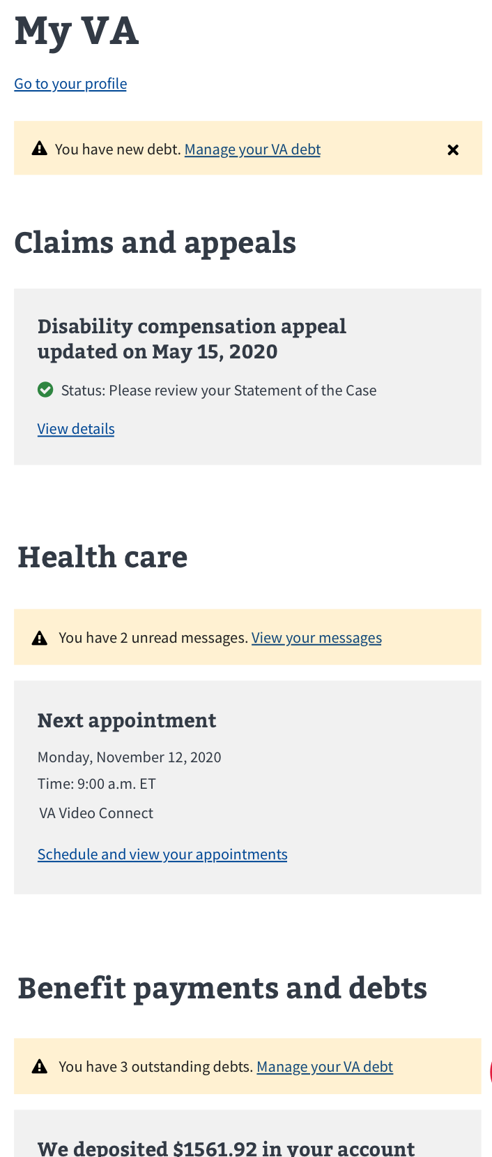
2.2 Some participants found it helpful to know the number of outstanding debts.
Research Findings
Of the 6 participants we were able to ask about the specific number of outstanding debts, 5 stated it would be important for them to see the number.
Their comments suggest that including the number of debts in the alert would spur them into action more than simply knowing there was a new debt.

Slide 27
“I think it’s important to know because up top, it just tells me I have a debt. But, you go down here and then see I have 3 debts. Oh man! 3 debts? Let me go in there and see what’s going on.” - P13

Slide 28
2.3 Two pieces of information were repeatedly named as being missing from the Benefit payments and debts section: remaining education benefits, and debt status.
Research Findings
Participants who had education benefits shared that it was not easy to figure out how much education benefit they had remaining
Participants wanted to see the status of their debt, even if they had no outstanding debt with VA.
Some expected the new debt alert to be replaced with a confirmation of payment, once they had paid.
Some wanted My VA to reflect that they did not have any outstanding debt. “It should say no debt. Or give a confirmation that it your debt has been paid in full.” - P3

Slide 29
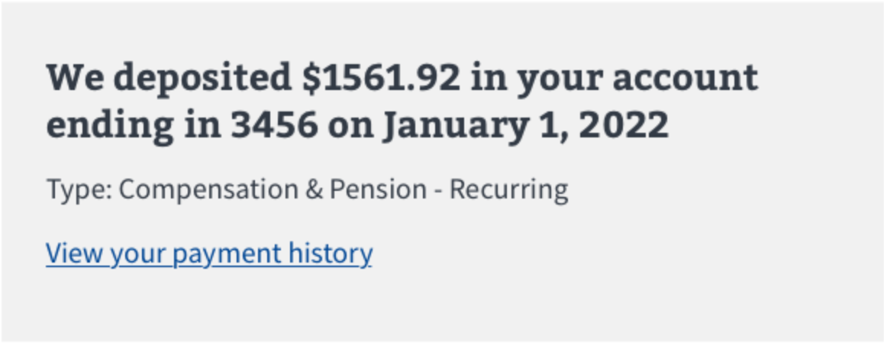
2.4 Seeing the most recent payment on My VA was sufficient for participants, since the information is accompanied by the View Payment History link.
Research Findings
Most participants rely on information from their bank to get payment information.
Felt it was helpful to see the last payment history
Multiple people talked about wanting to see the last payment regardless of how far in the past it was, but expected to go to another page to view detailed payment information.

Slide 30
2.5 The majority of participants intuitively used the View payment history and Manage your direct deposit links; the exception was a participant using screen magnification software.
Research Findings
Almost all participants easily found the links to take action on their payments, and had no trouble navigating back to My VA after viewing the information.
A participant using ZoomText, a screen enlargement software with a speech component, shared feedback about challenges navigating multi-column layouts.
They stated that it was unlikely they would have found it had they not been in a moderated research session.

Slide 31
“When I move it over to see manage your direct deposit [link], then I can’t see manage your benefit and payment debts [heading]. . .it’s one of those things, once you get used to it, you know you got to do it, it’s ok . . . See, if you hadn’t mentioned changing that, I probably never would’ve moved over there and found that manage your direct deposit.” - P17

Slide 32
3. Onsite notifications

Slide 33
3.1 Participants could intuitively take action on a notification via a link.
Research Findings
All participants clearly understood the hyperlink in our notification design
They understood that it would allow them to take action on the information they were being alerted about.
Participants expected to find more detailed financial information on subsequent pages.
"It [a link] is sufficient. I don’t think it should be on the first screen. Some of it you will need the next page. You may need privacy in that particular area." - P7

Slide 34
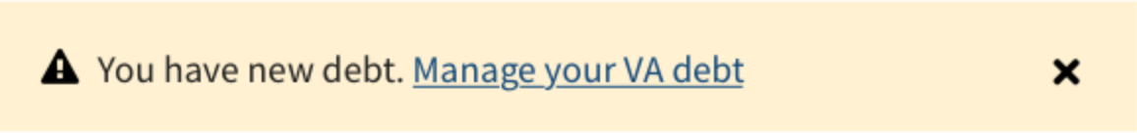
3.2 Participants expected that if they dismissed an alert, it would display on My VA until they had completed the action they were being alerted about.
Research Findings
No participants dismissed the alert without prompting.
Once prompted, they easily understood the X icon would dismiss the alert.
Toward the end of the sessions, we asked participants how they expected to see the onsite notification again once they dismissed it. All participants stated they could access similar information by going down to Benefit payment and debts.
Notes:
Toward the end of the sessions, we asked participants how they expected to see the onsite notification again once they dismissed it. All participants stated they could access similar information by going down to Benefit payment and debts.
This makes sense, since they had already been exposed to the content. If they dismissed the alert without scrolling down first, it’s likely they would feel unsure about how to see that information again. That could cause a moment of panic if they had caught a glimpse of the debt related content just before dismissing it.

Slide 35
3.3 Multiple participants commented that the light yellow color for the alert did not stand out to them, and one participant stated it made the text very difficult to read.
Research Findings
Several commented that the light yellow did not communicate the appropriate level of urgency that should accompany a message about debt or health care. “This is a soft soothing yellow, it’s kind of chill - it doesn’t strike urgency.” - P15
A legally blind participant stated they could not read the text against that color background. “That, yellow or brown, whatever that color is, it makes it hard for me to read in that color.” - P17

Slide 36
Additional Insights

Slide 37
Additional Insights
Research Findings
2 participants wanted a heading above the alert section at the top of the page to provide additional context.
2 participants shared frustration with the new process to request travel reimbursement.
When asked where they would expect to find a link to co-pay information, participants were split between 2 sections.
Participants shared a variety of information that would be helpful to have on My VA.
The complete findings report goes into detail about each of these insights.

Slide 38
Recommendations

Slide 39
Recommendations
Put the travel reimbursement link under health care.
Keep onsite notifications at the top of the page, and within sections.
Create logic so that alerts can only be permanently dismissed once the action is addressed, rather than by a person’s action.
Include specific information in debt alerts, including the total amount and number of debts.
Display a “you have no debt” confirmation message in Benefit payments and debts, and possibly also a link to debt management so Veterans can get more information.
Include amount of remaining education benefits and a link to information about how what’s left in the Benefit payment and debt section.

Slide 40
Recommendations
7. Iterate on the alert design to improve usability for people with low vision. Also, consider changes that will more clearly communicate a sense of urgency.
8. Add a heading for the onsite notification section at the top of the page, when there is a notification to display.
The complete findings report highlights evidence supporting these recommendations.

Slide 41
Next Steps

Slide 42
Next Steps
Near term - MVP
Put the travel reimbursement link under health care
Keep onsite notifications at the top of the page, and within sections.
Display a “you have no debt” confirmation message in Benefit payments and debts, and possibly also a link to debt management so Veterans can get more information.
Add a conditional heading for the onsite notification section at the top of the page, when there is a notification to display.
Iterate on the alert design to improve usability for people with low vision.
Validate changes with Veterans in a combined UAT/usability session

Slide 43
Next Steps
Long term - future versions
Conduct additional research to better understand Veteran expectations and mental model around dismissal of alerts and onsite notifications that are part of a larger notification center.
Explore additional, more specific, debt information we can include in alerts
Incorporate education specific information (remaining balance and eligibility) into My VA.
Explore design iterations to the alert pattern that will more clearly communicate a sense of urgency, without triggering Veterans.
Validate changes with Veterans in a usability study, including Veterans from identified in the further research needed section of our report.

Slide 44
Further Research
In our next round of research, we should include participants that:
Have debt with VA, so we can get information based on lived experience.
Use magnification, so we can better understand any usability hurdles of My VA’s multi-column layout.
Identify has having cognitive considerations, so we can validate that our alert pattern works for that population.
We will also aim to recruit a majority BIWOC participant group, since this round of research included mostly white, male participants.
We’ll need to conduct additional research to better understand Veteran expectations around co-pay information, since we didn’t get definitive conclusions on that in this study.

Slide 45
Appendix

Slide 46
Links
Documentation
Research plan
Conversation guide
Tools used for Synthesis
Interview transcripts
Mural board
Pages and applications used
VA.gov
Desktop prototype
Mobile prototype

