Slide 1

Find VA Forms
Search and Detail Pages Product Guide
Making it easier to find the right application forms for benefits and other services.
VA.gov/find-forms VA.gov/find-forms/about-form-

Slide 2
Contents
Find VA Forms—Search
Navigating to Find VA Forms—Search
Search Experience
Helpful Sections and Links
Find VA Forms—Detail Pages
Navigating to Find VA Forms—Detail Pages
Sample Detail Pages

Slide 3
Find VA Forms—Search

Slide 4
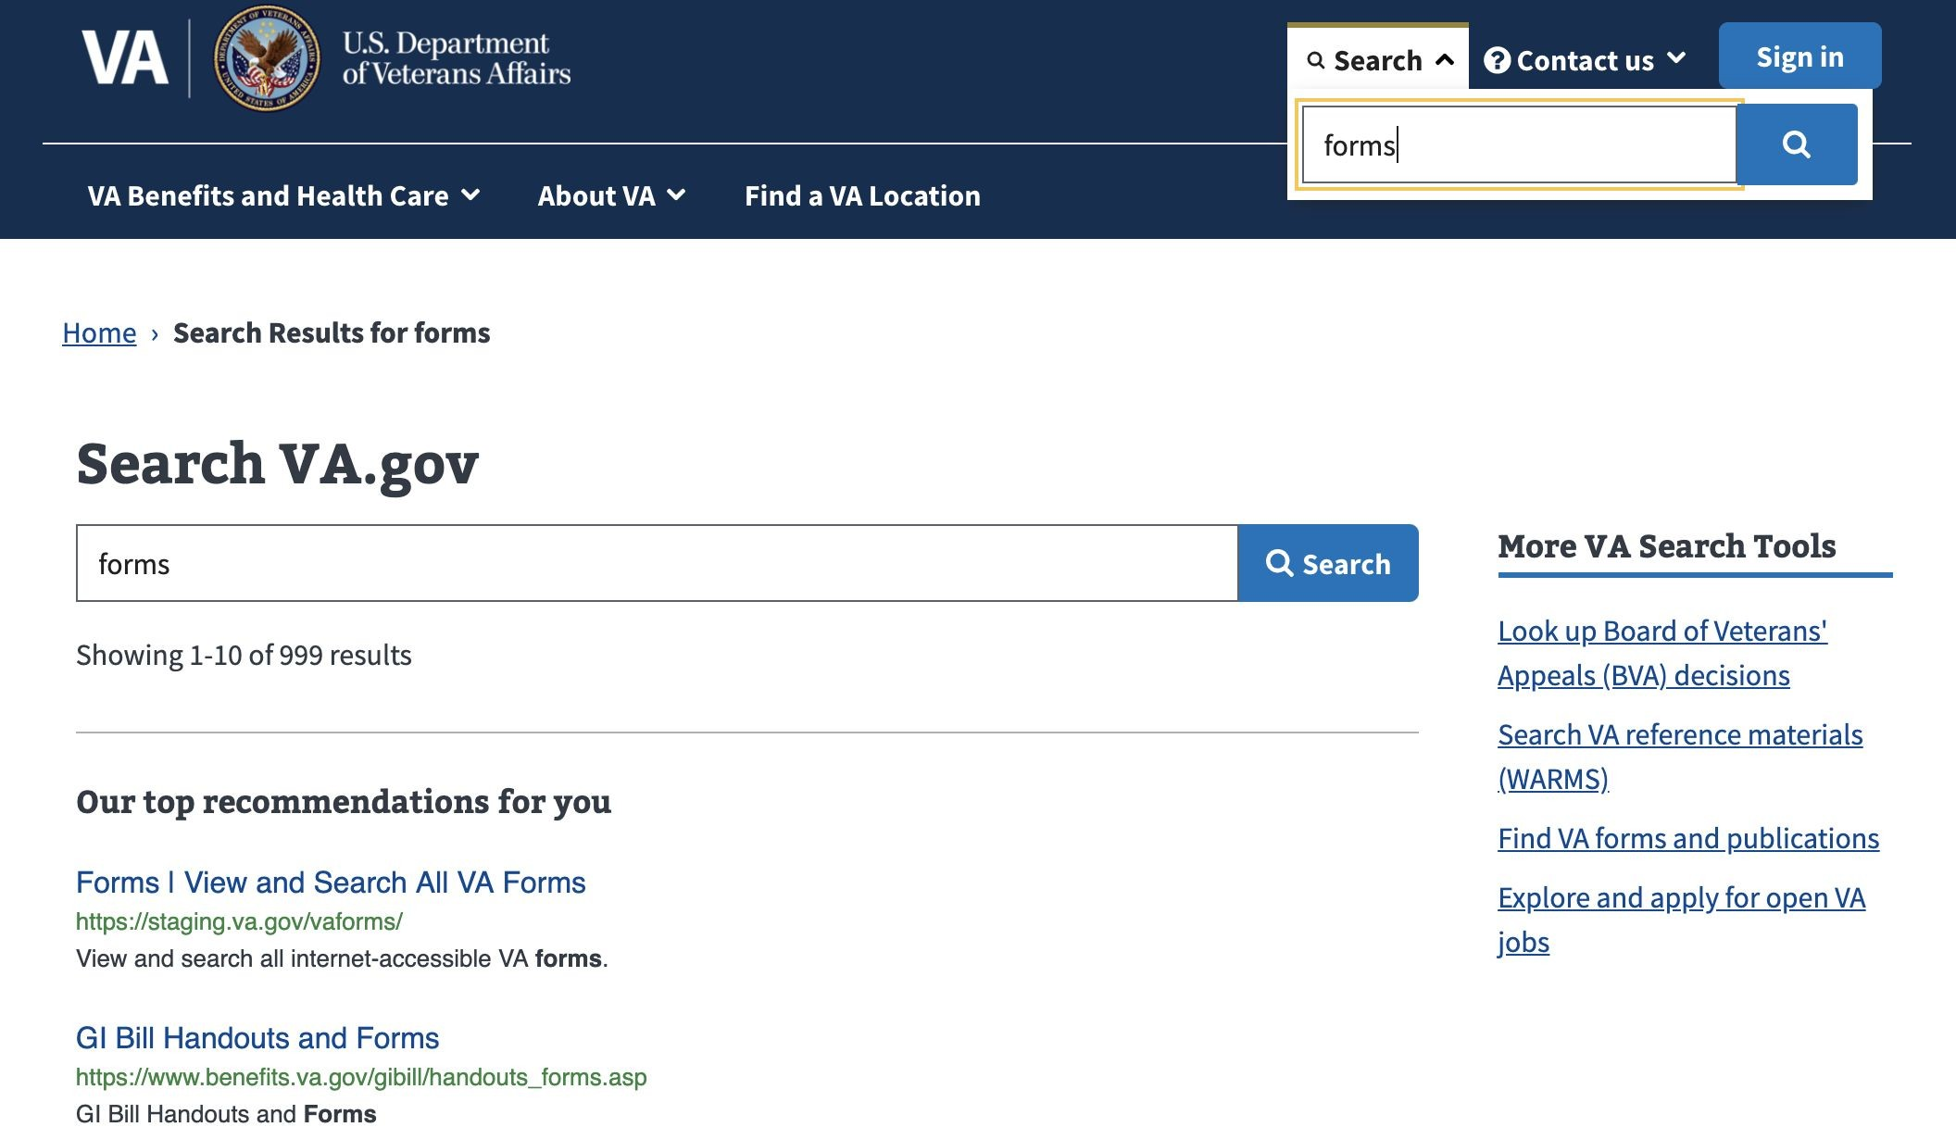
Find VA Forms—Search Product Guide
Navigating to Find VA Forms—Search
Search for “forms” from VA.gov on-site search.
Choose top recommendation link to Find VA Forms—Search.

Slide 5
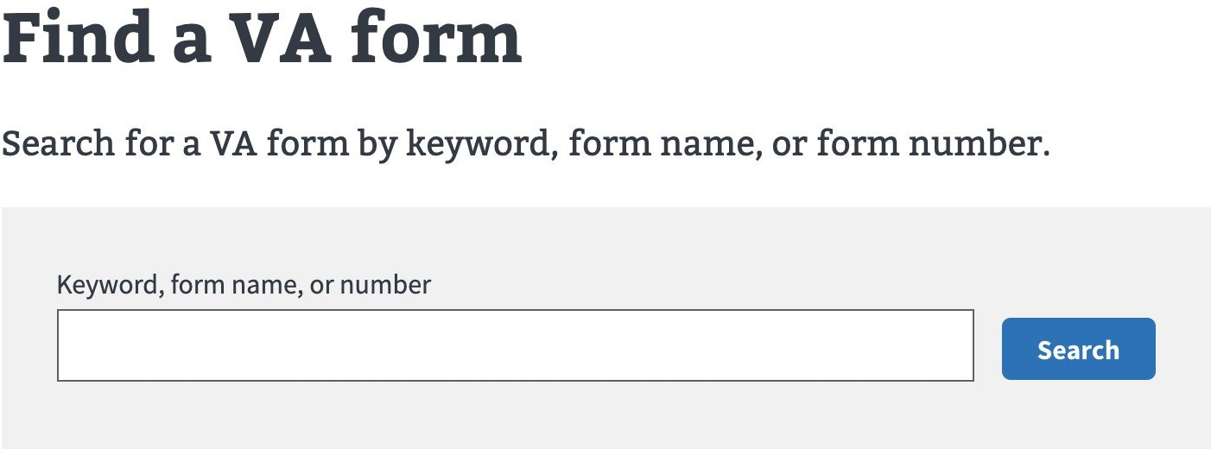
Search for VA forms at VA.gov/find-forms
Find VA Forms—Search Product Guide

Slide 6
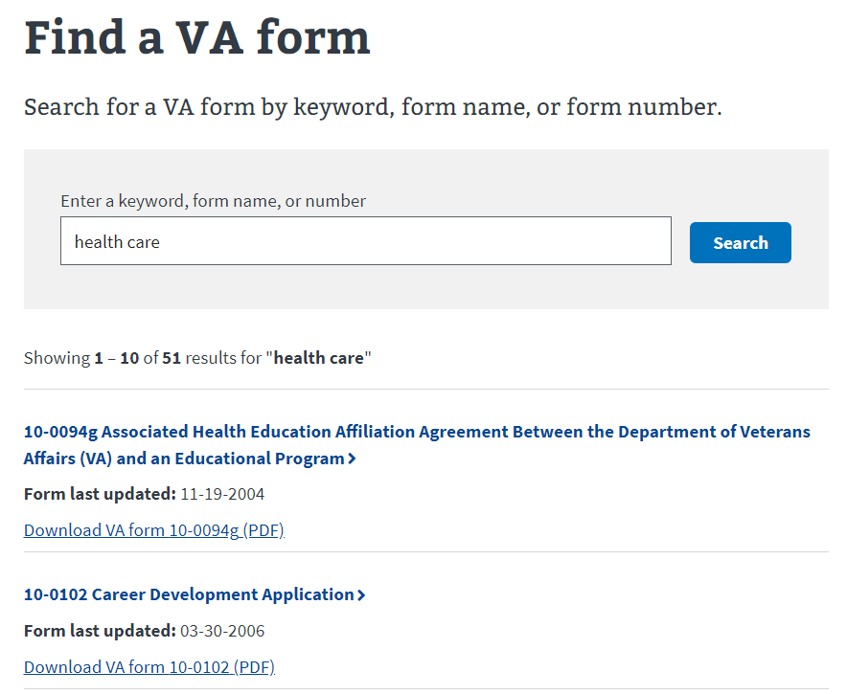

Sort results by Form Last Updated date
Find VA Forms—Search Product Guide

Slide 7
Quickly Access Form Details Pages
Find VA Forms—Search Product Guide

Slide 8
Download VA Form PDFs
Find VA Forms—Search Product Guide

Slide 9
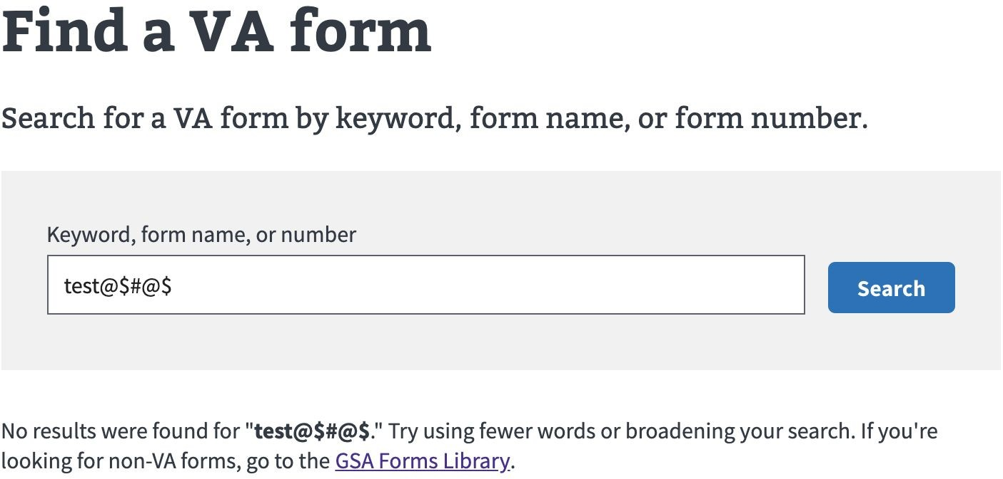
No Results? Find More in GSA Forms Library
Find VA Forms—Search Product Guide

Slide 10
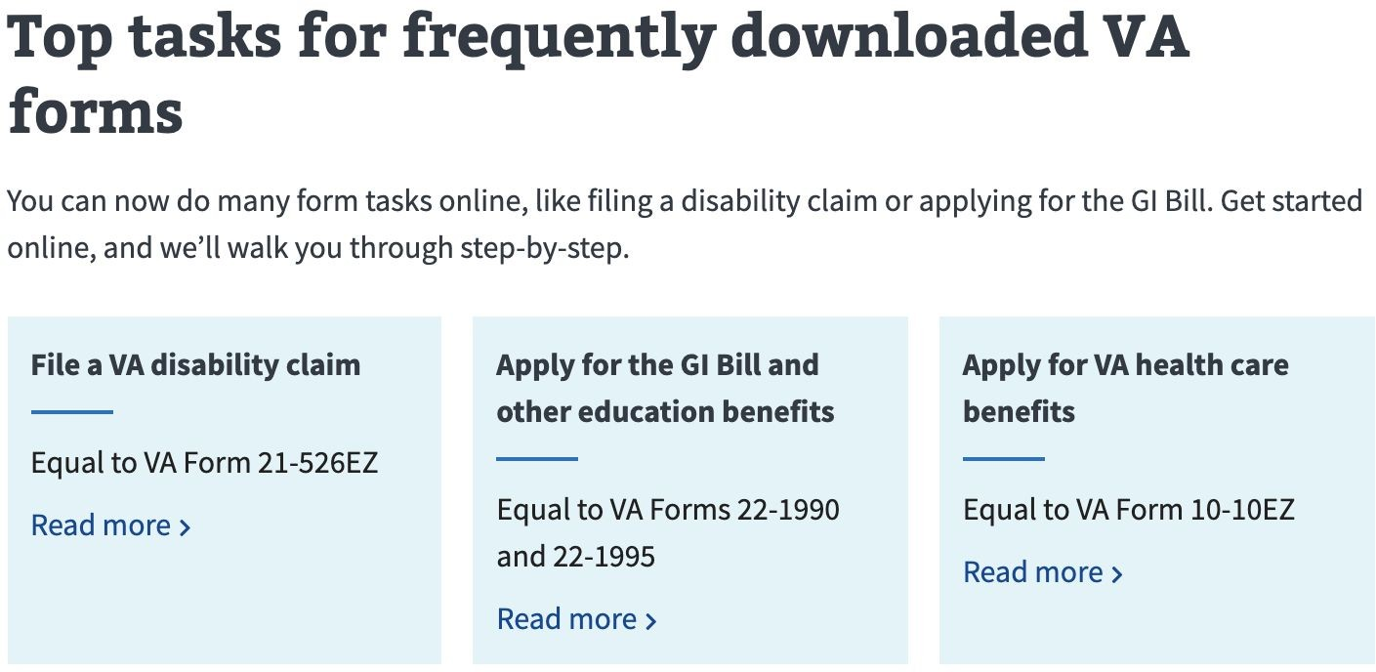
Quickly Navigate to Top Tasks
Find VA Forms—Search Product Guide

Slide 11
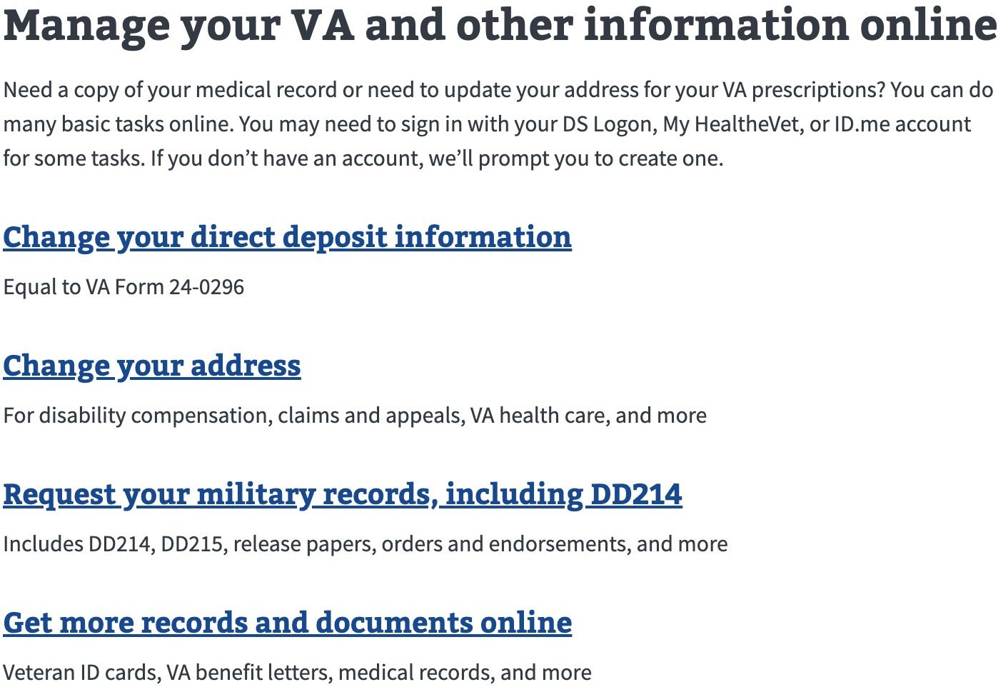
Manage Personal Profile Information
Find VA Forms—Search Product Guide

Slide 12
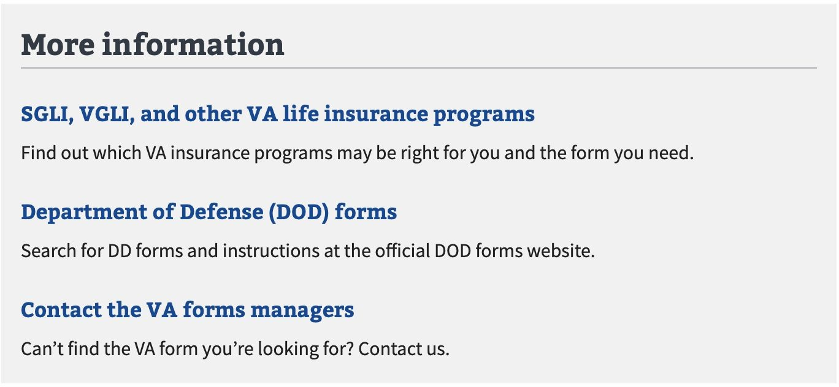
Find Additional Information Outside VA
Find VA Forms—Search Product Guide

Slide 13
Find VA Forms—Detail Pages

Slide 14
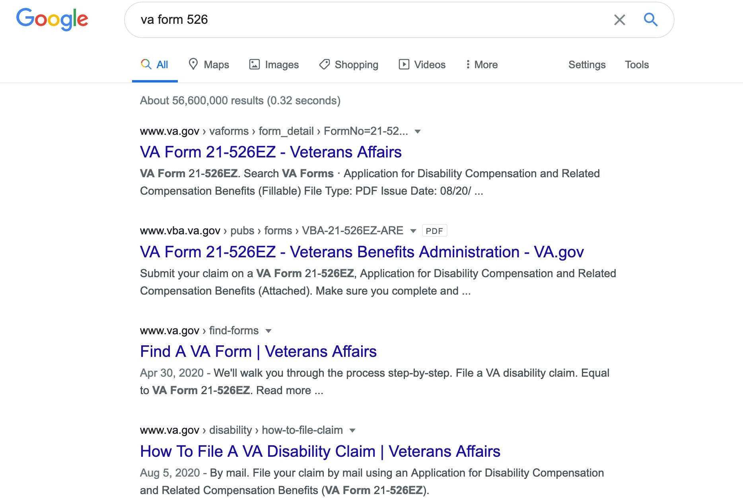
Find VA Forms—Detail Pages Product Guide
Locating Detail Pages via Search Engine
Search for a particular form organically on Google.
Results will include links to legacy VA Form pages.

Slide 15
Locating Detail Pages via Find a VA Form
Find VA Forms—Search Product Guide

Slide 16
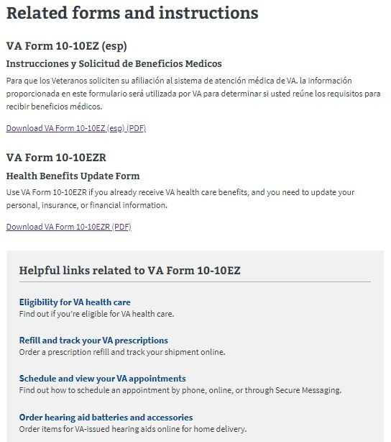
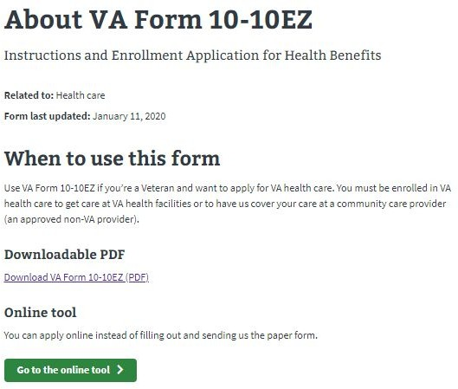
Find VA Forms—Detail Pages Product Guide
Sample Form Detail Page
Form Detail pages with maximum form data provide:
Information on when to use the form
PDF download link
Online Tool link for the form
Information about related forms
Links to helpful tools across VA.gov

Slide 17
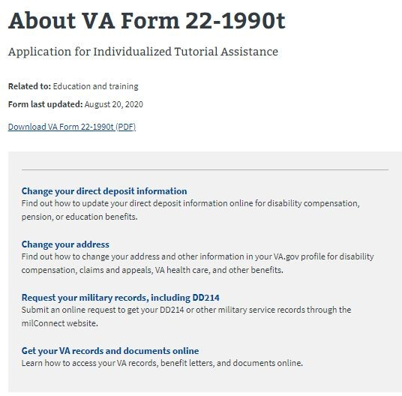
Find VA Forms—Detail Pages Product Guide
Sample Form Detail Page
Forms with minimal information provide
the following links:
PDF Download
Helpful Tools Across VA.gov

