Slide 1

Find VA Forms
Search and Detail Pages Product Guide
Making it easier to find the right application forms for benefits and other services.
VA.gov/find-forms VA.gov/find-forms/about-form-

Slide 2
Contents
Find VA Forms—Search
Navigating to Find VA Forms—Search
Search Experience
Helpful Sections and Links
Find VA Forms—Detail Pages
Navigating to Find VA Forms—Detail Pages
Sample Detail Pages

Slide 3
Find VA Forms—Search

Slide 4
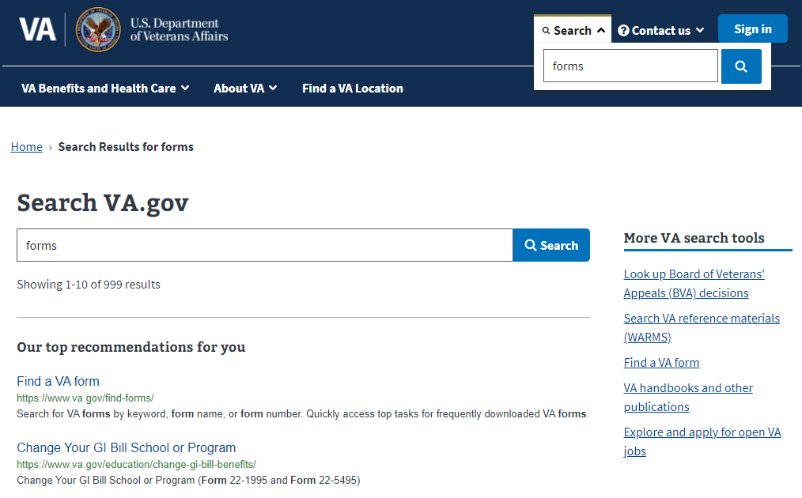
Find VA Forms—Search Product Guide
Navigating to Find VA Forms—Search
Search for “forms” from VA.gov on-site search.
Choose top recommendation link to Find VA Forms—Search.

Slide 5
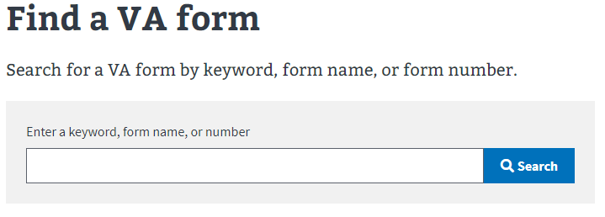
Search for VA forms at VA.gov/find-forms
Find VA Forms—Search Product Guide

Slide 6
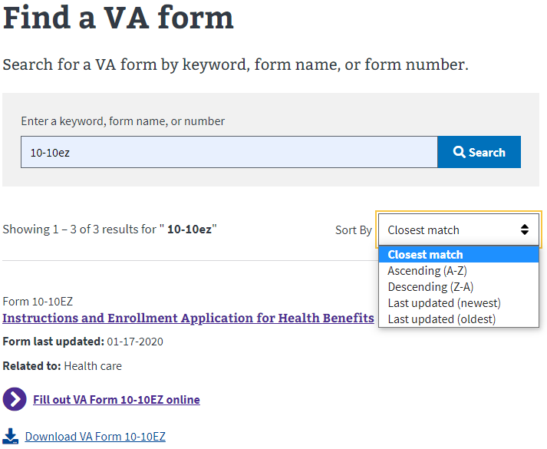
Sort Results
Find VA Forms—Search Product Guide
By default, results are sorted by closest match to the search term.
Use the Sort By drop-down to sort results alphabetically in ascending or descending order, or by last updated date (newest or oldest).

Slide 7
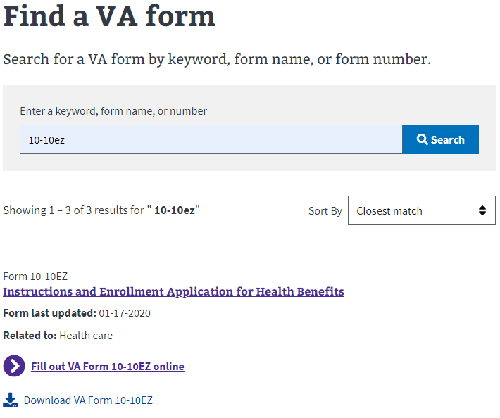
Quickly Access Form Details Pages
Find VA Forms—Search Product Guide

Slide 8
Access Online Tools Where Available
Find VA Forms—Search Product Guide

Slide 9
Download VA Form PDFs
Find VA Forms—Search Product Guide

Slide 10
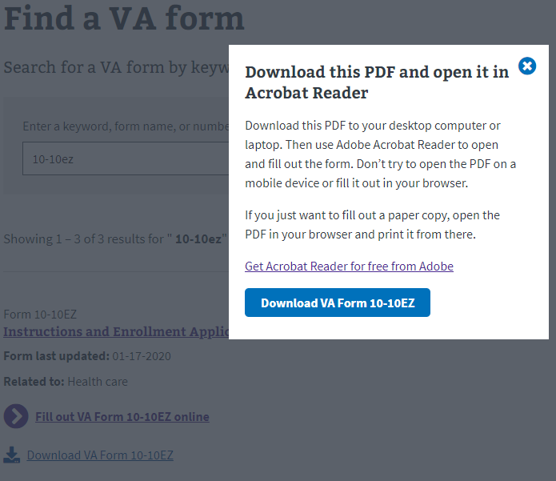
Modal with PDF Information
Find VA Forms—Search Product Guide
The first time a PDF link is clicked in the search results a modal will appear advising to download and open forms in Adobe Acrobat Reader. A link to download Acrobat Reader is also provided.
Clicking the button from here will download the PDF.
If the PDF opens in the browser window or new tab, right click on the button instead and save to your computer if you wish to complete the form digitally.
This modal is displayed only once every 24 hours.

Slide 11
Download VA Form PDFs
Find VA Forms—Search Product Guide
If the modal shown on the previous page was displayed in the last 24 hours, the download VA Form link will start to download the PDF rather than display the modal.
If the PDF opens in a browser window or tab, right click on the link instead and save to your computer if you wish to complete the form digitally.

Slide 12
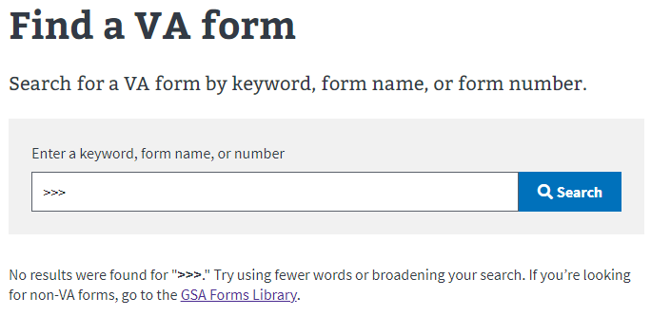
No Results? Find More in GSA Forms Library
Find VA Forms—Search Product Guide

Slide 13
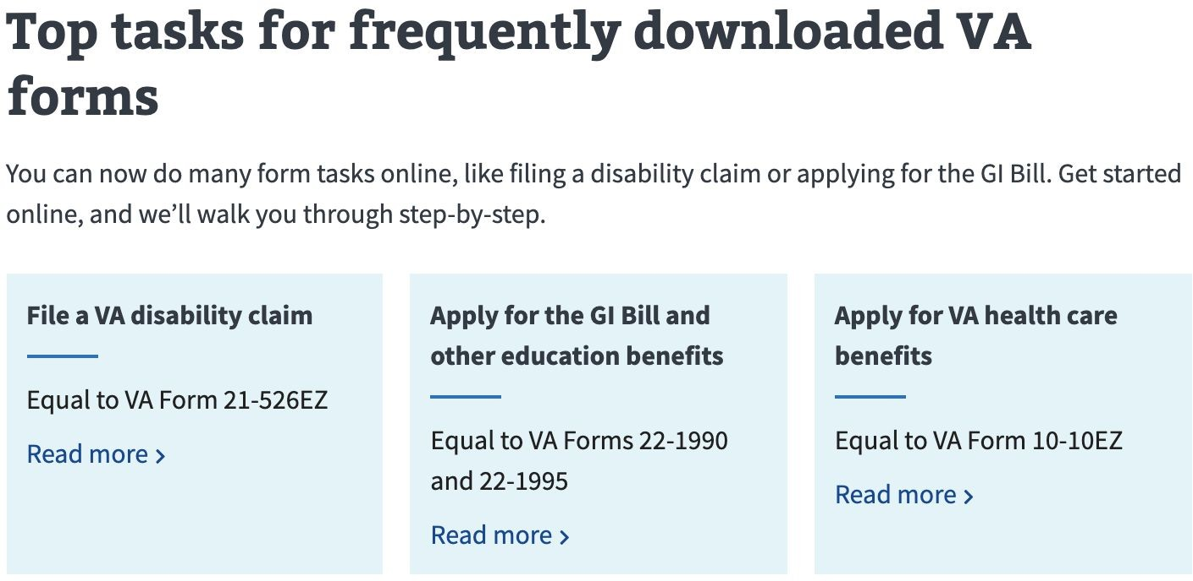
Quickly Navigate to Top Tasks
Find VA Forms—Search Product Guide

Slide 14
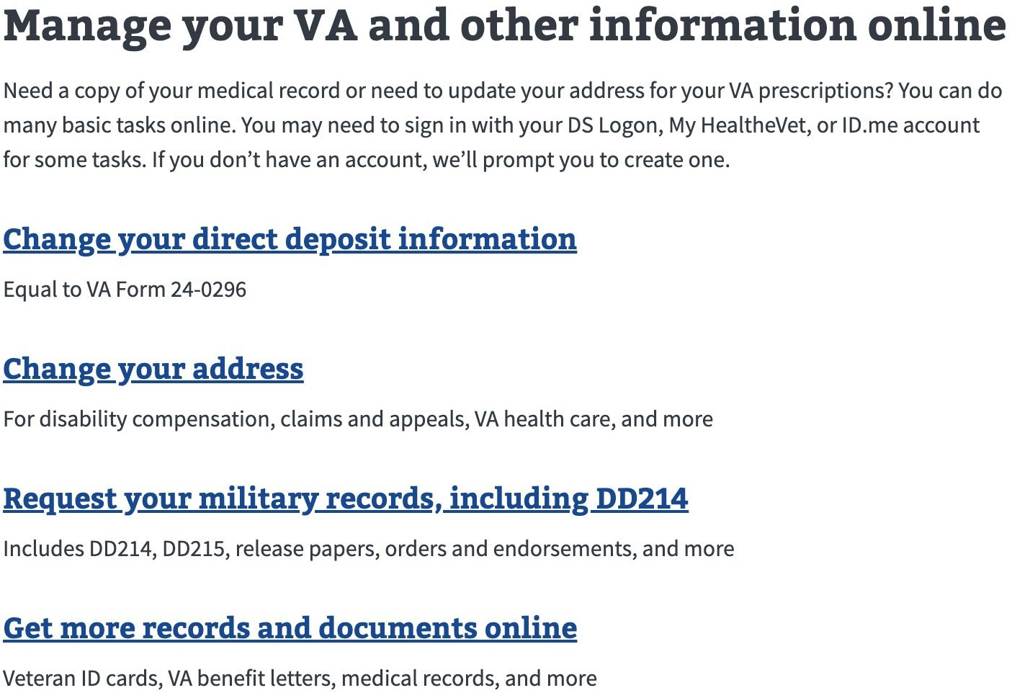
Manage Personal Profile Information
Find VA Forms—Search Product Guide

Slide 15
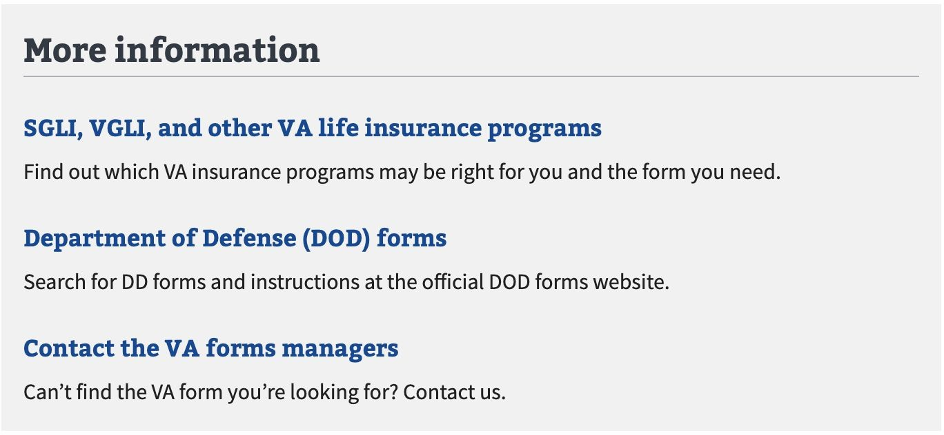
Find Additional Information Outside VA
Find VA Forms—Search Product Guide

Slide 16
Find VA Forms—Detail Pages

Slide 17
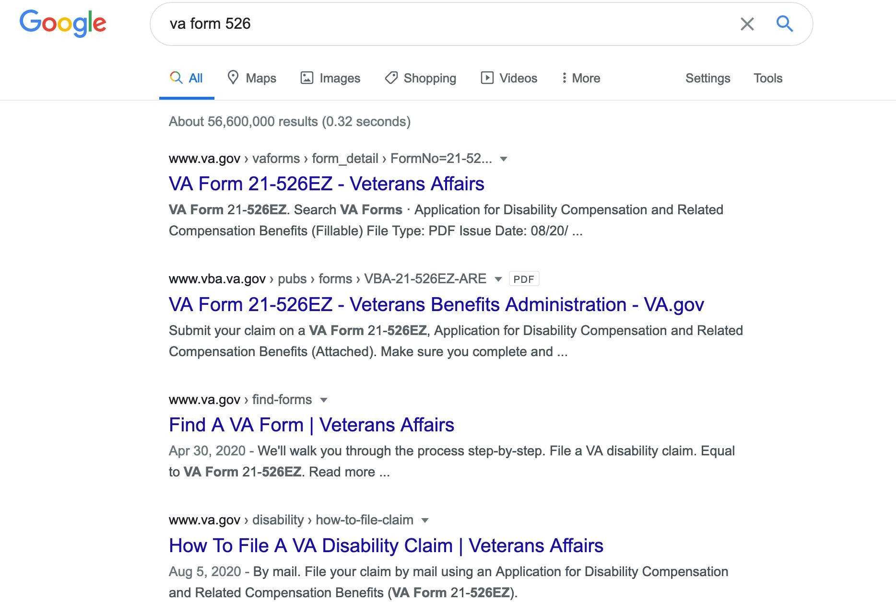
Find VA Forms—Detail Pages Product Guide
Locating Detail Pages via Search Engine
Search for a particular form organically on Google.
Results will include links to legacy VA Form pages.

Slide 18
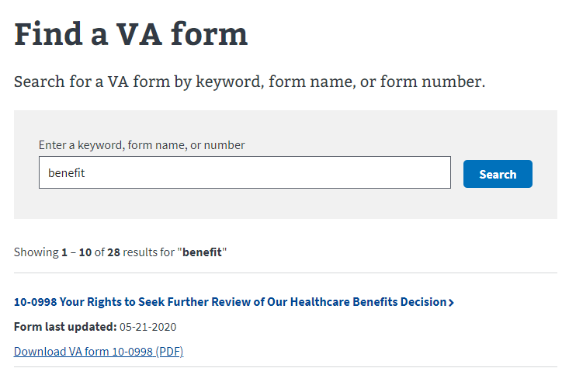


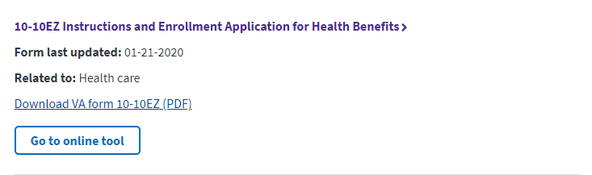
Locating Detail Pages via Find a VA Form
Find VA Forms—Search Product Guide

Slide 19
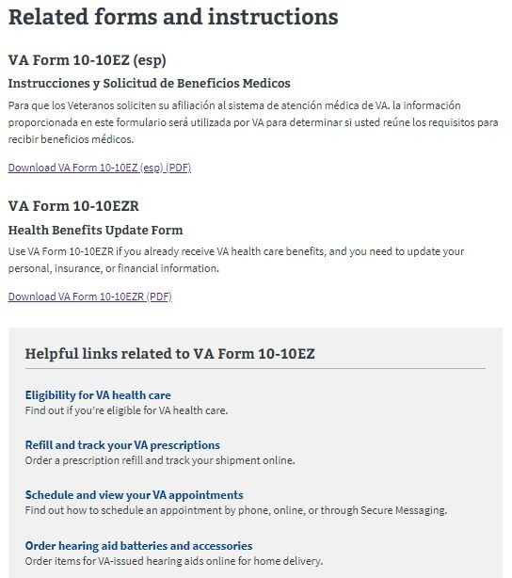
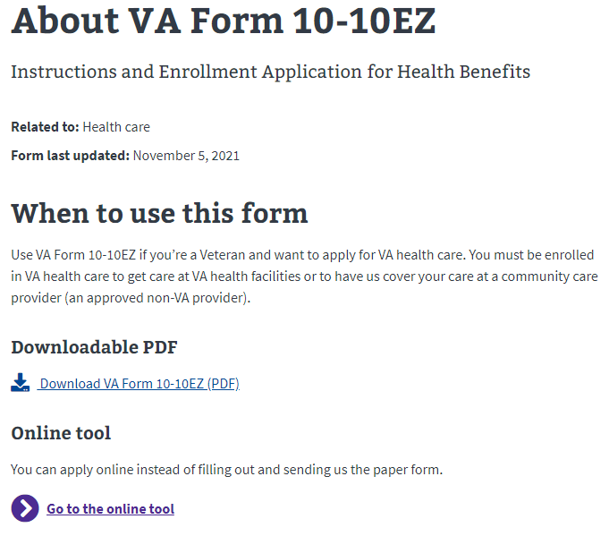
Find VA Forms—Detail Pages Product Guide
Sample Form Detail Page
Form Detail pages with maximum form data provide:
Information on when to use the form
PDF download link (works same as search page)
Online Tool link for the form
Information about related forms
Links to helpful tools across VA.gov

Slide 20
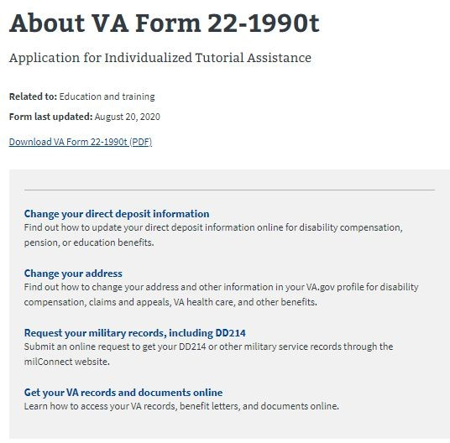
Find VA Forms—Detail Pages Product Guide
Sample Form Detail Page
Forms with minimal information provide the following links:
PDF Download (works same as on search page
Helpful Tools Across VA.gov

