Slide 1

Dependency Claims (21-686c): Product Guide
Making it easier for Veterans to attach dependents and apply for benefits and other awards.
VA.gov/view-change-dependents/ VA.gov/view-change-dependents/view/ VA.gov va.gov/view-change-dependents/add-remove-form-686c/
eBenefits Team (VSA) | June 2020

Slide 2
What is this?
Dependency Claims (21-686c) - Product Guide
Viewing and modifying dependents for a Veteran is a common function to see which dependents the Veteran has associated with their benefits and awards. Using the 686 form, the Veteran can inform the VA about additional dependents that can take advantage of their benefits or remove dependents as needed for various reasons.
View/Modify Dependents also conforms to 508 compliance and can be used with major screen readers and other assistant tools.
Target launch date is end of September 2020.
Who can access?
View/Modify Dependents is currently available to LOA3 (eBenefit Premium) users. While other users can currently login on a Veterans behalf, it is not anticipated that this will be possible on VA.gov until Roles and Relationships are finalized. Other non-ID.me login methods should be valid.
How can users access?
This feature is accessible for testing within the staging environment at this url: https://staging.va.gov/view-change-dependents/view for Viewing, and https://staging.va.gov/view-change-dependents/add-remove-form-686c/ for the actual 686 application and can be accessed in any modern browser.
There are few different pathways that a Veteran can get to the View page and the 686 application tool but they will be positioned per IA off the root of the site:
Static landing page - instructions on required documents and information va.gov/view-change-dependents
View Dependents - Page to view dependents both on and not on award va.gov/view-change-dependents/view
Add or remove dependents - application using the Form 21-686c va.gov/view-change-dependents/add-remove-form-686c/

Slide 3
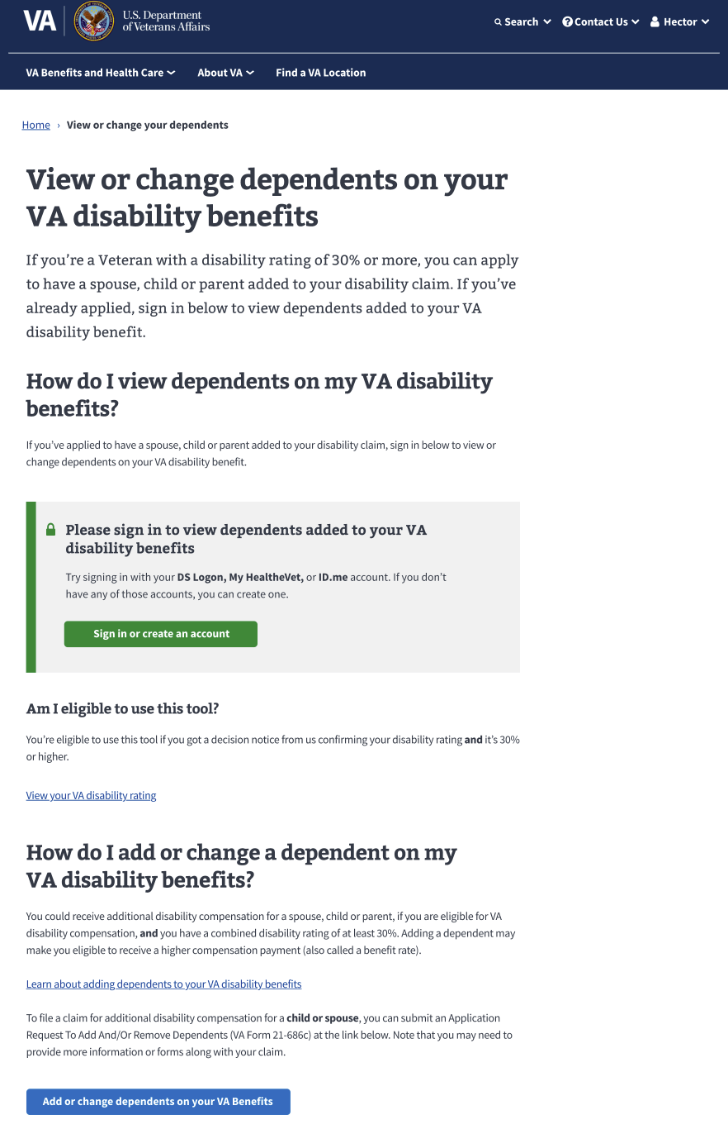
Navigating to View Dependents
Dependency Claims (21-686c) - Product Guide
Currently, browsing within VA.gov from the disability page should bring the user to the unauthenticated landing page seen to the right which should answer some general questions about the tool as well as present the login button to gain access. This will be incorporated into the Veteran Tools and most likely be accessible from the home page.
From the landing page, you can click here to login and View your dependents.
You can also click below to go directly to the updating application.

Slide 4
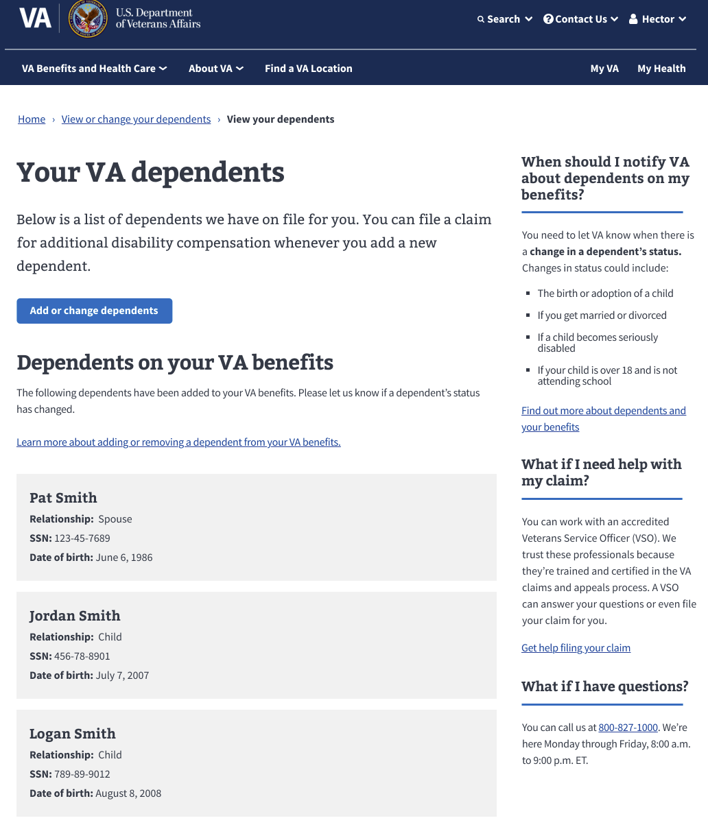
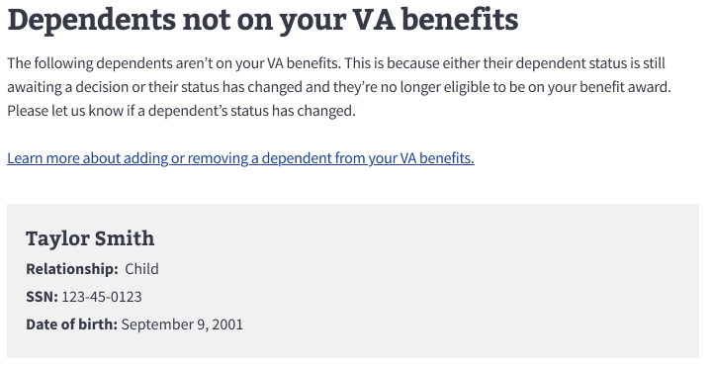
Navigating to View Dependents
Dependency Claims (21-686c) - Product Guide
The View Dependents page simply shows all the dependents associated with the Veteran with an indication as to whether they are currently on or not on an award.
These are important for inclusion as some might need to be added or removed via the 686 application itself.
Getting to the 686 application is easy from the View Dependents page and once on the first page of the application, the Veteran can select which workflow or outcome they are hoping to achieve and continue filling out the form. See the blue button with the red box around it.

Slide 5
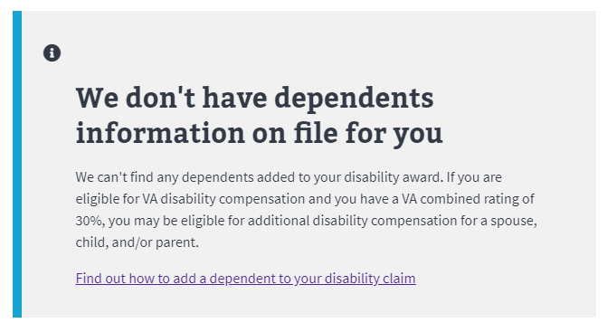
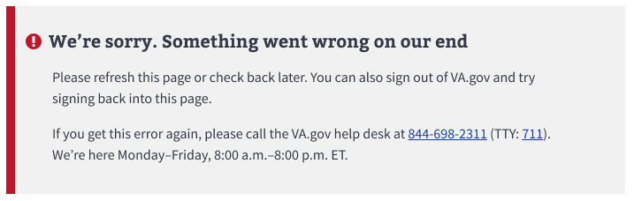
Error Handling: View Dependents
Dependency Claims (21-686c) - Product Guide
If the page does not see the data, a blue messaging window appears.
If the page cannot load the page (or part of a page) due to a system issue, a red messaging window appears with instructions on who to call.

Slide 6
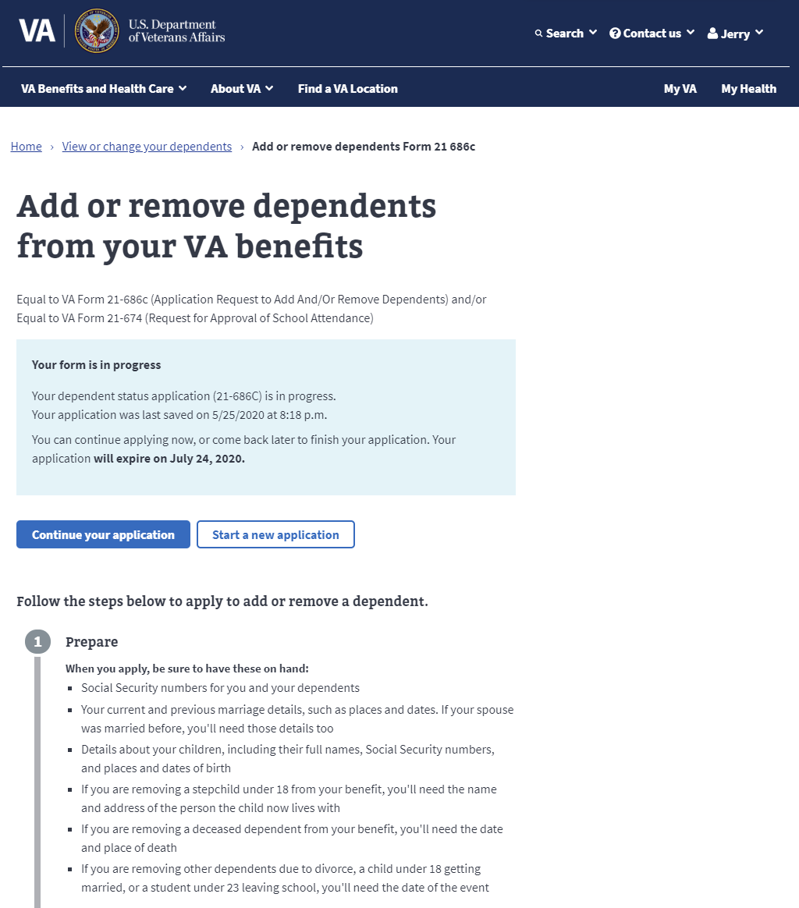
Making Changes to Your Dependents
Dependency Claims (21-686c) - Product Guide
It should be noted that Save in Progress is available, and the previous draft is available with either the choice to continue or to start over with a new application
Once you begin your application, you are informed with a short list of steps that inform the Veteran what is required and at what point.

Slide 7
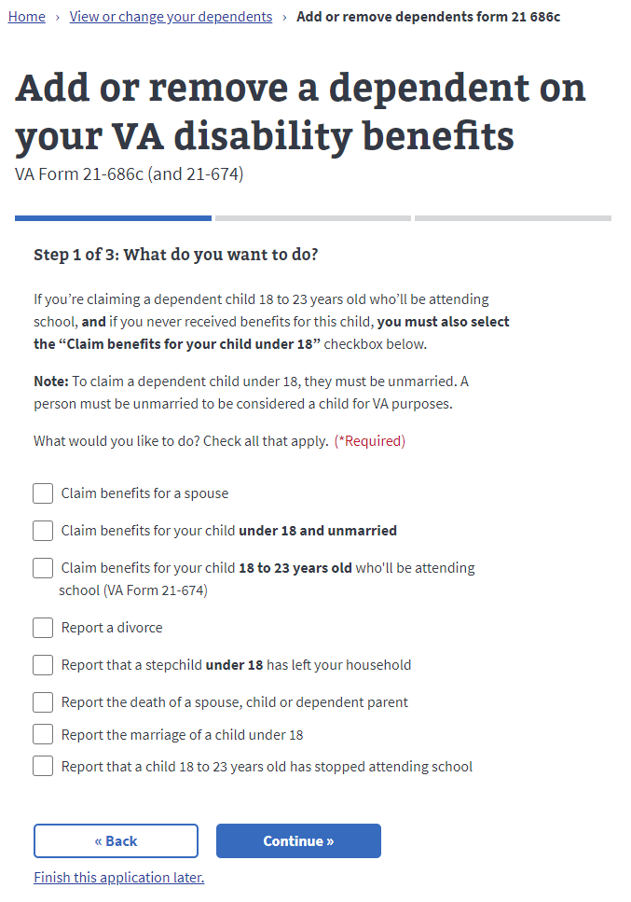
Getting Started
Dependency Claims (21-686c) - Product Guide
The Dependency Claims form (Form 21-686c) is long and winding depending on what the intended outcome is. To help with this and limit confusion, once the intended pieces are selected, only those will be presented to the Veteran.
The Veteran can return to this screen at any time and modify their selection. They may select any that apply.

Slide 8
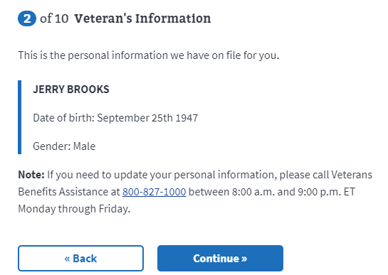
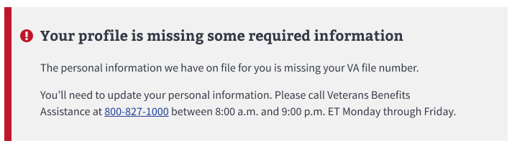
Getting Started
Dependency Claims (21-686c) - Product Guide
Once the selection has been made, the Veteran’s static information is presented and made available for confirmation.
If any information is incorrect, or unavailable, the Veteran is invited to contact the VBA for assistance before continuing.

Slide 9
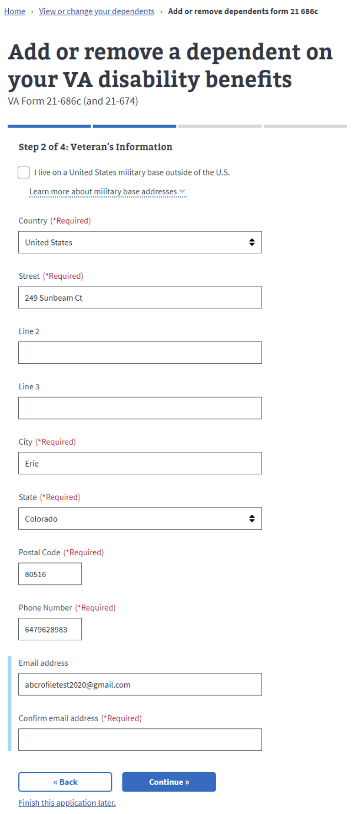
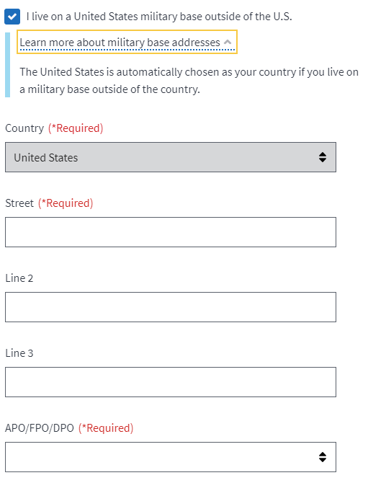
Veteran’s Information
Dependency Claims (21-686c) - Product Guide
When entering the Veterans Information, some will check the box that indicates they are living on a military base outside the U.S.
The result is the U.S. is considered the default country and State becomes APO/FPO/DPO
APO stands for Army Post Office and is associated with Army or Air Force installations. FPO stands for Fleet Post Office and is associated with Navy installations and ships. DPO stands for Diplomatic Post Office and is associated with U.S. Diplomatic locations

Slide 10
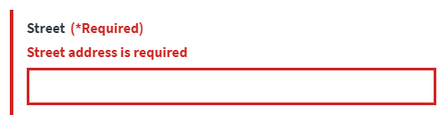
Required Information
Dependency Claims (21-686c) - Product Guide
In the event that a required field is left blank, the field indicates that is needs to be completed before proceeding.
This happens for each required field.

Slide 11
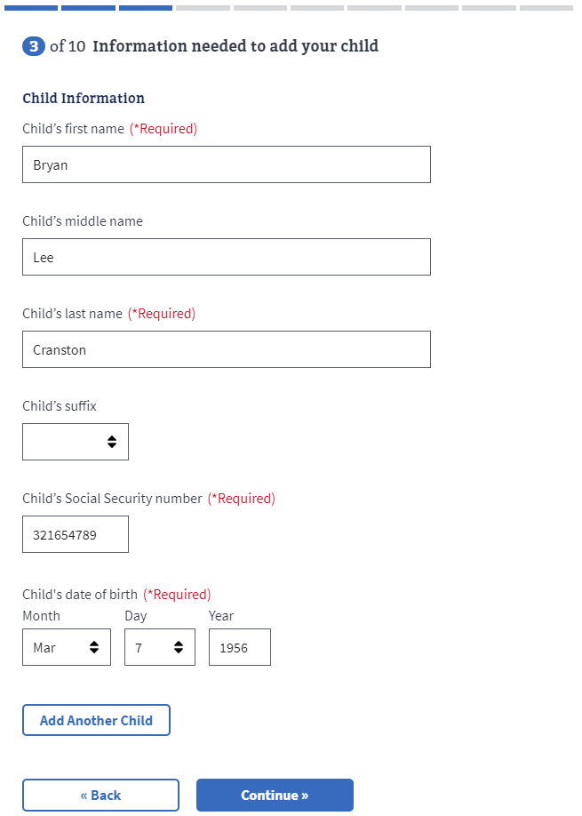
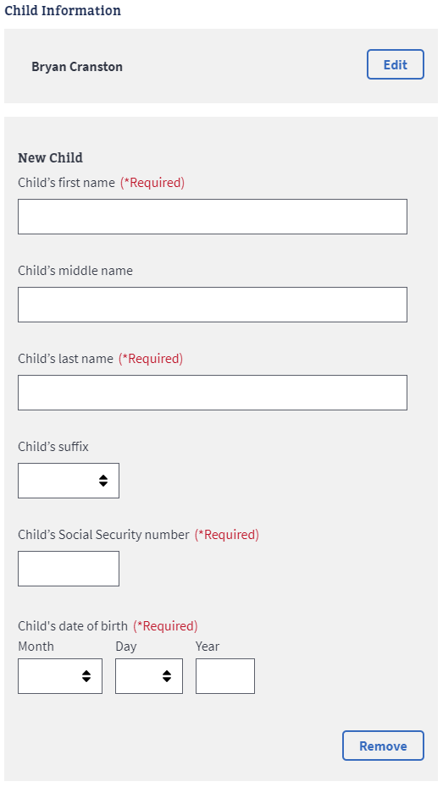
Adding Information
Dependency Claims (21-686c) - Product Guide
Some workflows within the form allow for another entity to be added and since we are not restricted by space on a paper form, as many as needed can be added.
Notice that the first child, in this case Bryan Cranston, is stored above where a new child can be added. Mr. Cranston’s information is available for editing as well.

Slide 12
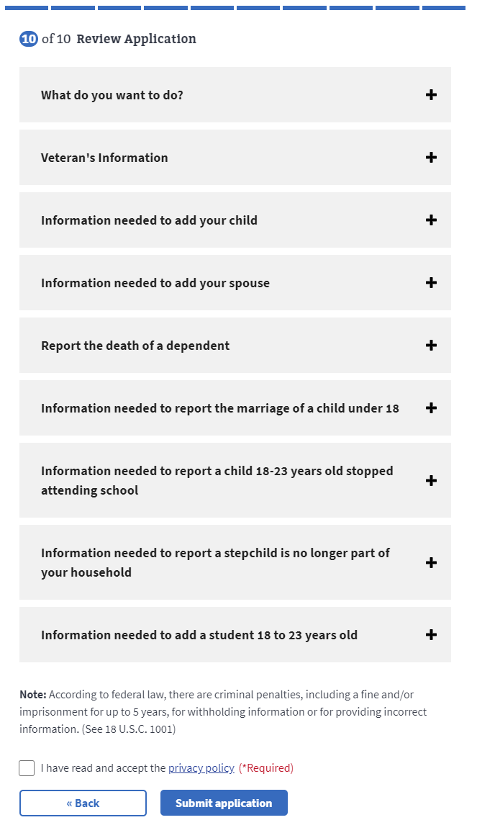
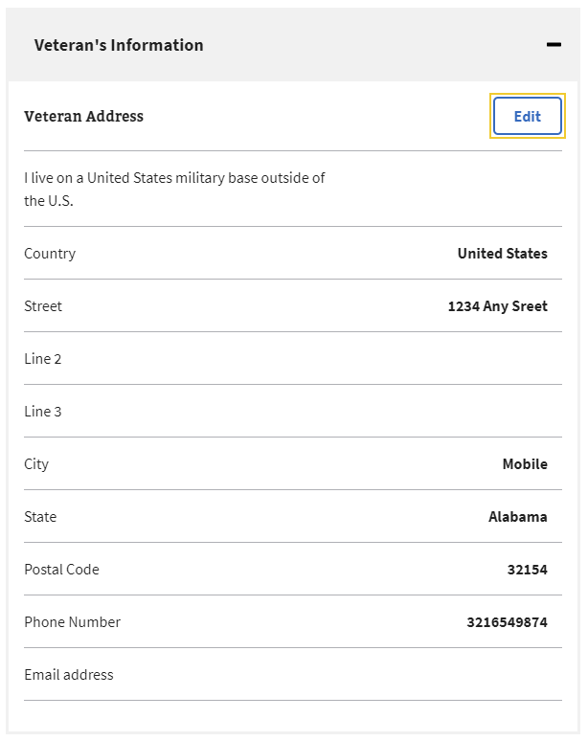
Confirming Information
Dependency Claims (21-686c) - Product Guide
Once all desired workflows are completed, they can be individually edited then confirmed all at once when Submit application is clicked.
It should be noted that the box for the privacy policy must be checked before continuing

Slide 13
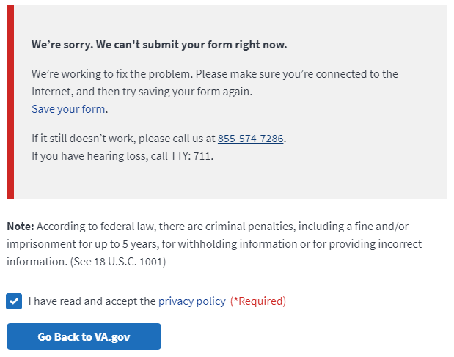
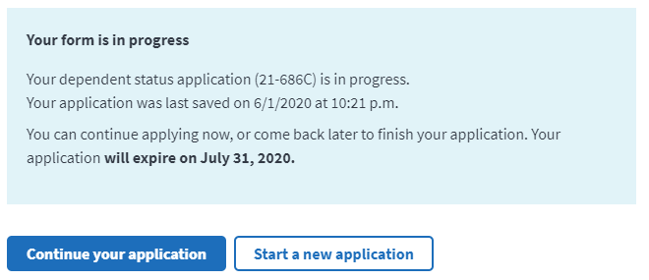
Returning to the Form
Dependency Claims (21-686c) - Product Guide
In the event that there is an issue and the form cannot be submitted normally, a red notification message will be displayed with further instructions for the user.
The next step the Veteran might take is to go back to the index page of VA.gov.
Please note that the form should save in place at this point and can be resubmitted without having to redo the whole form.

