Slide 1

Information architecture at VA.gov
Meg Peters and Mikki Northuis | June 17, 2020

Slide 2
We want to talk with you about IA.
How we will help you
What we’ve learned
Our plan
Your thoughts on ^
Because this is a lot, our top goals are to: 1) show you what we’re doing, and 2) talk again next Wednesday at 12:30pm.
Notes:
Thanks for the time today! I’m going to talk fast since we have a lot of exciting stuff to cover. Mikki is going to chime in as needed.

Slide 3
How we will help you
There are many ways! ☺

Slide 4
How do you define IA?
“
How information is structured.
For websites, this would not only include the navigation, but also how information is structured at all levels, whether that is on a page or how URLs are organized.
- One of y’all
Notes:
Solid, well-rounded definition from the survey.

Slide 5
What else can we say about IA?
“
IA is foundational.
It’s the structure for every user interaction.
- Meg and Mikki

Slide 6
We will help you by designing and testing:
Navigation system: Top nav, header, on-page links, side nav, footer, user flows, etc.
Structure: Site structure, page templates, etc.
Search: Search flows, page templates, and search tuning
Names and labels: Page titles, navigation labels, URLs, facility names, and more (think SEO!)
Taxonomies: Structured metadata to help users find things

Slide 7
What we’ve learned
From analytics.
Notes:
We want to cover these quickly, then take questions afterwards.

Slide 8
Top tasks on modernized VA.gov for the past year:
Check VA claim or appeal status
Sorry — we can’t find that page (facilities)
Sign in
Go to MyVA
Download VA letters
Search
6. (Tied with ^ ) Check education benefits (Post GI Bill)
^ From Google Analytics June 3, 2019 to June 3, 2020 (modernized pages). See the task summary.
Notes:
Thanks to Samara for her requests to the analytics team, which helped us tremendously.

Slide 9
More top tasks on modernized VA.gov for the past year:
7. Find VA locations
8. Apply for healthcare benefits (includes check eligibility)
Get veteran ID cards
Find out how to apply for GI Bill and related benefits
10. (Tied with ^ ) View profile or account
11. Find out how to file a disability claim
^ From Google Analytics June 3, 2019 to June 3, 2020 (modernized pages). See the task summary.

Slide 10
Top tasks on all of VA.gov for the past year:
Because of quirks with Google Analytics, this is a summary.
Track claims
Healthcare tasks (includes My HealtheVet):
Send messages
Refill prescriptions
Get lab and test results
Find VA locations
Apply for education benefits
Schedule appointments
Download my data
^ From Google Analytics June 3, 2019 to June 3, 2020 (all pages). See the page views report.

Slide 11
Mobile + tablet use is 45%.
Mobile: 39.59% or 33.8M
Tablet: 5.11% or 4.3M
^ From Google Analytics June 3, 2019 to June 3, 2020 (all of VA.gov). See the report.

Slide 12
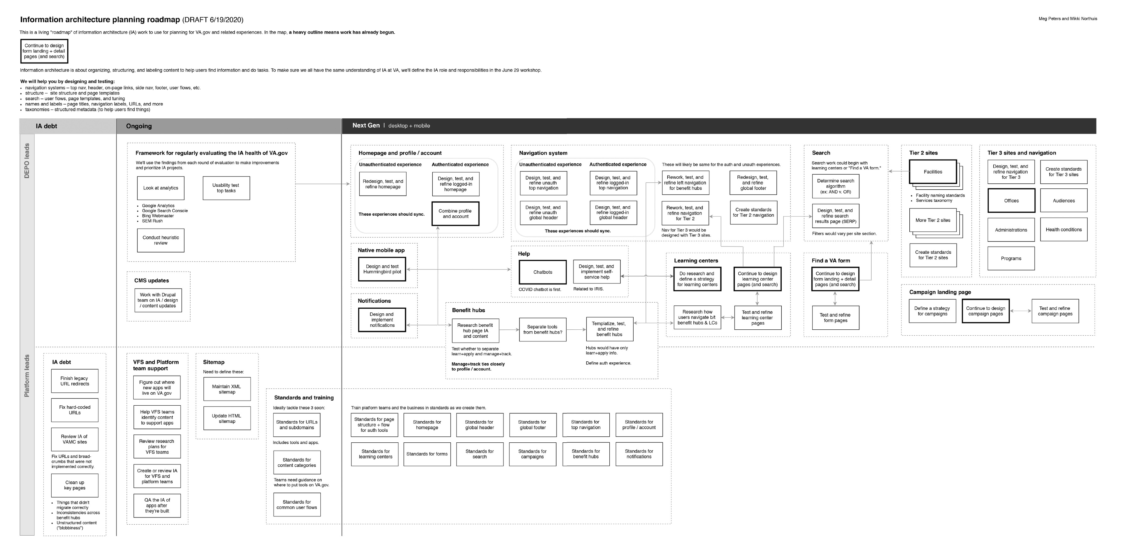
Road trip! We’ve mapped out IA needs for VA.gov.
^ This is a living map. Let us know if we’ve missed something. See the IA planning roadmap.
Notes:
Map shows DEPO and Platform work – this mainly refers to who’s leading what. We also have phases: IA debt, Ongoing work, and “Next Gen.”

Slide 13
About the IA planning roadmap…
We created the roadmap to understand the full “landscape” of IA work.
We highly recommend looking at it to see how your projects relate to other efforts. (Downloading is best.)
Happy to give tours!
This is a living map. Let us know if we’ve missed something. See the IA planning roadmap.

Slide 14
Our recommendations for IA
Where to focus now.

Slide 15
Our #1 goal:
“
Create a holistic, seamless experience for veterans every time they interact with the VA.
And help teams do this, too.
- Meg and Mikki

Slide 16
DEPO – Meg focuses on strategy, research, and design.
Working with teams on public-facing initiatives and improving global IA.
IA strategy
Facilities naming
Services taxonomy
Learning centers
Notifications
Search
Research and evaluation
Top tasks research at regular intervals (includes authenticated)
IA design
Navigation system
Homepage (authenticated and unauthenticated)
Notes:
Nav and auth were the most pressing needs (from the survey).

Slide 17
Platform – Mikki focuses on support, design, and debt.
Supporting VFS teams and working with existing site content and functionality.
Support/documentation
Documenting standard user flows (online tools and apps)
IA debt
Updating migrated tools with legacy URLs and breadcrumbs
Reviewing VAMC IA
IA design
Separating auth tools (fed by research)
Templatizing benefit hubs (defining standard core content)
Refining left nav and applying to benefit hubs
Simplifying benefit hubs (w/Danielle)

Slide 18
Your feedback drives change.
Come to our IA planning discussion Wednesday, June 24 at 12:30pm. We would love ideas and feedback on what you heard today!
Come to the IA roles & responsibilities workshop Monday, June 29 at 4pm. Help us define DEPO versus Platform IA roles and responsibilities.
Visit the #ia-forum on Slack. And comment!
Check out IA activities on Github. See analytics, the roadmap, and what we’re up to: https://github.com/department-of-veterans-affairs/va.gov-team/blob/master/products/global/IA-strategy%2Bplanning/information-architecture-activities.md

Slide 19
See you Wed, June 24 at 12:30pm!
#ia-forum on Slack
Meg.Peters@va.gov | Mikki@adhocteam.us

