Slide 1

Profile: Notification Settings
Discovery Readout
Liz Lantz
liz.lantz@adhocteam.us
June 29, 2021

Slide 2
Background
The VA is ramping up digital communications efforts, specifically through email and text. As a result, Veterans need to be able to manage and customize the communications they receive. The VA Profile team has built communications permissions engine that will integrate with the VA.gov profile frontend, and allow veteran-managed settings to be saved and shared across systems at the VA.
Through this research, we wanted to learn about the Veteran mental model around notifications, and evaluate our proposed design for a notification settings section of the VA.gov profile.

Slide 3
Research Goals
Specifically, we wanted to find out:
What expectations do Veterans have about discovering, receiving, and managing notifications?
Does our solution enable Veterans to manage notifications without encountering UX hurdles, especially when their profile is missing contact information?
What kind of static content support might make sense for this section of profile?
Bonus: We're also working on improvements to our user experience for removing contact information from profile, so we included one task to evaluate that process.

Slide 4
Method
Methodology
We spoke to a diverse group of 9 Veterans:
3 women, 6 men
4 participants who identify as Caucasian, 3 participants who identify as Black or African American, 2 participants who identify as American Indian or Alaska Native
Participants ranged in age from 34-74, with the most participants (3) falling into the 35-44 age range.
Participants live in Florida, Pennsylvania, Maryland, Arkansas, Oklahoma, Ohio and Texas; 5 participants live in a rural area.
2 participants had identified cognitive considerations of PTSD and/or TBI.
Education level ranged from high school/GED or equivalent to Master's degree, with the most participants (3) having completed some college (no degree).
50 minute remote, moderated session over Zoom
Warm-up interview, 5 tasks in a prototype, 2-3 post-task questions
GitHub Research Folder: plan, convo guide, and notes

Slide 5
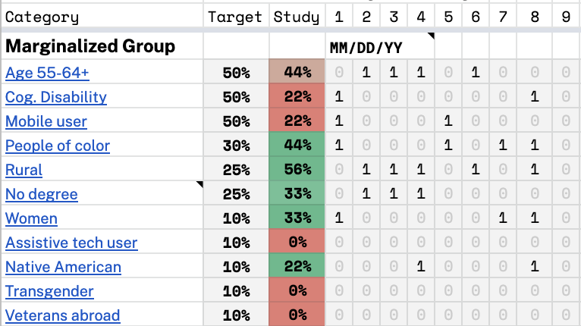
Marginalized groups we didn’t speak with
Methodology
This study may not meet the needs of the following marginalized Veteran groups:
Veterans above the age of 55
Veterans with cognitive disabilities
Mobile users
Assistive tech users
Transgender Veterans
Veterans living abroad
Other than honorable

Slide 6
Findings Summary
Research Findings
1. It was not intuitive for participants to look in profile to manage notification settings, and most don't actively manage settings for notifications they currently receive.
2. Overall, our design provides a good solution for Veterans to manage notifications, but status messages and available notification channels were not clear to all participants.
3. Leaving notification settings to add missing contact information caused confusion for participants.
4. 5 of 9 participants experienced concerns and confusion about their sign-in vs contact email address.
Note: These are selected highlights from our complete research report, available on Github.

Slide 7
Findings Summary
Research Findings
It was not intuitive for participants to look in profile to manage notification settings.
Six participants first looked on the homepage under various sections such as health care and records. We prompted them to see if there was anywhere else they would look; responses included using site search, the contact us link, and My Health eVet (MHV). Once guided to the profile menu options (My VA, My Health, Profile):
- 5 of 9 participants stated they would expect to find notification settings under My VA
- 2 said My Health
- 2 chose Profile
Part of the disconnect between profile and notification settings could be due to the fact that the 6 of 9 participants stated they don't update settings for notifications they currently receive. One participant with TBI felt the concept of managing notifications was overwhelming.

Slide 8
" “Probably under health care. I would say under refill and track your prescriptions. Or, I guess, the other thing I could do if I didn't find it there, I'd probably go up into the search block.” - P3"

Slide 9
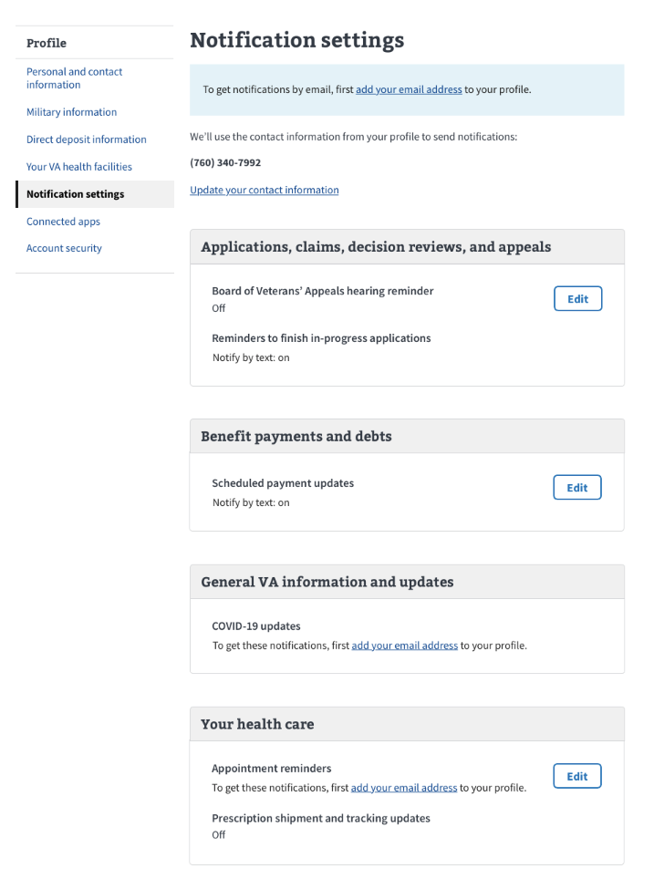
Findings Summary
Research Findings
Leaving notification settings to add missing contact information caused confusion for participants.
According to data provided by VA Profile, about 50% of VA.gov profiles have a mobile number on file, and fewer than that have an email on file. Keeping this in mind, we needed to account for notification settings for users who are a missing contact email or mobile number.
All participants understood content telling them they needed to add missing information, but leaving the notification settings page to do so caused confusion and a lack of confidence that the task had been completed.
Only 3 of 9 participants were confident about how to complete the notification opt-in task after adding missing contact information.

Slide 10
“I have not a clue. Because all you've done is added your email, you don't know whether the notifications are coming or not.”

Slide 11
Next Steps
Upcoming sprint
Share complete findings with team to collaborate on the path forward.
Establish plan to tackle improvements.
Start tackling.
Future sprints
More tackling.
More research.

