Slide 1
How do we ensure the quality of our tier 1 Veteran-facing benefit content and tools? So it continues to be a Veteran-first product platform
Notes:
For tier 1 Veteran-facing benefits content, there’s a strong desire by many teams for quality assurance.
The current web content process is a collaboration between VA digital partners (like VHA Digital Media, VBA Web Team) and SMEs, with the VA.gov content team providing content support.

Slide 2
Roll out of Drupal training, content onboarding, and editorial process
Cms in progress
We want to make sure everyone has the right training and support to feel confident in Drupal. And that trusted partners understand our common strategy of a unified, Veteran-first product platform and why we need the content steps that we have in place.
VACO partners will be trained and onboarded first (VHA, VBA, NCA, and OPIA digital web teams). ETA September: Look for calendar invite from CMS team.
Then we’ll work with VACO teams to onboard business line partners for the different tiers of content.
See attached PDF with this deck for editorial process.
Training and onboarding important because of headless nature of Drupal.
Notes:
Chunked roll out due partly to CMS still being very buggy and lacks the functionalities we want (because of headless).
Many CMS authoring bugs now being addressed as part of the first roll out of training (difference of being on the bleeding edge vs cutting edge).

Slide 3

This new tier 1 editorial process will be a collaborative partnership (of VA.gov team, stakeholders/SMEs, and VBA/VHA/NCA digital teams) based on trust and a common goal.
Notes:
Dual keys! Warheads! But not as scary.

Slide 4
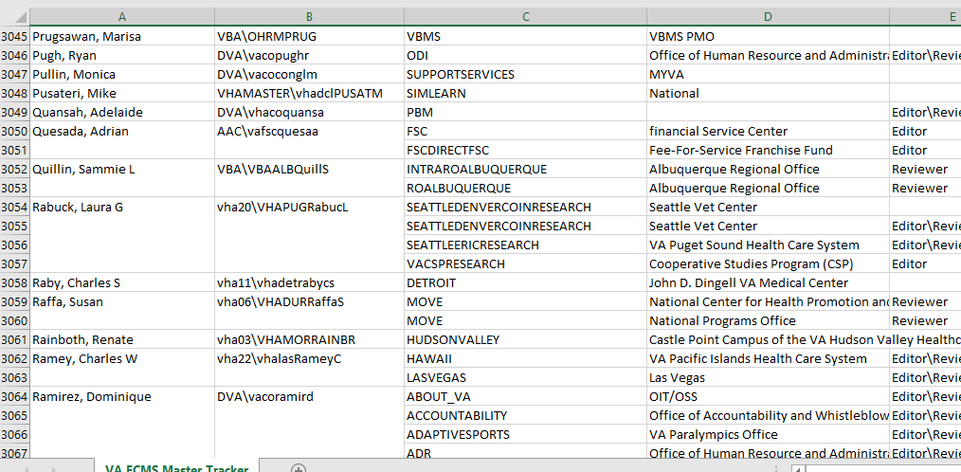
Today’s CMS: Few resources for design and content standards, quality control, UX and search optimization, and management of content lifecycle
Governance challenge for ensuring quality standards
7,000+ TeamSite users with edit/review/publish access
Notes:
TeamSite

Slide 5
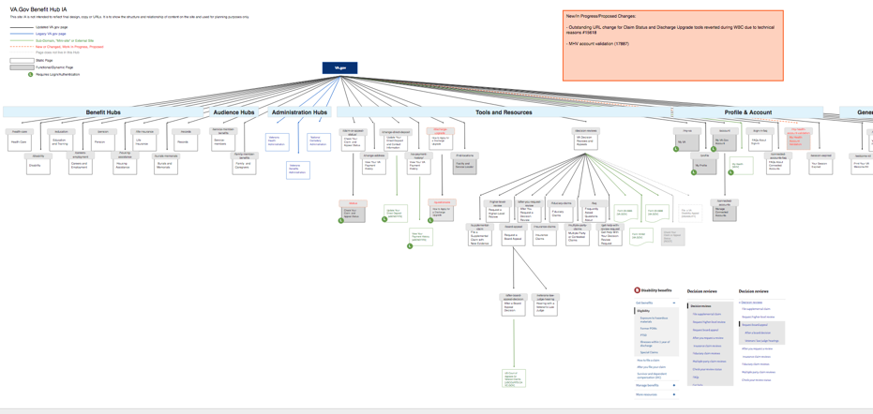
This is VA.gov: complex, inter-related platform
Notes:
IA view. TeamSite IA is probably also this complex – it’s just that there wasn’t an Information Architect (a Mikki on the content team) to manage it all, so that it makes sense from a UX standpoint.

Slide 6
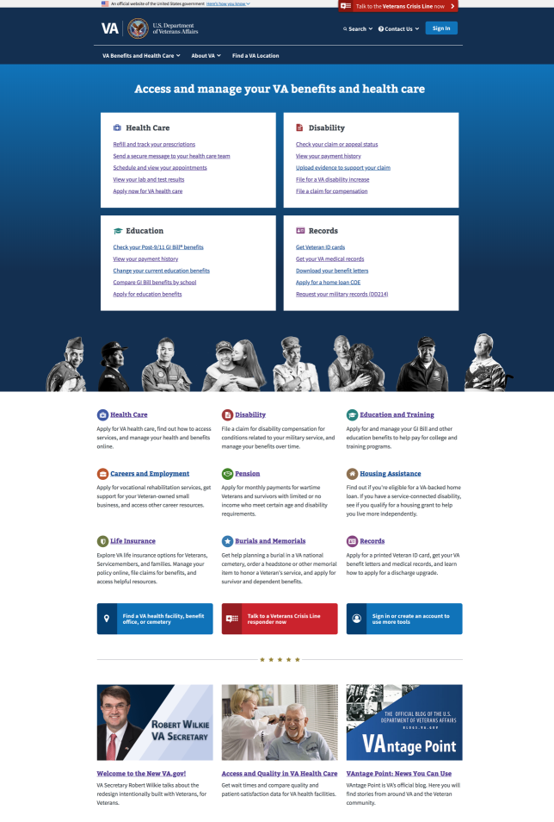
Common goal: A unified, Veteran-first experience with tier 1 benefit content

Slide 7
Different content and tools need different kinds of quality control, governance, or DEPO involvement or consultation
VA.GOV Content HIERARCHY
Tier 1
Veteran-facing benefit and health care content and tools
Tier 2
Benefit-related program and engagement content
Tier 3
Administration and office content
Notes:
Content and tools are prioritized on the new VA.gov

Slide 8
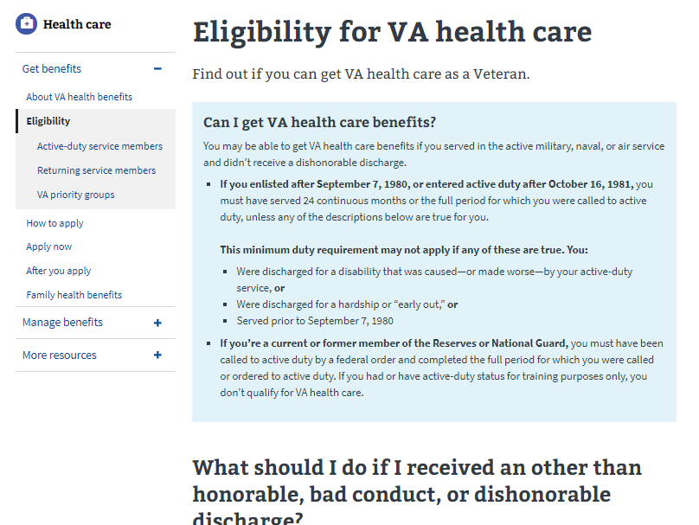
Tier 1 Veteran-facing benefit and health care content and tool
VA.GOV Content HIERARCHY
Primary users
Veterans and other beneficiaries (family members, service members)
Examples
Benefit eligibility content
Online applications and tools
Authenticated (signed in) experiences like My VA dashboard
Veteran-facing content on VAMC and RO facility sites (top tasks, parking, directions, available services)
Quality assurance
Inter-administration and DEPO collaboration
Centralized quality control and processes at DEPO/VACO level
Web Content Team white-glove support

Slide 9
Tier 1 content includes a lot of invisible “white glove” content support
Content audit, sometimes competitive analysis
SEO (search engine optimization) research
IA research (including nav and other access links, redirects)
Content lifecycle management (retiring outdated or consolidating duplicative content)
Writing that specializes in user experience (UX) and the new VA.gov voice and tone
Proofreading (by an editor who didn’t write the content) for a final quality check of VA.gov content style guide and plain language requirements

Slide 10
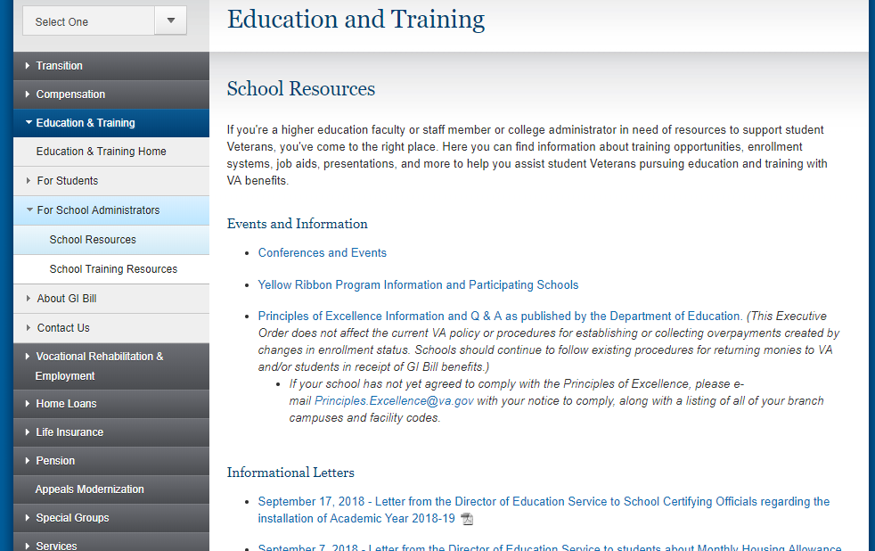
Later: Tier 2 benefit-related program and engagement content
VA.GOV Content HIERARCHY
Primary users
A mix of non-beneficiary audiences (e.g., VSOs, caregivers, loan officers, school administrators) and Veterans
Examples
Health wellness content
Support/learning resources for caregivers (who don’t receive family member benefits)
Content for benefit servicers and others who work with Veterans
Quality assurance
Intra-administrations and DEPO collaboration
Quality control and processes, mix of VACO and business lines
Some content support or review
Notes:
Tier 2 is the largest category of content at VA, with the most nuanced variety of content. It will require similarly a spectrum of centralized vs decentralized quality control and DEPO and web content team support. (For example: maybe on most tier 2 content, the WCT might review, but not support the creation or Drupal implementation.)
Tier 2 includes content that supports benefits and can include Veteran and non-beneficiary audiences. EX: GI Bill eligibility and how to apply content and the online application are tier 1 content. Content for school administrators who work with students receiving the GI Bill is tier 1; but also engagement/learning/help content whose main purpose is to make more students aware of all the services at and outside VA to help them finish their education is also tier 2.

Slide 11
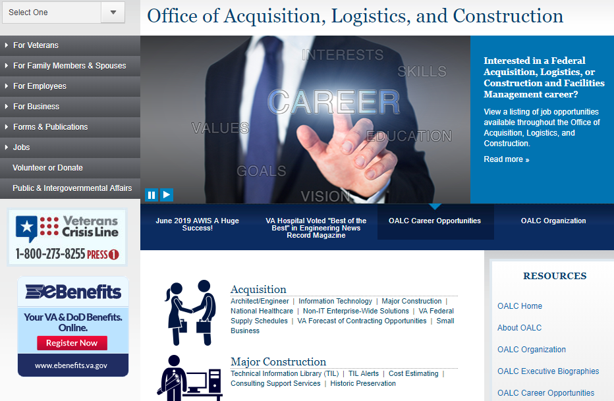
Later: Tier 3 administration and office content
VA.GOV Content HIERARCHY
Primary users
Non-Veteran and non-beneficiary audiences (press/media, medical professionals, Congress, vendors and suppliers, other government offices, etc.)
Examples
Administration pages
Program office/department pages
Legal or other regulatory information (e.g, FOIA, OIG, policies)
Quality assurance
Set by each administration or business
Templates, training, VA.gov design system and content style guide resources
Notes:
Tier 3 content – little to no DEPO and web content team support

Slide 12

We’re moving
The editorial process is moving to the new CMS.
Moving isn’t always fun, but we’ll get there together.

