Slide 1

Information architecture planning
Meg Peters and Mikki Northuis | June 24, 2020

Slide 2
Today we want to:
Show you the “lay of the land” for IA needs
Share our plan
Answer questions + get your thoughts on ^

Slide 3
Refresher… IA is about designing and testing:
Navigation system: Top nav, header, on-page links, side nav, footer, user flows, etc.
Structure: Site structure, page templates, etc.
Search: Search flows, page templates, and search tuning
Names and labels: Page titles, navigation labels, URLs, facility names, and more (think SEO!)
Taxonomies: Structured metadata to help users find things

Slide 4
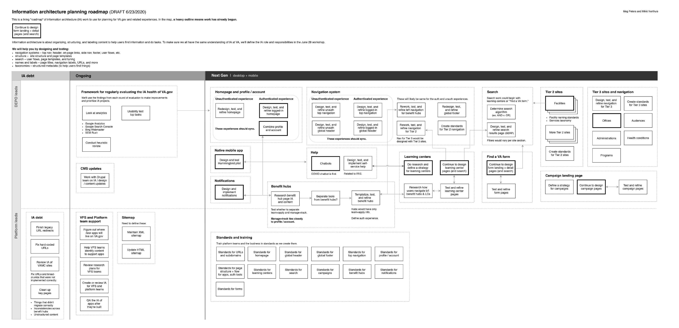
Road trip! We’ve mapped out IA needs for VA.gov.
^ This is a living map. Let us know if we’ve missed something. See the IA planning roadmap.
Notes:
Map shows DEPO and Platform work – this mainly refers to who’s leading what. We also have phases: IA debt, Ongoing work, and “Next Gen.”

Slide 5
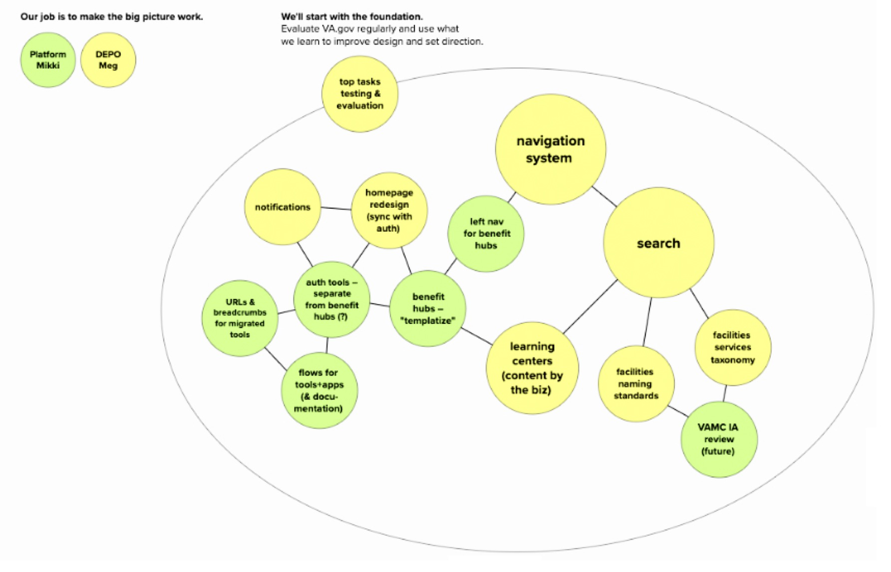
Here’s
the
plan.
We’ll start with these “slices” of the roadmap.
Larger circles mean more effort.
This visual is easier to see in Mural.

Slide 6
What’s next?
Come to the IA roles & responsibilities session Monday, June 29 at 4pm. Help us define DEPO versus Platform IA roles and responsibilities.
Visit the #ia-forum on Slack. And comment!
Check out IA activities on Github. See analytics, the roadmap, and what we’re up to: https://github.com/department-of-veterans-affairs/va.gov-team/blob/master/products/global/IA-strategy%2Bplanning/information-architecture-activities.md

Slide 7
See you Monday, June 29 at 4pm!
#ia-forum on Slack
Meg.Peters@va.gov | Mikki@adhocteam.us

