Slide 1
Search & Discovery
Social Listening
Scanned social media posts within the last 12 months on Reddit.com/r/Veterans and Hadit.com for posts that contained the phrases: “can’t find” and “looking for”.

Slide 2
Search & Discovery
Social Listening Findings
Veterans wanting to locate their own data
Could not find forms their VSOs had uploaded
Needed to locate documentation of their disability and medical notes
Veterans who needed help locating a specific form
Needed a short version of a form
Needed a form stating their service connected percentage
Veterans who had general benefits questions
Whether they could receive SS and disability benefits
Whether they were eligible for certain school benefits
Looking for health benefits coverage information
Power of attorney/fiduciary help for themselves or a relative

Slide 3
“... It's almost like fraudsters can smell vulnerability…
I don't know why the VA won't help me. The laws that protect vulnerable adults doesn't seem to cover me. You would think they'd have some protections written in for disabled veterans who are not elderly, but they don’t.
Does anyone know of some kind of resource that can help? I can't do homeless again. I just can't.”
Notes:
48 year old veteran who had a traumatic brain injury, she had reached out to doctors, social workers but said she hadn’t received help

Slide 4
Search & Discovery
Impact of Scams on Veterans
Veterans are twice as likely to become victims of scams compared to other Americans
78% of veterans have been targeted by scams specifically crafted to exploit their service history

Slide 5
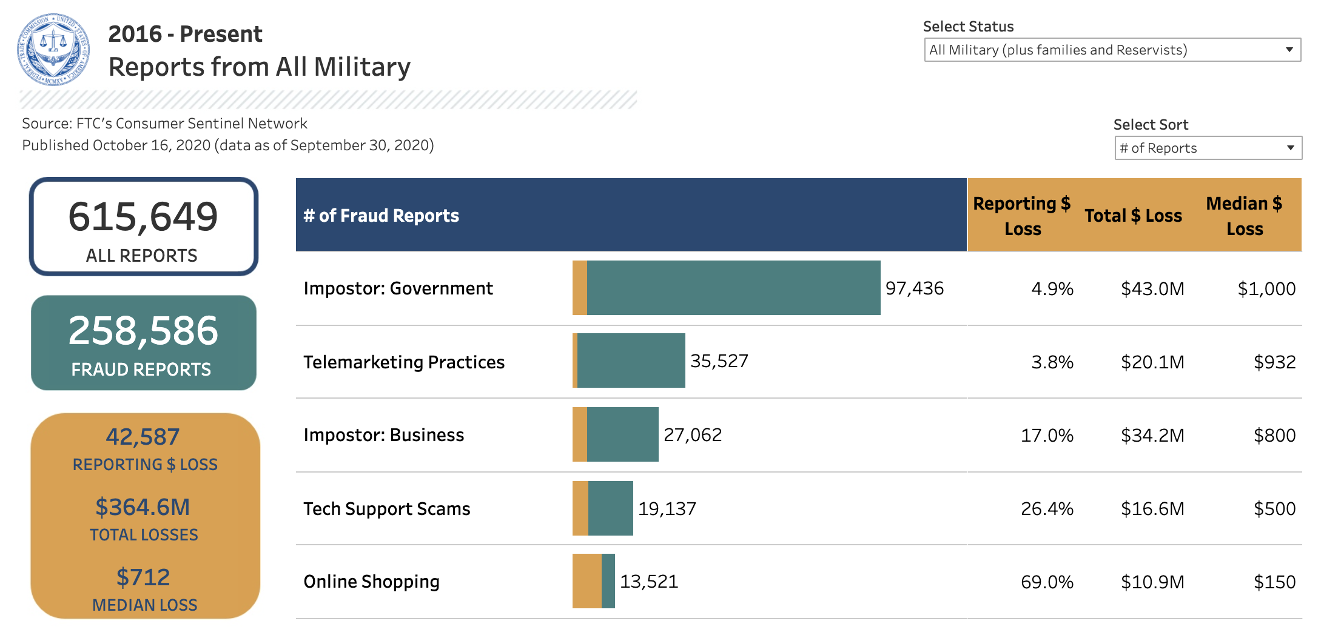
Search & Discovery
Fraud Reports from FTC
https://public.tableau.com/profile/federal.trade.commission#!/vizhome/MilitaryReports/Infographic

