Slide 1

Personalized Career Planning and Guidance: Product Guide
Making it easier for Veterans to sign up for career counseling. Also known as Chapter 36.
va.gov/careers-employment/education-and-career-counseling/ apply-career-guidance-form-28-8832/
eBenefits Team (VSA) | December 2020

Slide 2
What is this?
Personalized Career Planning and Guidance - Product Guide
The Personalized Career Planning and Guidance (PCPG) tool is a short form (VA Form 28-8832) that allows a Veteran to sign up to be contacted for career counseling. Also included on this page is an eligibility wizard that helps Veterans understand if they are using the right form or service.
Target launch date is end of January 4, 2021.
Who can access the PCPG tool?
View Your VA Payment History is currently available to LOA3 (eBenefit Premium) users. While other users can currently log in on Veterans’ behalf, it is not anticipated that this will be possible on VA.gov until Roles and Relationships are finalized. Other non-ID.me login methods should be valid. Users can also access this feature unauthenticated without logging in.
How can users access the PCPG tool?
This feature is accessible for testing within the staging environment at https://staging.va.gov/careers-employment/education-and-career-counseling/apply-career-guidance-form-28-8832/introduction in any modern browser.
This feature is available from the Career and Employment hub (https://staging.va.gov/careers-employment) as well as on the Dependents Benefits page at https://staging.va.gov/careers-employment/dependent-benefits/

Slide 3
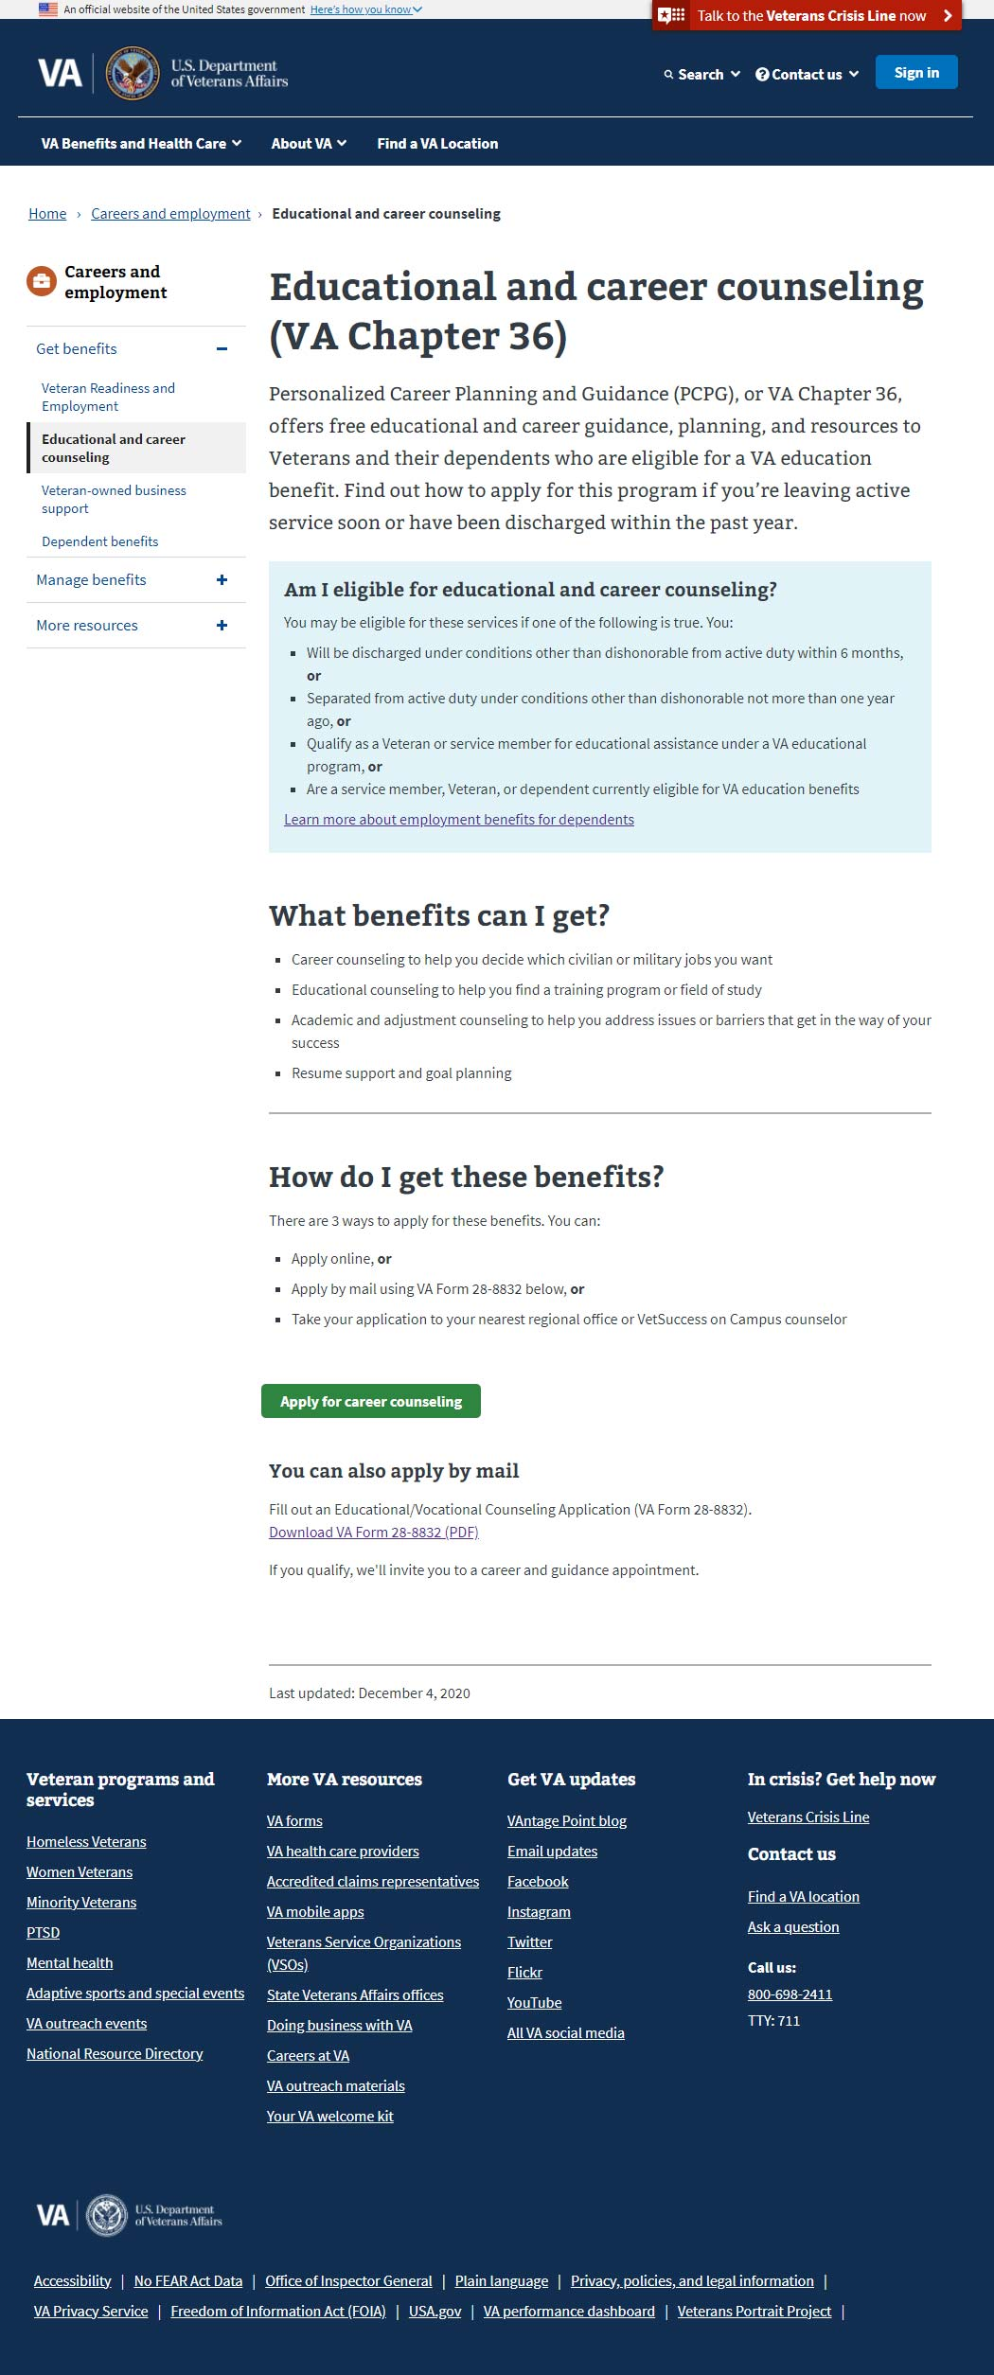
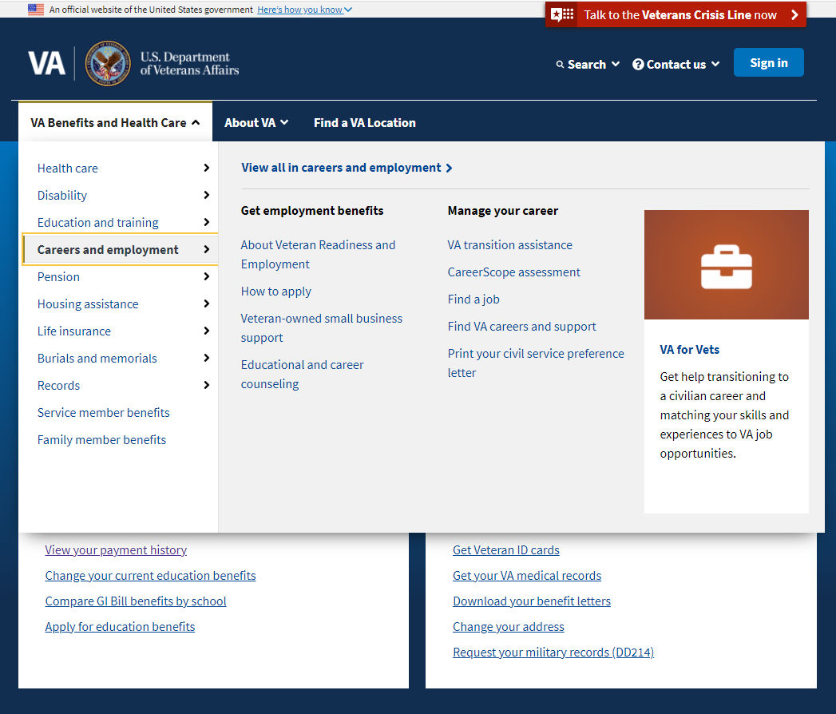
Navigating to PCPG
Personalized Career Planning and Guidance - Product Guide
Currently, to browse to this tool, the user should open the main mega menu on the home page and find the Careers and employment tab, select it, and within that, select the Educational and career counseling link
Next slide after clicking

Slide 4
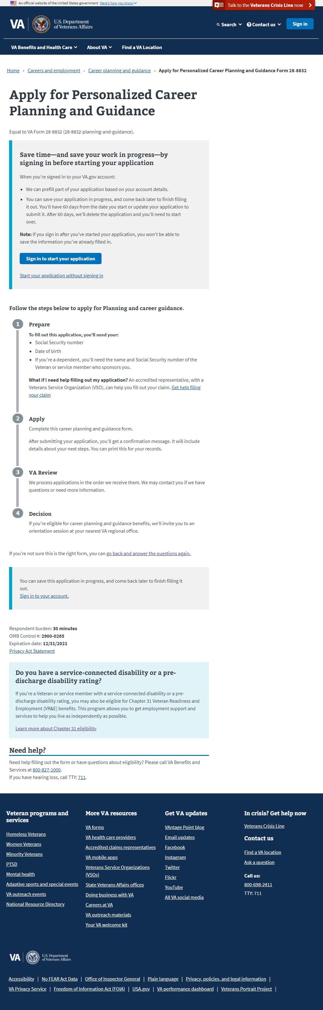
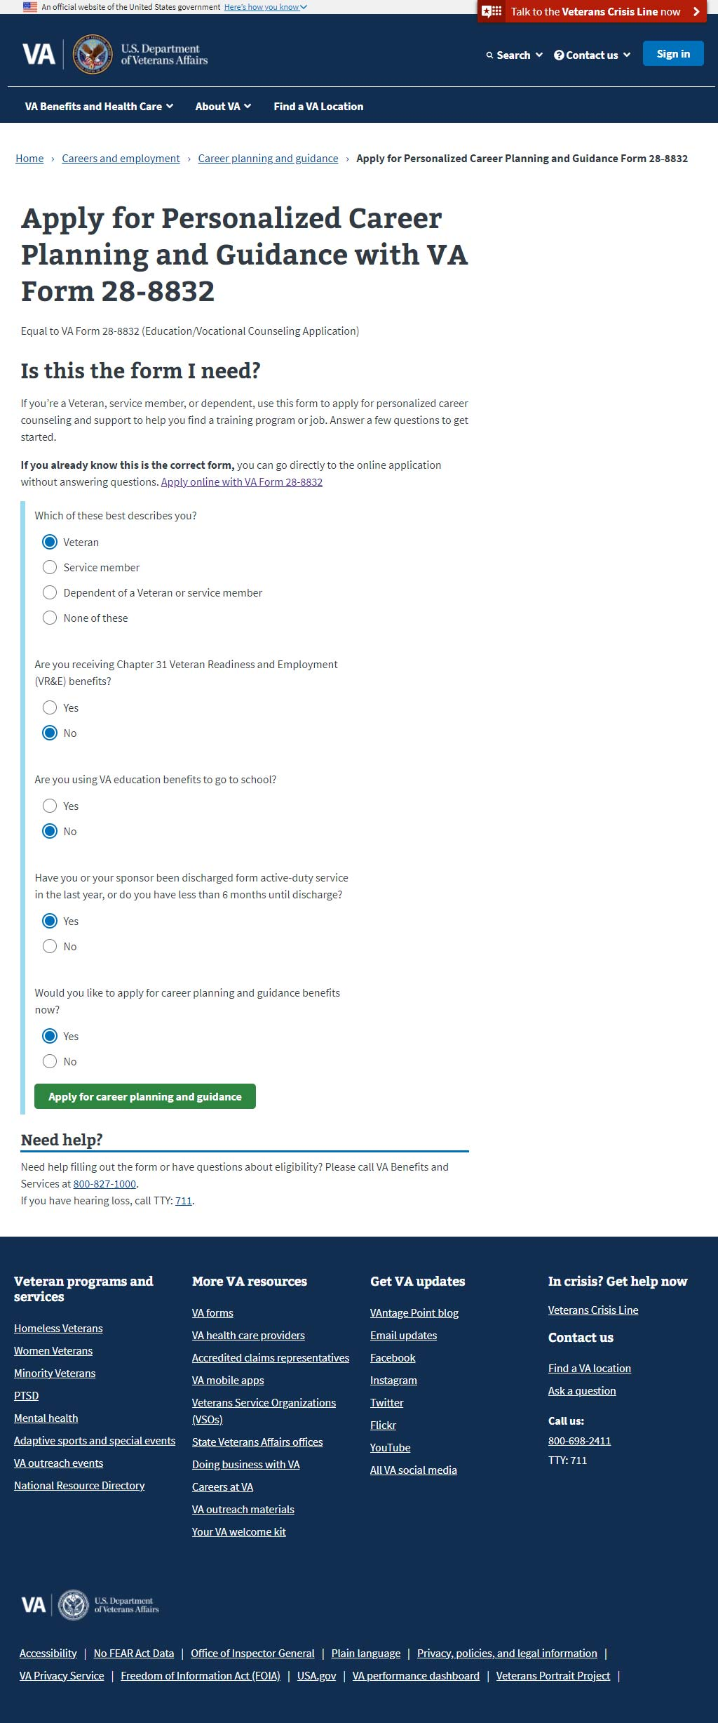
Navigating to PCPG
Personalized Career Planning and Guidance - Product Guide
Next, the user is shown an eligibility wizard and a button to the form is presented at the end. Depending on how the eligibility wizard questions are answered, various options and links are shown.
Next slide after clicking

Slide 5
Navigating to PCPG
Personalized Career Planning and Guidance - Product Guide
Next, the user is shown an eligibility wizard and a button to the form is presented at the end. Depending on how the eligibility wizard questions are answered, various options and links are shown.
Next slide after clicking

Slide 6
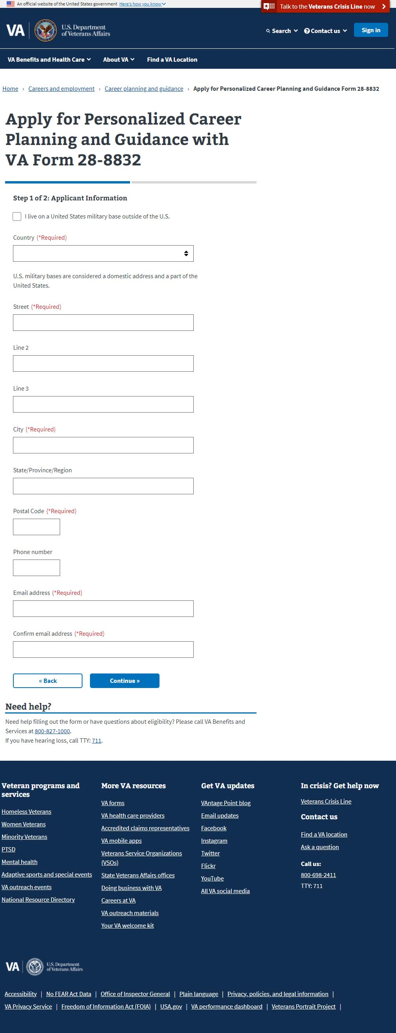
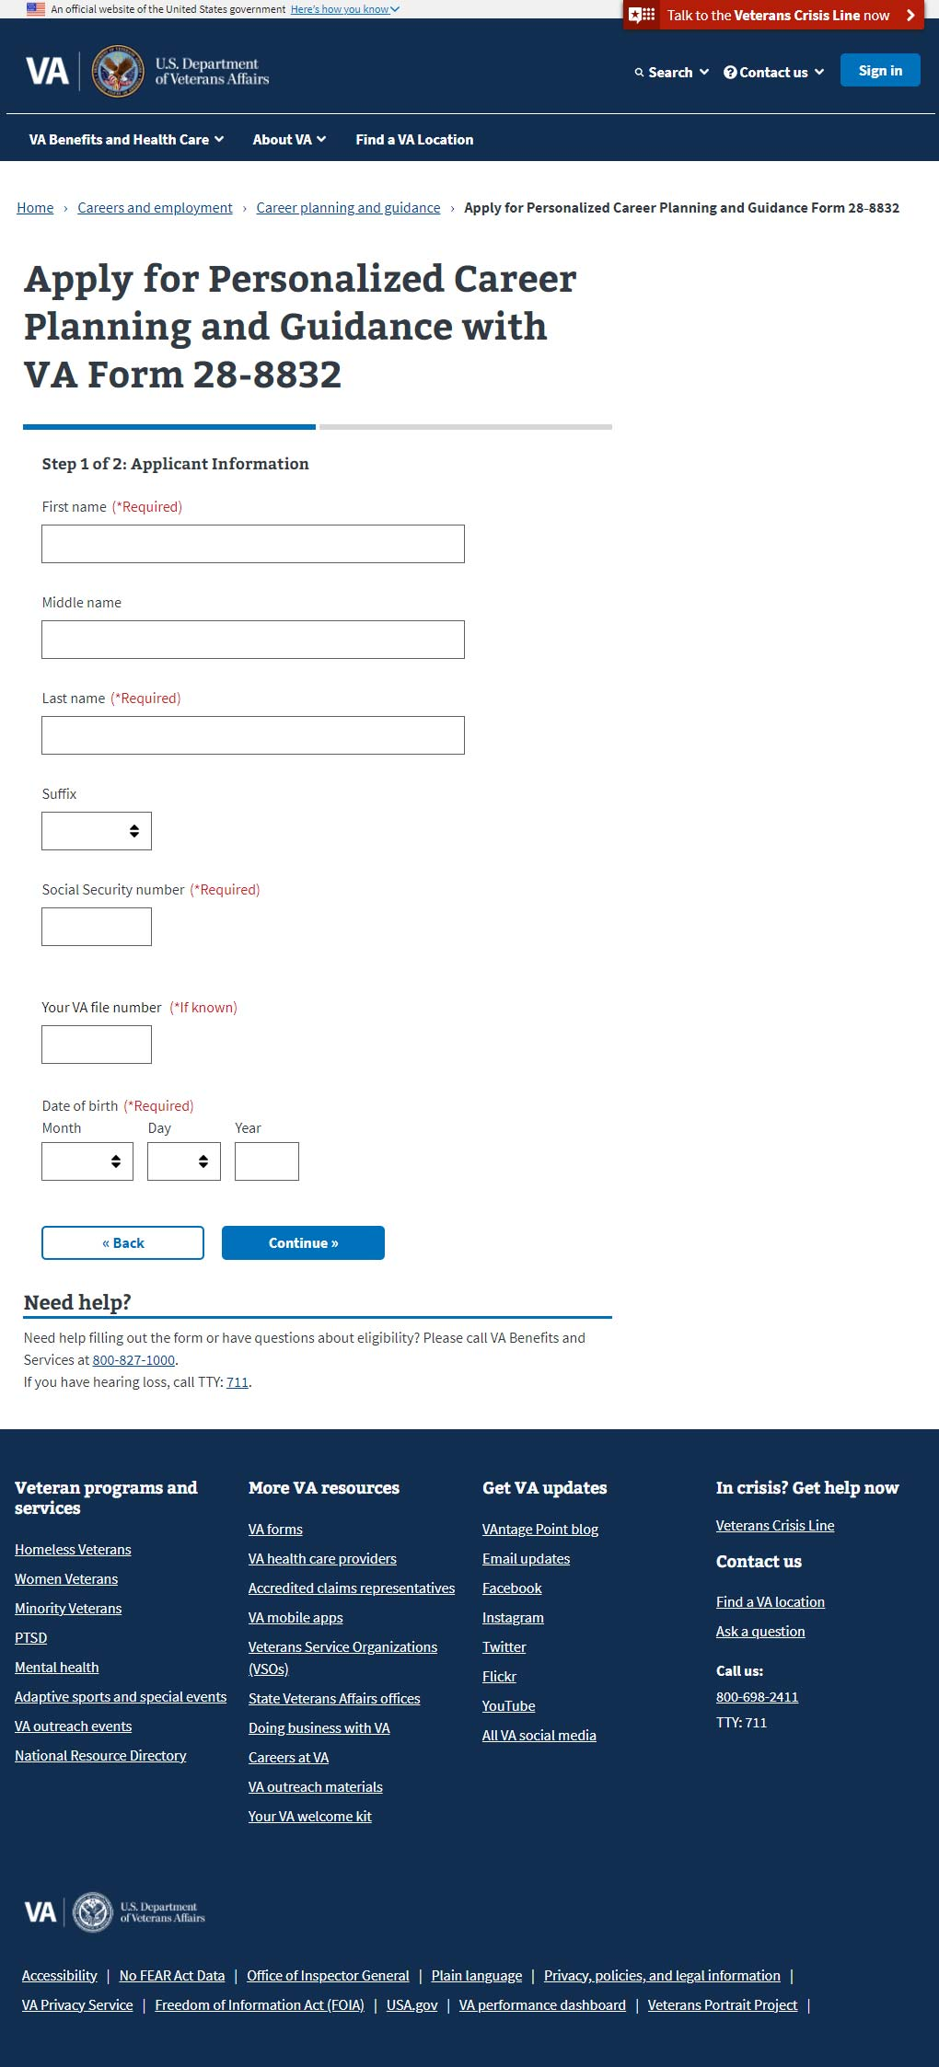
Getting Started
Personalized Career Planning and Guidance - Product Guide
The PCPG form is short and straight to the point seeking information, if unauthenticated:
the Veteran’s name SSN DOB
(next page)
physical address email address

Slide 7
Completion
Personalized Career Planning and Guidance - Product Guide
The PCPG form is short and straight to the point seeking information, if unauthenticated:
the Veteran’s name SSN DOB
(next page)
physical address email address

Slide 8
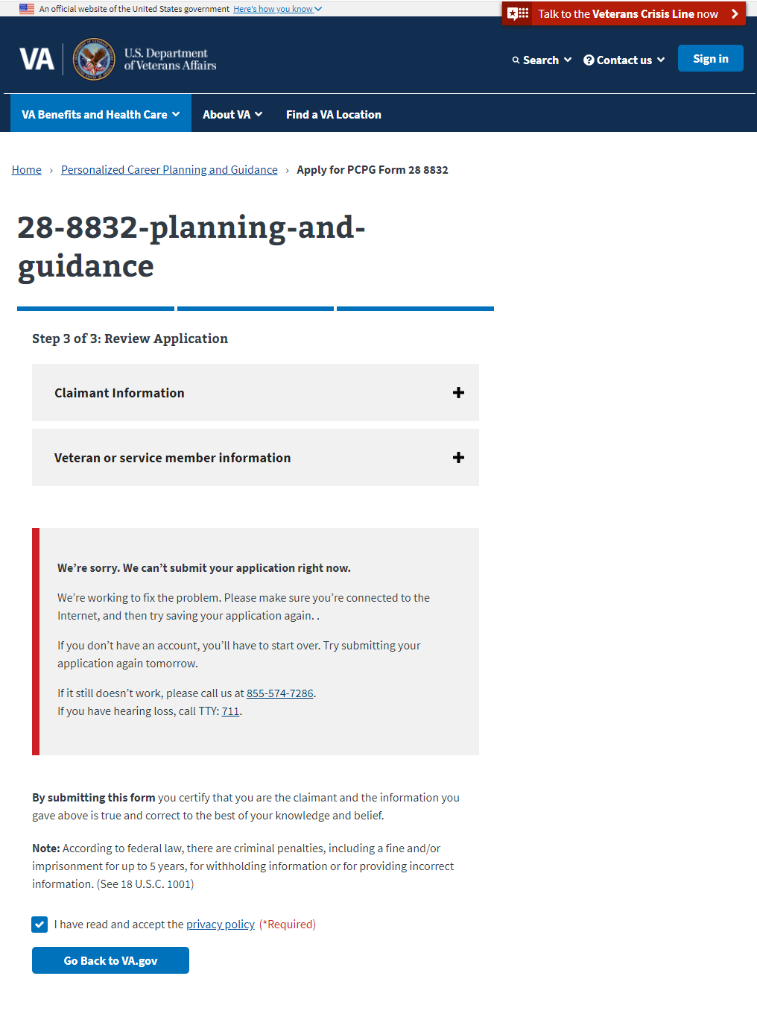
Error Handling: Form 28-8832
Personalized Career Planning and Guidance - Product Guide
If the page cannot load the page (or part of a page) due to a system issue, a red messaging window appears with instructions on who to call.

