Slide 1

Accessibility Compliance
Accessibility Beyond Compliance (ABC)
Trevor Pierce Designer + Accessibility Specialist, VSP trevor@adhocteam.us
Jennifer Strickland Designer + Accessibility Specialist, VSA
jennifer.strickland@adhocteam.us
July 24, 2020

Slide 2
Upcoming Learning Sessions
ABC » Cognitive Considerations
TBD 2020 Web Performance Impact on UX & Accessibility
Then, we’ll evaluate how these learning sessions are going, to ensure this is a useful format.
Previous ABC Learning Sessions are available in the VA repo.

Slide 3
Agenda and intro
ABC » Cognitive Considerations
Why are we having this talk
Obligated versus what to “reach for”
Avoiding launch blocker surprises
Contractual obligations
Resources
!
!

Slide 4
Why are we having this talk
Accessibility Compliance

Slide 5
Compliance confusion
Accessibility Compliance > Why are we having this talk
We have heard folks are confused about how accessibility specialists’ feedback map to required compliance.
Teams are unsure what issues are “launch blockers” versus what can wait until after a feature is launched, and why.
We want to make sure everyone understands accessibility language like “508,” “ATO,” “compliance,” “severity levels,” and “WCAG.”
Compliance likely means different things to different people.
We want to create a common meaning for all VFS teams.

Slide 6
There’s some ambiguity…
Accessibility Compliance > Why are we having this talk
Accessibility is worded differently in every contract.
There is no boilerplate the VA uses to describe requirements.
If it’s available to you, it’s worth looking into your contract to see what it says.
Each requires meeting Section 508.

Slide 7
Our work is seen as a “good example”
Accessibility Compliance > Why are we having this talk
The VA and the 508 office see our teams as “going above and beyond” and as good examples, which is why we don’t only tell you what you must do in reviews.
We set a standard for others to follow.

Slide 8
“Accessible”
Accessibility Compliance > Why are we having this talk
Accessible doesn’t mean it has to deliver the intended experience and content to assistive technologies.
It means anyone (with disabilities or not, screen reader or not), should be able to access it.
This is Accessibility Beyond Compliance.

Slide 9
Obligated versus what to “reach for”
Accessibility Compliance

Slide 10
If everything’s !important,
then nothing is.

Slide 11
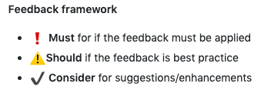

Feedback framework
Accessibility Compliance > Obligated versus what to “reach for”
We have a structure to help understand what is contractually obligated versus what you can “reach for”: the Must/Should/Consider feedback framework.

Slide 12
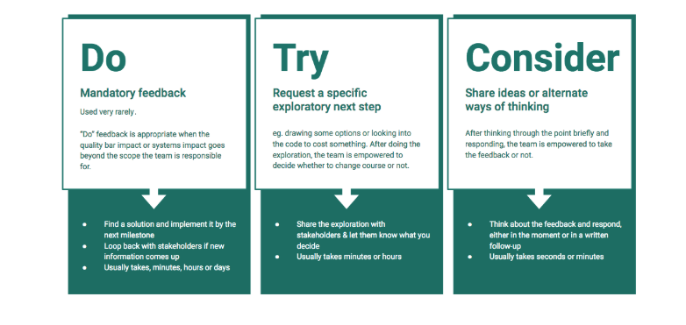
Must/Should/Consider started from this feedback framework
HT to Mickin for introducing it! https://medium.com/@jackiebo/do-try-consider-how-we-give-product-feedback-at-asana-db9bc754cc4a

Slide 13
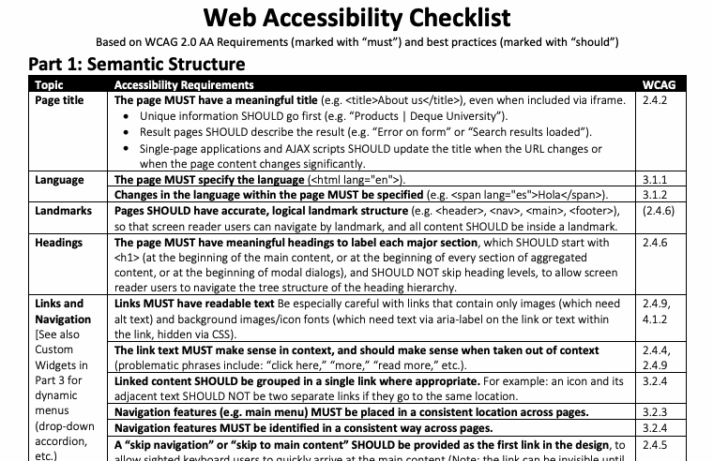
Combined with WCAG success criteria language
Notes:
WCAG 2.0 AA uses:
MUST: Required
SHOULD: Strongly recommended
MAY: Optional or conditionally recommended

Slide 14
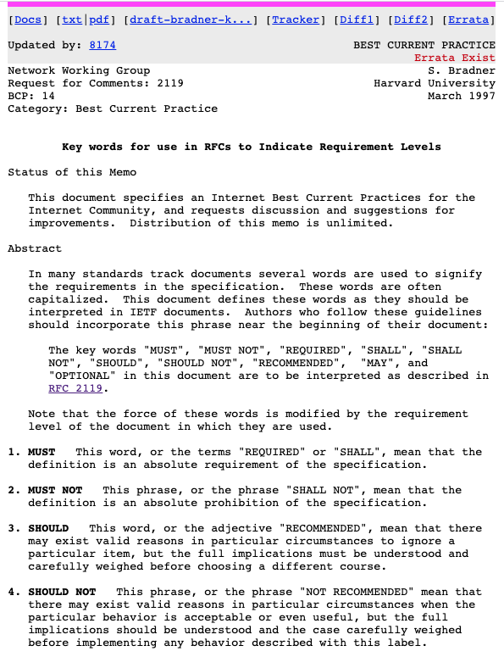
Key words for use in Request for Comments (RFC) to indicate requirement levels, from Harvard University, provided by Deque
https://tools.ietf.org/html/rfc2119

Slide 15
Accessibility Feedback Framework
Accessibility Compliance > Obligated versus what to “reach for”
Must | required for compliance
Should | best practice, industry recommendations, and should be implemented for compliance
Consider | suggestions, enhancements, inclusive design, questions/items to consider

Slide 16
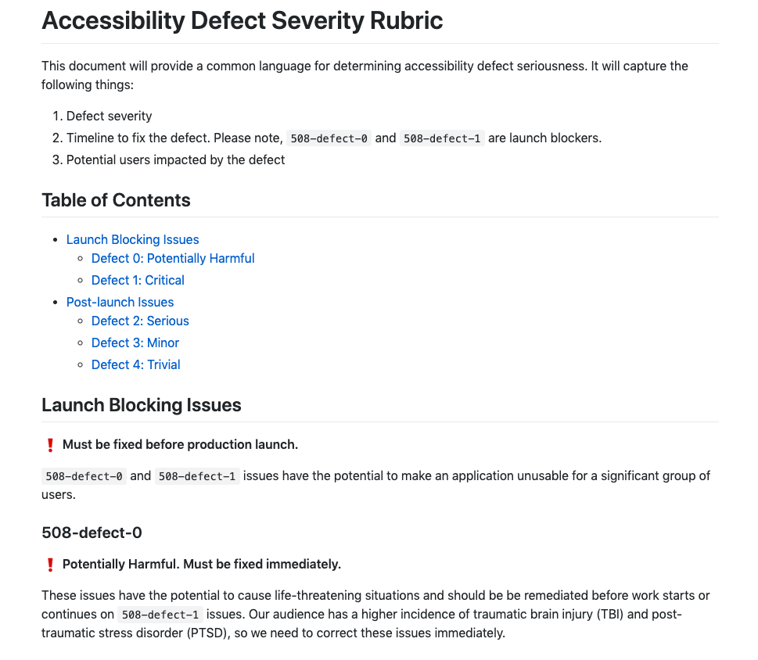
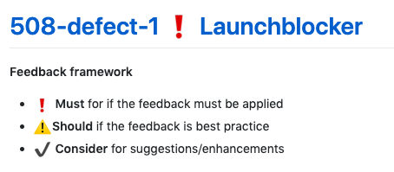
VA Accessibility Defect Severity Rubric
Accessibility Compliance > Obligated versus what to “reach for”
The framework aligns to the severity rubric. Each issue ticket has a label indicating the severity or impact of the issue that links to the rubric level documentation.
Must: 508-defect-0, 1, 2
Should: 508-defect-3, 4
Find the rubric in the va.gov-team repo.
This appears at the top of each ticket, with the defect rating, linked to its defect description.
Note: 508-defect-0 and 508-defect-1 issues are launch blockers.
Notes:
https://github.com/department-of-veterans-affairs/va.gov-team/blob/master/platform/accessibility/guidance/defect-severity-rubric.md

Slide 17
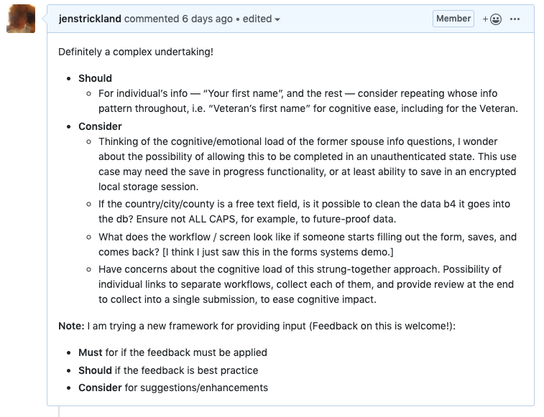
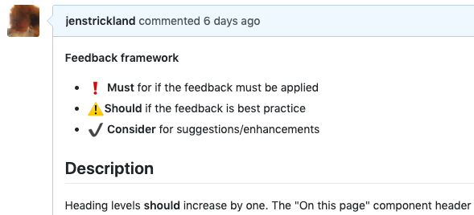
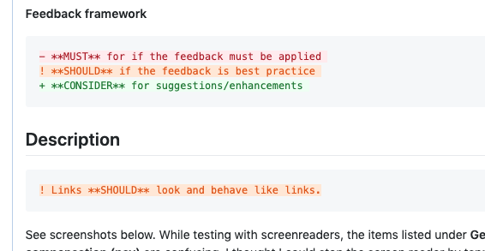
What does it look like in practice?
Accessibility Compliance > Obligated versus what to “reach for”
Feedback in comments and design reviews
Feedback in issue tickets

Slide 18
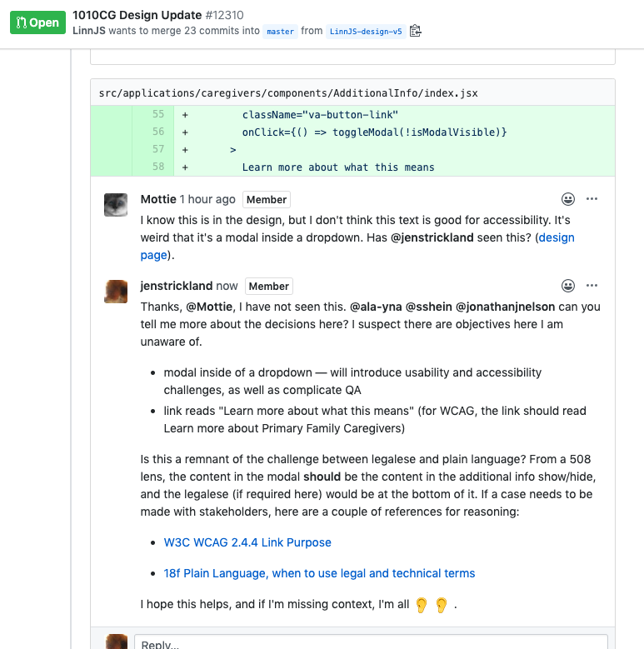
What does it look like in practice?
Accessibility Compliance > Obligated versus what to “reach for”
Feedback in pull request comments
Where appropriate, WCAG guidance links are provided.

Slide 19
Avoiding launch blocker surprises
Accessibility Compliance
!
!

Slide 20
What can you can do to make sure there are no high severity compliance issues that you are unaware of until you’re wanting to launch?

Slide 21
VSP Collaboration Cycle
Accessibility Compliance > Avoiding launchblocker surprises
The VSP Collaboration Cycle is intended to ensure teams building on VA.gov align with established standards, including accessibility.

Slide 22
Accessibility spot checks early on
Accessibility Compliance > Avoiding launchblocker surprises
Plan to collaborate with your accessibility specialist and perform accessibility spot checks throughout phases of your work. Issues can be identified and remediated during planning, research, design, as well as development.
Measure accessibility, set KPIs
Include people with disabilities in research
Early design collaboration with your a11y specialist
Consider a design-dev intent check in with your a11y specialist before starting a build (ping Jennifer for VSA or Trevor for other contracts)
If you’re interested in using screen readers to test your work, reach out to your accessibility specialist for support with NVDA and VoiceOver

Slide 23
VSP Collaboration Cycle
Accessibility Compliance > Contractual obligations
Accessibility is included in the following collaboration points:
Project Kickoff — may provide accessibility and inclusive design considerations, or relevant previous work
Design Intent Collaboration — review team’s design intentions for potential accessibility issues or considerations
Usability Testing Prep — review design and/or research plan materials for accessibility issues or considerations
Staging Review — conduct a series of automated and manual accessibility audits to ensure compliance before launch
Full Accessibility and 508 Office Audit — complete a full accessibility audit after launch, identify outstanding accessibility concerns, coordinate with VA 508 Office for feedback and approval

Slide 24
Contractual obligations
Accessibility Compliance

Slide 25
What is 508 Compliance?
Accessibility Compliance > Contractual obligations
Section 508, an amendment to the United States Workforce Rehabilitation Act of 1973, is a federal law mandating that all electronic and information technology developed, procured, maintained, or used by the federal government be accessible to people with disabilities. Since June 2001 the law has required all content created using federal money to be 508 compliant.
This law requires that all website content be accessible to people with disabilities, including government hosted or contractor hosted websites and intranet sites, both public- and government-facing.
This applies to Web applications, Web pages, and all attached files on the Intranet and the Internet, including website content, emails, computer software, gaming systems, and PDF versions of traditionally printed assets. PDFs may require 508 remediation as they are not accessible by screen readers.

Slide 26
Section 508 uses WCAG standards
Accessibility Compliance > Contractual obligations
Pronounced “Wuh cag,” WCAG is a rule called the Web Content Accessibility Guidelines (WCAG) created by a group at the W3C. This ruleset explains how to make the web work better for people with disabilities.
In January 2017, Section 508 underwent a refresh that was many years in the making. A significant change is that the WCAG 2.0 Level A and AA guidelines are now incorporated by reference and required by Section 508. Prior to the refresh, Section 508 included its own list of requirements, which were a modified subset of WCAG 1.0 (not the current version of WCAG).
To be Section 508 compliant, WCAG 2.0, Level A and AA, is the standard.
We use a series of automated and manual success criteria for ensuring electronic content and web apps are accessible for the largest group of users.

Slide 27
WCAG 2.0, possibly soon to be 2.1?
Accessibility Compliance > Contractual obligations
Remember that previously mentioned “ambiguity”?
Section 508 is based on WCAG 2.0 success criteria.
WCAG 2.1 was released on June 5, 2018.
Section 508 is rumoured to adopt WCAG 2.1 “soon,” although the Access Board indicated they may choose to wait for WCAG 3.0 (Silver / Ag).
We aim to future-proof in our work.
Section 508 is based on WCAG 2.0, and was not created with mobile in mind, so the criteria is insufficient to address mobile design use cases.
WCAG 2.1 prioritizes mobile success criteria, and improves the quality of mobile UX.
Notes:
What makes sense for us to support on VA.gov?

Slide 28
Usability overall ease of use
Accessibility Guidelines Release Dates
WCAG 2.0 — 2008
Section 508 adopted WCAG 2.0 in 2017.
WCAG 2.1 — 2018
Adds considerations for mobile design and cognitive considerations.
WCAG 3.0 — final expected 2022 Work began late 2016, Candidate Recommendation (approved first draft) expected late 2021, final guidelines expected to launch in late 2022.
The Access Board has indicated they will wait to update Section 508 when WCAG 3.0 (a.k.a. Silver) is released.
Product is highly usable and accessible:
business + user goals attained
Inclusive Design accessible for all — not just people w/ disabilities
Enhances UX through improved data access and web performance: More users!
WCAG 2.1 adds mobile & cognition success criteria
More people can use on mobile; improves comprehension through plain language & other s.c.
Section 508 = WCAG 2.0
success criteria for: blindness, deafness, and keyboard usage

Slide 29
Authority to Operate (ATO)
Accessibility Compliance > Contractual obligations
The DSVA ATO requires:
All code which is committed and deployed passes a required set of integrated tests before the code is launched. The ATO lists Deque’s axe integrated test as the preference, as it includes the 508 required rule set.
The ATO acknowledges some issues are unable to be identified by automated tests alone; manual reviews using accessibility software are important to fully confirm the software is accessible.
Digital Service will perform a series of manual checks that have been supplied by the 508 office using accessibility software.
Notes:
https://github.com/department-of-veterans-affairs/va.gov-team-sensitive/blob/master/Administrative/memos/508-ds-process.md

Slide 30
Severity of issues
Accessibility Compliance > Contractual obligations
If you have a 508-defect-0, 508-defect-1, 508-defect-2, or 508-defect-3 issues your product is not fully compliant.
If you have 508-defect-4 issues, you have opportunities for improving the user experience and accessibility beyond compliance.
Find the rubric in the va.gov-team repo.

Slide 31
Resources
Thank you!

Slide 32
Resources
ABC > Accessibility Compliance
WCAG Checklist available on the VA Github, to understand success criteria
A customizable How to Meet WCAG, Quick Reference from the W3C is useful to understand how to meet the success criteria
Resources in the VA Accessibility repo, and your individual team’s accessibility repo
#vetsgov-accessibility Slack channel
Elissa Olinsky’s Accessibility Beyond Compliance blogpost, also available in the VSA accessibility repo
Accessibility review tool for design and development [Google Sheet]

