Slide 1
Burnham-on-Sea Community Centre
History Image Viewer

Slide 2
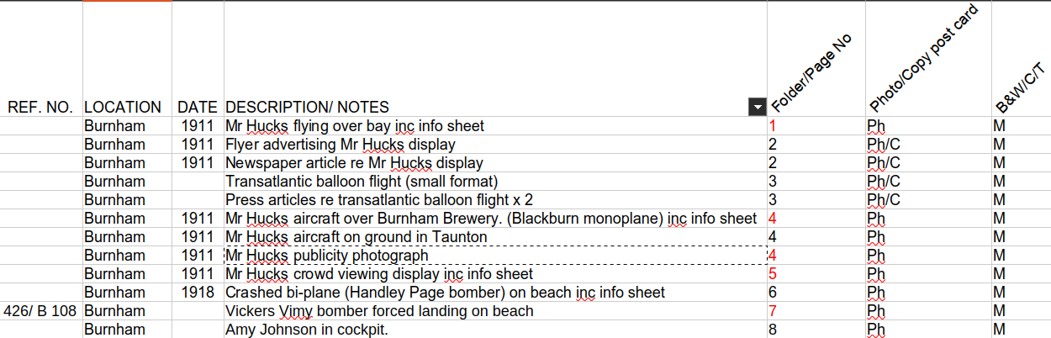
Current AVIATION Sheet Structure
Problem :
1. No image location

Slide 3
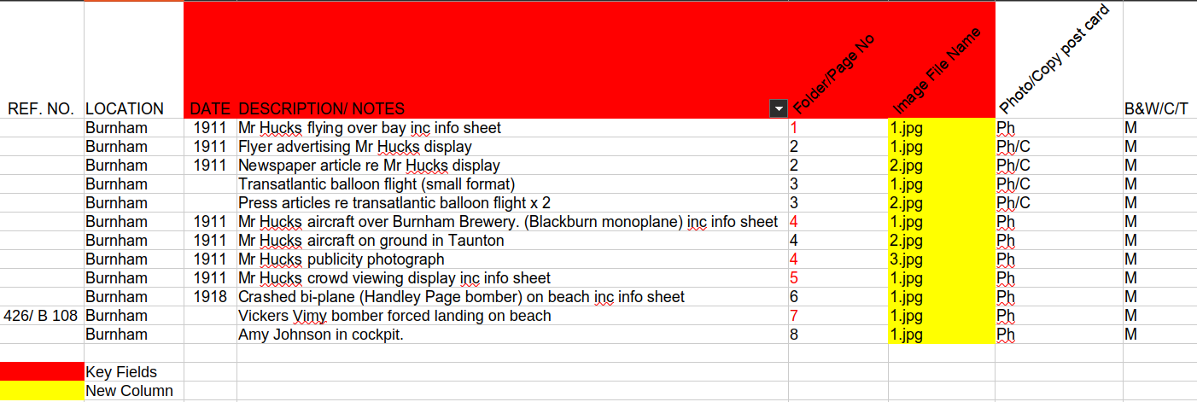
New AVIATION Sheet Structure
Suggested Changes/Notes :
1. Column containing name of scanned image file name and saved within its folder e.g “Mr Hucks publicity photograph”, full image file location “/AVIATION/4/3.jpg” – NOTE: image can be more descriptive as long as it’s unique.
2. Combine values for Front-End single field searching e.g “Mr Hucks publicity photograph (1911)”

