Slide 1
Adebayo Gbenga Bello
Web Tech Summer 2025 Final Exams

Slide 2
Adebayo Bello is developing a data-powered website to help Property Managers and Landlords solve the problem of fragmented property management and inefficient tenant tracking..

Slide 3
RentalFlow
PERSONA(s) The system is designed for a property management business that oversees multiple rental units.
Primary User: The Property Manager (Admin)
Role: The business owner or head administrator.
Responsibilities: They own the data. They add new properties, hire employees, oversee all financial reports.Secondary User: The Employee
Role: Staff members hired by the manager.
Responsibilities: They manage day-to-day operations for specific assigned properties. They collect rent, update tenant details, and log maintenance issues.
PROBLEM: Currently, small-to-mid-sized landlords rely on disconnected tools like Excel spreadsheets, WhatsApp messages, and paper receipts to manage their business. This leads to:
Lost Data: Rent payments and maintenance requests get lost in chat histories.
Lack of Oversight: Managers cannot easily see which employees are managing which properties effectively.
Inefficiency: There is no central place to view the real-time occupancy status or total revenue of the portfolio.
PAYOFF: The Manager Dashboard: A "God-view" screen that instantly shows:
Total Monthly Revenue (calculated dynamically from payment records).
Occupancy Rates (Visual badges showing "Vacant" vs. "Occupied").
Recent Activity Logs (Real-time feed of what agents are doing).
FINISH: Managers gain peace of mind and financial clarity without micromanaging. Employees have a clear workspace to log their work without using personal phones.The Business scales faster because data is centralized and secure.

Slide 4
User / Customer
describe the business, organization, or group of people that will use this website. If a business, describe its products or services and what its purpose is.
Managers will be able to add rentals, remove rentals, edit rental information, create employees, assign rentals to employees, see all rentals under their business, see rental logs, rental revenue, and remove rentals from employees.
Employees will be able to view assigned rentals, input tenant information, and create logs about events pertaining to that rental.

Slide 5
Main Functions of the Website
Property & Asset Management: Managers can add/edit/delete properties and upload images. System automatically tracks the status (Occupied/Vacant) based on tenant assignment.
Role-Based Access Control (RBAC):Managers have full access to all data and can create Employee accounts .Employees can only see and manage the specific properties assigned to them by the Manager.
Financial & Activity Logging: Employees can record rent payments and log maintenance events. The system aggregates these logs into a history view for each property, creating a permanent audit trail.
Tenant Management: Employees can update tenant contact info and assign tenants to properties, ensuring the "Occupied" status is always accurate.

Slide 6
Architecture
Presentation Layer (Client)
Application Layer (Server)
Data Layer (Database)
HTML, CSS (Bootstrap 5), JavaScript
MySQL
PHP

Slide 7
Architecture
Tier 1: Presentation Layer (Frontend)
Technologies: HTML5, CSS3 (Bootstrap 5), JavaScript.
Role: Handles user interaction and input validation.
Key File: login.js – Intercepts the login form to check for empty fields before sending data to the server, reducing server load.
Tier 2: Application Layer (Backend Logic)
Technologies: PHP 8.2.Role: Processes logic, handles security, and manages sessions.
Logic Flow Example:
Input: User clicks "Add Property" on add_property.php.
Logic: PHP checks $_SESSION['role'] to ensure user is a "Manager".
Process: PHP renames the uploaded image file to a unique ID to prevent overwriting.
Output: PHP sends the data to the Database.
Tier 3: Data Layer (Storage)Technologies: MySQL (Relational Database).
Role: Permanent storage of complex relationships.
Key Relationships (ERD):
One-to-Many: One Manager employs many Employees.
One-to-Many: One Employee manages multiple Properties.
Foreign Keys: The Logs table uses property_id and employee_id to link every action back to a specific building and agent.
Why This Stack
Security: PHP's password_hash() ensures passwords are never stored as plain text.
Scalability: The separation of logic (PHP) and data (MySQL) allows the business to grow without rewriting the code.
Responsiveness: Bootstrap ensure agents can log payments on their mobile phones while at the property.

Slide 8
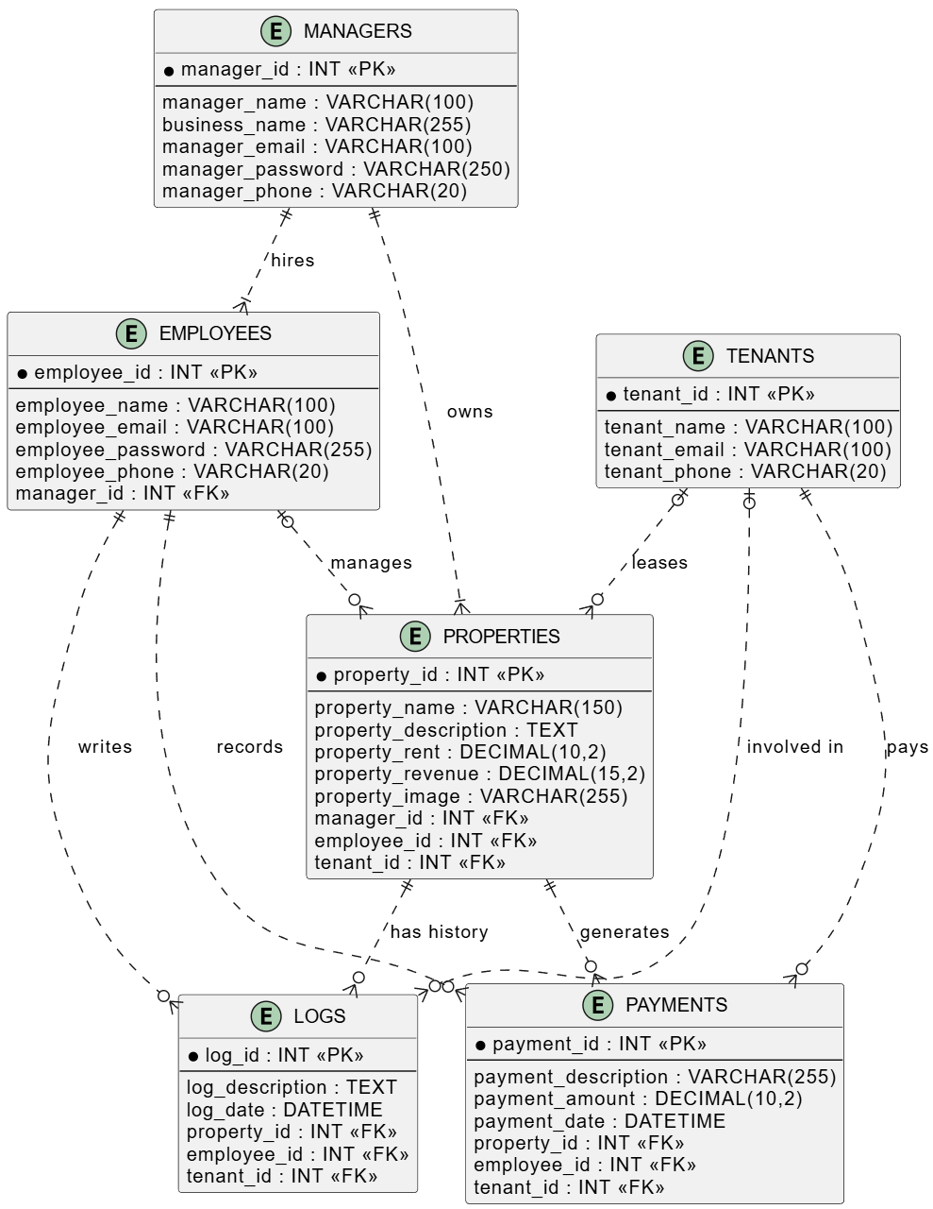
ERD

