Slide 1
Introduction to Web Technologies
Dr Govindha Ramaiah Yeluripati

Slide 2
Outline
What is this course all about?
Introduction to Web Development and Web Technologies

Slide 3
What are Web Technologies?
Web technologies refer to the tools and techniques used for creating, deploying, delivering, and managing web-based applications and websites.
These technologies enable communication between web browsers (clients) and web servers, facilitating the display and interaction of content on the internet.

Slide 4
What is Web Development?
The process of creating, deploying, delivering, and managing web-based applications and websites is called Web Development.
So, Web development encompasses everything from designing the user interface (UI) and writing the code (front-end and back-end) to setting up the infrastructure (deployment) and maintaining the performance, security, and scalability (management) of websites or web applications.
Also known as Web Programming.
Examples of Web Applications:
  Social networking sites like Facebook, X(Twitter) or
  E-commerce sites like Amazon, eBay, Shopify, Walmart, AliExpress
  .... etc.
  Including your favourite ChatGPT.

Slide 5
Why is it important to me?
Practical Skill Set for the Modern Job Market
  many businesses need professionals who can build, deploy, and maintain web applications
  CS/CE: a key skill for software engineers, developers, and system architects
  MIS: gets the ability to manage and oversee IT projects, a pre-requisite for e-commerce, makes more versatile in roles such as IT project managers, business analysts, and system administrators
Exposure to a Broad Range of Technologies
Understanding the Client-Server Model
Hands-on Experience with Databases and APIs
Problem-Solving and Critical Thinking
Foundation for Entrepreneurship and Innovation

Slide 6
Why is it important to me?
Adaptability to Future Technologies
Demand Across Industries
Understanding User Experience (UX) and Human-Computer Interaction (HCI):
  creating user-friendly, accessible, and responsive web applications. This understanding of UX/UI design is crucial for any tech role

Slide 7
Website Vs Web app
A website is a collection of static or dynamic web pages accessible over the internet that primarily provide content to the user.
Purpose: The main goal is to deliver information (e.g., articles, blogs, news, company profiles).
User interaction is generally limited to navigating between pages and consuming content (e.g., reading, watching videos, filling out forms).
Examples: News websites, personal blogs, informational company websites.
A web app is a dynamic, interactive application that runs in a web browser, often requiring user input to perform various tasks.
Purpose: It is designed to perform complex tasks, interact with databases, and offer a more application-like experience (e.g., performing tasks, creating content, manipulating data).
Users can perform various operations such as form submissions, account management, transactions, or real-time interactions.
Examples: Google Docs, Gmail, online banking apps, social media platforms.

Slide 8
WWW Vs Web
Often used interchangeably. But they can have nuanced differences
WWW (World Wide Web):
  The original system of hyperlinked documents accessible over the internet, commonly used as part of URLs.
  Historically significant but now often used synonymously with the Web.
Web:
  A broader term that refers to all websites, web applications, and services accessed via the Internet.
  It includes the WWW but also encompasses modern developments like dynamic web apps, APIs, and more.

Slide 9
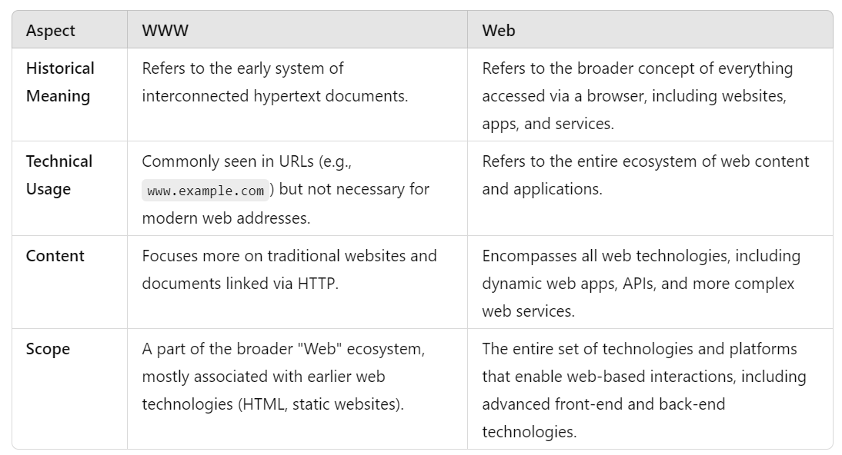
WWW Vs Web: Key Differences

Slide 10
History of the Web (WWW)
Useful Reading:
  https://en.wikipedia.org/wiki/History_of_the_World_Wide_Web
  World Wide Web Consortium
  The History of the Web
  Computer History Museum
  World Wide Web Foundation’s Web at 30
  The Web Foundation

Slide 11
Internet vs Web
The Internet is the global network of interconnected computers and servers that communicate with each other. It’s a massive infrastructure that allows computers worldwide to exchange information using a variety of protocols.
The Web (or World Wide Web) is one of the services that run on the Internet. It consists of interconnected documents and resources (such as websites, web pages, images, videos, etc.) that are accessed via browsers like Chrome, Firefox, or Safari.
Analogy: If the Internet is the roads and highways, the Web is like the shops, homes, and other places you visit while travelling on those roads.

Slide 12
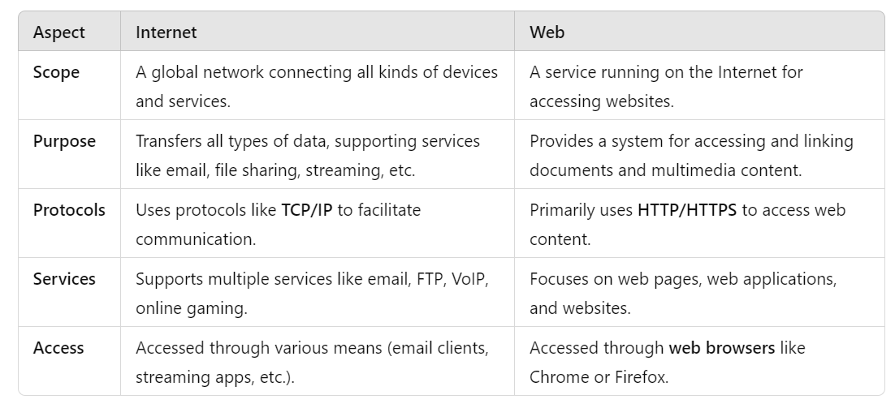
Internet vs Web: Key Differences

Slide 13
The Web Development
The process of Web development is typically divided into:
Front-End Development: Focuses on the client side, working with technologies like HTML, CSS, and JavaScript to create the user interface.
Back-End Development: Involves server-side programming, databases, and APIs to handle the application’s business logic and data processing.
Full-Stack Development: Combines both front-end and back-end development, managing the entire stack of web technologies.
It's an iterative process that often involves collaboration between developers, designers, system administrators, and other IT professionals.

Slide 14
Web Technologies
Front-End (Client-Side) Technologies:
HTML (Hypertext Markup Language): Defines the structure of web pages using elements like headings, paragraphs, and links.
CSS (Cascading Style Sheets): Controls the appearance and layout of web pages, such as fonts, colours, and positioning.
JavaScript: A programming language that enables dynamic content and interactivity on websites, such as form validation, animations, and real-time updates.
Frameworks & Libraries: Tools that simplify web development like
  React, Angular, Vue.js (JavaScript frameworks) for building user interfaces.
  Bootstrap and Tailwind CSS (CSS frameworks) for responsive design.

Slide 15
Web Technologies
Back-End (Server-Side) Technologies:
Server-Side Programming Languages: Languages like Node.js, PHP, Python (Django, Flask), Ruby on Rails, and Java (Spring) handle data processing, business logic, and database interactions.
Databases: Store and retrieve data for web applications. Examples include MySQL, PostgreSQL, MongoDB, and Redis.
APIs (Application Programming Interfaces): Enable communication between different software applications. REST and GraphQL are popular for web APIs.
Web Servers: Software that serves web pages to users. Common servers include Apache, NGINX, and IIS.

Slide 16
Web Technologies
Web Protocols:
  HTTP/HTTPS: Protocols for transmitting data over the web. HTTPS is the secure version that encrypts data.
  WebSockets: Enables real-time communication between clients and servers.
Web Development Tools:
  Version Control (Git): Tracks changes in code and facilitates collaboration.
  IDEs (Integrated Development Environments): Code editors like Visual Studio Code and Sublime Text.
  Package Managers: Tools like npm (for JavaScript) or pip (for Python) to manage dependencies.

Slide 17
Web Technologies
Web Hosting & Cloud Services:
  Platforms like AWS, Google Cloud, and Azure provide infrastructure for hosting web applications.
Web Standards:
  Organizations like W3C (World Wide Web Consortium) define standards and guidelines for web technologies to ensure compatibility and accessibility.

Slide 18
Web Development Approaches
Amateur process:
  Involves taking a template and customizing it to fit the needs of you or your client
Professional Process:
  Involves starting from a blank canvas and designing a bespoke solution

Slide 19
Web Development: Amateur Process
Typically uses basic HTML, CSS, and JavaScript, without in-depth knowledge of frameworks or best practices.
Code may be messy, poorly organized, and difficult to maintain.
May lack proper version control, testing, and documentation.
Developers often use a "trial-and-error" approach, leading to inefficient workflows and potential security issues.
Focuses on "quick fixes" to solve immediate problems, often neglecting long-term stability.

Slide 20
Web Development: Professional Process
Follows industry best practices, such as MVC (Model-View-Controller) architecture, code organization, and proper project structure.
Uses modern tools and technologies like React, Angular, Vue.js, or Node.js, alongside server-side frameworks like Django, Ruby on Rails, or ASP.NET.
Employs version control systems like Git and uses platforms like GitHub or Bitbucket for collaboration.
Ensures code quality through peer reviews, testing, and adherence to coding standards.
Professionals develop using agile methodologies with clear iteration cycles and feedback loops..

Slide 21
The Web Development: Summary
Front-end (Client-side)
Technologies:
HTML5 – Markup language for the structure of the web pages.
CSS3 – Styling and layout with Flexbox/Grid.
JavaScript – Programming language for adding interactivity.
React (or Vue.js/Svelte) – Front-end framework/library for building dynamic user interfaces.
Tailwind CSS – Utility-first CSS framework for rapid UI development.

Slide 22
The Web Development: Summary
Back-end (Server-side)
Technologies:
Node.js – JavaScript runtime for building scalable network applications.
Express.js – Web framework for Node.js to create APIs.
MongoDB (NoSQL) or PostgreSQL (SQL) – Database for storing data.
Mongoose (for MongoDB) or Sequelize (for PostgreSQL) – ORM for database management.
RESTful APIs or GraphQL – For communication between front-end and back-end.

Slide 23
The Web Development: Summary
Database
Use MySQL or MongoDB (NoSQL).
Deployment
Front-end: Deploy using platforms like Netlify or Vercel for easy React app hosting.
Back-end: Use Heroku or AWS EC2 for hosting the Express server.

Slide 24
Content Management Systems
A Content Management System (CMS) is a software platform that allows users to create, manage, and modify content on a website without needing specialized technical knowledge (such as coding skills).
CMSs are widely used for websites that require frequent updates, such as blogs, e-commerce sites, or corporate portals.
Popular CMSs include:
  WordPress (PHP-based)
  Joomla (PHP-based)
  Drupal (PHP-based)
  Ghost (Node.js-based)

Slide 25
The meaning of Stack in Web Development
The word "stack" refers to a set of technologies, tools, and frameworks that work together to build and run a complete web application.
The stack typically consists of different layers responsible for handling the front-end (client-side), back-end (server-side), and database.
The idea is that each "layer" of the stack handles a specific aspect of the application's functionality.

Slide 26
The meaning of Stack in Web Development
Each layer in a stack plays a specific role:
Front-end: Responsible for the user interface and user experience. Technologies like HTML, CSS, JavaScript, React, and Angular are part of this.
Back-end: Manages business logic, handles HTTP requests, communicates with the database, and sends data to the front-end. Examples include Node.js, Express.js, or Python (Django, Flask).
Database: Stores and retrieves data for the application, using systems like MongoDB, MySQL, or PostgreSQL.

Slide 27
Popular Web Development Stacks
LAMP stack (Linux, Apache, MySQL, PHP)
MERN Stack (MongoDB (database), Express.js (back-end framework), React (front-end framework), Node.js (runtime))
MEAN Stack (MongoDB, Express, Angular, Node.js)
JAMstack (JavaScript, APIs, Markup)
LEMP Stack (Linux, Nginx, MySQL/MariaDB, PHP/Python/Perl)
T3 Stack (Next.js, tRPC, TypeScript, Tailwind CSS, Prisma)
Serverless Stack (e.g., AWS Lambda, Firebase, Netlify Functions)

Slide 28
What stack do we follow?
Using HTML, CSS, JavaScript, React, PHP, and MySQL, is a combination of traditional LAMP elements (with PHP and MySQL) and modern front-end technologies like React.
This stack doesn’t have a specific name like MERN or MEAN, but it could be described as a hybrid of: LAMP Stack (with PHP and MySQL)React for the front-end.
A blend of a PHP-based back-end with a modern React-based front-end. This gives the flexibility of using a more dynamic and powerful front-end with React while relying on the tried-and-tested back-end technologies of PHP and MySQL.
We might refer to this stack as a React + LAMP stack or simply a custom stack depending on your specific use case.

