Slide 1
PHP
Dr Govindha Ramaiah Yeluripati

Slide 2
Outline
Introduction to PHP
Setting Up a PHP Development Environment
Connecting PHP to a Database (MySQL)
PHP Syntax and Basics

Slide 3
Introduction: What is PHP?
PHP (Hypertext Preprocessor) is a server-side scripting language embedded in HTML.
Unlike HTML, CSS, or JavaScript, which are processed on the client (user’s browser), PHP is executed on the server.
This enables PHP to handle sensitive tasks like interacting with databases and creating customized web responses based on user input.

Slide 4
Introduction: A little history
PHP was created by Rasmus Lerdorf in 1994.
Originally developed it as a set of Common Gateway Interface (CGI) scripts in the C programming language to manage his personal homepage, which is why it was initially called "Personal Home Page" tools (PHP Tools).
Over time, as PHP evolved into a more robust programming language for web development, the name was changed to stand for "PHP: Hypertext Preprocessor."
This name reflects its function: PHP processes code on the server to produce HTML content for web pages.

Slide 5
Introduction: Trends and Popularity
PHP is quite popular and widely used for web development
PHP powers around 77% of websites, including popular platforms like WordPress, Facebook, and Wikipedia.
It is easy enough to be a beginner's first server-side language
The latest stable release of PHP is PHP 8.3.0, which was officially released on November 23, 2023
  See https://www.php.net/downloads
Competition:
  Rise of JavaScript on Both Frontend and Backend (Node.js)
  Newer languages and frameworks like Python with Django or Flask, Ruby on Rails, and Java with Spring Boot

Slide 6
Introduction: How PHP Works in a Web Request Cycle?
Request Submission - A user sends a request to access a .php file (e.g., clicking a link or submitting a form)
Server-Side Execution - The web server (like Apache, Nginix, LiteSpeed) processes the PHP script and performs the necessary operations, such as fetching data from a database or handling form submissions
Response Delivery - The server sends back an HTML response to the user’s browser, which displays the result of the PHP script

Slide 7
Summary of What PHP can do
PHP can generate dynamic page content
PHP can create, open, read, write, delete, and close files on the server
PHP can collect form data
PHP can send and receive cookies
PHP can add, delete, and modify data in your database
PHP can be used to control user-access
PHP can encrypt data

Slide 8
Setting Up for PHP Development
Install a Local Server (XAMPP, WAMP, or MAMP)
  These server bundles include Apache, MySQL, and PHP, allowing you to test PHP scripts on your computer.
Create Your First PHP File:
  In your web server's root directory (usually htdocs in XAMPP), create a new file named index.php.
Write a Simple PHP Script (See the next slide )
Run Your PHP Script:
  Open your browser and go to http://localhost/index.php
Use the file name you used.

Slide 9
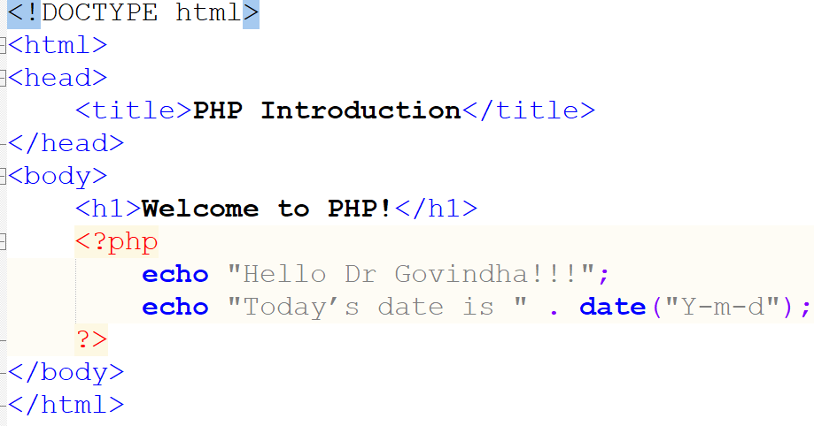
Sample PHP Script
A PHP script can be placed anywhere (head, body, footer etc.) in the document.
PHP code is written within <?php ...
?> tags.
Uses echo to output data
PHP statements end with a semicolon
A PHP file may contain HTML tags, CSS, JavaScript, and some PHP code or PHP only

Slide 10
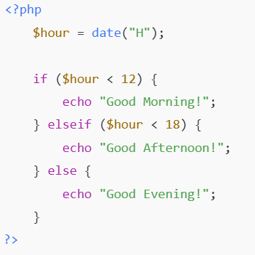
Practice Exercise 1
Using PHP, create a small script that outputs "Good Morning," "Good Afternoon," or "Good Evening" based on the current time.

Slide 11
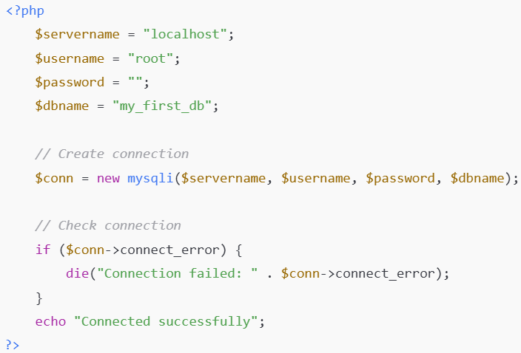
Practice Exercise 2
Test Database Connection: In a new PHP file, try connecting to your database using the sample script:
You can change them in 'phpmyadmin'

Slide 12
Practical Exercise: Database connection
Three ways to connect to the database in PHP:
  Procedural (supports MySQL only)
  Object-Oriented (supports MySQL only)
  PDO (PHP Data Objects; Supports several relational database types like MySQL, PostgreSQL, SQLite)
Procedural :
  $connection = mysqli_connect($host, $username, $password, $database);
  Then use mysqli_query, mysqli_fetch_assoc, and mysqli_close functions to query the database (e.g. SQL commands), fetch records (as an associative array), and close the connection.
Check the file posted on Canvas named: dbconnectprocedural.php

Slide 13
Practical Exercise: Database connection
Object-Oriented approach:
  $connection = new mysqli($servername, $username, $password, $dbname);
  Then $connection->connect_error is used to check for a connection error,
  $connection->query($sql) is used to perform a query.
  $result->fetch_assoc() fetches the results row by row in an associative array format.
  $connection->close() is used to release the connection.
Check the file posted on Canvas named: dbconnectobject.php

Slide 14
Understanding PHP more

Slide 15
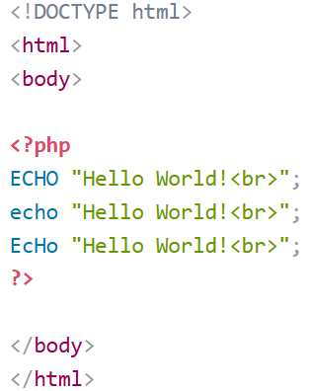
PHP Case Sensitivity
Keywords (e.g. if, else, while, echo, etc.), classes, functions, and user-defined functions are not case-sensitive.

Slide 16
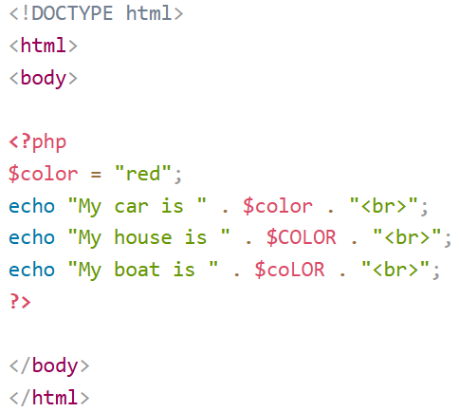
PHP Case Sensitivity
However, all variable names are case-sensitive!

Slide 17
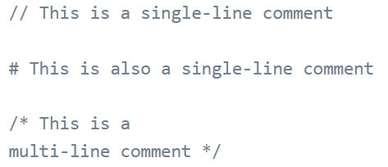
PHP Comments

Slide 18

PHP Variables
A variable creation starts with the $ sign, followed by the name of the variable.
Rules for writing variable names:
  A variable name must start with a letter or the underscore character
  A variable name cannot start with a number
  A variable name can only contain alpha-numeric characters and underscores (A-z, 0-9, and _ )
  Variable names are case-sensitive ($age and $AGE are two different variables)

Slide 19
Variables Scope
The scope of a variable is the part of the script where the variable can be referenced/used
PHP has three different variable scopes: local, global, and static
A variable declared outside a function has a GLOBAL SCOPE and can only be accessed outside a function (example on the next slide )
A variable declared within a function has a LOCAL SCOPE and can only be accessed within that function:

Slide 20
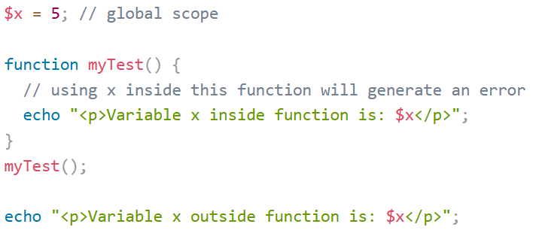
Variables Scope
Global Variable-Example:

Slide 21
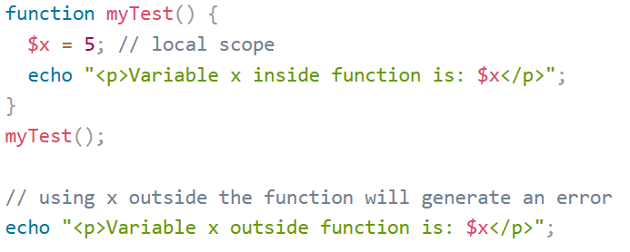
Variables Scope
Local Variable-Example:

Slide 22
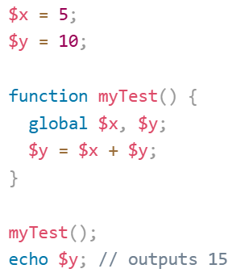
Variable Scope: The global Keyword
The global keyword is used to access a global variable from within a function.

Slide 23
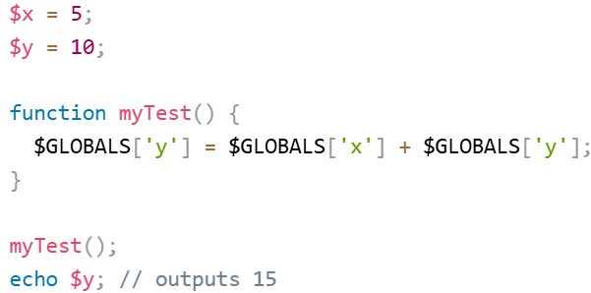
Variable Scope: The $GLOBALS Array
PHP stores all global variables in an array called $GLOBALS[index].
The index holds the name of the variable.
This array is also accessible from within functions and can be used to update global variables directly.

Slide 24
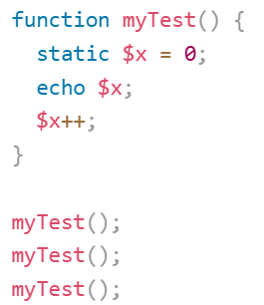
Variable Scope: The static Keyword
Normally, when a function is completed/executed, all of its variables are deleted.
However, if we want a local variable NOT to be deleted and need it for a further job, we can use the static keyword when we first declare the variable.

Slide 25
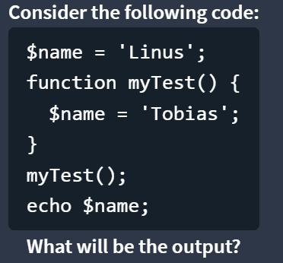
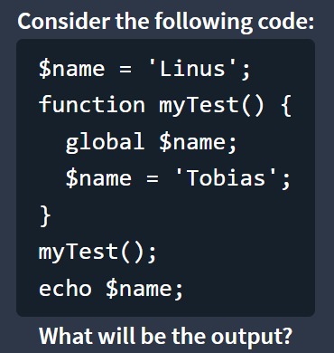
Variable Scope: Exercise
Linus
Tobias

Slide 26
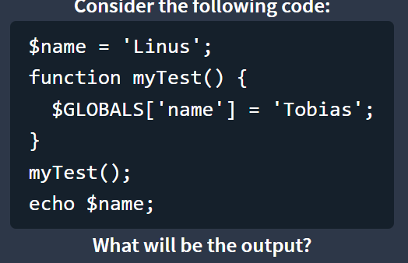
Variable Scope: Exercise
Tobias

Slide 27
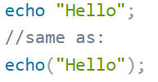
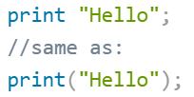
PHP Output
Two basic ways to get output: echo and print
More or less, they do the same
Differences:
echo has no return value while print has a return value of 1 so it can be used in expressions.
echo can take multiple parameters (although such usage is rare) while print can take one argument.
echo is marginally faster than print.

Slide 28
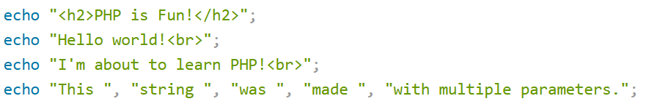
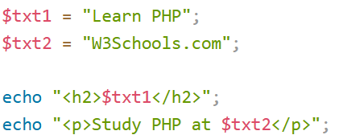
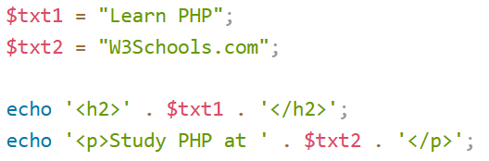
PHP Output: echo – more examples
Did you notice any difference here?

Slide 29
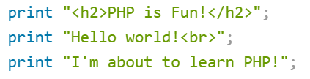
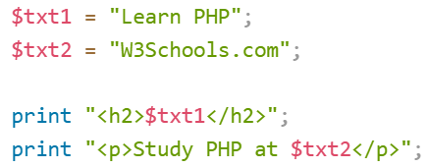
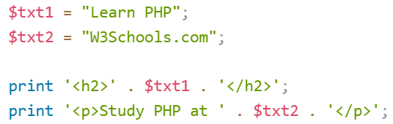
PHP Output: print – more examples

Slide 30

Data Types
PHP supports the following data types:
  String
  Integer
  Float (floating point numbers - also called double)
  Boolean
  Array
  Object
  NULL
  Resource
The var_dump() function can be used to know the data type and the value of a variable.

Slide 31
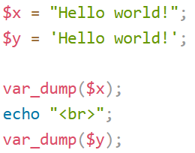


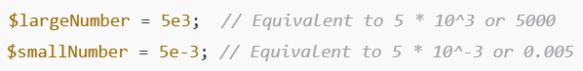
Data Types
String:
Integer:
Float:
Double quotes process special characters, single quotes do not.

Slide 32
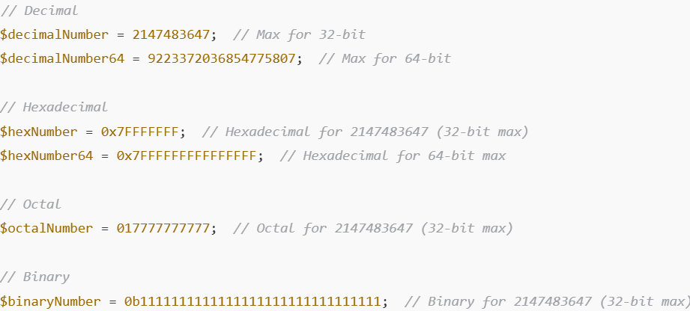
Note on Integers
Integers can be in decimal, hexadecimal (prefixed with 0x), octal (prefixed with 0), or binary (prefixed with 0b)

Slide 33



Data Types
Boolean:
Array:
OR from PHP 5.4+
Associative arrays (i.e., key-value pairs)
print_r (), var_dump(), and json_encode() can be used to display an array

Slide 34
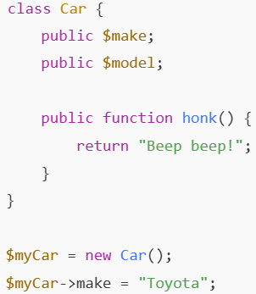
Data Types
Object:
An instance of a class that allows for storing data and methods together.
PHP is an object-oriented language and supports creating classes and objects to model real-world entities.

Slide 35
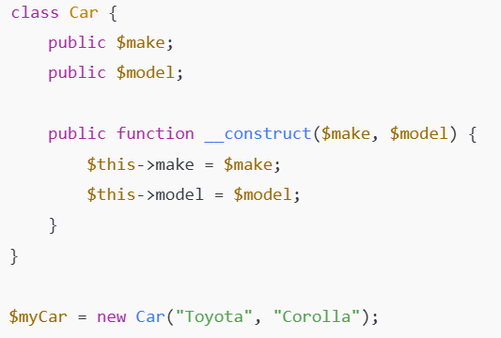
Data Types
Object: We can write optional constructor

Slide 36
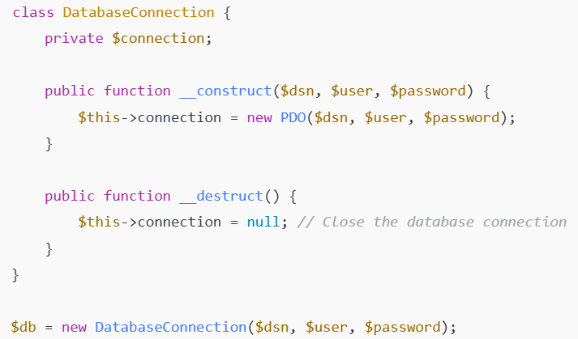
Data Types
Object: Though PHP supports automatic garbage collection, we can write an optional destructor.

Slide 37
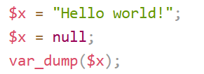
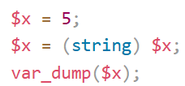
Data Types
NULL:
a special data type that can have only one value: NULL.
A variable of data type NULL is a variable that has no value assigned to it.
If a variable is created without a value, it is automatically assigned a value of NULL.
Variables can also be emptied by setting the value to NULL
Type Casting:

Slide 38
Data Types
Resource:
A resource is a special type that holds a reference to an external resource, such as a database connection or file handle.
Resources are not actual data but references to functions or resources outside of PHP.
Database object

Slide 39

Commonly Used String Functions
strlen(): Returns the length of the string
str_word_count(): Counts and returns the number of words
//output: 2
strpos(): Searches for a specific text within a string. If a match is found, the function returns the character position of the first match. If no match is found, it will return FALSE.
//output: 6
strtoupper() and strtolower(): returns the string in upper case and lower case respectively.

Slide 40


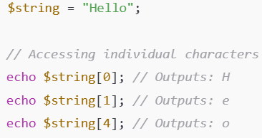

Commonly Used String Functions
String functions Reference:
https://www.w3schools.com/php/php_ref_string.asp
str_replace(): replaces some characters with the given characters in a string.
strrev() function reverses a string.
substr() slices and extracts substring
Accessing individual characters

Slide 41
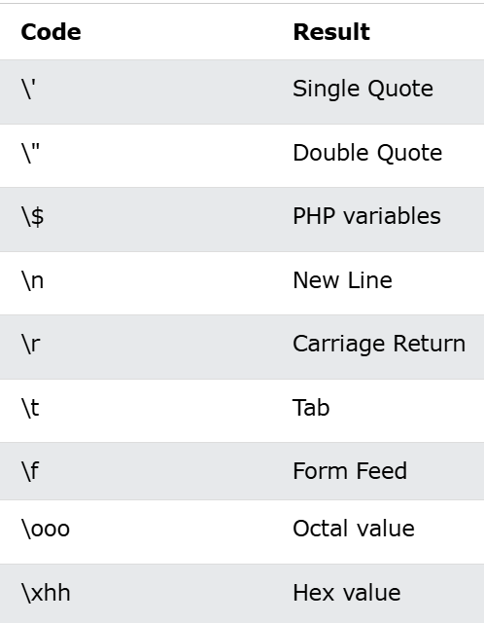
Escape Characters

Slide 42
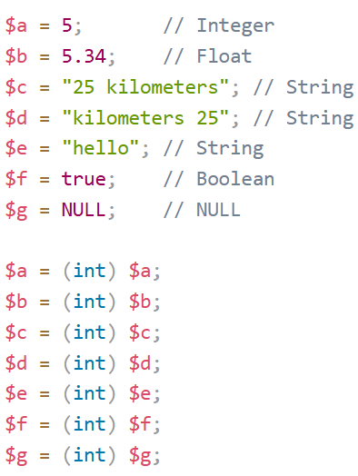
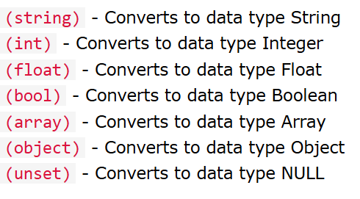
Type Casting
Example with (int):

Slide 43
Type Casting
Note 1: When casting a string that starts with a number, the (int) and (float) functions use that number. If it does not start with a number, these functions convert strings into the number 0.
Note 2: If a value is 0, NULL, false, or empty, the (bool) converts it into false, otherwise true. Even -1 converts to true.
Note 3: When converting into arrays, most data types convert into an indexed array with one element. NULL values convert to an empty array object.
Note 4: Objects convert into associative arrays where the property names become the keys and the property values become the values.
Note 5: most data types convert into an object with one property, named "scalar", with the associated value.

Slide 44







Some Math Functions
Math Reference: https://www.w3schools.com/php/php_ref_math.asp

Slide 45


Defining Constants
A constant is an identifier (name) for a simple value. The value cannot be changed during the script.
Starts with a letter or underscore (no $ sign before)
To create a constant, use the define() function or const keyword
Difference: const is allowed at the global or class level. It cannot be used inside another block scope, (e.g., inside a function or if statement), but define() can be used inside another block scope.

Slide 46


Defining Constants
Constant Arrays:
const imposes strict immutability, but define() does not.
NOTE: All constants are automatical global except those defined in a class with const. (See the example in the next slide)
Using const
Using define

Slide 47
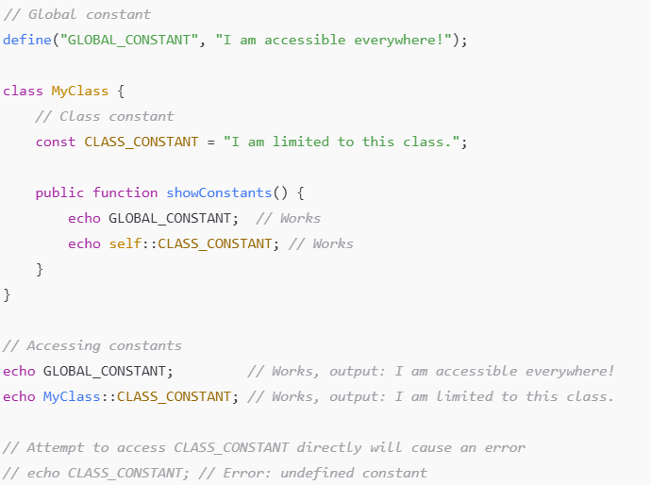
Defining Constants

Slide 48
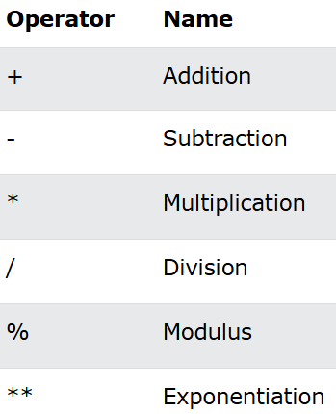
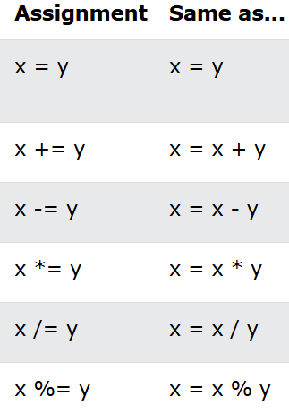
Operators
Arithmetic operators
Assignment operators

Slide 49
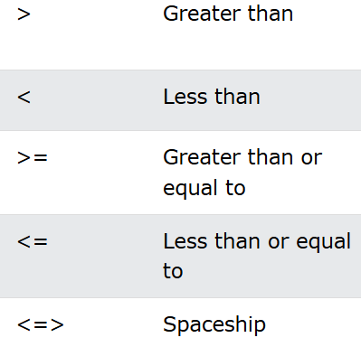
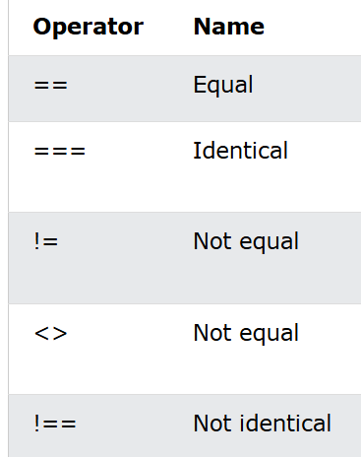
Operators
Relational operators
Returns -1 if the left side is less than the right side, 0 if both sides are equal, 1 if the left side is greater than the right side

Slide 50
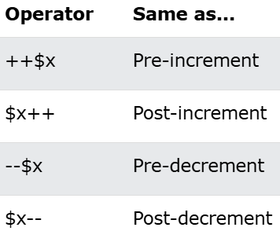
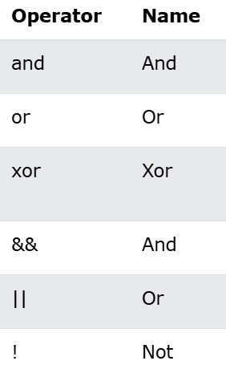

Operators
Increment/Decrement
5) Logical Operators
Note:  'and' has lower precedence in '=' )

Slide 51
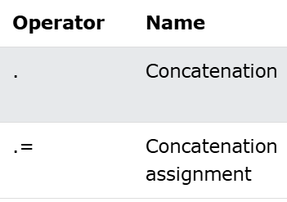
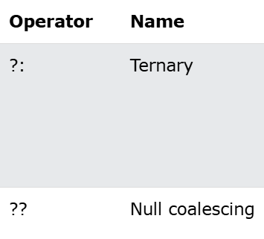
Operators
String Operators
7) Conditional Assignment
Usage: $x = expr1 ?? expr2
The value of $x is expr1 if expr1 exists, and is not NULL.
If expr1 does not exist or is NULL, the value of $x is expr2.

Slide 52
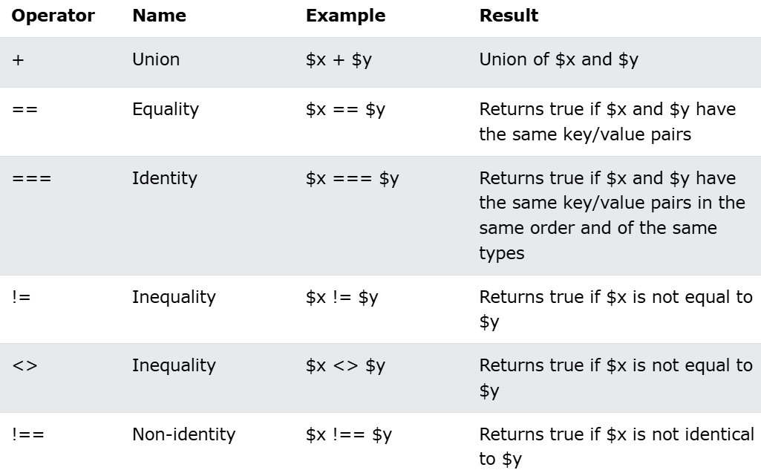
Operators
Array Operators

Slide 53
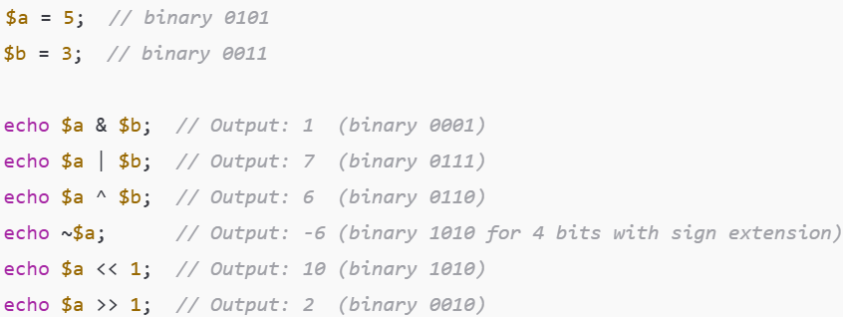
Operators
Bitwise Operators

Slide 54
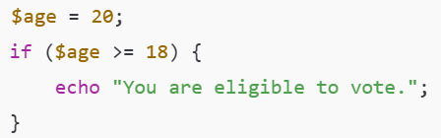
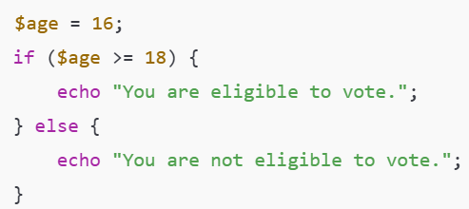
Conditional Statements

Slide 55
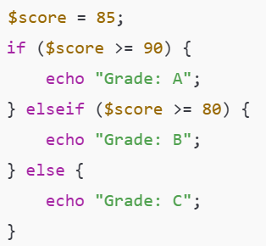
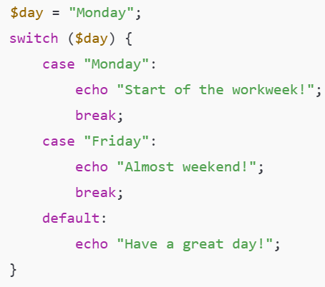
Conditional Statements

Slide 56
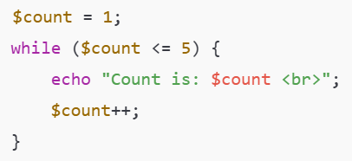

Looping

Slide 57


Looping

Slide 58


Looping: break, continue

Slide 59



Functions in PHP
PHP has over 1000 built-in functions that can be called directly, from within a script, to perform a specific task.
User-defined functions can be created using the function keyword

Slide 60


Functions in PHP
Default parameters: Returning values:

Slide 61

Functions in PHP
PHP allows you to specify data types for parameters and return values, helping to prevent type-related errors.

Slide 62

Functions in PHP
Anonymous Functions (often used as arguments to other functions)

Slide 63


Functions in PHP
Arrow functions (PHP 7.4+) provide a more concise syntax, especially useful for single-line expressions.
Note the keyword used

Slide 64
Practice Exercise: Working with Arrays and Functions in PHP
Define an array named $students containing the names of five students. Write a function displayStudents that 1) accepts an array as an argument, 2) loops through the array, and 3) prints each student's name on a new line.
Write another function addStudent that 1) accepts an array and a name as arguments, 2) adds the new student name to the array, and 3) returns the updated array.
Call displayStudents and addStudent functions to show the initial list of students, add a new student, and display the updated list.
Expected Output: The list of students before and after adding a new student.

Slide 65
Thank you
Questions???
Dr Govindha

