Slide 1
JavaScript
Dr Govindha Ramaiah Yeluripati

Slide 2
What is JavaScript?
(What is it?)
(What is it?)
High-level, dynamic, scripting, programming language of the Web
Primarily used to create and control interactive elements on websites.
JavaScript is one of the 3 languages all web developers must learn:
1. HTML to define the content of web pages
2. CSS to specify the layout and styles of web pages
3. JavaScript to program the behavior of web pages
      JavaScript makes the page interactive by responding to user actions, manipulating content, and more.
JavaScript runs in the browser and interacts with the HTML and CSS to make web pages interactive.
(What are interactive elements?)

Slide 3
Where is JavaScript Used?
Frontend Web Development:
  The most common use.
  Allows developers to create dynamic web pages with features like form validation, interactive maps, animations, and more.
Backend Web Development:
  Using environments like Node.js, JavaScript can also be used to create server-side applications.
Mobile Apps:
  Frameworks like React Native and Ionic allow JavaScript to be used in mobile application development.
Game Development:
  With the help of frameworks like Phaser, JavaScript can be used to build browser-based games.
Desktop Applications:
  Using tools like Electron, one can create cross-platform desktop applications using JavaScript.

Slide 4
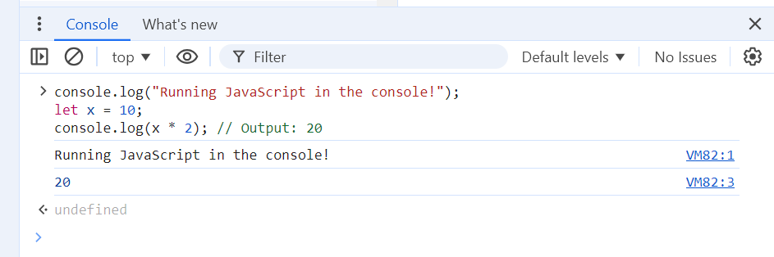
How is JavaScript Used?
Writing/Editing the code: JavaScript code can be written directly in the web browser's developer console (usually opened with F12)
For larger projects, we can use a text editor (e.g., Notepad++, Visual Studio Code) to create .js files
Helpful if done on a blank page (type 'about:blank' in the address bar)

Slide 5
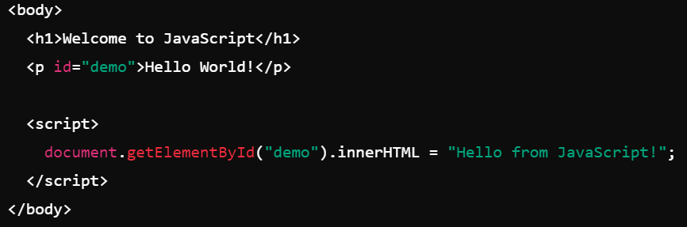

How is JavaScript Used?
Running the code: To include JavaScript in a web page, add a <script> tag within the <head> or <body> of the HTML file
JavaScript can be embedded directly within HTML documents
JavaScript can be used as an external file.

Slide 6
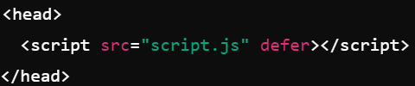
How is JavaScript Used?
Running the code: To include JavaScript in a web page, add a <script> tag within the <head> or <body> of the HTML file.
Do these two approaches produce the same effect?
Placing within <head> section:
  Causes the browser to load and execute the JavaScript before it loads the content of the page (i.e., the HTML elements in the body)
  Issues: This leads to a delay in rendering the page leading to poor user experience and if the script is manipulating any <body> elements, it may fail to do so
  To prevent these problems, defer and async attributes can be used but only with an external JavaScript file.

Slide 7
How is JavaScript Used?
Running the code: To include JavaScript in a web page, add a <script> tag within the <head> or <body> of the HTML file.
Do these two approaches produce the same effect?
So, the best placement for the <script> is just before the closing </body> tag of the HTML file.
This ensures that the content loads first, offering better performance and a more responsive user experience.
Note: There are several other approaches to running JavaScript without HTML (e.g. node.js)

Slide 8
Is there any relation with Java?
Some History
Despite the similarity in their names, JavaScript and Java are entirely different programming languages with distinct purposes, features, and use cases.
JavaScript was developed by Brendan Eich in 1995 while working at Netscape Communications Corporation.
It was created in just 10 days and was originally called Mocha, later renamed to LiveScript, and finally JavaScript.
The name "JavaScript" was chosen for marketing reasons, as Java was gaining popularity at that time, and Netscape wanted to capitalize on Java's name recognition.

Slide 9
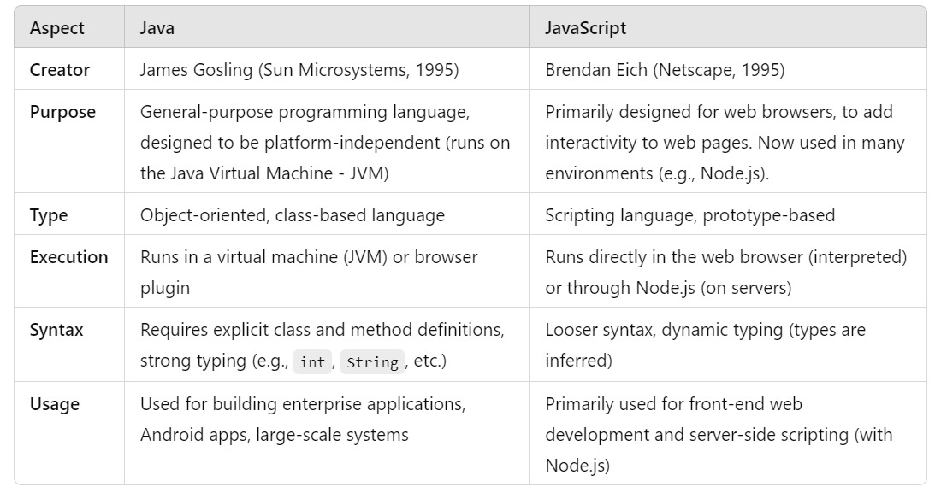
Java vs JavaScript

Slide 10
JavaScript Programming Aspects

Slide 11
Program Structure
Just like other HLLs, a JavaScript program may consist of:
Keywords
Variables: Containers that store data.
Operators: Used to manipulate data and variables.
Expressions: Pieces of code that evaluate to a value.
Statements: Instructions or actions for the browser to perform.
Control Flow: Structures like if-else, switch, and loops (for, while) that determine the flow of execution.
Functions: Blocks of reusable code to perform specific tasks.
Objects: Collection of properties and methods
Comments

Slide 12
Syntax Rules
Case sensitivity: JavaScript is case-sensitive (myVariable and myvariable are different).
Semicolons: Although optional, it's recommended to use semicolons (;) to terminate statements.
Whitespace and indentation: JavaScript ignores extra spaces and newlines, but indentation is crucial for code readability.

Slide 13
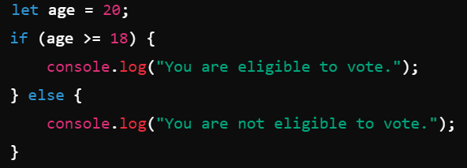
Sample Programs/Scripts
A JavaScript program can start with any type of statement

Slide 14
Execution Flow
Execution Order: JavaScript reads and executes the code from top to bottom. Each statement is processed in sequence.
Control Flow: Loops, conditionals, and function calls can alter the execution flow (i.e., skip certain statements, repeat code blocks, or jump to a function).
Event-driven Programming: In client-side JavaScript (for the web), much of the code may run based on user interactions (e.g., button clicks). Although the code starts executing from the top, user events often trigger more code execution later.
Function Hoisting: In JavaScript, function declarations are hoisted. This means you can call a function before it’s defined in the code. However, function expressions (where functions are stored in variables) are not hoisted.

Slide 15
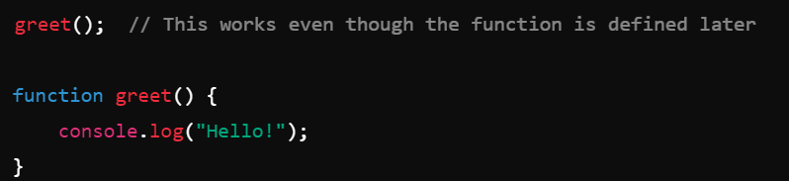
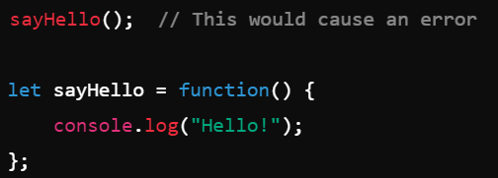
Execution Flow
Function Hoisting-Example:

Slide 16

Output
alert(): Displays a pop-up alert box with a message for the user.
console.log(): Outputs information to the browser's console. This is commonly used for debugging purposes.
document.write(): Writes directly into the HTML document. This method should be used sparingly as it overwrites the entire document if used after the page has loaded.

Slide 17
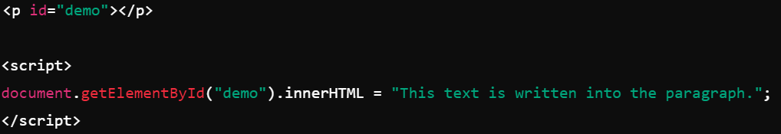

Output
innerHTML: Used to change or insert content inside an HTML element dynamically. We target an element by its id and change its content.
window.prompt(): Prompts the user for input and returns the input value.

Slide 18
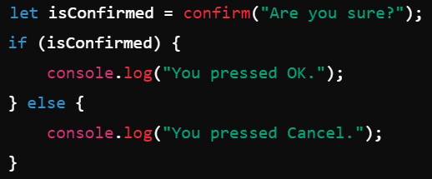
Output
window.confirm(): Displays a confirmation dialog box with "OK" and "Cancel" options, returning a Boolean value.

Slide 19

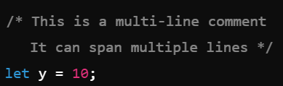
Comments

Slide 20
Variables
Variables are Containers for Storing Data
JavaScript Variables can be declared in 4 ways:
Using var
Using let
Using const
Automatically (no declaration)

Slide 21
Variables: var
The original way (1995 to 2015) to declare variables
Will have function scope (or global scope if declared outside any function)
Allows to re-declare and update variables
Has been largely replaced by let and const due to issues with scoping.

Slide 22
Variables: let
Introduced in ES6 (ECMAScript 2015 or ECMAScript 6)
Allows to declare block-scoped variables. This means the variable only exists within the block (e.g., inside an if or for loop).

Slide 23

Variables: const
Also, introduced in ES6
Used to declare constants, meaning the variable cannot be reassigned after its initial declaration.
It is block-scoped like let but must be assigned a value when you declare it

Slide 24
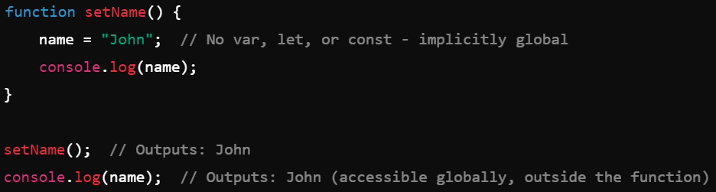
Variables: no declaration
When not declared with var, let, or const, JavaScript implicitly declares the variable in the global scope, which can lead to bugs, especially in larger programs or functions.

Slide 25
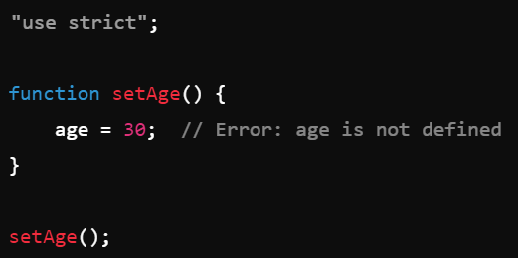
Variables: strict mode
In strict mode, JavaScript enforces proper variable declaration, so failing to use var, let, or const will throw an error.

Slide 26
Variable declaration: Best practice
Always use let, const, or var to explicitly declare variables.
This improves code readability, avoids global scope pollution, and ensures proper scoping.

Slide 27
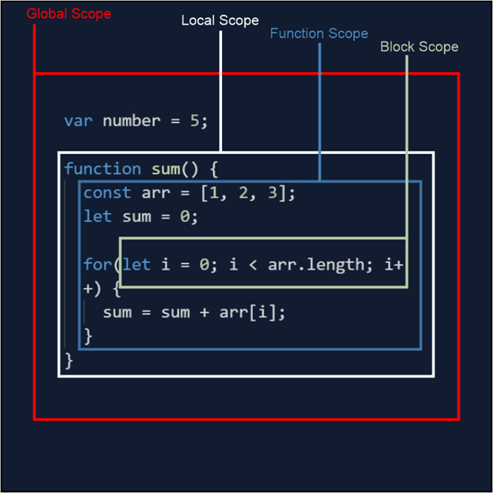
Variables: Scope
Global Scope: Variables declared outside functions or blocks are globally scoped and accessible anywhere in the code.
Function Scope: Variables declared with var inside a function are scoped to that function.
Block Scope: Variables declared with let or const inside a block (e.g., if, for, {}) are only accessible within that block.

Slide 28
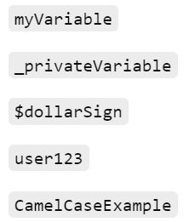
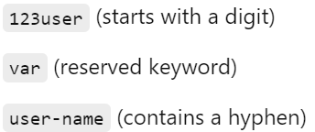
Identifiers
Valid examples
Names used to identify variables, functions, properties, or objects
General Rules
  Identifiers can contain letters (both uppercase and lowercase), digits, underscores (_), and dollar signs ($)
  Identifiers cannot begin with a digit (0–9), but they can start with letters, underscores, or dollar signs.
  Identifiers are case-sensitive (e.g., myVariable and myvariable are different)
  Reserved keywords (like var, let, const, function, return, etc.) cannot be used as identifiers.
Invalid examples

Slide 29
Operators
Types of JavaScript operators:
Arithmetic Operators
Assignment Operators
Comparison Operators (Relational)
String Operators
Logical Operators
Bitwise Operators
Ternary Operator
Type Operators

Slide 30
Operators
Arithmetic Operators:
Operator | Description
+ | Addition
- | Subtraction
* | Multiplication
** | Exponentiation (ES2016)
/ | Division
% | Modulus (Division Remainder)
++ | Increment
-- | Decrement

Slide 31
Operators
Assignment Operators:
Operator | Example | Same As
= | x = y | x = y
+= | x += y | x = x + y
-= | x -= y | x = x - y
*= | x *= y | x = x * y
/= | x /= y | x = x / y
%= | x %= y | x = x % y
**= | x **= y | x = x ** y

Slide 32


Operators
Comparison/Relational Operators:
Operator | Description
== | equal to
=== | equal value and equal type
!= | not equal
!== | not equal value or not equal type
> | greater than
< | less than
>= | greater than or equal to
<= | less than or equal to
? | ternary operator
Outputs false
Outputs true

Slide 33
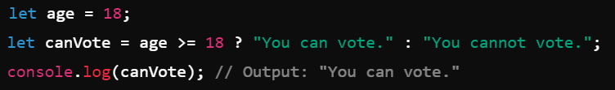
Operators
Ternary Operator:
A shorthand for an if-else statement.
It takes three operands
Syntax
Examples

Slide 34


Operators
String Operators: The following operators work on strings.
+ (Addition/Concatenation)
+= (Compound assignment)
== (Loose Equality): Compares values, performing type coercion
e.g., 5 == "5"; // true
=== (Strict Equality): Compares values and types, no coercion
e.g., 5 === "5"; // false (no type coercion)
<, >, <=, >= (Relational Operators): (lexicographical comparison)
e.g., "abc" < "xyz"; // true
Unary + or - :

Slide 35
Operators
Logical Operators:
Type Operators:
Operator | Description
&& | logical and
|| | logical or
! | logical not
Operator | Description
typeof | Returns the type of a variable
instanceof | Returns true if an object is an instance of a specific class or constructor function

Slide 36
Operators
Bitwise Operators:
Operator | Description | Example | Same as | Result | Decimal
& | AND | 5 & 1 | 0101 & 0001 | 0001 | 1
| | OR | 5 | 1 | 0101 | 0001 | 0101 | 5
~ | NOT | ~ 5 | ~0101 | 1010 | 10
^ | XOR | 5 ^ 1 | 0101 ^ 0001 | 0100 | 4
<< | left shift | 5 << 1 | 0101 << 1 | 1010 | 10
>> | right shift | 5 >> 1 | 0101 >> 1 | 0010 | 2
>>> | unsigned right shift | 5 >>> 1 | 0101 >>> 1 | 0010 | 2

Slide 37
Datatypes
Primitive
Number
String
Non-Primitive (Reference)
Object
Function
Boolean
Symbol
Null
BigInt
Undefined
Array
Date
RegExp
Map
Set

Slide 38

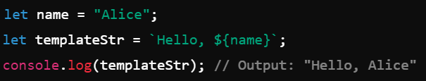
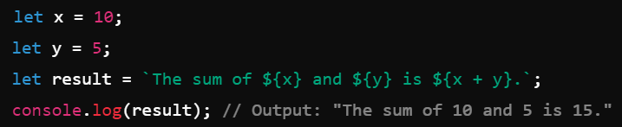
Datatypes: Primitive
Simplest forms of data, which are immutable (cannot be changed)
Number: Represents both integer and floating-point numbers
String: Used to represent text enclosed within quotes (single, double, or backticks for template literals).

Slide 39



Datatypes: Primitive
Simplest forms of data, which are immutable (cannot be changed)
Boolean: Represents true or false values
Undefined: Represents a variable that has been declared but has not yet been assigned a value
Null: Represents an explicitly empty or non-existent value
Note: Also, works on reference types

Slide 40
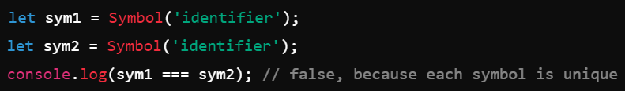
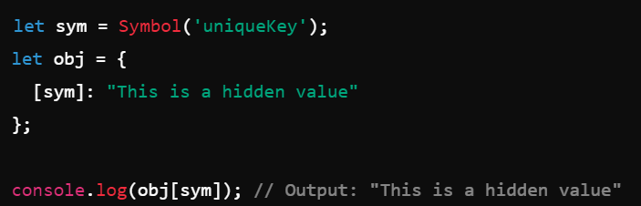
Datatypes: Primitive
Simplest forms of data, which are immutable (cannot be changed)
Symbol: A unique and immutable primitive value, often used as keys for object properties

Slide 41

Datatypes: Primitive
Simplest forms of data, which are immutable (cannot be changed)
BigInt: Used for integers larger than the maximum safe integer for the Number type.
JavaScript's Number type, which is based on the IEEE 754 double-precision floating-point, can accurately represent integer values only up to 2^53 - 1 (which is 9007199254740991).
This is referred to as Number.MAX_SAFE_INTEGER.

Slide 42
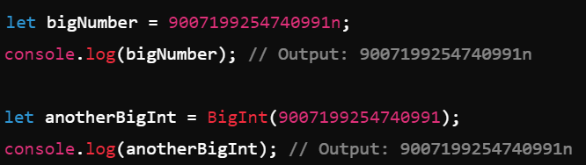
Datatypes: Primitive
Simplest forms of data, which are immutable (cannot be changed)
BigInt: Used for integers larger than the maximum safe integer for the Number type.
To create a BigInt, you can either add the n suffix to a number literal, for example, 9007199254740991n, or use the BigInt() function.

Slide 43
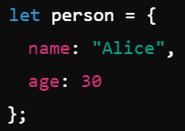

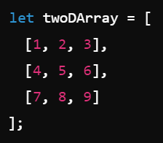
Datatypes: Non-Primitive (Reference)
Complex forms of data, which are mutable.
Object: A collection of key-value pairs, where the keys are strings (or symbols) and the values can be any type.
Array: A special type of object used to store ordered collections of values, which can be of any type.
1-D Array
2-D Array

Slide 44
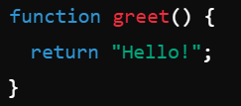

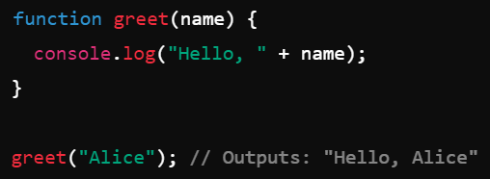
Datatypes: Non-Primitive (Reference)
Complex forms of data, which are mutable.
Function: A block of code designed to perform a particular task, which can be called (executed) as needed.
Arrow function

Slide 45
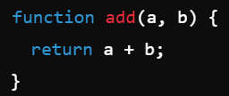

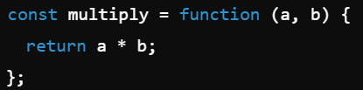
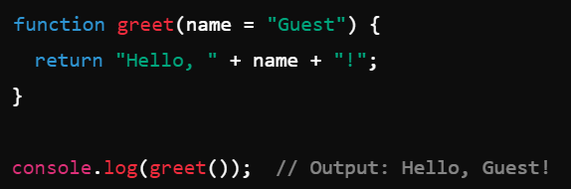
Datatypes: Non-Primitive (Reference)
More examples of functions:
Function expression (assigned to a variable).
Not hoisted
With default parameter value

Slide 46

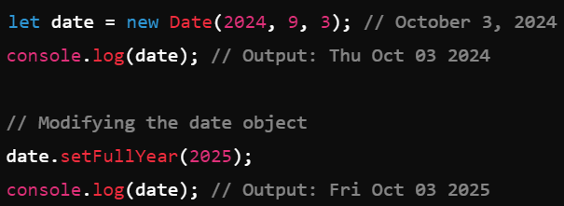
Datatypes: Non-Primitive (Reference)
Complex forms of data, which are mutable.
Date: Represents dates and times.
Some more functions:
setMonth()
setDate()
setHours()

Slide 47


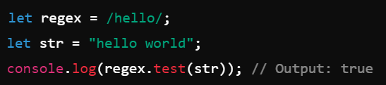
Datatypes: Non-Primitive (Reference)
Complex forms of data, which are mutable.
RegExp: Regular expressions for pattern matching within strings.
g (global search),
i (case sensitive search), m (multiline search) etc.
Usage:

Slide 48
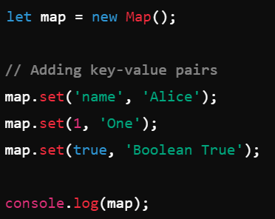
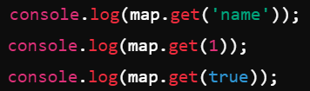




Datatypes: Non-Primitive (Reference)
Complex forms of data, which are mutable.
Map: A collection of key-value pairs where keys can be of any type

Slide 49
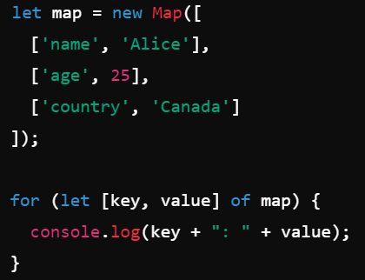
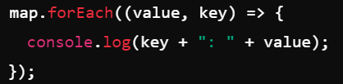
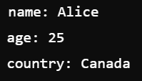
Datatypes: Non-Primitive (Reference)
Iterating over Map:
Output

Slide 50

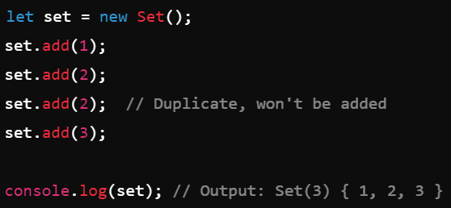

Datatypes: Non-Primitive (Reference)
Complex forms of data, which are mutable.
Set: A collection of unique values (no duplicates allowed).
Deleting

Slide 51
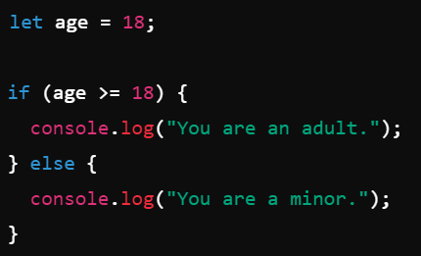
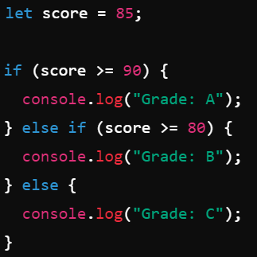
Control Structures : Branching
if-else and else if statements:

Slide 52
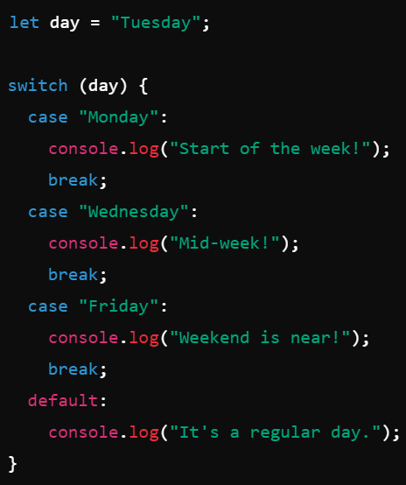
Control Structures : Branching
switch statement:

Slide 53
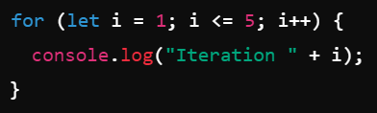
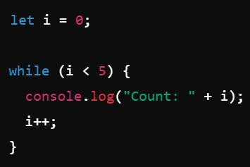
Control Structures : Looping
for loop:
while loop:

Slide 54
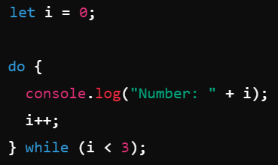
Control Structures : Looping
do-while loop:

Slide 55
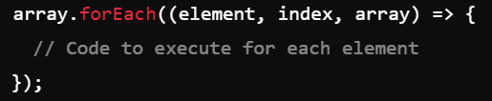
Control Structures : Looping
A function passed as an argument to another function
forEach() Method:
specifically used to iterate over arrays.
It calls a callback function once for each element in the array, passing the element, the index, and the entire array to the callback
Syntax:
Passing the array again is optional

Slide 56
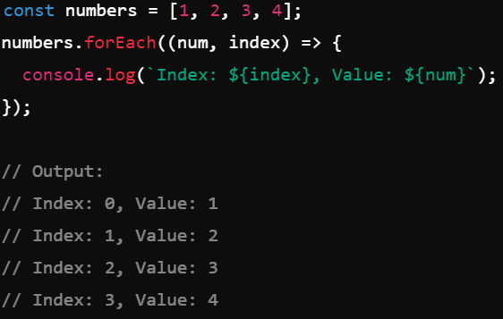
Control Structures : Looping
A function passed as an argument to another function
forEach() Method:
specifically used to iterate over arrays.
It calls a callback function once for each element in the array, passing the element, the index, and the entire array to the callback
Example:

Slide 57
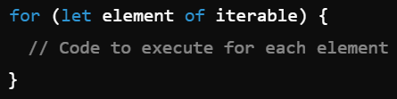
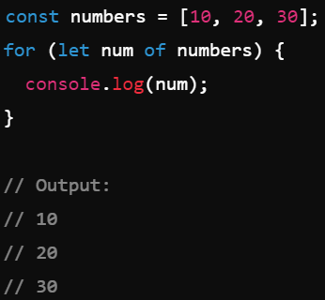
Control Structures : Looping
for...of Loop: designed to iterate over iterable objects like arrays, strings, sets, maps, etc.
Syntax:
Example:

Slide 58
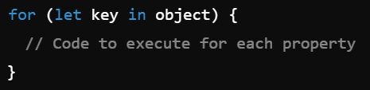
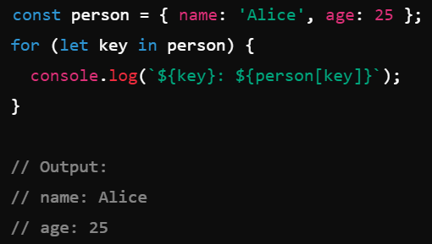
Control Structures : Looping
for...in Loop: iterates over enumerable properties of an object.
Syntax:
Example:

Slide 59
Document Object Model (DOM)
The DOM (Document Object Model) is a programming interface for web documents.
It represents the structure of a web page as a tree of nodes (or objects) created based on the HTML content.
Each element, attribute, or piece of text in HTML is represented as an object in this model, which can be manipulated using JavaScript.
The DOM allows you to interact with a webpage dynamically using JavaScript, turning a static HTML document into a dynamic, interactive application.

Slide 60
Document Object Model (DOM)
Node: Everything in the DOM is a node. The document is a node, as are all the elements and attributes.
Element: HTML elements such as <div>, <p>, <h1>, etc., are element nodes.
Attribute: Attributes like class, id, and style are attribute nodes.
Text: The content inside an HTML element is a text node.

Slide 61
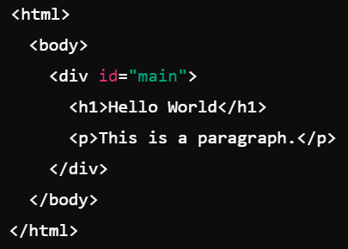
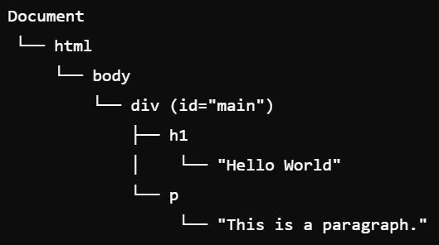
Document Object Model (DOM)
Example:
DOM Tree
The <html> element is the child of the Document node.
The <body> element is a child of <html>.
The <div> is a child of <body>, and so on.
Text nodes like "Hello World" are the leaf nodes.

Slide 62
Accessing DOM Tree Elements
JavaScript can locate elements in the DOM tree and interact with them.
As the elements are represented as nodes in the DOM tree, JavaScript provides methods to access them based on attributes like id, class, tag name, or CSS selectors.
Common ways to access DOM elements:
By ID: document.getElementById('element-id')
By Class Name: document.getElementsByClassName('class-name')
By Tag Name: document.getElementsByTagName('tag-name')
By CSS Selector: document.querySelector('selector') or document.querySelectorAll('selector')

Slide 63

Accessing DOM Tree Elements
Example:

Slide 64

Accessing DOM Tree Elements
Example: Changing the content and style of elements

Slide 65



More on Working with Functions
Recap:
Defining functions-Example1:
Defining functions-Example2:
Function expression and Anonymous function

Slide 66


More on Working with Functions
Recap (Continued...):
Defining functions-Example3: Arrow Functions (ES6)
In arrow functions, you can skip { } and return if there's only one statement (shorthand syntax).
Did you notice anything here?
Parentheses in an arrow function definition are optional when there is a single parameter.

Slide 67




Commonly used Functions (Built-in)
alert():
console.log():
prompt():
parseInt() and parseFloat() (Converting Strings to Numbers)

Slide 68


Commonly used Functions (Built-in)
setTimeout(): executes a function after a specified time delay
setInterval() repeatedly executes a function at specified intervals

Slide 69

Commonly used Functions (Built-in)
Math.random() generates a random decimal between 0 and 1
Math.floor() rounds a number down to the nearest integer.

Slide 70

Commonly used Functions (Built-in)
String and Array 'length': Returns the number of characters in a string or the number of elements in an array.

Slide 71

Commonly used Functions (Built-in)
push() adds an element to the end of an array, while pop() removes the last element.

Slide 72

Commonly used Functions (Built-in)
shift() removes an element from the beginning of the array, while unshift() adds one or more elements to the beginning of the array.

Slide 73

Commonly used Functions (Built-in)
shift() removes an element from the beginning of the array, while unshift() adds elements to the beginning of the array.

Slide 74


Commonly used Functions (Built-in)
Array.map() and Array.filter() for Array Transformation:
map() creates a new array by applying a function to each element, while filter() creates a new array with elements that pass a test.

Slide 75

Commonly used Functions (Built-in)
DOM Manipulation:
Refer to slides No. 17, 61-64.
Another useful function:
Creating a new element (createElement and appendChild):

Slide 76

Commonly used Functions (Built-in)
JSON.stringify() and JSON.parse() converts between Objects and JSON.
JSON.stringify() converts a JavaScript object to a JSON string, and JSON.parse() parses a JSON string back into an object.

Slide 77
What is JSON?
JSON stands for JavaScript Object Notation.
Data Interchange Format:
  JSON is primarily used to send data over the web, often in client-server communications (e.g., fetching data from an API).
Language Independent:
  Although it's based on JavaScript object syntax, JSON is language-agnostic, meaning it can be used in many programming languages like Python, Java, C#, and others.
Text-Based:
  JSON data is stored as text, making it easy to transmit over networks.

Slide 78

Example of JSON
JSON Syntax:
JSON data consists of key-value pairs.
Keys are always strings, and values can be strings, numbers, arrays, booleans, null, or other objects.
JSON uses curly braces { } to define objects and square brackets [ ] to define arrays.

Slide 79
A Simple Form Validation Exercise
Create a form that accepts the user name as input. If the user enters the name and clicks submit, no error occurs. If the user clicks the submit button without a name, an alert message should be generated indicating the error.

Slide 80
Practice (Homework)
Create a simple function-based calculator that adds, subtracts, multiplies, and divides two numbers.
There will be three input fields (for two operands and result) with 6 buttons: Add, Sub, Mul, Div, Result, and Reset.
When the user enters values and presses an appropriate button, the calculator behaves correctly.

Slide 81
DOM Manipulation Functions (Exercise)
Take this as homework.
Create a list of commonly used DOM manipulation functions and state their use with an example.

Slide 82
Events
An event is an action or occurrence that happens in the browser, such as clicking a button, hovering over an element, typing in a text box, submitting a form, etc.
JavaScript can respond to these events by executing code, which allows developers to create interactive experiences.
Examples of Common Events:
  Click: Triggered when a user clicks on an element (e.g., a button).
  Keypress: Triggered when the user presses a key on the keyboard.
  Mouseover: Triggered when the mouse pointer hovers over an element.
  Submit: Triggered when a form is submitted.

Slide 83
Event Handling
Event handling refers to capturing the events and executing JavaScript code in response to them.
The function that handles an event is called an event handler or event listener.

Slide 84
Event Handling
Ways to attach event handler:
Inline HTML Attribute: Use HTML attributes directly (like onclick, onmouseover, etc.), to call a function when an event occurs.
  Attaches the onclick event handler to the button element, which will trigger an alert when clicked.

Slide 85

Event Handling
Ways to attach event handler:
JavaScript Event Listener (Recommended): Use addEventListener() which allows multiple events to be attached to the same element and keeps the JavaScript logic separate from HTML.

Slide 86
Event Handling: Common Event Types
Mouse Events:
click: Triggered when an element is clicked.
dblclick: Triggered when an element is double-clicked.
mouseover: Triggered when the mouse pointer moves over an element.
mouseout: Triggered when the mouse pointer moves away from an element.
Keyboard Events:
keydown: Triggered when a key is pressed down.
keyup: Triggered when a key is released.
keypress: Triggered when a key is pressed (deprecated in modern browsers; use keydown).

Slide 87
Event Handling: Common Event Types
Form Events:
submit: Triggered when a form is submitted.
focus: Triggered when an element gains focus (e.g., when a text input is clicked).
blur: Triggered when an element loses focus.
Document Events:
DOMContentLoaded: Triggered when the HTML document has been fully loaded and parsed.
load: Fired when the entire page has finished loading, including all dependent resources such as images, stylesheets, and iframes.
resize: Triggered when the browser window is resized. You may adjust the layout or elements for responsiveness.

Slide 88
Asynchronous JavaScript
JavaScript is traditionally a single-threaded, synchronous language, meaning that it executes code one line at a time, in order.
However, in many real-world scenarios, you need to perform multiple tasks, some of which take time, like fetching data from a server, without blocking other tasks.
Asynchronous JavaScript allows JavaScript to perform long-running tasks without stopping the entire program.

Slide 89
Asynchronous JavaScript
Use cases:
Non-blocking operations: Asynchronous JavaScript allows you to perform tasks like API calls, timers, or file reading without stopping the execution of other code.
Real-world use: Tasks like fetching data from a server, handling user input, and waiting for I/O operations need to be done asynchronously to keep the application responsive.

Slide 90
Asynchronous JavaScript
Callbacks: A callback function is a function passed as an argument to another function, which will be executed once a task is completed.
This was the traditional way to handle asynchronous operations in JavaScript.
Problem: Callback Hell.
As applications grow, callbacks can become nested inside other callbacks, leading to hard-to-read code known as callback hell.

Slide 91

Asynchronous JavaScript
Callbacks: Example

Slide 92
Asynchronous JavaScript
Promises: A Promise is a modern alternative to callbacks.
It represents a value that may be available now, or in the future, or never.
A Promise can be in one of three states:
Pending: The initial state, waiting for the operation to complete.
Fulfilled: The operation was completed successfully.
Rejected: The operation failed.

Slide 93

Asynchronous JavaScript
Promises: Example-Creating a Promise

Slide 94

Asynchronous JavaScript
Promises: Example-Consuming a Promise

Slide 95
Asynchronous JavaScript
async/await:
async and await are modern JavaScript features that provide a cleaner and more readable way to handle asynchronous code.
async/await is built on top of Promises but allows you to write asynchronous code that looks and behaves more like synchronous code.

Slide 96

Asynchronous JavaScript
async function: An async function always returns a Promise. Inside an async function, you can use the await keyword to pause the execution of the function until the Promise is resolved.

Slide 97
Thank you
Questions???
Govindha Yeluripati

