Slide 1
CLOUD COMPUTING APL — PROJECT PRESENTATION
Elastic ML Inference Serving
A Custom Horizontal Pod Autoscaler vs. Kubernetes HPA
Adeel Ahmed
July 2026
Notes:
Welcome / intro. This project implements elastic autoscaling for a containerized ML inference service on Kubernetes, and compares a custom autoscaler against the built-in Kubernetes HPA.

Slide 2




Goal
Achieve Elasticity
For a Cloud ML inference service under variable load
Hands-On Kubernetes
Container orchestration in a real cluster
Understand SLOs
Service Level Objectives that bound acceptable latency
Outperform Stock HPA
Build a custom autoscaler that beats Kubernetes' default
Notes:
Four teaching objectives: elasticity for cloud services, hands-on Kubernetes experience, understanding SLOs, and building an autoscaler that beats the built-in HPA.

Slide 3




The Challenge
ResNet18 Classification
< 0.5s p99 Latency
CPU-only inference, no GPU
Server-side SLO target
Beat Kubernetes HPA
Minikube Cluster
At 70% and 90% CPU targets
Laptop-scale deployment
Notes:
The service classifies images with ResNet18 on CPU only. We must hold p99 latency under 0.5s while beating stock Kubernetes HPA at both 70% and 90% CPU targets, all on a laptop-scale Minikube cluster.

Slide 4
System Architecture
DATA PATH
scales replicas
Load Tester
Dispatcher
ML Replicas
×N pods
metrics
CONTROL PATH
Kubernetes API
Autoscaler
Monitoring
Prometheus
Only the Load Tester runs outside the cluster — every other component is a Kubernetes pod.
Notes:
Load Tester sends traffic to the Dispatcher, which routes to free ML Replica pods. Replicas and the Dispatcher expose metrics to Prometheus. The Autoscaler polls Prometheus every 15 seconds and calls the Kubernetes API to change replica count, closing the loop back to the ML Replicas.

Slide 5



Data Path Components
Load Tester
Dispatcher
ML Replica
Async Python script
Configurable req/s workload
Sends queries to the Dispatcher
Centralized request queue
Tracks live pod IPs via K8s Watch API
Drops requests (HTTP 503) when full
FastAPI + ResNet18, CPU-only
One request at a time per pod
No queuing — Dispatcher owns the queue
Notes:
Load Tester replays a fixed workload. Dispatcher is the only place queuing happens. ML Replica pods run ResNet18 on CPU and process one request at a time, so the Dispatcher's routing decision directly determines utilization.

Slide 6


Control Path Components
Monitoring
Autoscaler
Prometheus
Custom control loop
Scrapes /metrics from Dispatcher + Replicas
Live dashboards for request rate & latency
Single source of truth for the Autoscaler
Polls Prometheus every 15 seconds
Decides the target replica count
Calls the Kubernetes API to scale
Notes:
Monitoring is Prometheus, scraping both the Dispatcher and Replica pods. The Autoscaler is our own control loop — polls every 15s and decides replica count, which we'll cover in detail next.

Slide 7



How the Autoscaler Decides
desired replicas = ceil ( λ × W / target_utilization )
λ = arrival rate (req/s) W = mean inference time (s), both read from Prometheus every 15s
Queueing theory sets the baseline. Three safety mechanisms keep it stable:
Queue-Depth Kicker
Step-Limited Scaling
Asymmetric Cooldowns
+1 replica the moment the dispatcher queue starts building
Up to +2 replicas up, -1 down, per 15s decision
15s before scaling up again, 180s before scaling down
Notes:
The base formula comes from queueing theory: desired replicas equals arrival rate times mean service time, divided by target utilization. On top of that we added three safety mechanisms: a queue-depth kicker so we react the instant a backlog forms, step-limiting so we never lurch, and asymmetric cooldowns so we scale up fast but scale down cautiously.

Slide 8


Experiment Setup
Same workload replayed on every run — 630s, peak 44 req/s
Custom Autoscaler
Kubernetes HPA
Kubernetes HPA
Queueing-theory control loop
70% CPU target
90% CPU target
Notes:
All three runs start from 2 replicas and replay the exact same workload file: a quiet baseline around 6-8 req/s, a sharp spike to 44 req/s, then back down. Run 1 uses our custom autoscaler, runs 2 and 3 use the built-in Kubernetes HPA at 70% and 90% CPU targets.

Slide 9
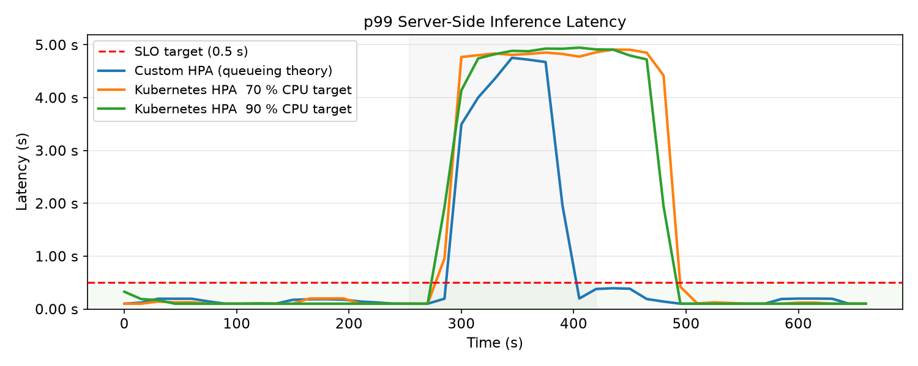
Latency Under Load
Only the custom autoscaler pulls p99 latency back under the 0.5s SLO before the spike ends.
Notes:
All three runs spike well past the 0.5s SLO once the load jumps to 44 req/s. The custom autoscaler (blue) recovers within about 100 seconds; both stock HPA configurations stay saturated for the rest of the spike.

Slide 10
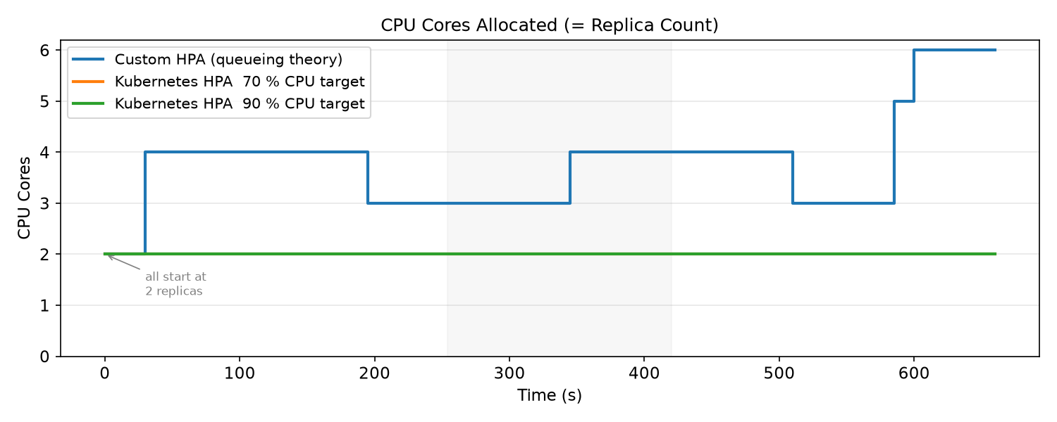
Scaling Behavior
The custom autoscaler is the only one that moves — stock HPA stays pinned at 2 replicas the entire run.
Notes:
Both Kubernetes HPA lines sit exactly on top of each other at 2 replicas — they never scale during this run. The custom autoscaler ramps up to 4 replicas during the spike and continues climbing afterward as later traffic builds. We'll explain why stock HPA never triggers on the next slide.

Slide 11
Start-of-Run vs. End-of-Run
Autoscaler | p99 Latency (start) | p99 Latency (end) | CPU Cores (start) | CPU Cores (end)
Custom Autoscaler | 100 ms | 100 ms | 2 | 6
K8s HPA — 70% CPU | 100 ms | 100 ms | 2 | 2
K8s HPA — 90% CPU | 326 ms | 100 ms | 2 | 2
6× more compute at the end for the custom autoscaler — because it actually reacted to load.
Notes:
Kubernetes HPA at 90% starts with a cold-start latency spike of 326ms (still under SLO) but never adjusts replica count. Both HPA configurations end the run exactly where they started: 2 replicas. The custom autoscaler ends at 6, tracking the second traffic ramp near the end of the workload.

Slide 12
Why Stock HPA Never Scaled
The dispatcher queue caps replica CPU at ~76% — regardless of true demand.
Tolerance band (no scaling)
Actual utilization
Target
70% CPU Target
76% actual sits inside the 63–77% tolerance band → no scale-up triggered
90% CPU Target
76% actual sits below the 81–99% band, and replicas are already at the 2-pod floor
The custom autoscaler avoids this blind spot entirely — it scales on arrival rate, not CPU%.
Notes:
This is the core insight: the dispatcher's backpressure caps replica CPU at roughly 76% no matter how much real demand is queued up, because replicas only ever process one request at a time. That 76% happens to fall inside Kubernetes HPA's tolerance window at a 70% target, and below the floor at a 90% target with replicas already at minimum. CPU-based autoscaling is blind to this; arrival-rate-based autoscaling is not.

Slide 13


Limitations
Cold-Start Latency
Laptop-Scale Cluster
One Workload Trace
First inference after pod startup takes ~800ms (model JIT warmup); later requests settle to 75-100ms
Single-node Minikube — no real multi-node network variance
Only tested a single traffic pattern; generalization to other shapes is untested
Notes:
Three honest limitations: cold-start warmup on new pods, everything running on a single laptop-scale Minikube node rather than a real multi-node cluster, and only one workload trace tested end to end.

Slide 14

Key Takeaways
Held the SLO Under Load
Custom autoscaler pulled p99 latency back under 0.5s through the spike — stock HPA never did
Closed the CPU Blind Spot
Arrival-rate-based scaling avoids the tolerance-window trap that hides demand behind dispatcher backpressure
No GPU, No Managed Cloud
Achieved on lightweight, laptop-scale Kubernetes tooling with Minikube
Notes:
Three headline takeaways: we held the SLO where stock HPA couldn't, we closed a real blind spot in CPU-based autoscaling, and we did it without GPUs or managed cloud infrastructure.

Slide 15
Questions?
Thank you
Adeel Ahmed · Cloud Computing APL
Notes:
Open the floor for questions.

