Slide 1
LEARNMATE AI
IBM AICTE PROJECT
Presented By:-
Student name : ADEEBA SAMAN
College Name & Department : SIKSHA ‘O’ ANUSANDHAN UNIVERSITY & CSE

Slide 2
OUTLINE
Problem Statement
Technology used
IBM Cloud Services used
Wow Factors
End Users
Results
Conclusion
Future Scope
IBM Certifications
GitHub Link

Slide 3
Problem Statement
Students often struggle to find the right learning path that aligns with their interests and long-term goals due to the overwhelming number of online courses and lack of personalized guidance.
Proposed Solution: LearnMate AI is an Agentic AI coach built using IBM watsonx.ai and Granite models. It interacts with students, understands their interests (like Frontend Development, Cybersecurity, UI/UX Design, etc.), assesses their current skill level, and dynamically builds a personalized course roadmap that adapts over time based on their progress and preferences.

Slide 4
Technology used
IBM Cloud lite services
Natural Language Processing (NLP)
IBM Granite model

Slide 5
IBM cloud services used
IBM Cloud watsonx AI Studio
IBM Cloud watsonx AI runtime
IBM Cloud Agent Lab
IBM Granite foundation model

Slide 6
Wow factors
The agent stays focused on education, suggests trusted tutorials and resources, and supports learners from beginners to advanced levels, making personalized guidance accessible and engaging.
Unique features :
Dynamic & adaptive learning roadmaps
Flexible for beginners to advanced learners
Suggests trusted tutorials and resources
Flexible for beginners to advanced learners
Focused on education only (ignores unrelated topics)

Slide 7
End users
Students – to get personalized learning paths.
Training Institutes – to guide learners into courses.
Career Counselors – for AI-backed career suggestions.
Educators – to support students with structured guidance.

Slide 8
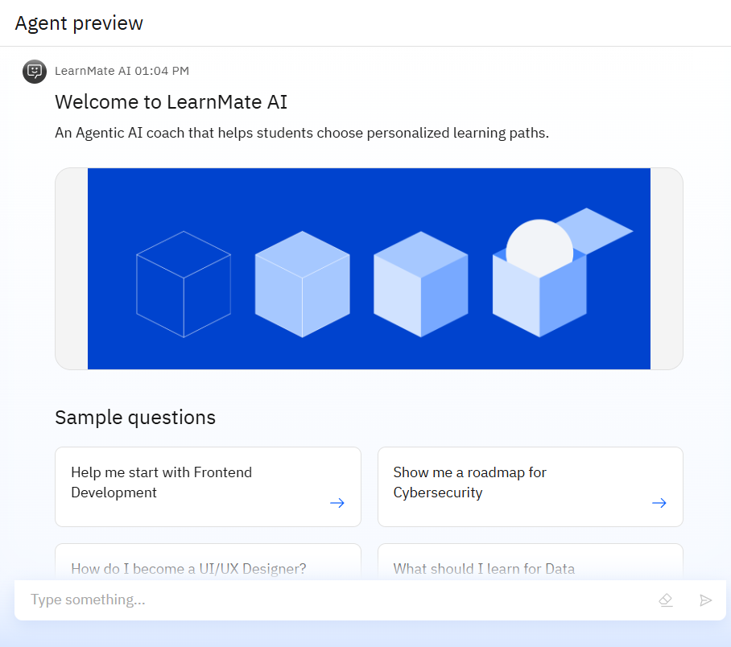
Results
LearnMate AI was developed and deployed using IBM Agent Lab, providing students with tailored learning roadmaps and trusted tutorials across various fields.

Slide 9
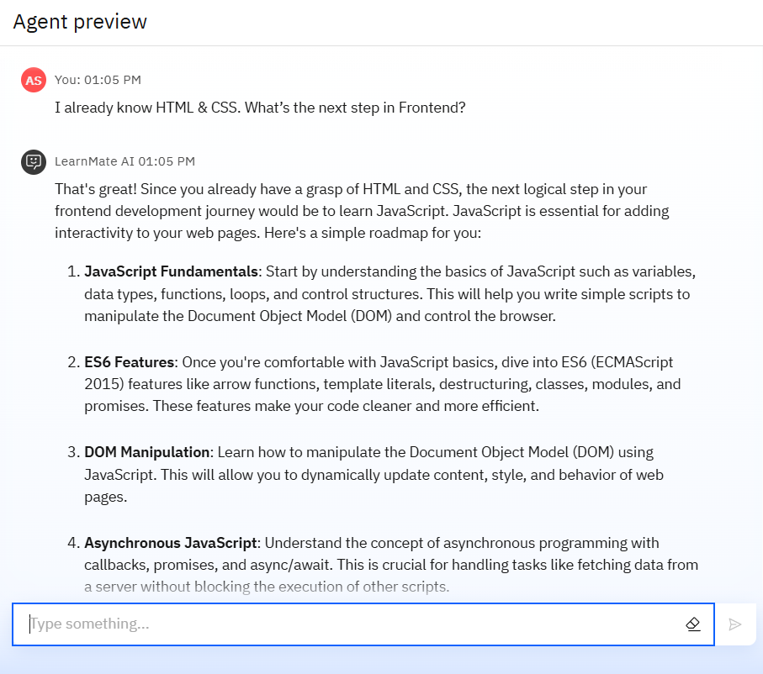
Results
When asked about progressing after HTML and CSS, LearnMate AI outlined an advanced path covering JavaScript fundamentals, ES6, DOM manipulation, asynchronous concepts, etc to deepen Frontend skills.

Slide 10
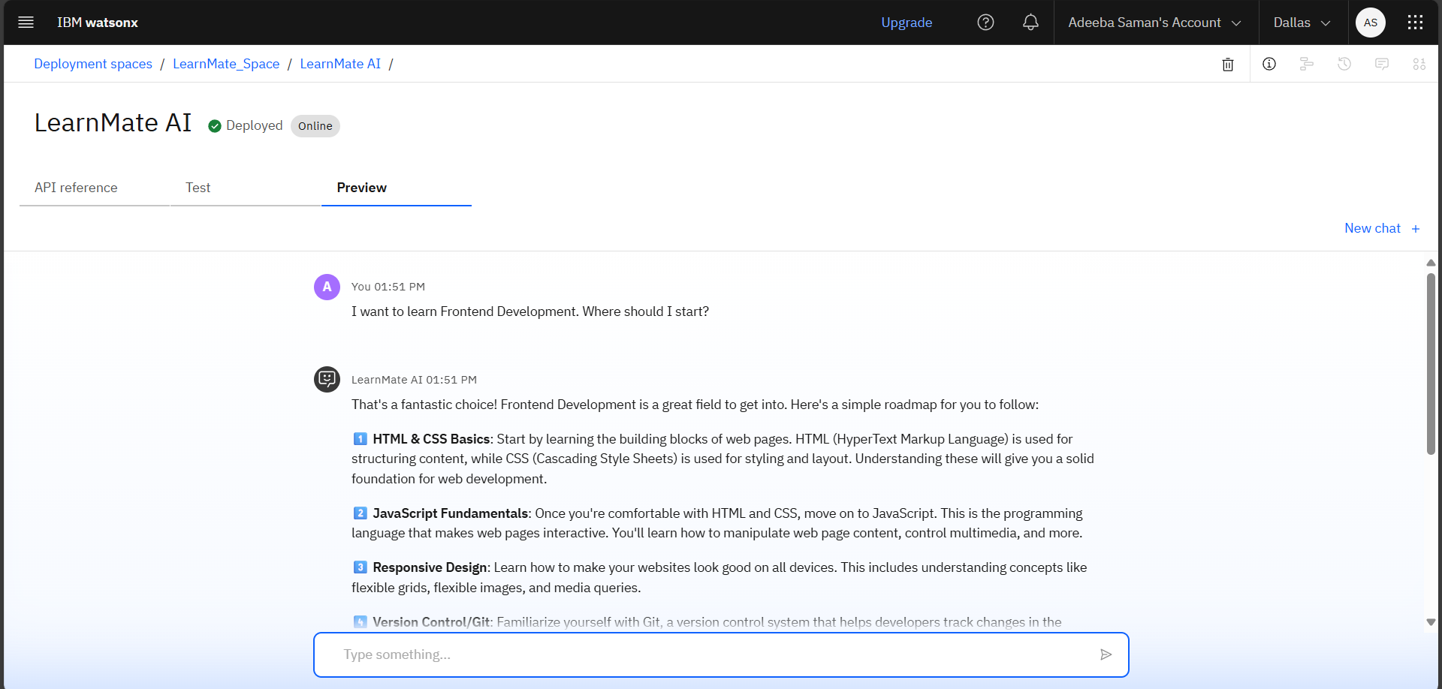
Results
Deployed AI Agent

Slide 11
Conclusion
It helps students save time and avoid confusion by recommending clear, structured learning pathways.
Acts as a mentor-like AI – friendly, informative, adaptive.
Suggests trusted tutorials and resources like YouTube channels and beginner-friendly materials.

Slide 12
Future scope
Multi-language Support
Voice-enabled Interaction
Integration with E-learning Platforms
Collaboration with Educators and Institutions

Slide 13
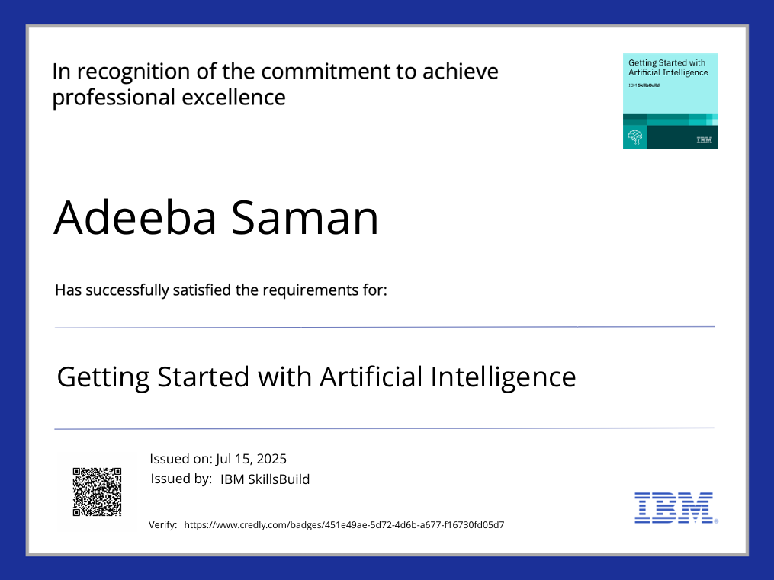
IBM Certifications

Slide 14
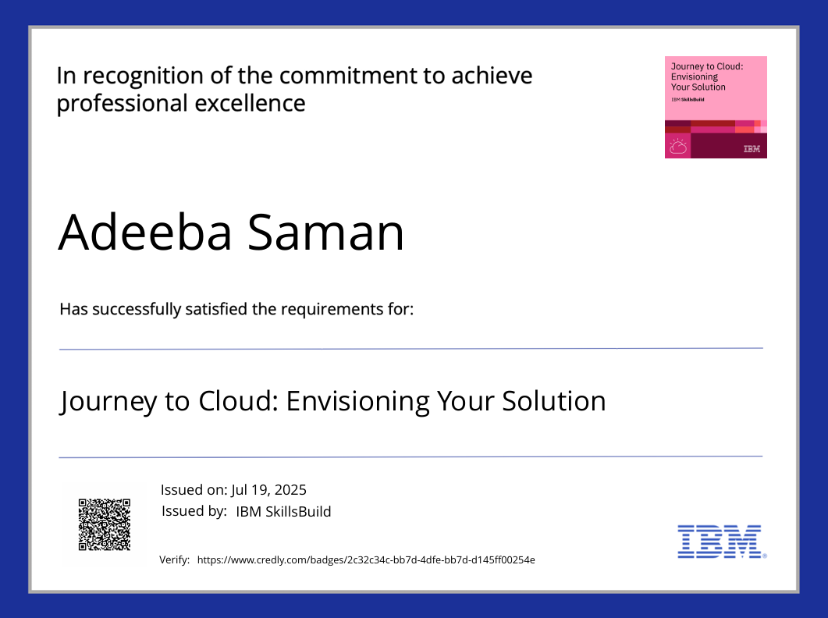
IBM Certifications

Slide 15
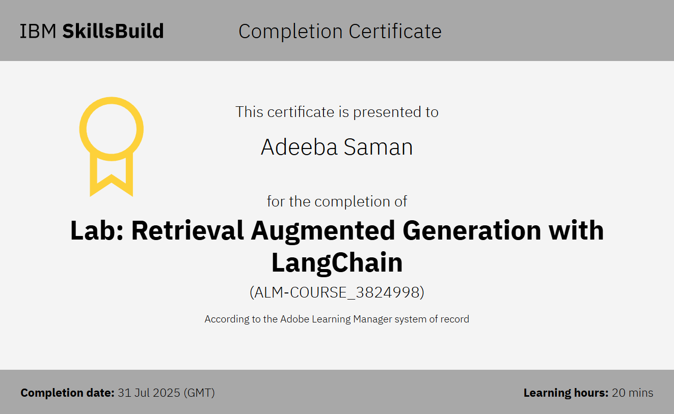
IBM Certifications

Slide 16
GitHub Link
Below is the link to the complete LearnMate AI project, presentation, and resources on GitHub.
GitHub Link :- https://github.com/AdeebaSaman/LearnMate-AI

Slide 17
THANK YOU

