Slide 1
Digital Image Processing
By
Muhammad Ameen Chhajro
(Assistant Professor)
Sindh Madressatul Islam University

Slide 2
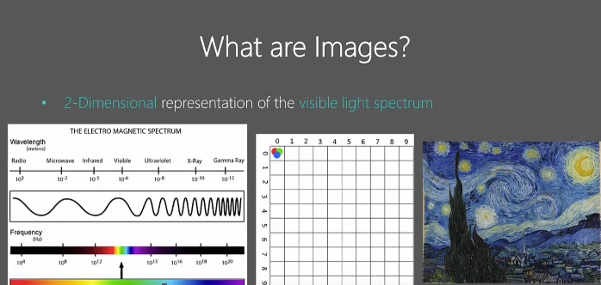
What are images?
Now, you may have in mind that an image can be a photograph, can be something you see on your
laptop screen or a TV screen. Those are all two-dimensional planes where there's only an X Y dimension.
that X Y dimension here corresponds to different pixel points on computer screens or in photographs, basically dots per inch deep.

Slide 3
We know each pixel or DPI(dots per inch) points reflect different wavelengths of light, and that is where we refer to the visible light spectrum.
The visible light spectrum is part of the electromagnetic spectrum, which consists of radio waves to gamma rays and different waves here have different wavelengths and the visible part.
we see visible because it's visible to our eyes consists of different wavelengths and each wavelength corresponds to different colors from red, green to blue and slightly purple.
Each point corresponds to a different color, which means it reflects different wavelengths of light, which is what we see in these images.

Slide 4
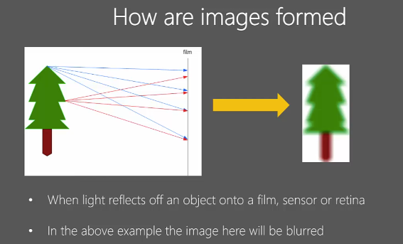

Slide 5
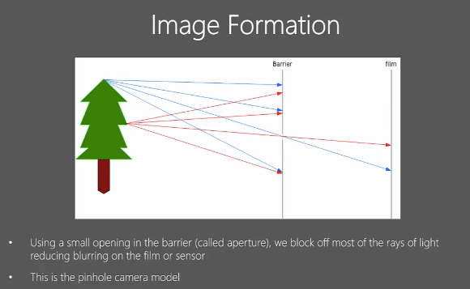

Slide 6
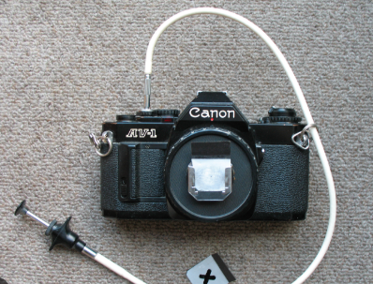
Pinhole camera model (source Google)

Slide 7
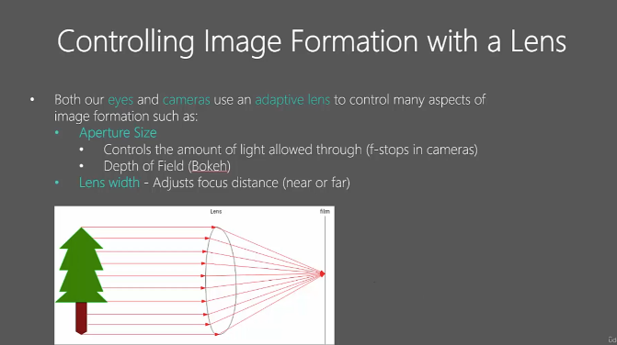

Slide 8
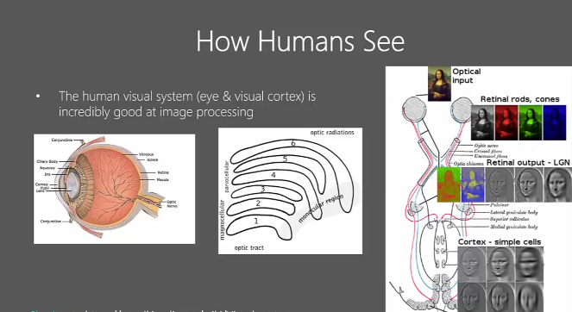
our brain or brains do this by using six layers of visual processing.

Slide 9
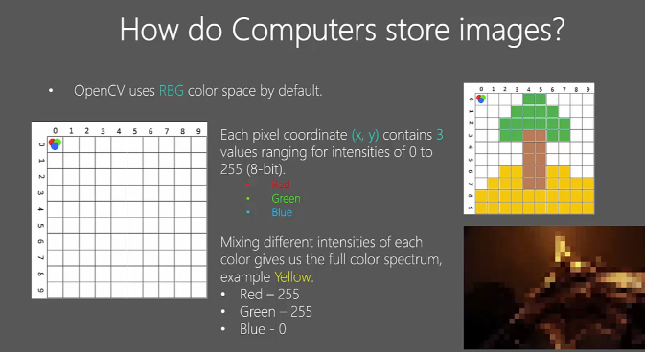

Slide 10
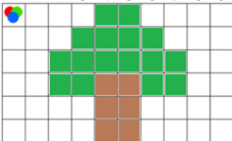
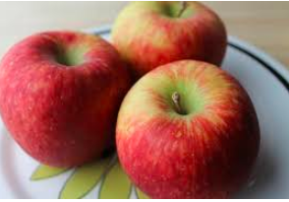
Each pixel coordinate (x, y) contains 3 values ranging for intensities of 0 to 255 (8-bit). (RGB)
Mixing different intensities of each color gives
the full color spectrum , for Yellow
• Red – 255 • Green – 255 • Blue - 0

Slide 11
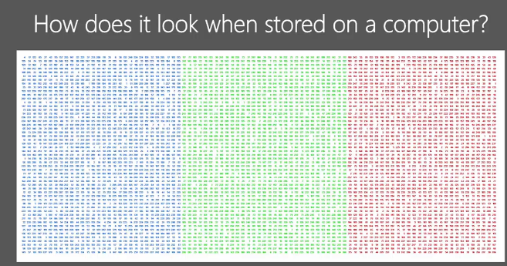
These are the colors for theoretical intensities, for blue, green and red. If you're familiar with programming, you'd quickly realize that this data can be easily stored in arrays, and that's exactly how OpenCV stores images.

Slide 12
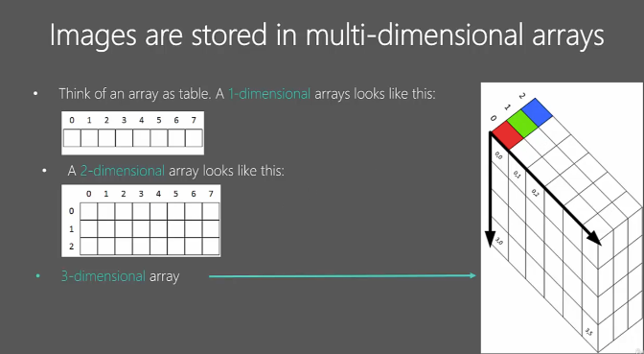
third layer behind
For green
(0,0,1)

Slide 13
In a three-dimensional array, think of the same two-dimensional, but with layers of stacks
behind them.
It is like the two-dimensional arrays in stack form to represent red three-dimensional (0,0,0)

Slide 14
Understanding Black and White Images
Black and White images are stored in 2-Dimensional arrays
There are two types of B&W images
Grayscale Images
Binary Images
What is a Grayscale Image?
A grayscale image is one where each pixel represents only the intensity of light, ranging from black (0 intensity) to white (maximum intensity).
It contains no color information, only shades of gray.

Slide 15
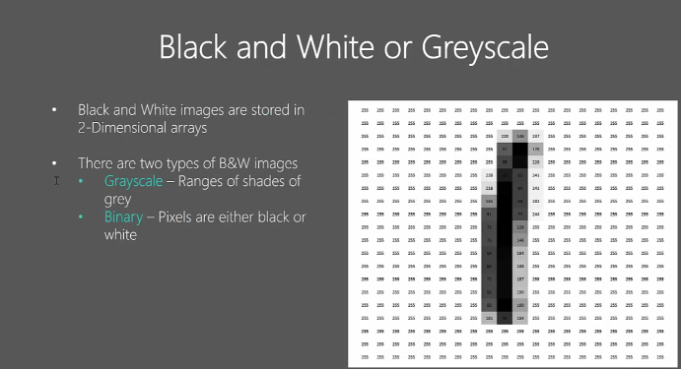

Slide 16
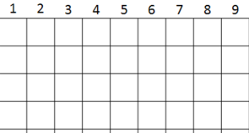
Understanding Black and White Images
Black and White images are stored in 2-Dimensional arrays
There are two types of B&W images
Grayscale Images
Binary Images
What is a Grayscale Image?
A grayscale image is one where each pixel represents only the intensity of light, ranging from black (0 intensity) to white (maximum intensity).
It contains no color information, only shades of gray.

Slide 17
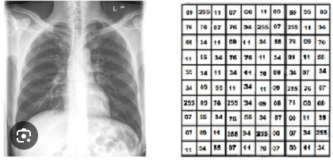
Understanding Black and White Images
Each pixel has a single value representing its brightness.
Typically, an 8-bit grayscale image has 256 shades of gray (0 = black, 255 = white)
Applications of gray scale images.
Medical Imaging: X-rays, MRIs, and CT scans etc

Slide 18
Advantages of Gray scale images
Simplified Data: Easier to process and analyze.
Reduced File Size: Smaller than color images.
Focus on Details: Enhances texture and contrast.
Noise Reduction
Increase Processing time due to less information
They store important information from image
Color information is good but not necessary every time

Slide 19

Grayscale vs. Black and White
Grayscale:
Contains multiple shades of gray (e.g., 256 levels).
Black and White:
Only two colors: pure black and pure white (no shades of gray).

