Slide 1
Digital Image Processing
By
Muhammad Ameen Chhajro
(Assistant Professor)
Sindh Madressatul Islam University

Slide 2
Image Manipulation

Slide 3
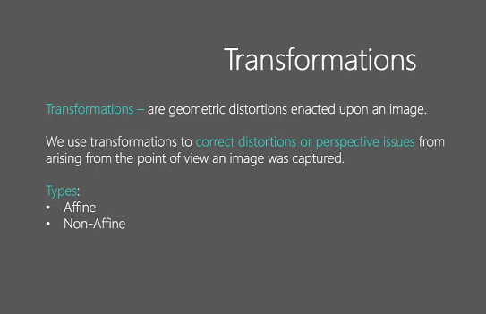

Slide 4
Affine transformations are a class of linear transformations that preserve certain geometric properties.
Common Affine Transformations:
Translation: Shifting an image by a fixed distance in a specific direction.
Rotation: Rotating an image by a certain angle around a point.
Scaling: Enlarging or reducing the size of an image.

Slide 5
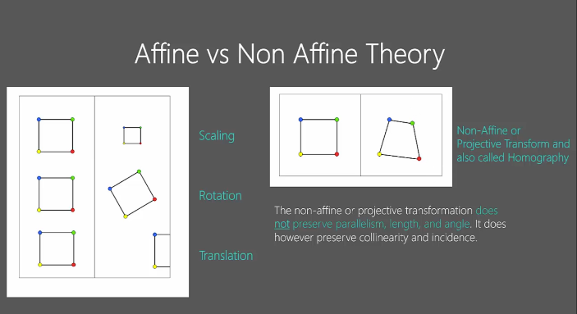

Slide 6
Collinearity in Non-Affine Transformation
Collinearity refers to the property of points lying on a single straight line. In affine transformations, collinearity is preserved—meaning that if three or more points lie on a straight line before the transformation, they will still lie on a straight line after the transformation.
However, in non-affine transformations, collinearity is not necessarily preserved. Non-affine transformations can bend or warp straight lines into curves, causing points that were originally collinear to no longer lie on a straight line.
Original Points: Three points A, B, and C lie on a straight line.
After Non-Affine Transformation: The transformed points A′, B′, and C′ may no longer lie on a straight line. Instead, they could lie on a curve.

Slide 7
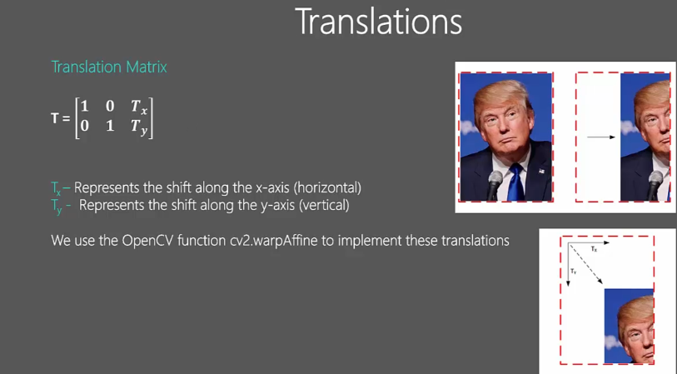

Slide 8
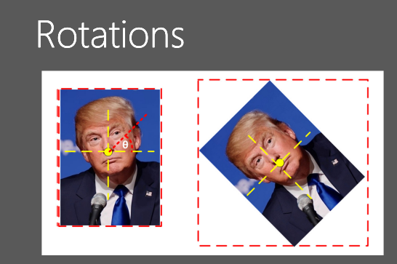
Image rotation
Image rotation is a geometric transformation that rotates an image by a specified angle around a fixed point (usually the center of the image). It is a type of affine transformation and is widely used in image processing for tasks like image alignment, data augmentation, and correcting orientation.

Slide 9
Properties of Rotation
Preserves Shape and Size: Rotation does not alter the shape or size of the image.
Preserves Parallelism: Parallel lines remain parallel after rotation.
Preserves Collinearity and Incidence: Points lying on a straight line remain collinear, and incidence relationships are preserved.
Angle and Center: The rotation angle and center determine the final orientation of the image.

Slide 10
Applications of Image Rotation
Image Alignment: Aligning images for stitching or comparison.
Data Augmentation: Rotating images to create new training data for machine learning models.
Correcting Orientation: Fixing the orientation of scanned documents or photos.
Computer Vision: Rotating images for object detection or feature extraction.

