Slide 1
Semester Project (Graph Theory)
Muhammad Shakeel 2021-CS-625
Muhammad Adeel Tariq 2021-CS-684

Slide 2
Introduction
Document classification is the automated process of assigning predefined categories or labels to documents based on their content. It facilitates efficient organization and retrieval of textual data across various domains.
Classical/NLP-based methods for document classification include techniques such as bag-of-words, TF-IDF(Term Frequency-Inverse Document Frequency), word embeddings, and traditional machine learning algorithms like Naive Bayes, Support Vector Machines (SVM), and logistic regression. These methods rely on linguistic patterns and statistical modeling to categorize documents based on their content.

Slide 3
Introduction
Graph-based document classification leverages graph representations of documents, with nodes denoting words or concepts and edges depicting their relationships. Algorithms such as graph kernels or graph neural networks analyze the graph's structure and content to classify documents by semantic and syntactic similarities, enabling accurate categorization through rich relational information.

Slide 4
Problem Statement
The project utilizes an extended k-Nearest Neighbor (k-NN) algorithm for web document classification, drawing inspiration from the graph-based model introduced in the research paper. This approach replaces traditional vector-based models, enabling a thorough assessment of classification accuracy and execution time, thereby evaluating the efficacy of graph-based methods against conventional ones.

Slide 5
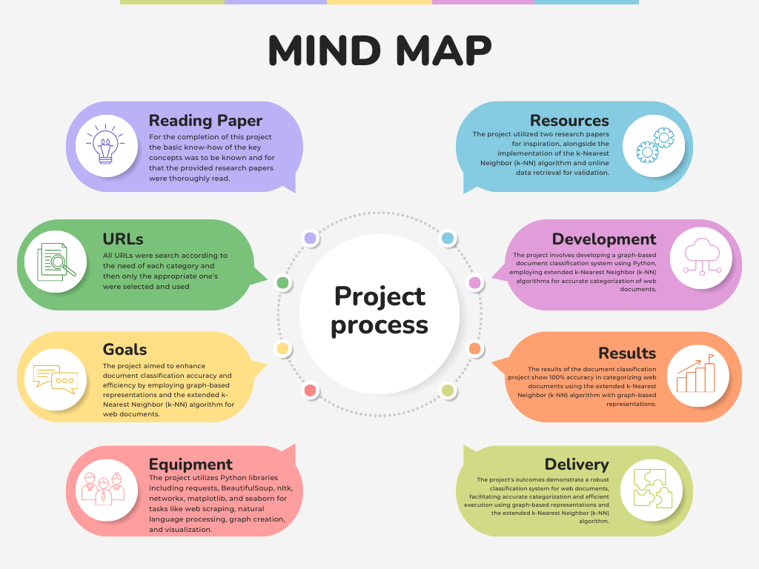

Slide 6
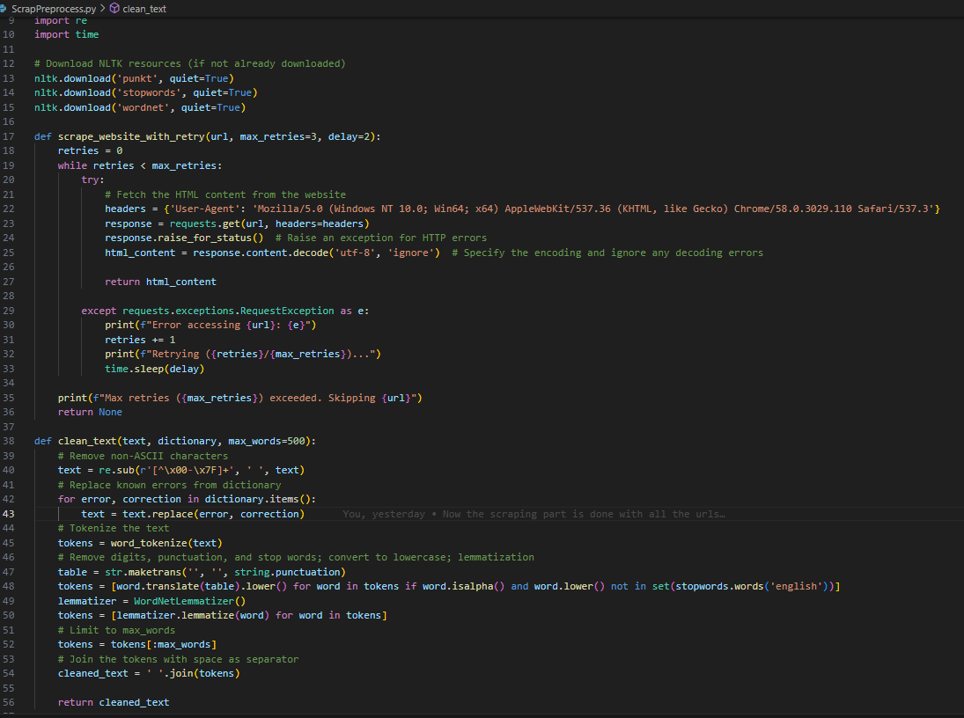
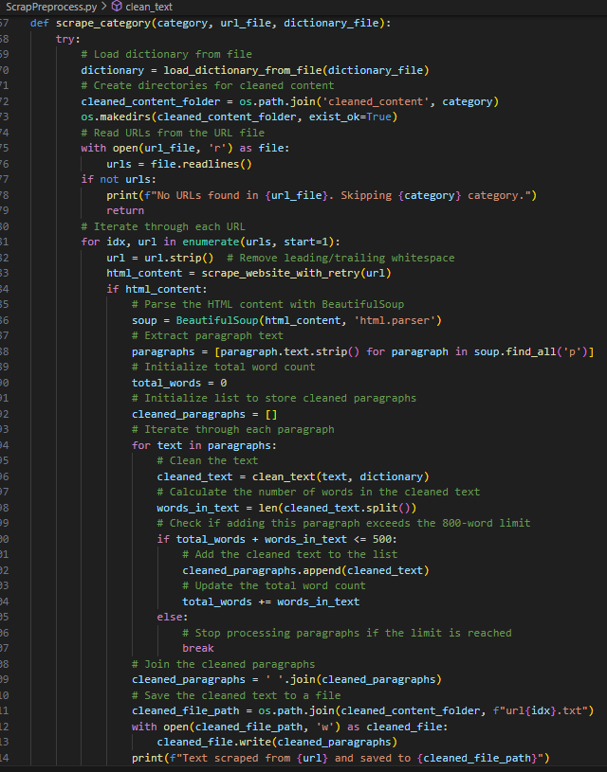
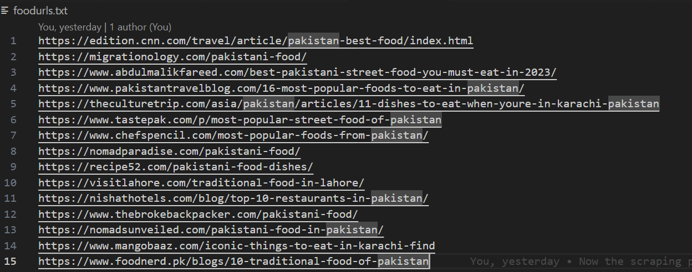
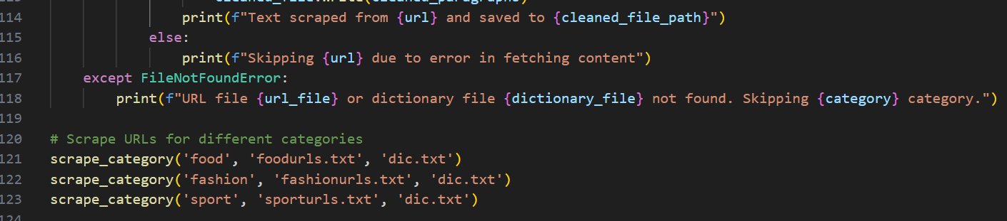
Methodology
Web Scraping
For web scraping, we first collected the URLs related to our topics and then placed these URLs in the respected txt files with names as their category, the python code then iterated through all the URLs inside all the files and saved the scraped and preprocessed content into the respected sub folders for the categories in the order of URLs.

Slide 7
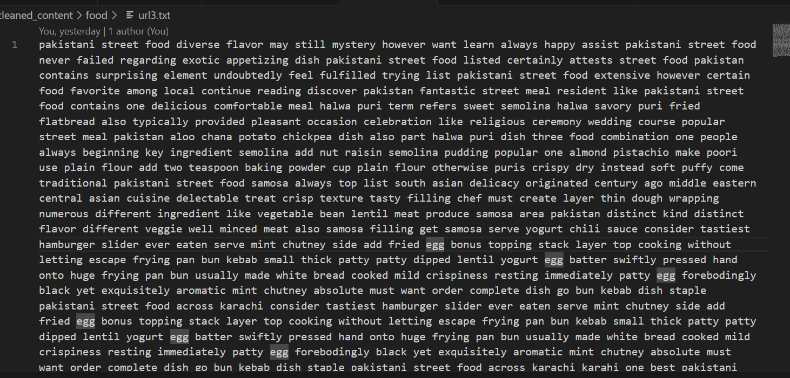
Methodology
Data Cleaning
For data cleaning, we used the ‘clean_text’ function which performs several data cleaning tasks. It removes non-ASCII characters, replaces known errors specified in a dictionary, tokenizes the text, removes digits, punctuation, and stop words, converts words to lowercase, and lemmatizes them. Additionally, it limits the number of words to a maximum specified value and joins the cleaned tokens back into a string. The preprocessed data looks like the second image below.

Slide 8
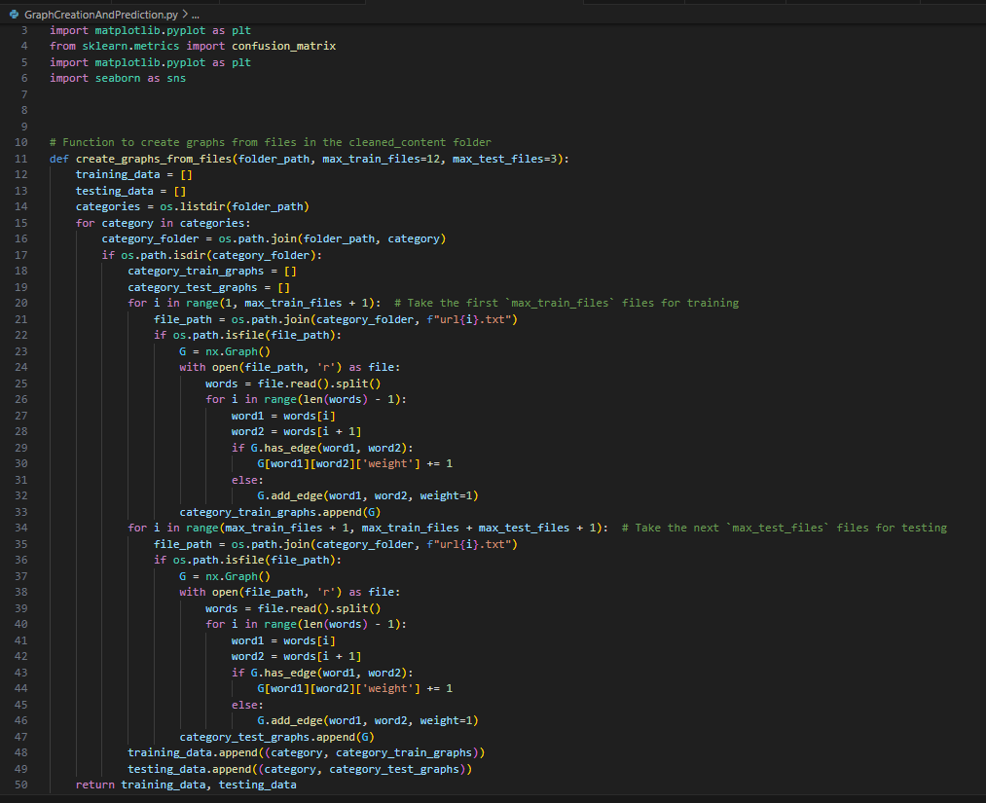
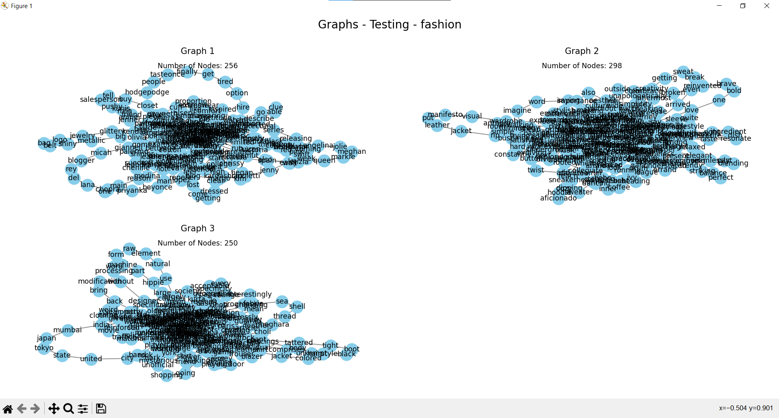
Methodology
Graph Creation
In the project, graphs are created from text files stored in the ‘cleaned_content’ folder using the ‘create_graphs_from_files’ function. This function traverses through the folder structure, reads text files, and constructs graphs based on the word relationships within each file. For each file, it iterates through adjacent words, adding edges between them in a graph representation. The resulting graphs(Represented in the right) capture the semantic relationships between words in the documents, which are then used for document classification purposes.

Slide 9
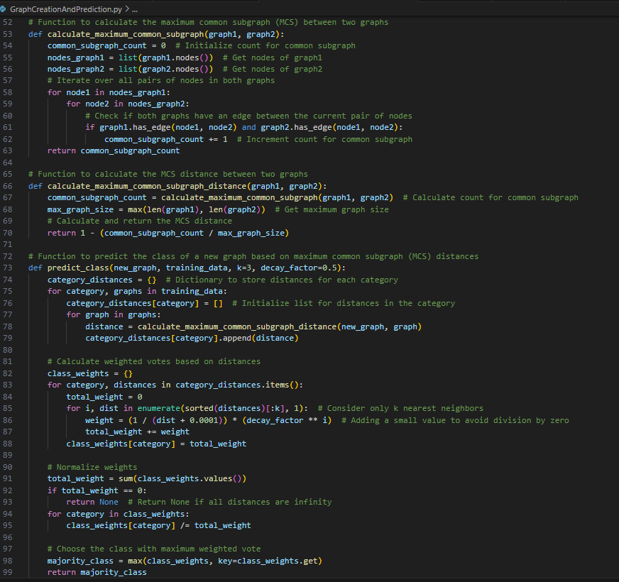
Methodology
Implementation of Paper / method
The project incorporates methodologies outlined in the research paper, implementing functions to assess the Maximum Common Subgraph (MCS) between pairs of graphs. The ‘calculate_maximum_common_subgraph’ function determines the number of common subgraphs between two graphs by iterating over their nodes and edges, while the ‘calculate_maximum_common_subgraph_distance’ function computes the MCS distance, representing the dissimilarity between graphs. These functions are pivotal in graph-based document classification, enabling the comparison of structural and semantic similarities among documents.

Slide 10
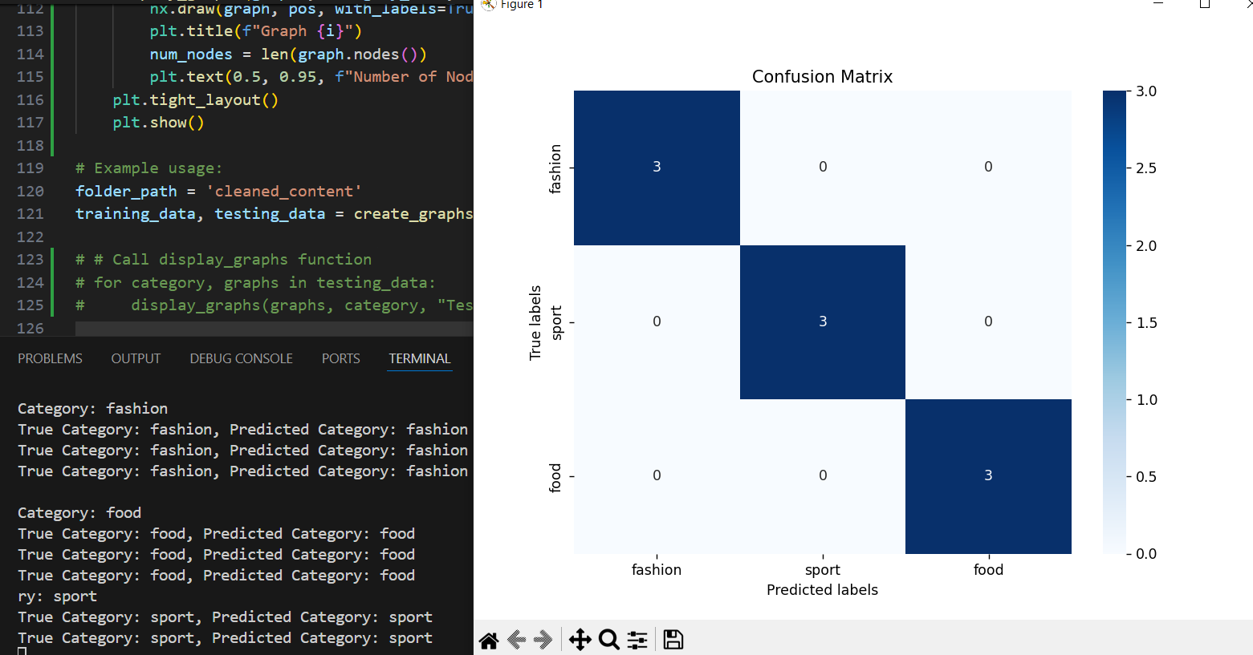
Results
Main results / Confusion Matrix
The project yielded accurate results by employing meticulously scraped and preprocessed data. Leveraging an extended k-Nearest Neighbor (k-NN) algorithm with graph-based representations, the classification process demonstrated efficiency and precision, showcasing the effectiveness of graph-based approaches for document classification tasks.

Slide 11
Future Work
In this project, an enhancement could be made by utilizing additional textual features such as headings and link text from the documents. Additionally, leveraging the labels of the edges in the graph representations could lead to more efficient and accurate results in document classification. By incorporating these elements into the analysis, the model could capture more nuanced relationships and semantic information, thereby improving its overall performance.
Any new idea for document classification?
To make document classification better using graphs, we can try fancier graph tricks like graph neural networks. Also, adding specific knowledge related to the topic or using outside knowledge graphs could make our document understanding smarter. We could also think about ways to change the graph based on what's in the documents or consider time factors for even smarter classifications.

Slide 12
Q & A

