Slide 1

LYNXgwas
Locus analYsis and geNomic eXplorer
A local-first, multi-project GWAS analysis & visualization platform
What it is
LYNXgwas takes raw GWAS summary statistics and turns them into an interactive, browser-based explorer — identifying risk loci, recovering rsIDs, computing LD against a reference panel, and rendering per-locus Manhattan plots, gene tracks, and LD triangles — all from a single Java application, with no cloud dependency and no data leaving the machine.
Why it matters
Reproducible & self-contained
Privacy-preserving
Built for scale
one tool covers loci calling, rsID recovery, LD, and figures — no juggling separate scripts or pipelines across a project.
runs entirely offline/local-first; sensitive summary statistics never have to leave the analyst's machine.
manages many GWAS projects side-by-side (populations, meta-analyses, models) from one home page, with staleness tracking so nothing goes out of date silently.
Slide 1 of 3 — Overview
lynxgwas.local | MIT License

Slide 2
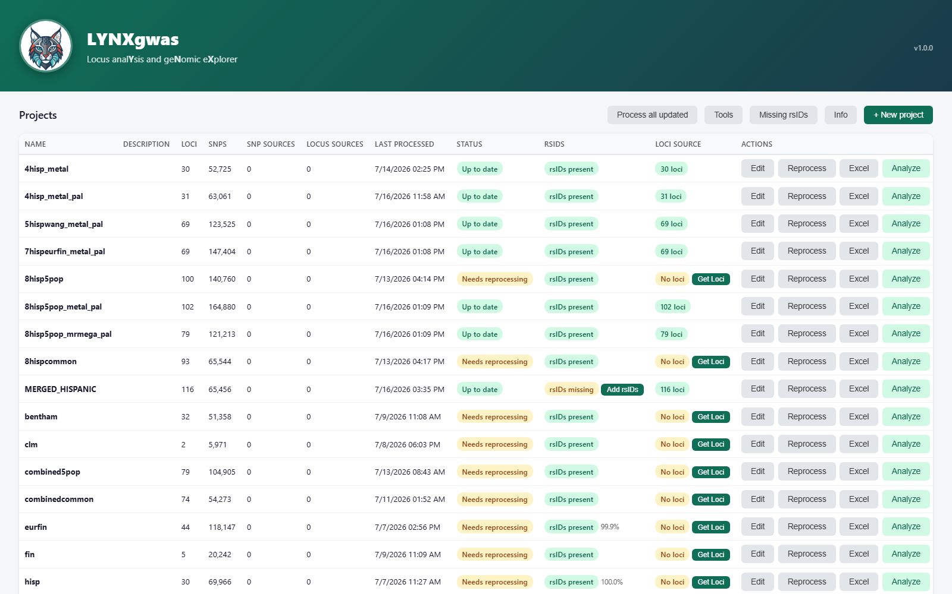
One home page, every GWAS project
Multi-project management, at a glance
› Project table name, loci count, SNP count, annotation sources, processing status and rsID recovery — all in one sortable view.
› Guided wizard step-by-step project creation: file selection, column mapping with auto-detection, and parameter setup.
› Get Loci one click runs PLINK LD-based clumping against a reference panel to identify genomic risk loci.
› Add rsIDs local dbSNP lookup (~99.8%) with optional NCBI + gnomAD API completion (~99.9%) for the rest.
› Staleness detection flags any project whose inputs changed since last processed, so results never silently drift.
› Shared resources reference panels and SNP databases are configured once and reused across every project.
Slide 2 of 3 — Home Page
lynxgwas.local | MIT License

Slide 3
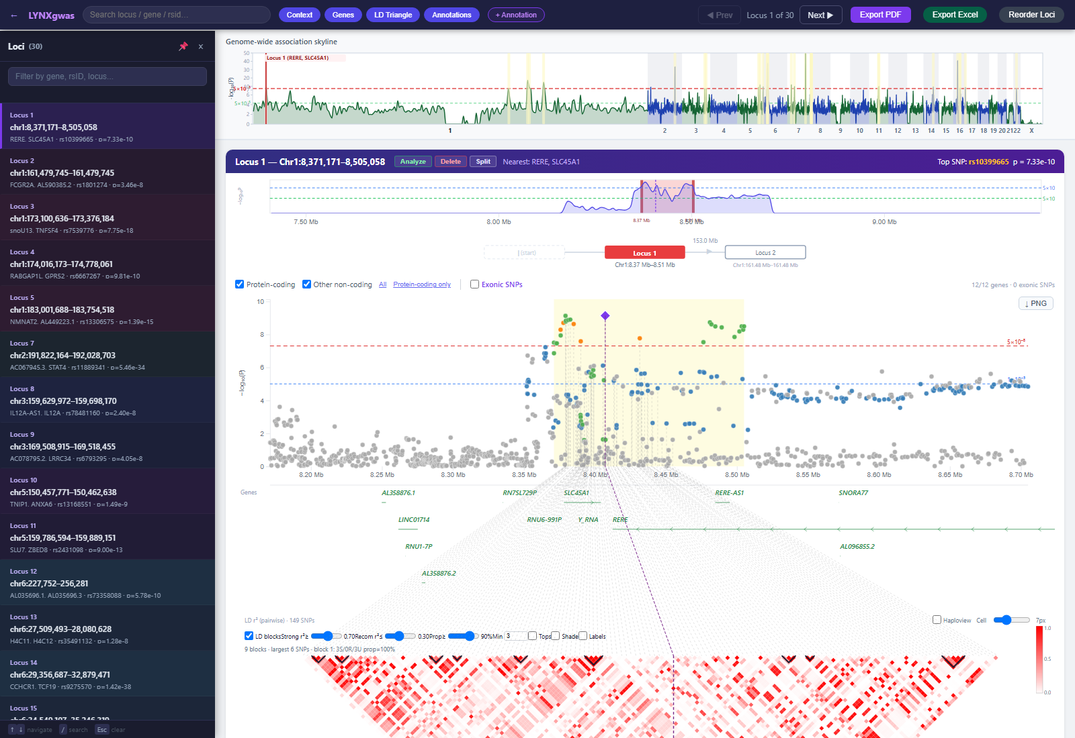
The locus viewer: from Manhattan plot to LD block, in one screen
Genome-wide skyline · regional association plot · gene track · LD triangle — synchronized and interactive
› Built-in plots genome-wide Manhattan skyline, zoomable regional association plot, gene structure track, and LD r² triangle, all synced to the selected locus.
› Fast navigation search by locus, gene, or rsID; step through loci with the keyboard; resize or split locus boundaries live.
› Annotation overlays layer fine-mapping PIP, colocalization PP.H4, or conditional-signal tracks directly on the plot.
› Export-ready one click produces a publication-quality PDF (1x–4x resolution) or an Excel workbook of the locus data.
› Why it matters turns a static table of SNPs and p-values into an explorable picture of each locus — faster triage of true signals and easier communication with collaborators.
Slide 3 of 3 — Locus Viewer & Plots
lynxgwas.local | MIT License

