Slide 1
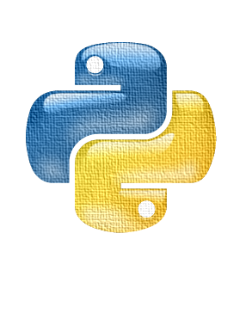
PROGRAMMING IN PYTHON 3
Week 6 – August 26th 2018
IACC Plano

Slide 2
Todays Training Agenda
 Other Python Frameworks
 Virtual Environments
 Dallas Police Incident Data Visualization
 Recap
 Week 4 Exercise Review
 Data Visualization
 Q&A

Slide 3
Github Repository : bit.ly/iaccpython2018

Slide 4
Q & A

