Slide 1
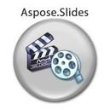
Evaluation only.
Created with Aspose.Slides for Java 6.9.1.0
Copyright 2004-2013 Aspose Pty Ltd.

