Slide 1
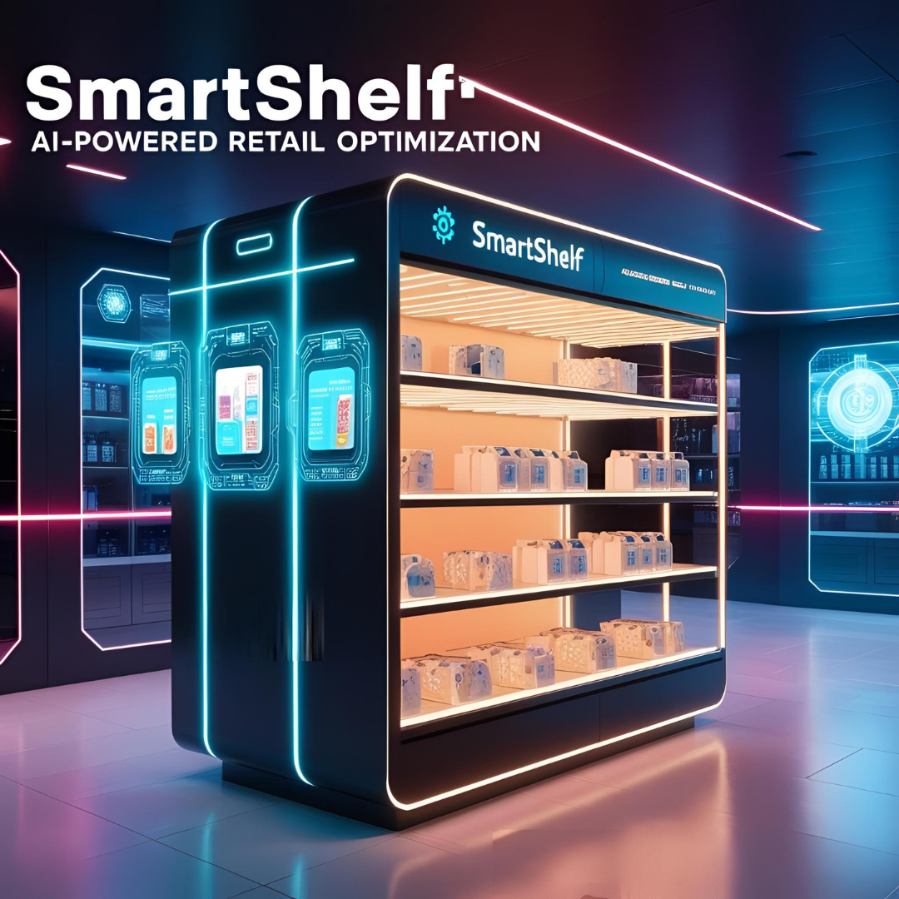

Introduction
SmartShelf
AI-Powered Retail Optimization
Team members
Syed Qasim Ali (BSAI-161)
Adeel Naeem (BSAI-146)
Haris Nawaz (BSAI-161)
Supervisor:
Mr. Daniyal Khan

Slide 2




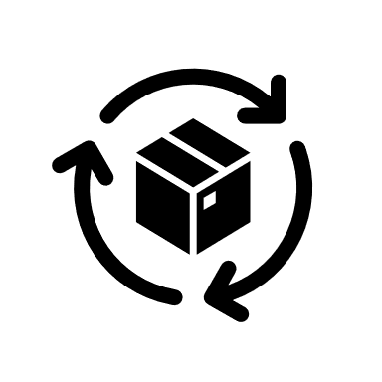
Problem Statement
Introduction
SmartShelf
AI-Powered Retail Optimization
Primary Goal
A smart retail services application for store owners.
App Purpose
Insufficient Impact
A smart retail services application for store owners.
Proposed Solution
Lack of tools
Strategic Gap
Team members
A platform for actionable analytics to boost sales.
Syed Qasim Ali (BSAI-161)
Adeel Naeem (BSAI-146)
Haris Nawaz (BSAI-161)
Technology Focus
Need for intelligent product bundling and placement strategies.
Inefficient shelf organization leads to missed profits.
Retailers lack tools to analyze consumer buying behavior.
Uses data mining to recommend optimal product placement.
Core Functions
Supervisor:
1
2
3
4
Core Functions Enables registration, product data upload, and transaction analysis.
Mr. Daniyal Khan

Slide 3

Multi-Store User Registration
Problem Statement
Introduction
Lack of tools
Insufficient Impact
Strategic Gap
Proposed Solution
Retailers lack tools to analyze consumer buying behavior.
Inefficient shelf organization leads to missed profits.
Need for intelligent product bundling and placement strategies.
A platform for actionable analytics to boost sales.
1
2
3
4
01
02
03
04

Slide 4

Product and Transaction Management
Multi-Store User Registration
Problem Statement
Transaction Data
Supports transaction history uploads for analysis.
Store Registration
01
Allows multiple retail stores to register and manage accounts.
User Interface
Provides easy-to-use interfaces for data entry and updates.
Security Feature
Lack of tools
Insufficient Impact
Strategic Gap
Proposed Solution
Supports user authentication and role-based access.
02
Profile Management
Catalog Upload
03
Store owners can update store details and manage profiles.
Retailers lack tools to analyze consumer buying behavior.
Inefficient shelf organization leads to missed profits.
Need for intelligent product bundling and placement strategies.
A platform for actionable analytics to boost sales.
Enables store owners to upload product catalogs.
Data Storage
Scalability
Stores data in MongoDB or PostgreSQL for efficient retrieval.
Ensures secure and scalable user management.
04
1
2
3
4
02
01
03
04

Slide 5


Association Rule Mining and Clustering
Product and Transaction Management
Multi-Store User Registration
Store Registration
01
Allows multiple retail stores to register and manage accounts.
Transaction Data
Rule Generation
Application
Clustering Analysis
Security Feature
Item Set Analysis
Supports transaction history uploads for analysis.
Supports user authentication and role-based access.
02
Profile Management
03
Powers product bundling and placement recommendations using both association rules and clustering insights.
User Interface
Store owners can update store details and manage profiles.
Uses Apriori algorithm to identify frequent item sets.
Applies K-Means clustering to group products or customers based on purchasing patterns.
Generates association rules for products often bought together.
2
Provides easy-to-use interfaces for data entry and updates.
4
3
1
Catalog Upload
Scalability
Enables store owners to upload product catalogs.
02
Ensures secure and scalable user management.
04
01
03
Data Storage
Stores data in MongoDB or PostgreSQL for efficient retrieval.
04

Slide 6

Recommendation Engine
Product and Transaction Management
Association Rule Mining and Clustering
01
02
03
04
Item Set Analysis
Rule Generation
Clustering Analysis
Application
Placement Strategy
Filtering Methods
Data Integration
Sales Impact
Recommends optimal product placement based on buying patterns.
Uses collaborative/content-based filtering for suggestions.
Integrates insights from association rule mining.
Helps maximize sales through strategic shelf organization.
Uses Apriori algorithm to identify frequent item sets.
Generates association rules for products often bought together.
Applies K-Means clustering to group products or customers based on purchasing patterns.
Powers product bundling and placement recommendations using both association rules and clustering insights.
1
2
3
4
02
01
Stores data in MongoDB or PostgreSQL for efficient retrieval.
03
Supports transaction history uploads for analysis.
Provides easy-to-use interfaces for data entry and updates.
Enables store owners to upload product catalogs.
Transaction Data
Catalog Upload
User Interface
Data Storage
04

Slide 7
Recommendation Engine
Association Rule Mining and Clustering
01
02
03
04
Item Set Analysis
Rule Generation
Clustering Analysis
Application
Placement Strategy
Filtering Methods
Data Integration
Sales Impact
Recommends optimal product placement based on buying patterns.
Uses collaborative/content-based filtering for suggestions.
Integrates insights from association rule mining.
Helps maximize sales through strategic shelf organization.
Uses Apriori algorithm to identify frequent item sets.
Generates association rules for products often bought together.
Applies K-Means clustering to group products or customers based on purchasing patterns.
Powers product bundling and placement recommendations using both association rules and clustering insights.
1
2
3
4

Slide 8

Recommendation Engine
01
02
03
04
Placement Strategy
Filtering Methods
Data Integration
Sales Impact
Recommends optimal product placement based on buying patterns.
Uses collaborative/content-based filtering for suggestions.
Integrates insights from association rule mining.
Helps maximize sales through strategic shelf organization.

Slide 9

Recommendation Engine
01
02
03
04
Placement Strategy
Filtering Methods
Data Integration
Sales Impact
Recommends optimal product placement based on buying patterns.
Uses collaborative/content-based filtering for suggestions.
Integrates insights from association rule mining.
Helps maximize sales through strategic shelf organization.

Slide 10


Analytics Dashboard
Recommendation Engine
01
02
03
04
Placement Strategy
Filtering Methods
Data Integration
Sales Impact
Recommends optimal product placement based on buying patterns.
Uses collaborative/content-based filtering for suggestions.
Integrates insights from association rule mining.
Helps maximize sales through strategic shelf organization.
Real-Time Insights
Visualization Tools
Provides store managers with real-time insights.
Built with Chart.js, D3.js, or Python Dash for interactive charts.
Decision Support
Provides store managers with real-time insights.
02
04
01
03

Slide 11

Visualizes sales trends, product associations, and performance metrics.
Visualizes sales trends, product associations, and performance metrics.
Technologies
Analytics Dashboard
Recommendation Engine
01
02
03
04
Real-Time Insights
Visualization Tools
Provides store managers with real-time insights.
02
Built with Chart.js, D3.js, or Python Dash for interactive charts.
04
Placement Strategy
Filtering Methods
Data Integration
Sales Impact
Recommends optimal product placement based on buying patterns.
Uses collaborative/content-based filtering for suggestions.
Integrates insights from association rule mining.
Helps maximize sales through strategic shelf organization.
01
Data Visualization
03
Decision Support
Visualizes sales trends, product associations, and performance metrics.
Provides store managers with real-time insights.

Slide 12












Visualizes sales trends, product associations, and performance metrics.
Visualizes sales trends, product associations, and performance metrics.
Expected Impact
Technologies
Expected Impact
User Accessibility
Scalable app with actionable insights.
User-friendly tool for small to medium retailers.
Datamining Tools
Database Choice
Sales Growth
Frontend Technology
Increased sales through optimized strategies.
Backend Technology
Hosting Platform
Real-Time Insights
Visualization Tools
Provides store managers with real-time insights.
Built with Chart.js, D3.js, or Python Dash for interactive charts.
Data Visualization
Decision Support
02
04
Visualizes sales trends, product associations, and performance metrics.
Provides store managers with real-time insights.
01
03

Slide 13

Visualizes sales trends, product associations, and performance metrics.
Visualizes sales trends, product associations, and performance metrics.
Conclusion
Expected Impact
Technologies
Expected Impact
User Accessibility
Scalable app with actionable insights.
User-friendly tool for small to medium retailers.
Datamining Tools
Database Choice
Sales Growth
Increased sales through optimized strategies.
Frontend Technology
Backend Technology
Hosting Platform

Slide 14





Conclusion
Expected Impact
Module Integration
3
4
Future Potential
Five modules deliver comprehensive store optimization.
Expected Impact
User Accessibility
Expand to larger chains and advanced analytics.
Scalable app with actionable insights.
User-friendly tool for small to medium retailers.
Project Vision
1
Sales Growth
SmartShelf revolutionizes retail with AI and data mining.
2
Target Audience
Increased sales through optimized strategies.
Scalable solution for small to medium size business

