Slide 1
AI PROJECT
Team Members
Sehla Razzak (24K-0575)
Adeel Rehman (24k-0910)
Tania Mukhi (24K-0713)
AI-Powered Fake News Detection
Domain
Natural Language Processing, Web Scraping & Machine Learning
Output
ARY News Headline Verifier — Detecting misinformation using Machine Learning, Web Scraping & NewsAPI
REAL / SUSPICIOUS / FAKE — with confidence score
Course: Artificial Intelligence

Slide 2
OVERVIEW
Project Overview:
What This System Does
🎯 Detect Fake Headlines
🌐 ARY News Scraping
Analyzes any news headline submitted by the user and evaluates its authenticity using multiple verification layers.
Scrapes live headlines from ARY News website using BFS algorithm to find the most similar published headline.
📡 NewsAPI Cross-Check
🤖 ML Prediction
Queries NewsAPI to fetch headlines from thousands of global news sources and counts how many match the input.
Uses a trained Logistic Regression model with TF-IDF to predict whether the headline is REAL or FAKE with a confidence score.
Final Output: REAL | SUSPICIOUS | FAKE

Slide 3
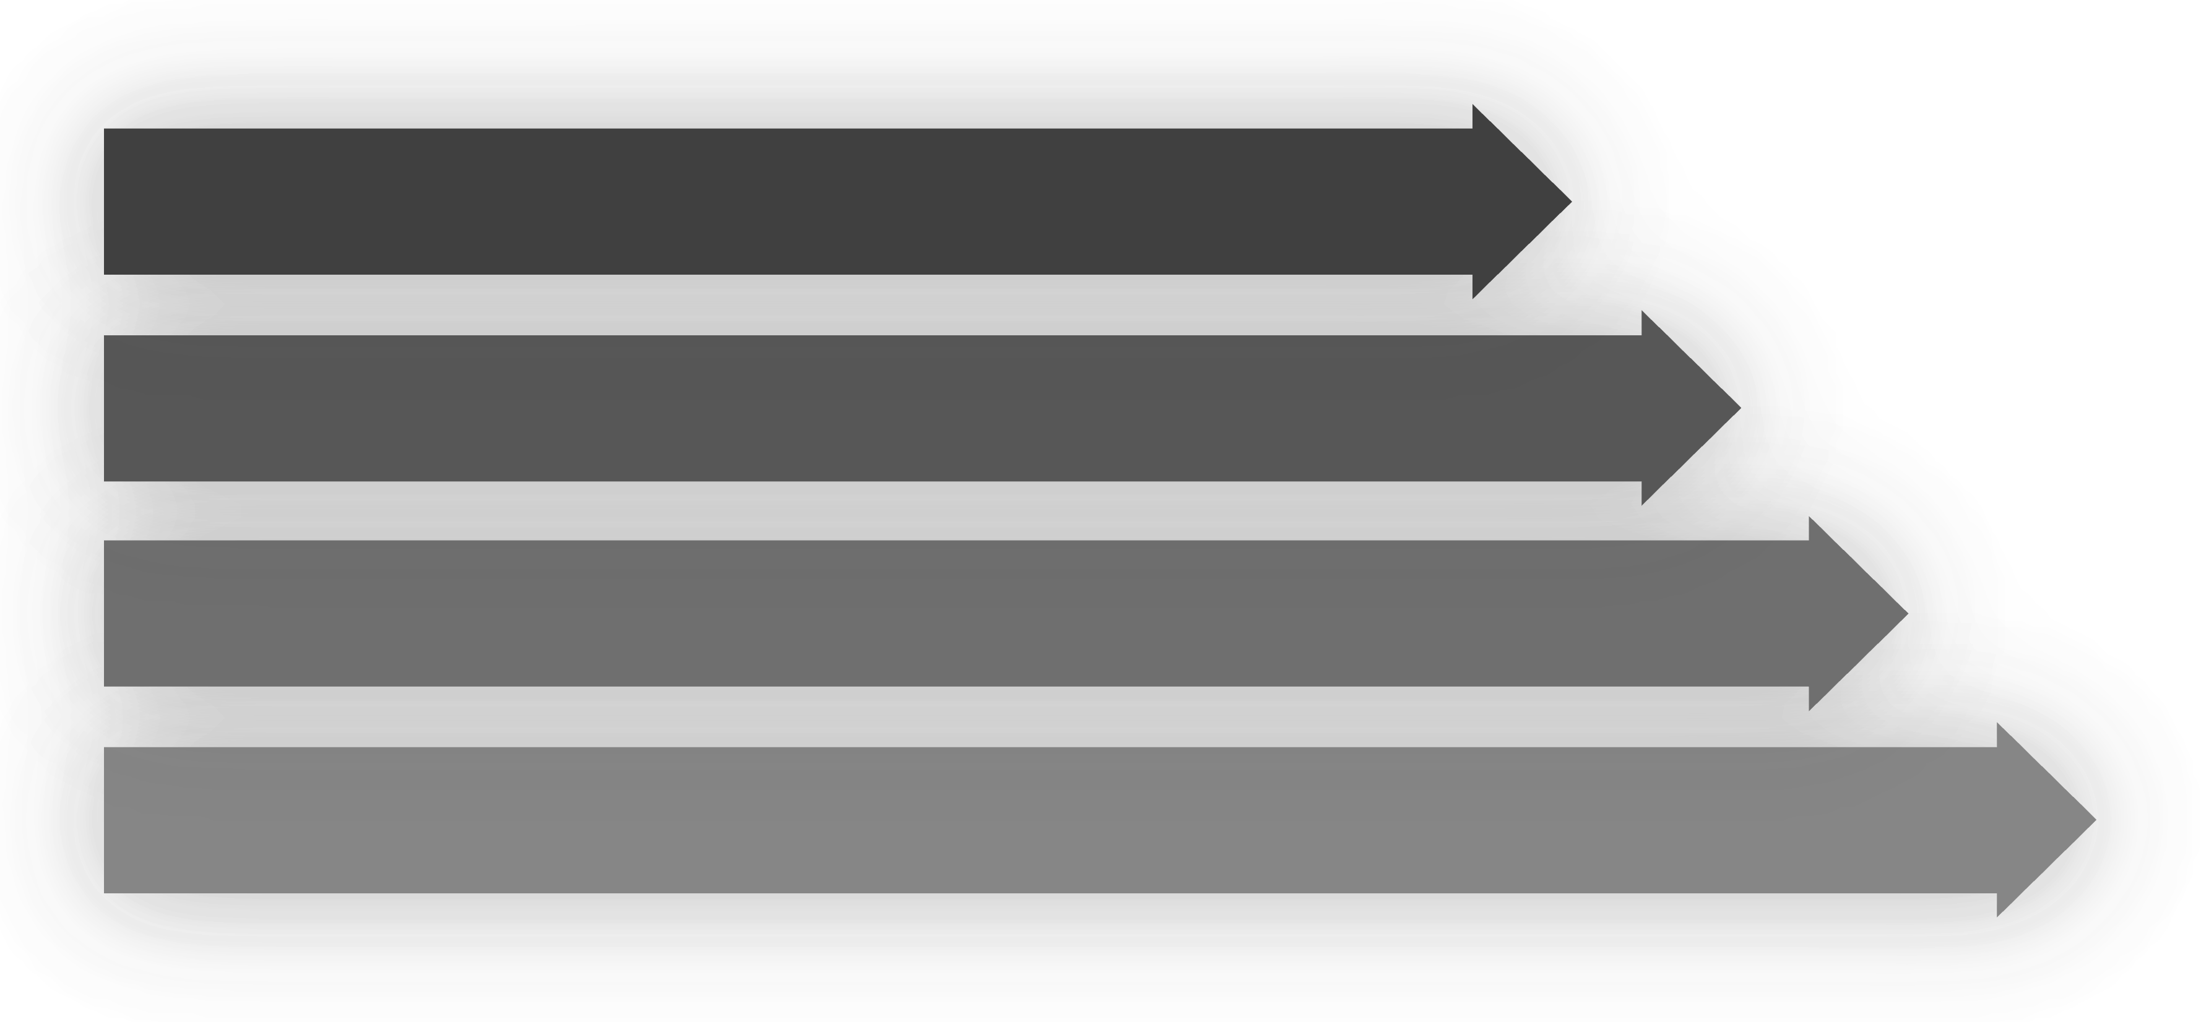
ARCHITECTURE
System Workflow
Every headline passes through a multi-layer verification pipeline before a final verdict is delivered.
User Input
ARY Scraper
NewsAPI
ML Verdict
Step 1 — User submits a headline for verification
Steps 2–3 — ARY Scraper & NewsAPI independently verify the headline
Step 4–5 — ML model predicts; all scores combine into final verdict

Slide 4

COMPONENT 1
ARY Scraper — BFS Algorithm
How BFS Works
Breadth-First Search explores pages level by level using a queue — visiting all pages at the current depth before going deeper.
Why BFS for Scraping?
Ensures broad coverage across all ARY News category pages before drilling into individual articles, maximizing headline discovery.
Start
Enqueue
Extract
Compare
Multi-Category — Scrapes politics, sports, tech & more simultaneously
HTML Parsing — Extracts headline text directly from page structure
Similarity Match — Finds the closest ARY headline to the user's input

Slide 5
COMPONENT 2
NewsAPI External Verification
Cross-checks the headline against thousands of global news sources to gauge worldwide coverage and credibility.
Matching Algorithms
🌍 Global Reach
Keyword Matching — Extracts key terms and checks presence in fetched headlines
1
Fetches headlines from thousands of sources worldwide in real-time
🔎 Headline Extraction
Fuzzy Similarity — Measures string-level similarity to handle minor wording differences
Parses API response to isolate headline text for comparison
2
📊 Match Count
Source Count — Counts how many independent sources report the same story
Higher matching source count → stronger credibility signal
3
Score Output — Returns a normalized API score used in confidence formula
4

Slide 6


COMPONENT 3
Model Decision Breakdown
Machine Learning Logistic Regression
How the Model Works
TF-IDF Features·45%
·45%
·
Word Frequency·25%
·25%
·
N-gram Patterns·20%
·20%
📝 TF-IDF Vectorization
·
Sentence Length·10%
·10%
·
Converts raw headline text into numerical feature vectors — Term Frequency × Inverse Document Frequency
⚙️ Logistic Regression
Trained on labeled real/fake headline datasets; learns linguistic patterns that distinguish genuine from false news
Model learns patterns of real vs. fake headlines from training data — no human rules needed.
📈 Probability Output
Returns a confidence percentage alongside the binary REAL / FAKE classification for every prediction

Slide 7
IMPLEMENTATION
Code Working — Your Implementation
Fetch from NewsAPI
Compare Using Similarity
Send headline keywords to NewsAPI endpoint; receive JSON response containing headlines from global sources.
Apply fuzzy matching and keyword overlap between user headline and each fetched headline to compute similarity scores.
Count Strong Matches
Combine & Generate Verdict
Tally headlines that exceed the similarity threshold — more strong matches indicate higher credibility.
Merge ARY Scraper score + API score + ML prediction using the weighted formula to produce the final REAL / SUSPICIOUS / FAKE result.

Slide 8

Weighted Formula
Confidence Score Formula
Confidence = (ML Score × 0.50) + (ARY Similarity × 0.30) + (API Score × 0.20)
The final confidence score blends three independent signals into a single 0–100 score reflecting headline authenticity.
Component Breakdown
1
ML Score × 0.50 — Logistic Regression probability of headline being real
2
ARY Similarity × 0.30 — Best match similarity from ARY News scraper
3
API Score × 0.20 — Global source match count from NewsAPI

Slide 9

WEIGHTAGE
Why These Weights?
🤖 Machine Learning — 50%
Highest weight because the trained model has learned deep linguistic patterns across thousands of real and fake headlines — most reliable signal.
20%
Machine Learning·50%
📰 ARY Scraper — 30%
·50%
·
ARY Scraper·30%
·30%
50%
·
Verifies directly against a trusted Pakistani news source. If the headline appears on ARY News, it's likely credible locally.
NewsAPI·20%
·20%
·
30%
🌍 NewsAPI — 20%
Provides global confirmation. Weighted lower due to API rate limits and variable source quality across regions.

Slide 10

FINAL OUTPUT
Final Verdict Thresholds
Based on the combined confidence score, every headline is classified into one of three categories:
✅ REAL NEWS
⚠️ SUSPICIOUS
❌ FAKE NEWS
≥ 70
45 – 69
< 45
Confidence score of 70 or above. Headline is verified by ML model, found on ARY News, and confirmed by multiple global sources.
Confidence score between 45 and 69. Partial matches found but insufficient evidence to confirm or deny authenticity.
Confidence score below 45. Headline not found in trusted sources and ML model predicts low authenticity probability.
This three-tier system balances precision and recall — avoiding both false positives (labeling real news as fake) and false negatives (missing misinformation).

