Slide 1
Analytics Insights
Telco Customer Churn Data Analysis
Muhammad Abdulmateen
Saturday, November 23, 2024

Slide 2
Agenda
Introduction
Data Preprocessing and Transformation
Data Analysis – Direct Insights
Data Analysis – Indirect Insights
Financial Impacts
Key Insights
Conclusion and Recommendation

Slide 3
Introduction
Telco, a leading telecom company in the U.S., is facing challenges with customer churn—when customers discontinue their service. Understanding why customers leave is crucial for retaining them, improving services, and maximizing revenue.
This project analyzes Telco's customer data to uncover key patterns and factors influencing churn. By identifying actionable insights, Telco can develop strategies to enhance customer satisfaction and loyalty.

Slide 4
Introduction
Objectives
Understand the dataset
Preprocess the data
Perform exploratory data analysis (EDA)
Answer key questions
Provide recommendations
Build an interactive Dashboard

Slide 5
Data Preprocessing and Transformation
Data Quality Assessment
The project was carried out using a data obtained from Kaggle at Customer churn data
The dataset contains detailed information about the telecom customers including their demographic details, subscription plans, and churn status, billing details, etc.

Slide 6
Data Preprocessing and Transformation
Data Quality Assessment
The data quality issues found in the datasets were:
Unnecessary Columns: Certain columns were irrelevant to the analysis and were removed.
Incorrect Formats: Some columns had data stored in inappropriate formats and required correction.

Slide 7
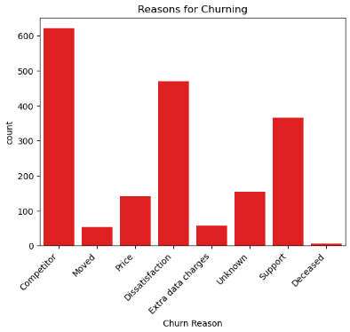
Data Analysis – Direct Insights
Reasons for Churning
7024 total customers with 1869 churned customers.
Competitors offering more appealing services,
Dissatisfaction with the services and related aspects
Challenges with service support
Other factors cited include price, extra charges, relocation and even death.

Slide 8
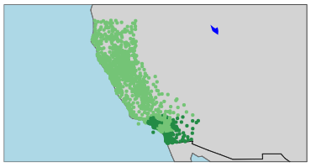
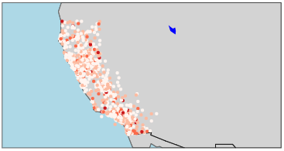
Data Analysis – Indirect Insights
Demography
The maps show the distribution of all customers and the distribution of churned customers across California respectively.
These maps indicate that customer churn is not influenced by geographical location.

Slide 9
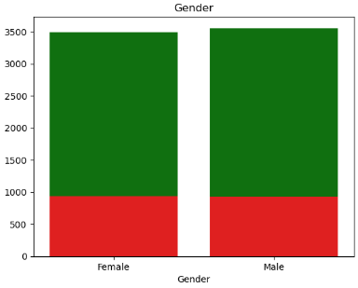
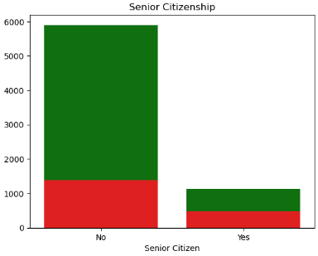
Exploratory Data Analysis
Demography
Both genders have similar churn rates
These findings suggest that customer churn is also not significantly influenced by gender.
Senior citizens have a higher churn rate that those who are not.
These findings suggest that senior citizenship could be a significant factor influencing customer churn.

Slide 10
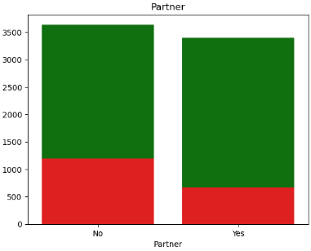
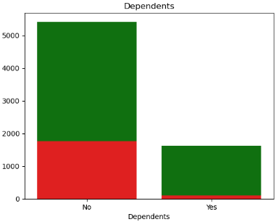
Data Analysis – Indirect Insights
Demography
Customers with partners or dependents have low churn rate than those without
This suggest that customer churn might be influenced by the presence of partners or dependents.

Slide 11
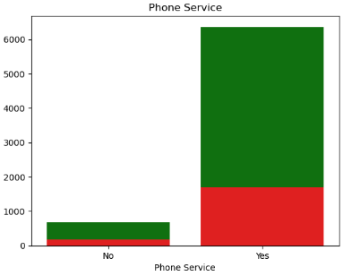
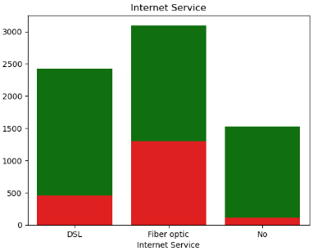
Data Analysis – Indirect Insights
Customer Service
Almost all customers use phone services
Fiber Optic users outnumber DSL users by approximately 27%. However, the churn rate among Fiber Optic users is also higher, with a significant difference compared to DSL users.
This suggests that the choice of internet service might influence customer churn.

Slide 12
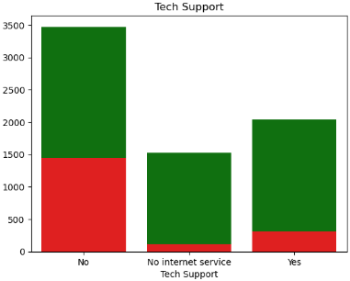
Data Analysis – Indirect Insights
Customer Service
Among those that have access to tech support, those that do not use it have a much higher churn rate compared to those that use it.
This suggests that the use of tech support may significantly contribute to customer retention.

Slide 13
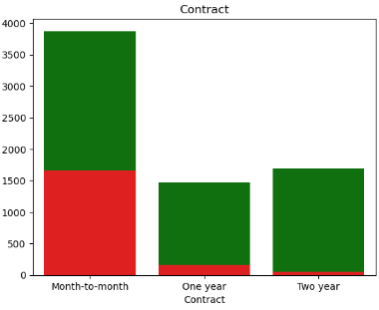
Data Analysis – Indirect Insights
Customer Service
Customers with long-term contracts have very little churn compared to customers with the month-to-month contract.
Due to stronger commitment associated with long-term contracts, contract type plays a significant role in customer retention.

Slide 14
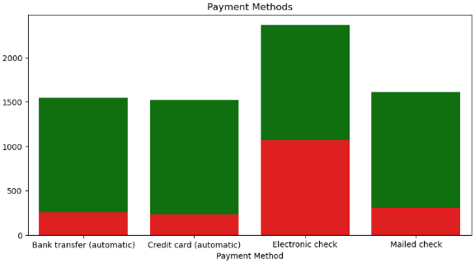
Data Analysis – Indirect Insights
Billing Details
About 33% of customers use electronic checks, and exhibit the highest rate of churn.
This suggests that the choice of payment might influence the churn among customers.

Slide 15
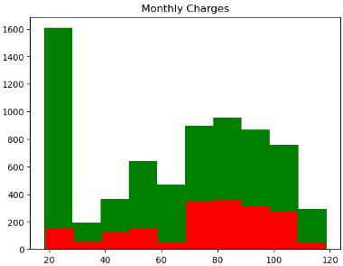
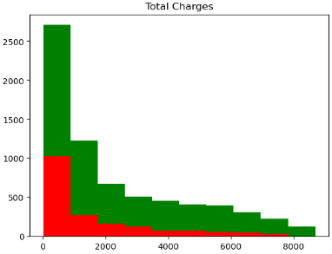
Data Analysis – Indirect Insights
Billing Details
The charts show the distribution of customers monthly and total charges, as well as the customer churn.
Due to the similar distributions, the monthly and total charges may not have a significant impact on customer churn.

Slide 16
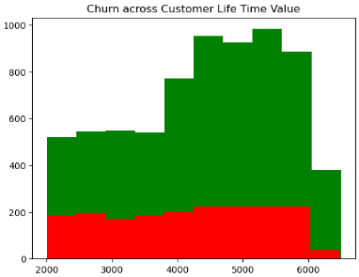
Financial Impact – Customer Lifetime Value (CLTV)
There are more high-value customers than low-value customers.
Churn rate does not vary much across the CLTV segments.

Slide 17
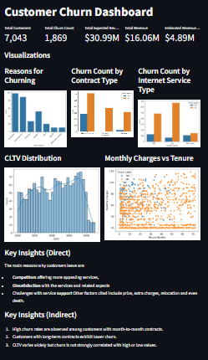
Financial Impact – Customer Lifetime Value (CLTV)
Estimated Loss
The company expects to generate over $30m in revenue from all the customers.
There are a total of 1,869 churned customers with an average remaining value of $2,617.
This results in a loss of almost $5m revenue for the company.

Slide 18
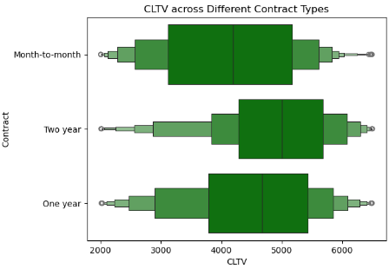
Financial Impact – Customer Lifetime Value (CLTV)
Cross Analysis – Contract
There is a preference for long-term contracts among high-value customers.

Slide 19
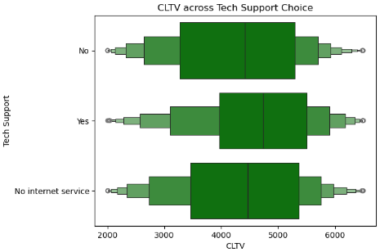
Financial Impact – Customer Lifetime Value (CLTV)
Cross Analysis – Tech Support
There is a slight preference for tech support usage among high-value customers.

Slide 20
Key Insights
1. Customer Characteristics and Churn:
Senior citizens, customers without dependents, and those with month-to-month contracts have significantly higher churn rates.
Long-term contracts and having tech support are associated with lower churn rates.
2. Churn by Payment Method:
Customers using electronic checks exhibit the highest churn (~50%), likely due to the prevalence of month-to-month contracts among them.
3. Churn by Tenure:
Churn is highest among customers with shorter tenures, decreasing as tenure increases.

Slide 21
Key Insights
4. Revenue Impact:
Churned customers had an average unrecovered value of $2,617.62, leading to a $4.89 million revenue loss.
While churn rates are comparable across CLTV segments, the total number of churned high-value customers is higher due to their larger base.
5. Service Preferences and Churn:
Customers with fiber optic internet have higher churn rates than DSL users or those without internet service.
Streaming services (TV or movies) have minimal impact on churn.
6. Satisfaction and Support:
Dissatisfaction with service, lack of support, and competitor offerings are the primary reasons for churn.

Slide 22
Conclusion and Recommendation
Conclusions
High churn among short-tenure, senior citizens, and electronic check users highlights vulnerabilities in customer retention strategies.
The CLTV analysis underscores the revenue impact of churn, emphasizing the importance of retaining high-value customers.
Long-term contracts and tech support services are key retention levers, with a noticeable influence on reducing churn rates.
Customer Demography has little to no impact on customer churn

Slide 23
Conclusion and Recommendation
Recommendations
1. Enhance Retention for High-Churn Groups:
Develop targeted retention campaigns for short-tenure customers, such as personalized offers and loyalty programs.
2. Promote Long-Term Contracts:
Incentivize customers to opt for longer contracts by offering discounts, better deals, or value-added services.
3. Optimize Support Services:
Improve tech support availability and quality to address dissatisfaction and increase retention.

Slide 24
Conclusion and Recommendation
Recommendations
4. Address Issues for Electronic Check Users:
Identify pain points specific to electronic check users (e.g., contract terms) and offer tailored solutions.
5. Focus on Competitor Analysis:
Benchmark services and pricing against competitors to address customer concerns about better offerings elsewhere.
6. Monitor High-Value Customers:
Implement proactive retention strategies for high-value customers, such as priority support and exclusive benefits, to minimize revenue loss.

Slide 25
Thank you

