Slide 1

Adejare Tobi Fasiku
6/14/25
A Comparative Analysis of Machine Learning and Deep Learning Tools and Frameworks: TensorFlow vs PyTorch

Slide 2
Introduction
Deep learning frameworks are essential tools for building AI applications.
TensorFlow and PyTorch are the two dominant frameworks to build, train, and deploy neural networks.
This analysis examines their backgrounds, features, applications, and comparative advantages.
Framework choice significantly impacts flexibility, development speed and model performance.

Slide 3
TensorFlow: Background and Development
Origin: Written in C++ with Python APIs Developed by Google Brain team in 2015
Purpose: Originally designed for large-scale machine learning and production deployment
Current Status: Mature framework with extensive ecosystem and enterprise adoption
Philosophy: Designed for portability — from research to scalable production

Slide 4
PyTorch: Background and Development
Origin: Written in C++ with Python APIs; developed by Facebook’s AI Research lab (FAIR) and released in 2016
Purpose: Originally designed for large-scale machine learning and production deployment
Current Status: Widely adopted mature framework with extensive ecosystem and enterprise adoption
Philosophy: "Pythonic and dynamic" — prioritize intuitive development and fast experimentation

Slide 5
PyTorch: Background and Development
• Origin: Developed by Facebook (Meta) AI Research in 2016, based on Torch library
• Purpose: Created for research flexibility and rapid prototyping
• Evolution: Built with Python-first approach and dynamic computation graphs
• Current Status: Dominates academic research with 70% adoption in AI research papers
• Philosophy: "Research-first" framework prioritizing ease of use and experimentation

Slide 6
TensorFlow: Distinguishing Features & Advantages
• Production Ready: TensorFlow Serving, TensorFlow Lite for mobile deployment
• Scalability: Distributed training across multiple GPUs and TPUs
• Ecosystem: TensorBoard visualization, TFX(TensorFlow Extended) for ML pipelines
• Performance: Optimized for large scale models and enterprise environments
• Cross-Platform: Supports web and mobile devices
• Static Graphs: Optimized execution with graph compilation

Slide 7
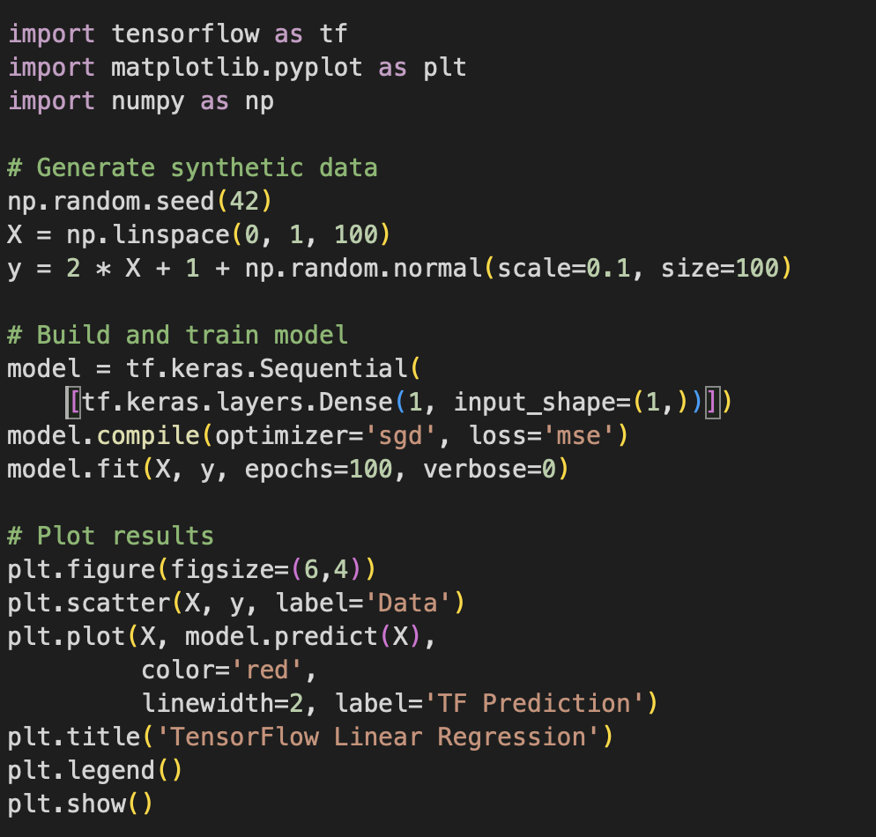
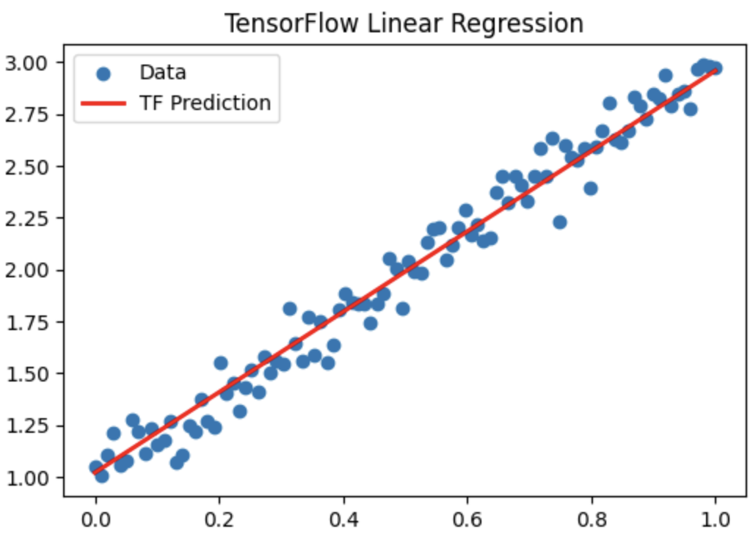
TensorFlow: Linear Regression Implementation

Slide 8
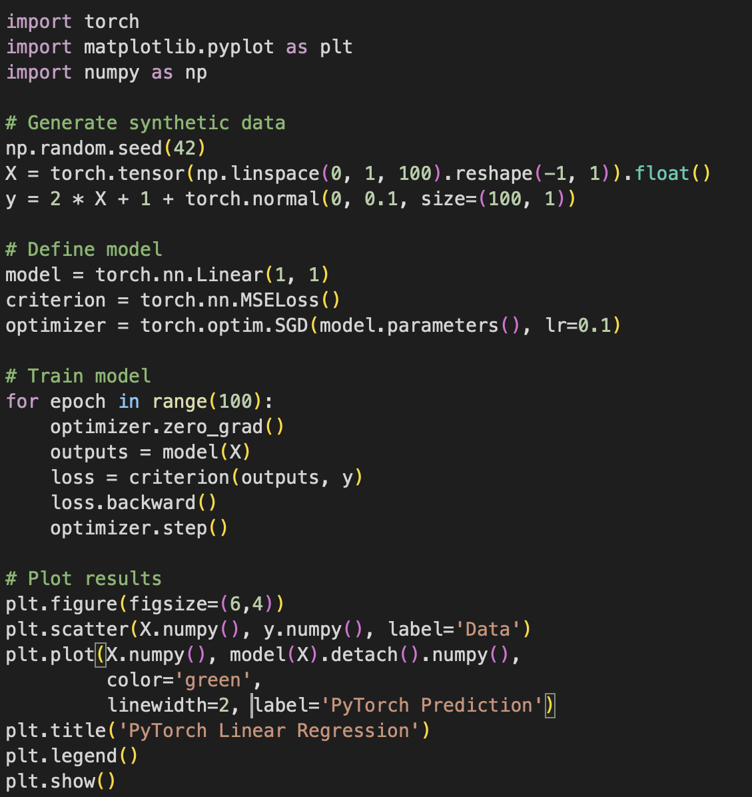
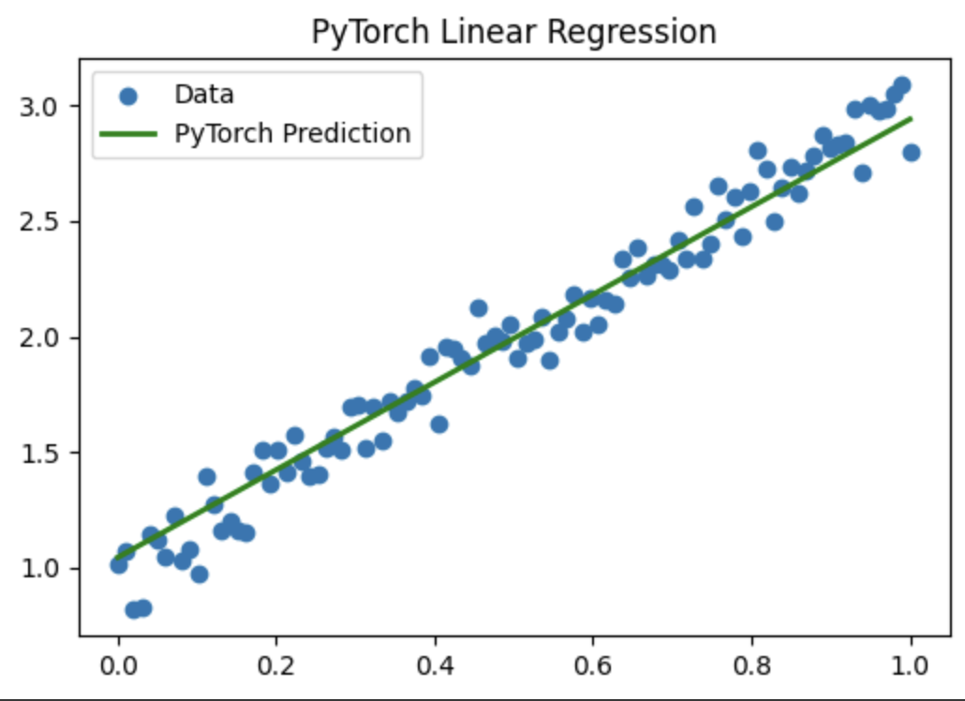
PyTorch: Linear Regression Implementation

Slide 9
PyTorch: Distinguishing Features & Advantages
• Dynamic Graphs: Real-time graph construction enabling flexible model architectures
• Pythonic Design: Intuitive syntax closely resembling standard Python
• Research-Friendly: Easy debugging with standard Python tools (pdb, ipdb)
• GPU Acceleration: Seamless CPU-GPU transfer with simple commands
• Community: Strong academic support with extensive research contributions
• PyTorch Lightning: Simplified training loops and standardized workflows

Slide 10
TensorFlow in Action: Real-World Success Stories
• Google Products: Powers Search, Gmail, and Google Translate
• Healthcare: Stanford-Google collaboration for diabetic retinopathy detection
• Telecommunications: China Mobile's network anomaly detection system
• Automotive: Toyota's crash prediction and autonomous driving systems
• E-commerce: Airbnb's image classification for improved guest experience
• Finance: PayPal's fraud detection with deep transfer learning

Slide 11
PyTorch in Action: Real-World Success Stories
• Social Media: Meta's content moderation and recommendation systems
• Gaming: Intel's generative AI solutions for gaming experiences
• Education: Duolingo's personalized language learning algorithms
• Agriculture: AI-powered pest detection for cotton farmers
• Geospatial: NASA-IBM collaboration for Earth observation data analysis
• Retail: Walmart's search relevance using BERT models with TorchServe

Slide 12
Usability Comparison: Developer Experience
TensorFlow:
• Steeper learning curve but more features
• Requires specialized debugging tools
• More verbose syntax
• High and low-level APIs available
• Comprehensive production documentation
PyTorch:
• Easier for beginners to learn
• Superior Python-native debugging
• More intuitive and Pythonic code
• Low-level control emphasis
• Excellent research-focused docs

Slide 13
Performance & Scalability: Technical Comparison
TensorFlow:
• Optimized for large-scale training
• Production-ready deployment tools
• Superior enterprise-level scaling
• Broader platform support
• Static graph optimization
PyTorch:
• Similar GPU performance
• More memory efficient for research
• Improving distributed training
• Strong GPU acceleration
• Dynamic graph flexibility

Slide 14
Community Support & Ecosystem Comparison
TensorFlow:
• Strong industry adoption
• Google corporate backing
• Mature ecosystem and tools
• Preferred for production systems
• Extensive enterprise support
PyTorch:
• Dominates academic research (70%)
• Meta corporate backing
• Rapidly expanding ecosystem
• Growing enterprise adoption
• Strong research community

Slide 15
Decision Framework: Choosing the Right Tool
Choose TensorFlow for:
• Production deployment
• Large-scale systems
• Mobile/web applications
• Enterprise environments
• Cross-platform deployment
Consider Both:
• Many organizations use PyTorch for research and TensorFlow for production
Choose PyTorch for:
• Research projects
• Rapid prototyping
• Academic work
• Custom model architectures
• Experimental development
Future Trends:
• Convergence in capabilities
• Learn both for maximum flexibility

Slide 16
Conclusion: The Future of Deep Learning Frameworks
• Main Finding: Both frameworks excel in their intended domains – research(PyTorch) vs production(TensorFlow)
• Key Insight: Choice depends on project requirements, team expertise, and deployment needs
• Industry Trend: PyTorch gaining production capabilities; TensorFlow improving research experience
• Best Practice: Use PyTorch for experimentation, TensorFlow for deployment
• Future Outlook: Continued innovation and convergence while maintaining distinct advantages

Slide 17
Thank You!

