Slide 1
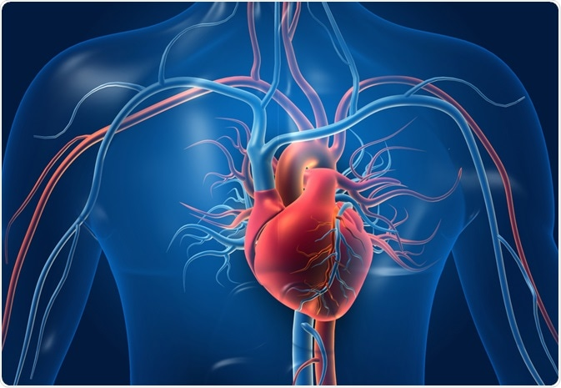
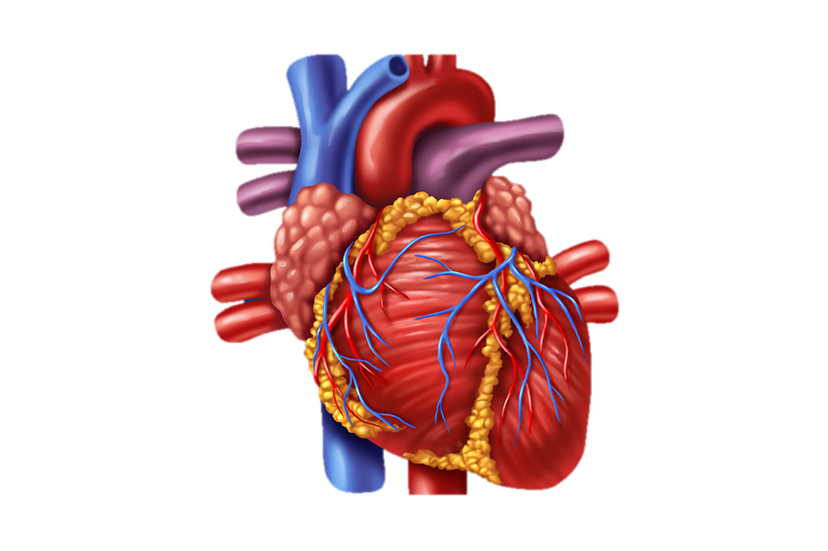

Predicting Heart Attacks
Prepared by: Adejumoke Adedokun.

Slide 2

Visualizations
In this section we would try to answer some of the questions the Hospital has about the data .

Slide 3
Variable Information
Cp
Chest pain
Cp
Chest pain
Cp
Chest pain
01
chest pain type where (1 = typical angina; 2 = atypical angina; 3 = non-anginal pain; 0 = asymptomatic)
05
chest pain type where (1 = typical angina; 2 = atypical angina; 3 = non-anginal pain; 0 = asymptomatic)
09
chest pain type where (1 = typical angina; 2 = atypical angina; 3 = non-anginal pain; 0 = asymptomatic)
Trtbps –
Resting blood pressure
Trtbps –
Resting blood pressure
Trtbps –
Resting blood pressure
02
06
10
resting blood pressure (in mm Hg on admission to the hospital)
resting blood pressure (in mm Hg on admission to the hospital)
resting blood pressure (in mm Hg on admission to the hospital)
Restecg-electrocardiographic results
Restecg-electrocardiographic results
Restecg-electrocardiographic results
03
07
11
resting electrocardiographic results 0 = normal; 1 = hypertrophy; 2 = having ST-T wave abnormality)
resting electrocardiographic results 0 = normal; 1 = hypertrophy; 2 = having ST-T wave abnormality)
resting electrocardiographic results 0 = normal; 1 = hypertrophy; 2 = having ST-T wave abnormality)
Restecg-electrocardiographic results
Restecg-electrocardiographic results
Restecg-electrocardiographic results
04
08
12
resting electrocardiographic results 0 = normal; 1 = hypertrophy; 2 = having ST-T wave abnormality)
resting electrocardiographic results 0 = normal; 1 = hypertrophy; 2 = having ST-T wave abnormality)
resting electrocardiographic results 0 = normal; 1 = hypertrophy; 2 = having ST-T wave abnormality)
Notes:
© Copyright PresentationGO.com – The free PowerPoint and Google Slides template library

Slide 4
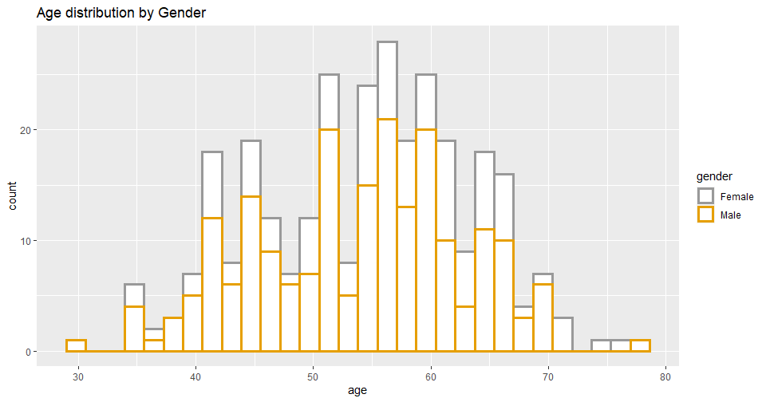
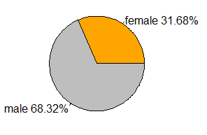
Age Distribution by Gender
The Hospital would like to the Gender and Age distribution of the Patients ?
The dataset contains an older population of patients with the average age of patients around 54 years of age.
The distribution is a normal distribution with the male population ranking higher than the female population with 68% to 32% approximately.

Slide 5
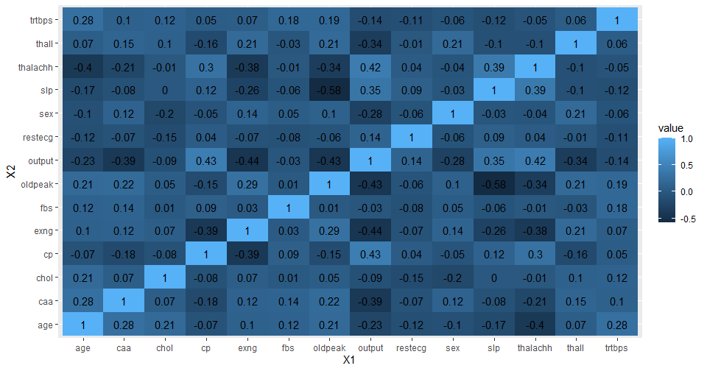
Correlation Heatmap
The Hospital would like to know the relationship between patients' information?
From the correlation Heatmap plot, we can see that oldpeak(ST depression induced by exercise relative to rest) and slp(the slope of the peak exercise ST segment) have the strongest correlation of -0.6 which depicts a negative relationship.
The patient’s data has a low negative relationship prevalent in the data.

Slide 6
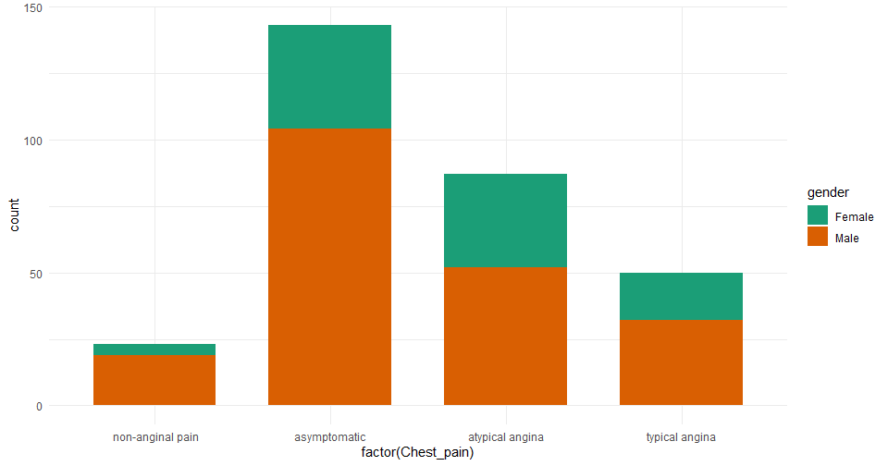
Chest pain by Gender
What gender has the highest or lowest type of Chest pain ?
The graph shows the bar plot of the Cp variable(Chest pain) and the gender of the patients. We can see that the male patients have the highest asymptomatic chest pain type while Females have the lowest non-anginal pain.
Patients with non-anginal chest pain type are lowest within the distribution.

Slide 7
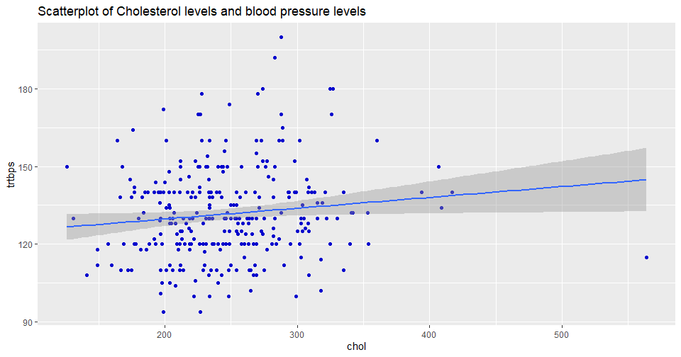
Scatterplot of Cholesterol levels and blood pressure
Is there a strong relationship between Cholesterol levels and blood pressure levels?
From the scatter plot diagram, we can see that a weak strong relationship exists between The Cholesterol level and the blood pressure levels. This shows that as Blood pressure rises the cholesterol levels would also increase.

Slide 8
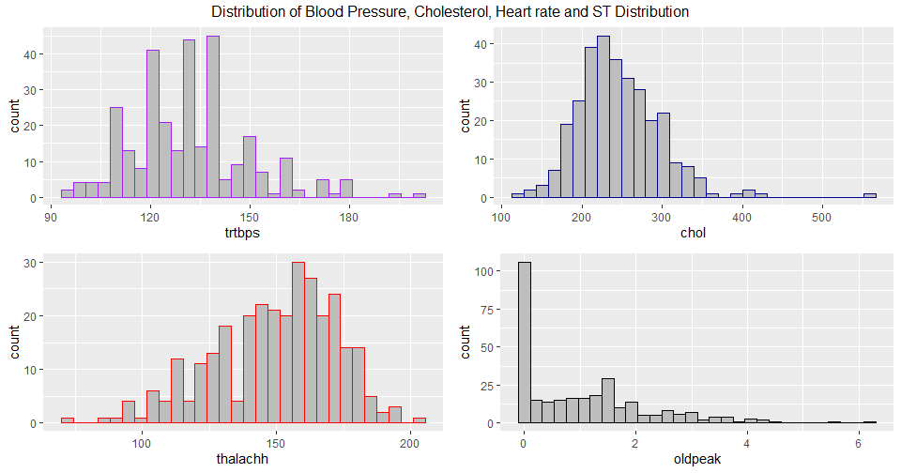
Distribution of Patient Data
What type of distribution does the patients data exhibit?
From the histogram charts, we see that the old peak and chol distributions are and has a slightly normal shaperight-skewed. The thalachh variable is left-skewed and unimodal.
The trtbps is right- skewed and has a bimodal distribution.

Slide 9
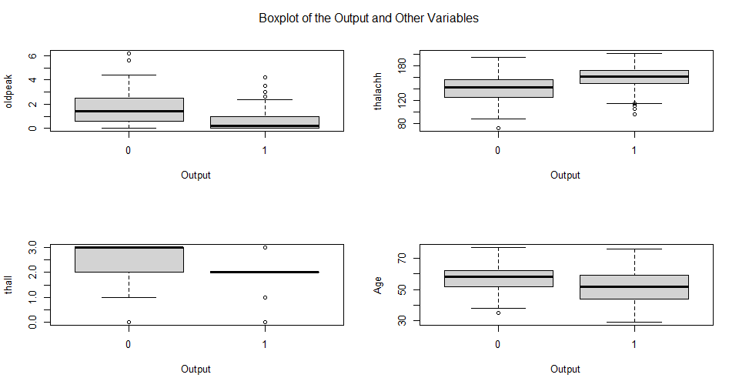
Boxplot of the Distributions by Output
What does the distribution say about the patients who have a high chance of getting a heart attack and does who don’t ?
Oldpeak- This shows that there are more patients who don’t have a chance of getting a heart attack. The maximum value is about 4.5 while for patients with a heart attack have lesser oldpeak values.
For the thalachh variable it shows that patients with heart attacks had a higher maximum heart rate.
The thall variable shows that patients with a low chance for heart attacks are higher than those who at a higher risk.
Age distribution shows that there is a similarity between patients with age of non risk patients being more than the patients who are at higher risk of a heart attack.

Slide 10
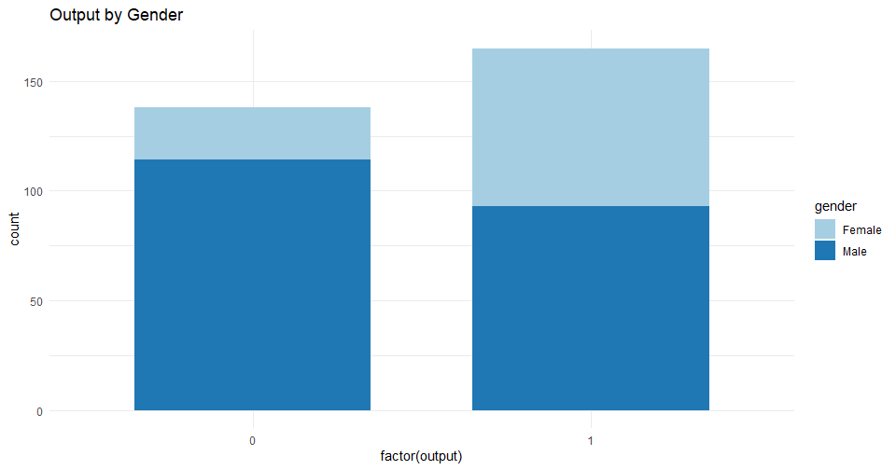
Output Variable by Gender
What is the share of patients who have a high risk of getting a heart attack and patients who don’t and their gender?
From the barplot, we can see that male patients who don’t have a chance of getting a heart attack are more than their female counterparts. Also, there is a little difference between male and females who are at a high risk of getting a heart attack.

Slide 11
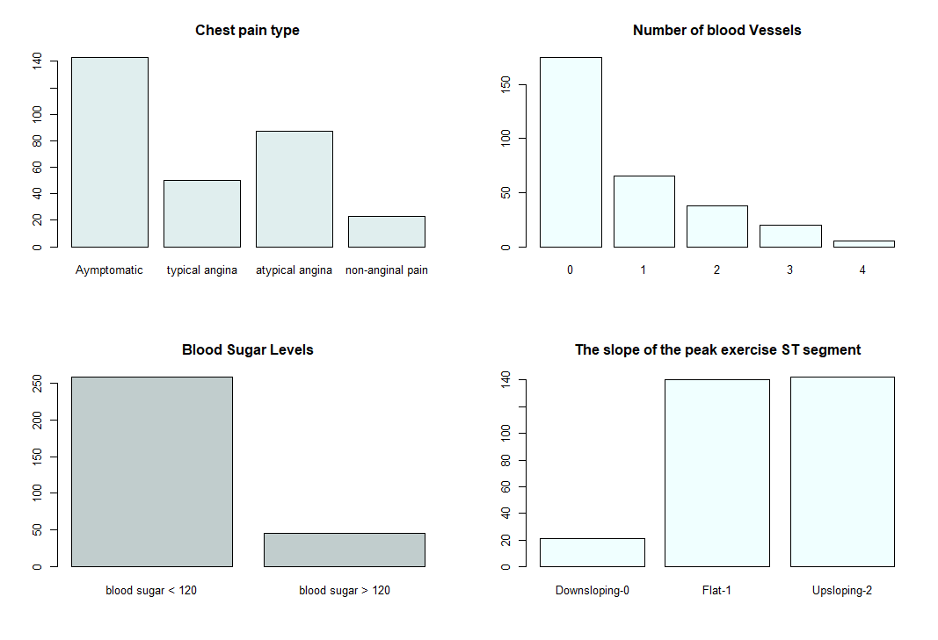
Barplots of the Categorical Variables
What are the patients’ distribution in the dataset?
The dataset shows that most of the patients have asymptomatic chest pain types while very few patients have non-anginal pains. Most of the patients have no blocked vessels while very few had more blocked blood vessels.
More patients have blood sugar levels lesser than 120 while very few patients have blood sugar levels above 120.
Most patients have Flat or upsloping slope of the peak exercise while very few had a downsloping result.

Slide 12
Summary
The dataset depicts a very interesting outlook of the patients, We can see that the relationship between the datasets are mostly negative and are very weak.
The data also depicts that there are more males than females in the sample patient's dataset and more males from the data had a higher chance of getting a heart attack.
The age range of the patients showed that of an older population with the median age around 55 years.
Most of the patients have asymptomatic chest pain type and have a normal blood pressure levels. It also shows that some patients will minimal symptoms are still at risk of getting a heart attack.

Slide 13
Prepared by: Adejumoke Adedokun.

