Slide 1
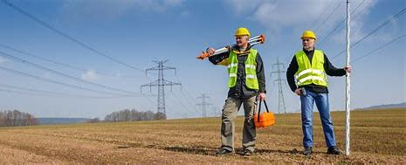

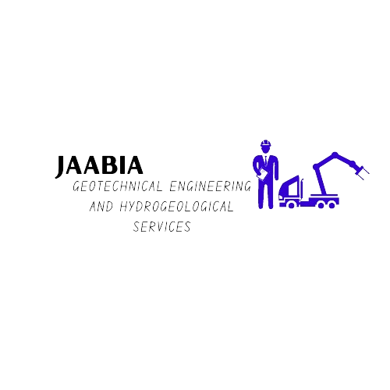

JAABIA GEOTECHNICAL
Engineering and Hydrogeological Services
Your Trusted Engineering Experts.
Provider of innovative and reliable geotechnical and hydrological solutions through advanced technology and expertise in Geotechnical Engineering, Hydrogeology, and Groundwater Geophysics.
WHAT WE DO
Geotechnical Engineering Consultancy
Hydrogeological Consultancy
Groundwater Geophysical Surveys
Borehole Drilling
Pump Installation and Maintenance
Borehole Maintenance
Water Treatment

