Slide 1

Agricultural Data Gathering and Analyzing Company.

Slide 2

Hello!
I am Ajikobi Emmanuel
I am here to tell you what we do at FOODDATA.
You can find me on LinkedIn @Ajikobi .O. Emmanuel

Slide 3
Investments in agriculture are the best weapons against hunger and poverty, and they have made life better for billions of people. But without DATA how can we know where and when and what to invest in.

Slide 4
What is the Problem?
Lack of Reliable Food Database
Scale of production
Uneven distribution of food
Food insecurity
Import and export Policies

Slide 5
Hack The Data
🔨

Slide 6
How? You might ask.
Through Extension Agents.
And an Online Data Bank.

Slide 7
Benefits
Decision And Policy Making
Boosts Investors And Patnership Confidence
Identify Number Of Subsistence and Commercial Farmers
Drives competitive Advantage
Eliminates Gluts And Scarcity

Slide 8
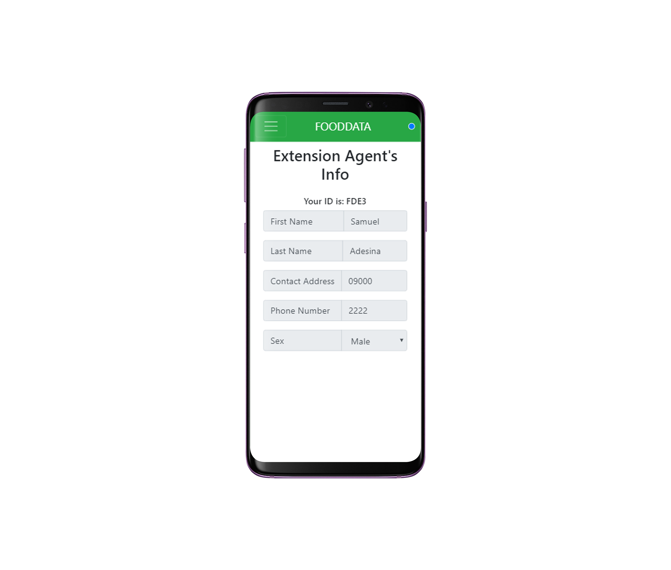
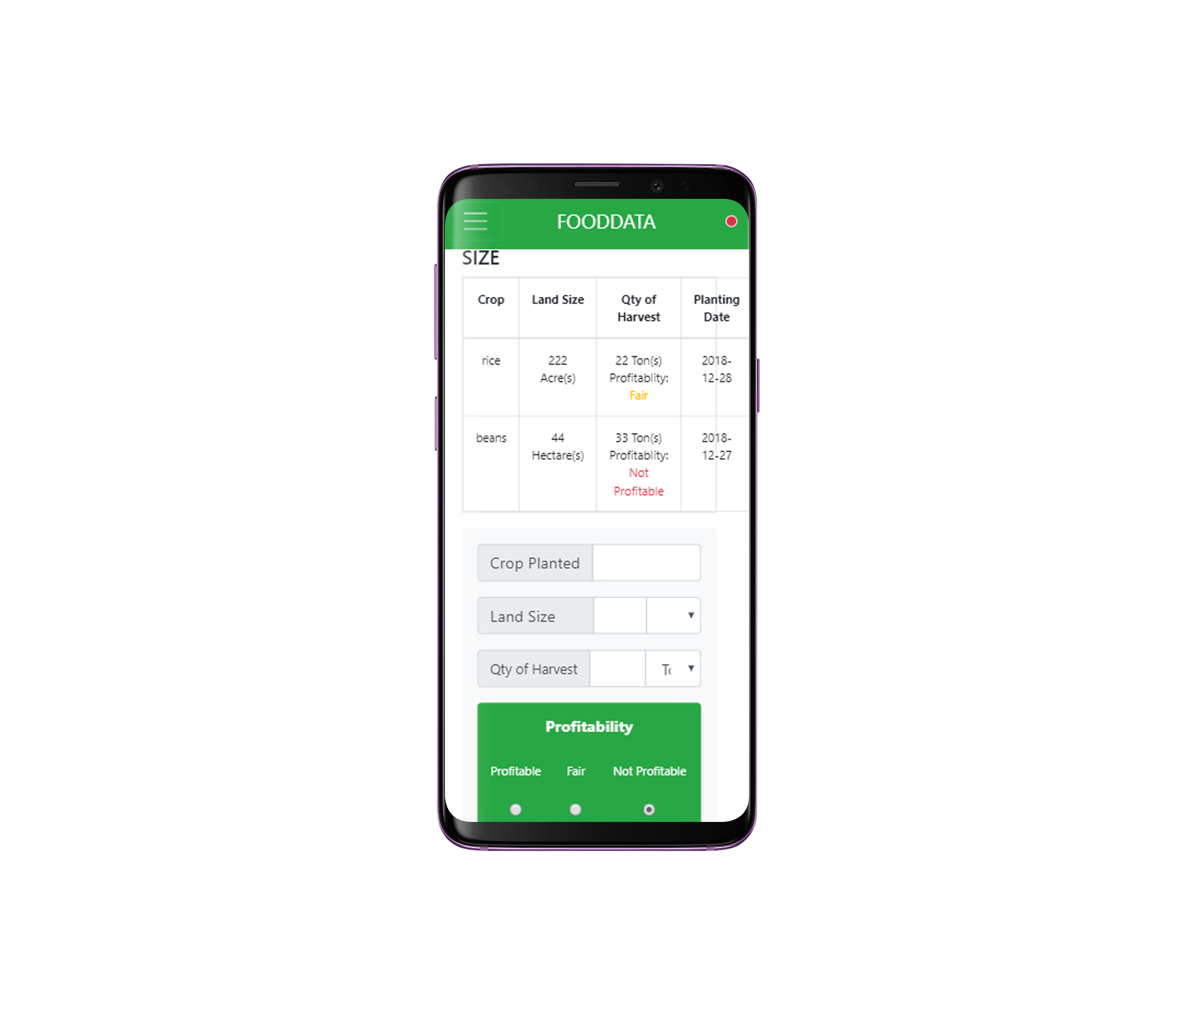
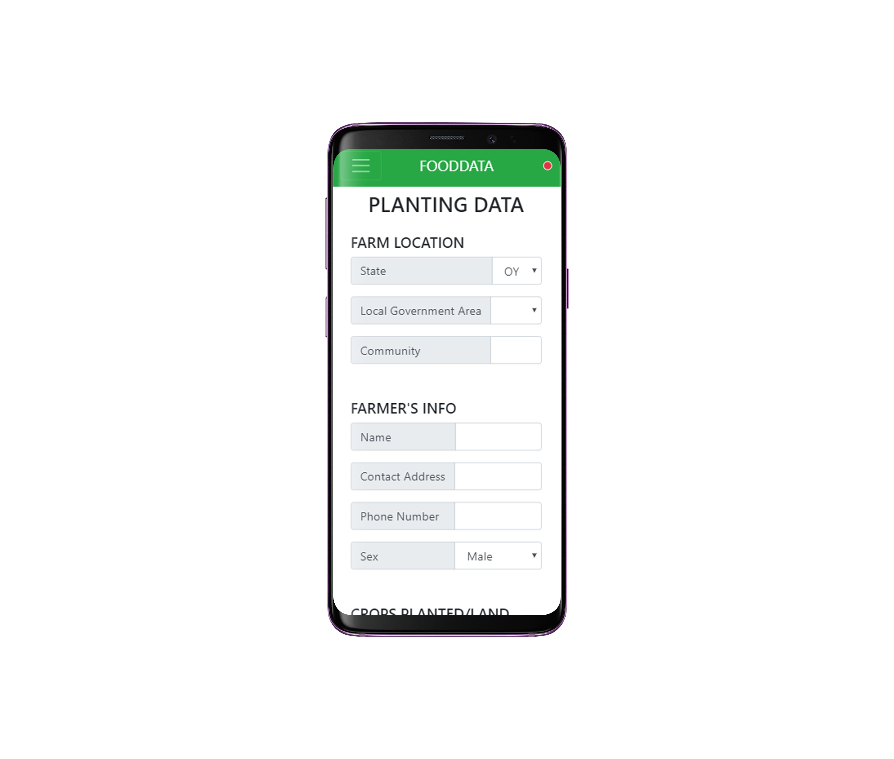
Mobile APP project
Place your screenshot here

Slide 9
Thanks!
Any questions?

