Slide 1

Sushi.com
Project Name:

Slide 2
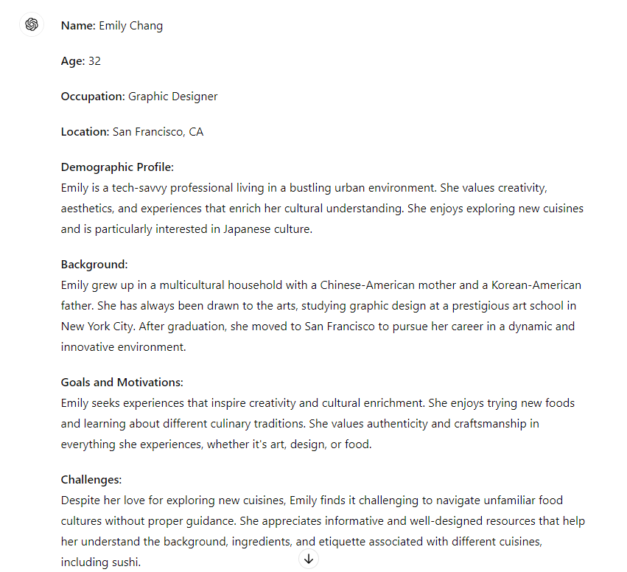
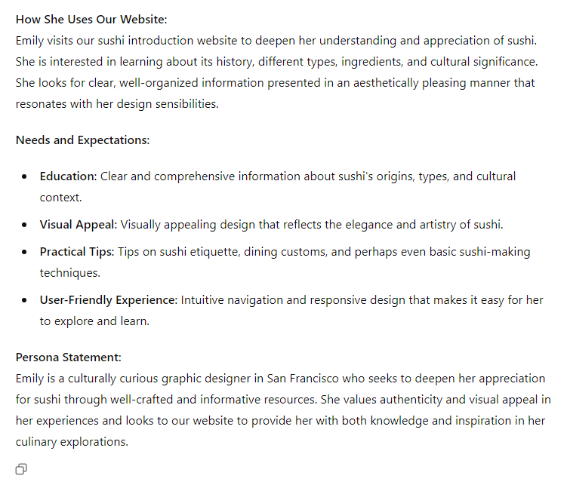
1-Persona:

Slide 3
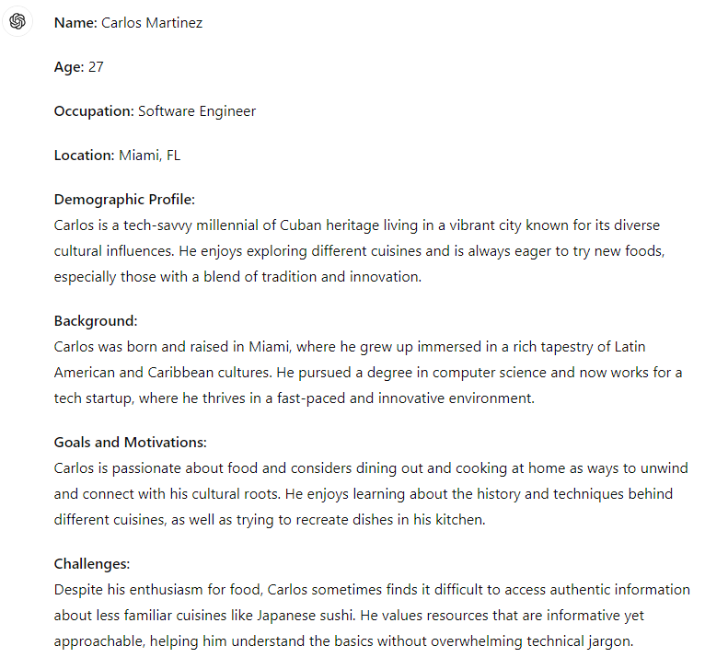
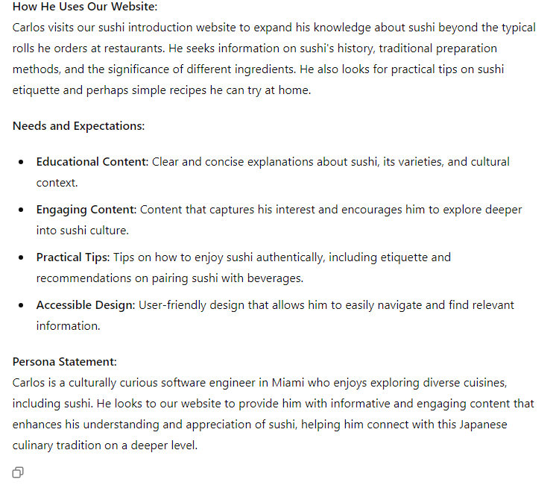
1-Persona:

Slide 4
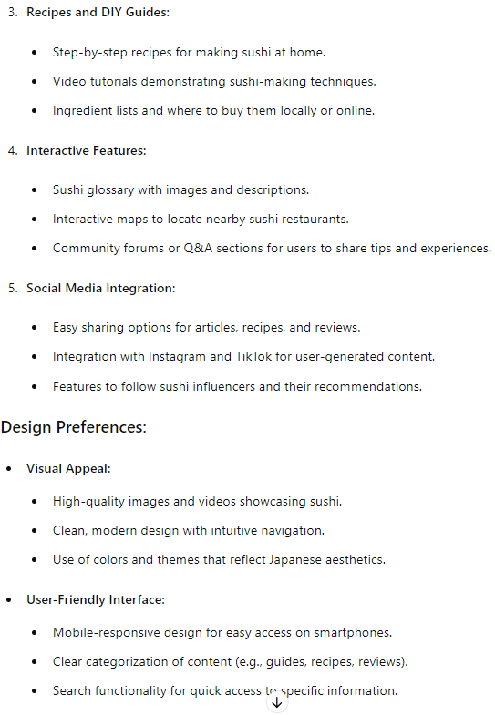
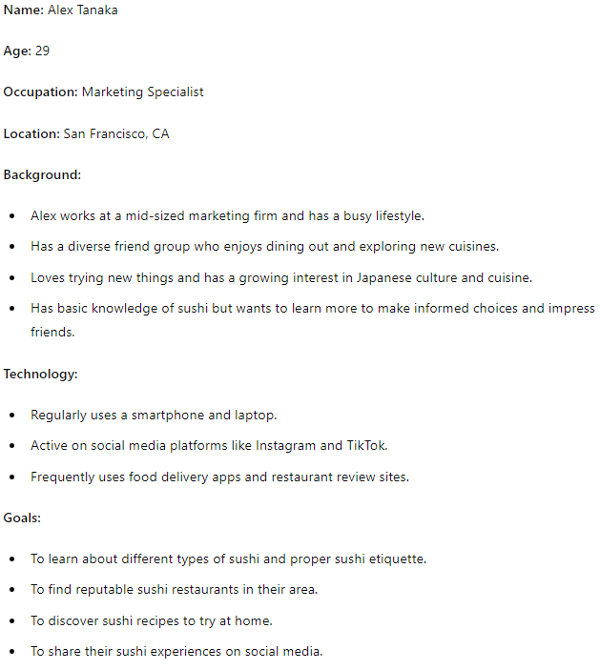
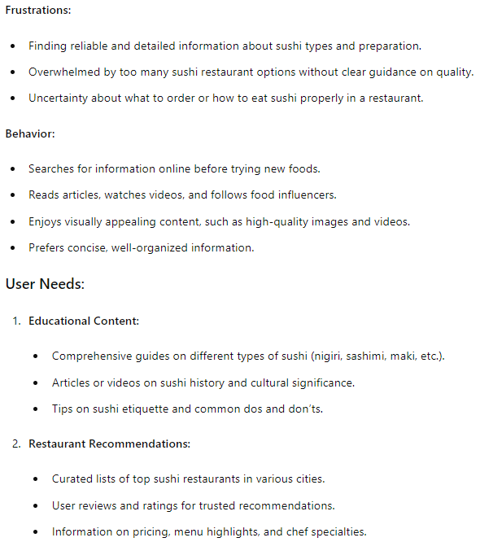
1-Persona:

Slide 5
1-Persona:
Name: Sarah Lee
Age: 26
Occupation: Graphic Designer
Location: New York, NY
Background:
Sarah works at a design agency and values creativity and aesthetics.
Has a passion for food and enjoys trying different cuisines, especially Japanese.
Knows the basics about sushi but wants to expand her knowledge and experiences.
Technology:
Frequently uses her smartphone for browsing and social media.
Prefers visually appealing and well-organized websites.
Regularly watches food-related videos on YouTube.
Goals:
To learn more about different types of sushi and their flavors.
To find new sushi restaurants to visit with friends.
To discover easy sushi recipes to make at home.
Frustrations:
Difficulty finding detailed yet concise information about sushi.
Uncertainty about which sushi restaurants are worth visiting.
Confusion about sushi terms and ingredients.
User Needs:
Educational Content:
Simple guides on different types of sushi and their ingredients.
Basic etiquette tips for eating sushi.
Restaurant Recommendations:
Lists of top sushi spots in her city.
Honest reviews and ratings from other users.
Recipes and DIY Guides:
Easy-to-follow sushi recipes.
Video tutorials for making sushi at home.
Interactive Features:
Glossary of sushi terms with images.
Maps to locate nearby sushi restaurants.
Social Media Integration:
Easy sharing of content on Instagram.
Follow sushi influencers and chefs for recommendations.
Design Preferences:
Visual Appeal:
High-quality images of sushi.
Clean, modern design with intuitive navigation.
User-Friendly Interface:
Mobile-friendly design.
Clear categorization of content (guides, recipes, reviews).
Search functionality for quick access to information.

Slide 6

2-User Story:
The problem is that I had to jump from one website to another to search about different information about the same subject: sushi.
As a food enthusiasms,
I love searching about different kind of food.
But recently,
I was having a hard time searching about sushi.
Until someone shared a website in the food enthusiasms chat group that had all the information, named: Sushi.com

Slide 7
1-Persona:

