Slide 1
Public Key Algorithms
Tutorial 6

Slide 2
RSA

Slide 3
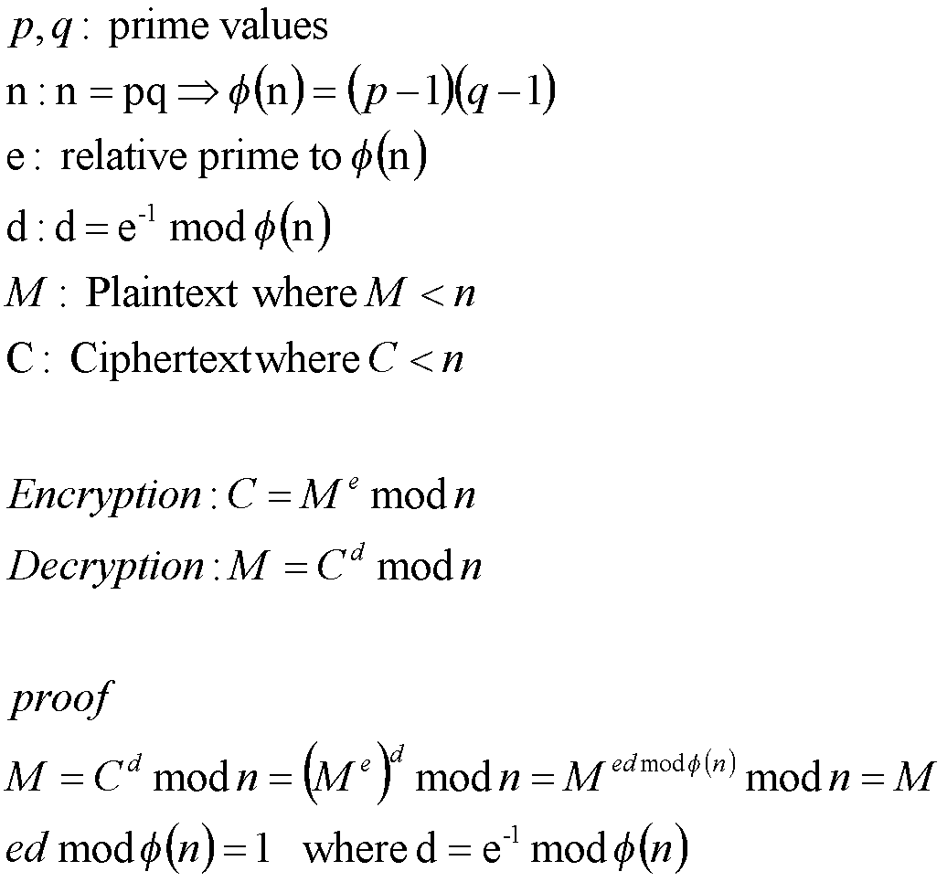
RSA

Slide 4
RSA
In RSA
{e, n} called the Public Key which is not secrete
{d, n} called the Private Key which is secrete
Public and Private keys called “Key Pairs”
Example
Alice and Bob has their own key pairs
Alice public key {e_{a},n_{a}}, Alice private key {d_{a},n_{a}}
Bob public key {e_{b},n_{b}}, Bob private key {d_{b},n_{b}}
Alice and Bob must not give the private key to any one
Alice and Bob can exchange their public keys with any one

Slide 5
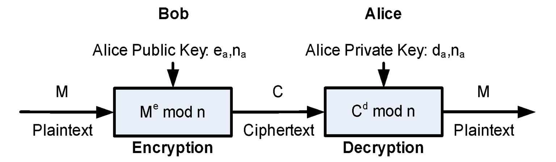
RSA Data Security “Confidentiality”

Slide 6
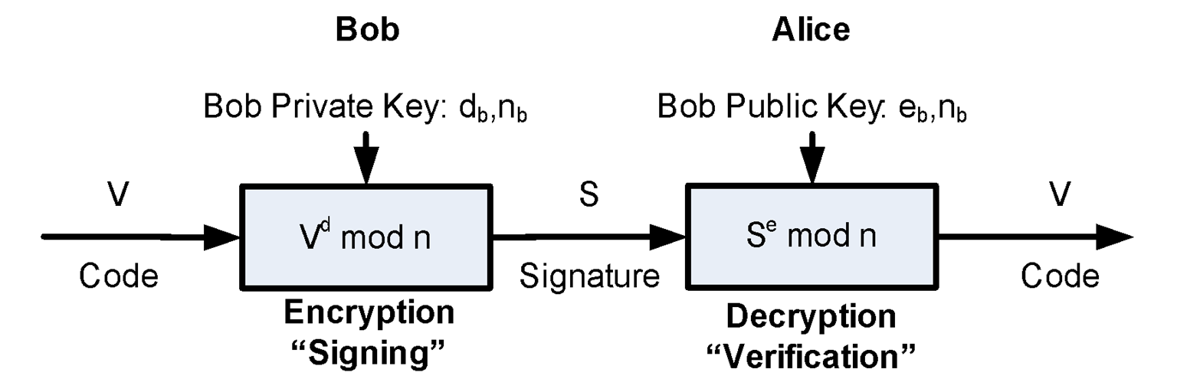
RSA Authentication

Slide 7
RSA
Given e, n it is difficult to get d
Consider n is very large 512..1024..8192 Bit
d=e⁻¹ mod ϕ(n)
ϕ(n) is unknown, to caclulate ϕ(n)
Get the number of all relative prime to n (Difficult)
Factorizing n to p, q ➔ ϕ(n)=(p-1)(q-1) (Difficult)
Try all values of d using brute force attack (Difficult)

Slide 8
RSA Example
Key Generation
User Miller Rabin to Generate Two Primes {p, q}
Given p = 17, q = 11 {Small Primes for Illustration}
Key Preparation
– n = pq = 17x11 = 187
– ϕ(n)=(p-1)(q-1) = 160
Select e where GCD(e, ϕ(n)) = 1 and < ϕ(n) ➔ e = 7
Small values of e is recommended, Why?
d = e⁻¹ mod ϕ(n), using extended euclidean ➔ d = 23
Practically d must be very large, Why?
Public Key {e,n} = {7,187}
Private Key {d,n} = {23,187}

Slide 9
RSA Example
Assume the Data Block M = 88
Encryption using Public Key {7, 187}
– C = Me mod n = (88)⁷ mod 187
– C = ((88)²)² x (88)² x (88) mod 187 = (132 x 77 x 88) mod 187
– C = 11
Decryption using Private Key {23, 187}
– M = C^{d} mod n = (11)²³ mod 187
– M = ((((11)²)²)²)² x ((11)²)² x (11)² x (11) mod 187
– M = (33 x 33 x 55 x 121 x 11) mod 187
– M = 88

Slide 10
Computation Aspects

Slide 11
Computation Aspects
Exponentiation
Efficient Operations Using Public Key
Efficient Operations Using Private Key
Key Generation

Slide 12
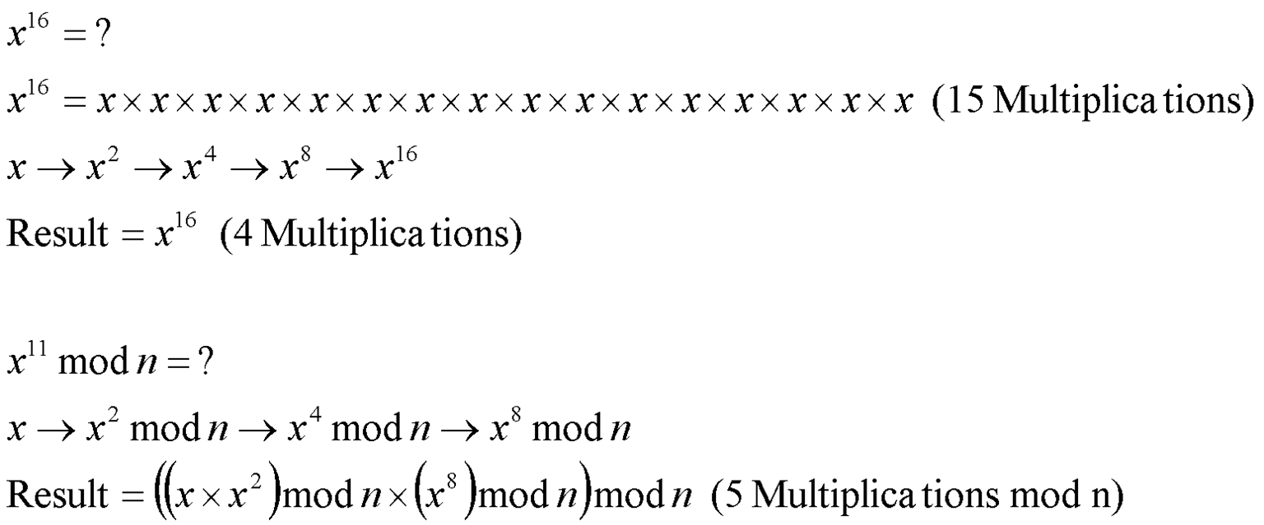
Exponentiation
General Optimization

Slide 13
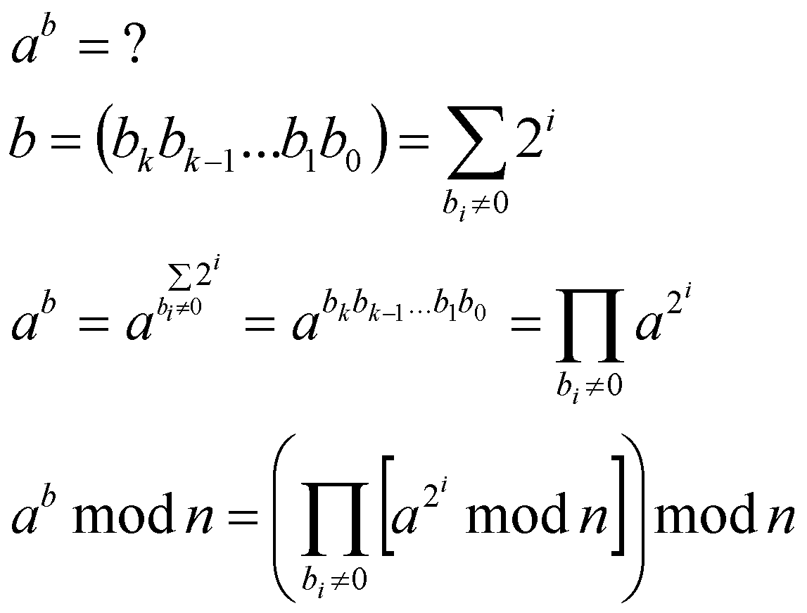
Exponentiation
Binary Optimization

Slide 14
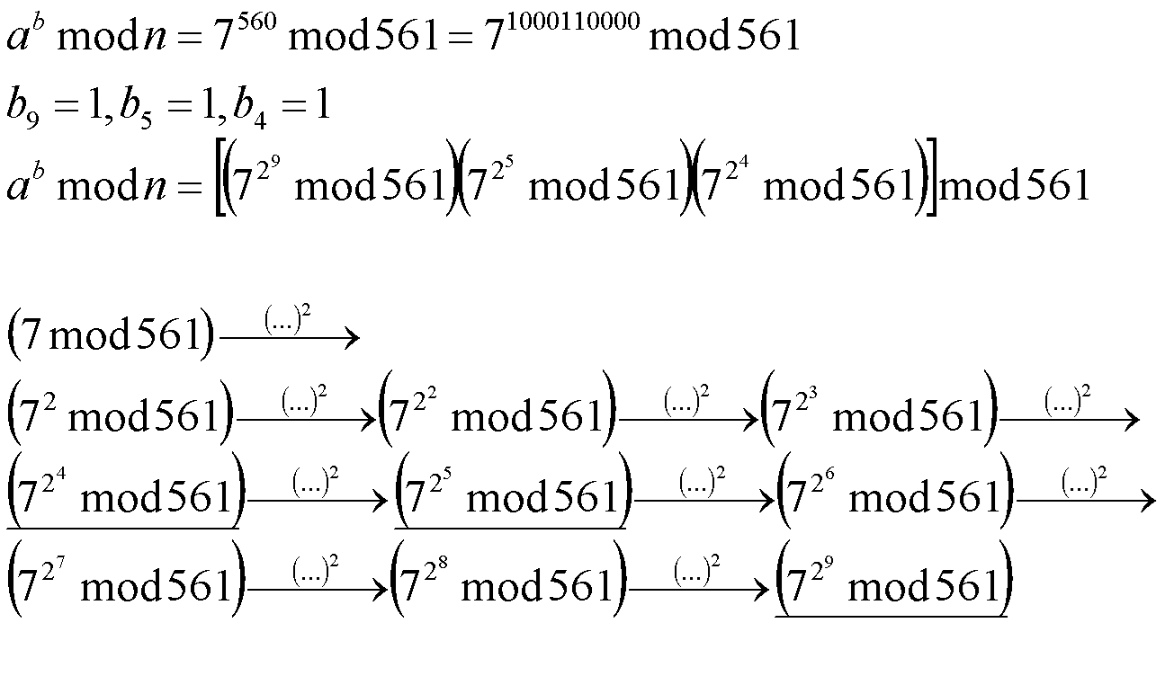
Exponentiation

Slide 15
Key Generation
Generate p, q as follows
Pick an odd integer n at random
Perform Miller Rabin test
If it return “composite” goto1
If it return “inclusive” repeat 2 several times to increase the trust
If GCD(ϕ(n), e)!=1 repeat A

Slide 16
RSA Security

Slide 17
RSA Security
Brute Force Attack
Mathematical Attack
Calculation of ϕ(n)
Factoring of n to p and q
Timing Attack
Chosen Cipher Text Attack

Slide 18
Brute Force Attack
d is very large 512,..,2048,..,8192
Brute Force is Infeasible

Slide 19
Calculation of ϕ(n) Attack
n is very large 512,..,2048,..,8192
Calculation is Infeasible Because
Huge number of tests ➔ infeasible time
Primality test failure ➔ wrong calculations
Example
If Miller Rabin with 10 trials is used
The false result probability is (9.5x10⁻⁷)
With huge number of test the false result will affect the final value

Slide 20
Factoring of n to p and q
Several algorithms can be used
Quadratic Sieve (1991)
Generalized Number Field Sieve (1996)
Lattice Sieve (2003)
Conclusion
Minimum RSA (512) need 8000 MIPS-Year
Attack is infeasible
Recommendations
P and Q should had similar length
Both (P-1) and (Q-1) should have large prime factors
GCD(P-1,Q-1) should be small

Slide 21
Timing Attack
Paul Kocher proof that d can be calculated by keep tracking of the required time to decipher different messages
Idea
higher significant bits need more time than lower ones
Recommendation
Maintain Constant Exponentiation Time
Add Random Delay
Random Values can be combined or multiplied with the plaintext

Slide 22
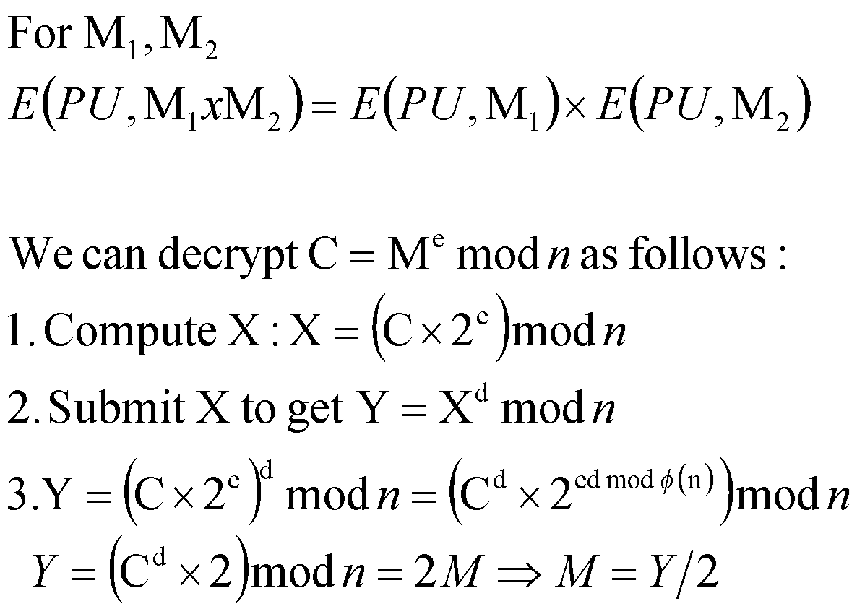
Chosen Cipher Text (CCT) Attack

