Slide 1
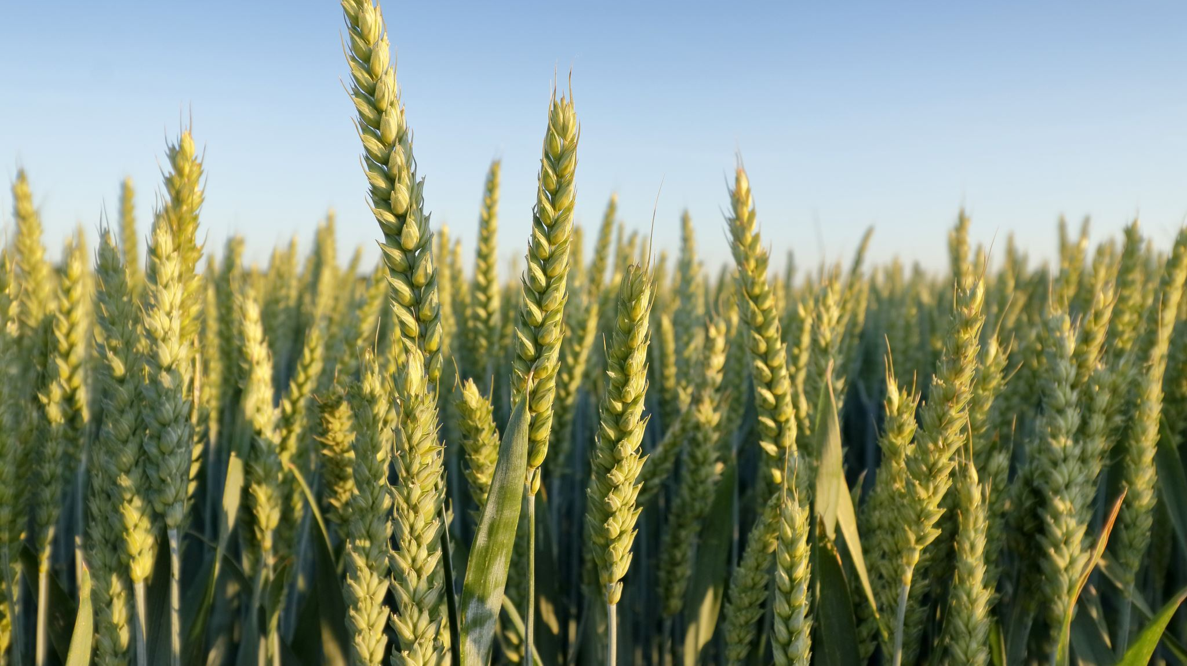
Crop Yield Analysis and Clustering
Data Analysis and Clustering for Rural Municipalities
Adel Baabbad

Slide 2
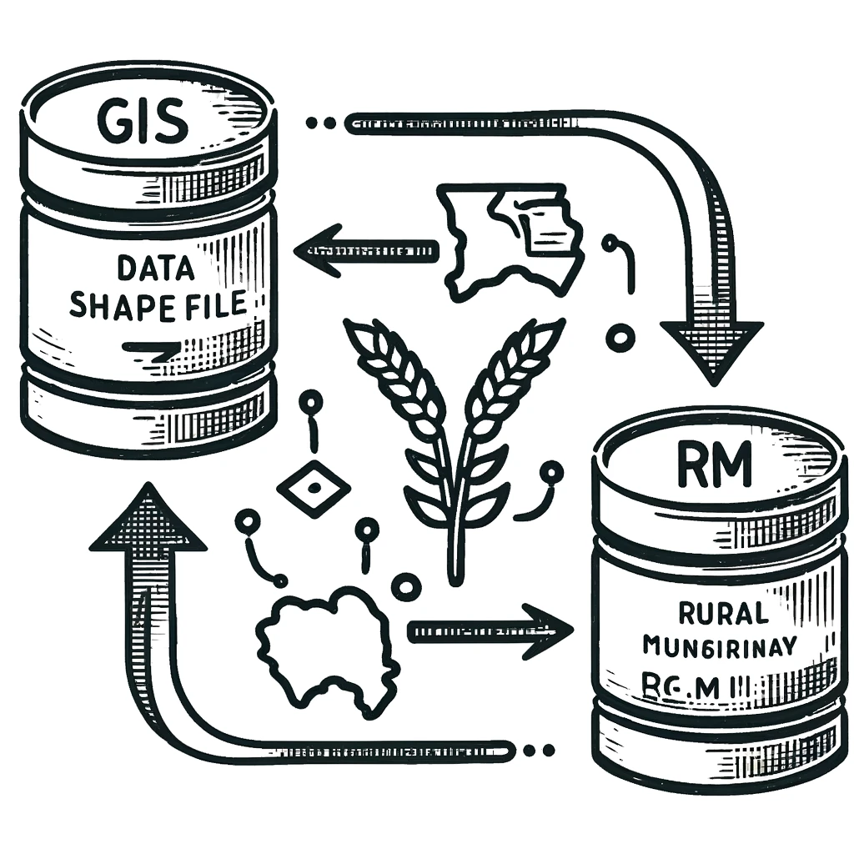
Data Collection
RM Shape File GeoHub
Crop Yields by Rural Municipality (R.M.)

Slide 3
Exploratory Data Analysis (EDA)
Understanding Data Structure and Contents
Identifying Data Quality Issues
Summarizing Key Characteristics
Detecting and Understanding Relationships

Slide 4
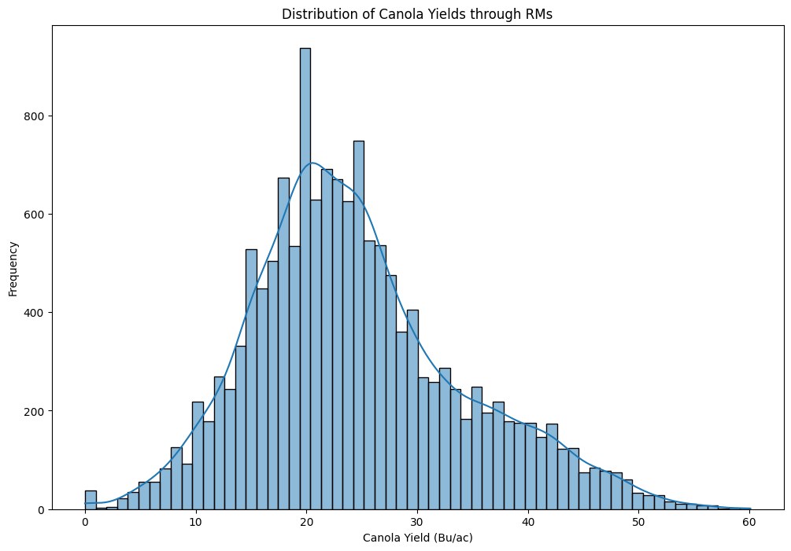
Yield Distribution Through RMs
This plot shows the distribution of Canola yields across different Rural Municipalities.

Slide 5
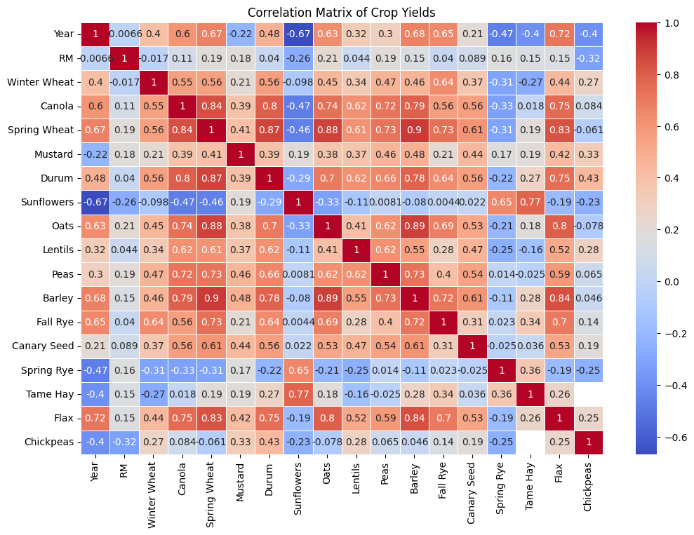
Correlations Between Crop Yields
This heatmap visualizes the correlations between different crop yields, helping us understand interdependencies.

Slide 6
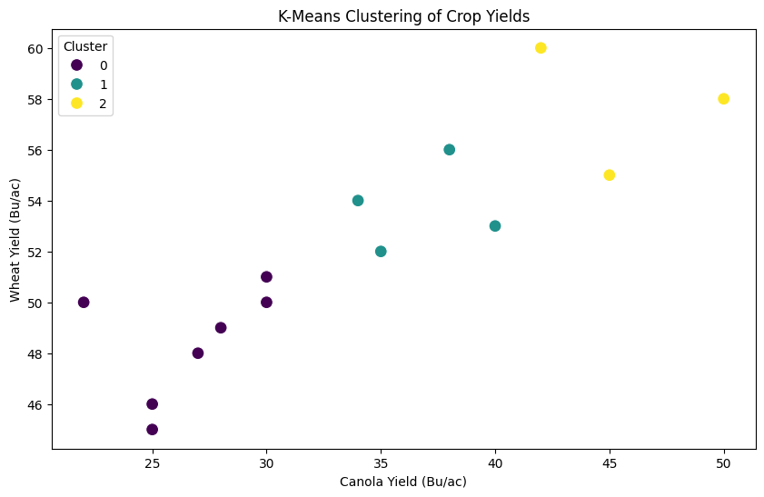
Clustering Analysis
Identification of Homogeneous Regions
Targeted Agricultural Practices
Predicting Crop Yields
Climate Impact Analysis
Breeding and Research

Slide 7
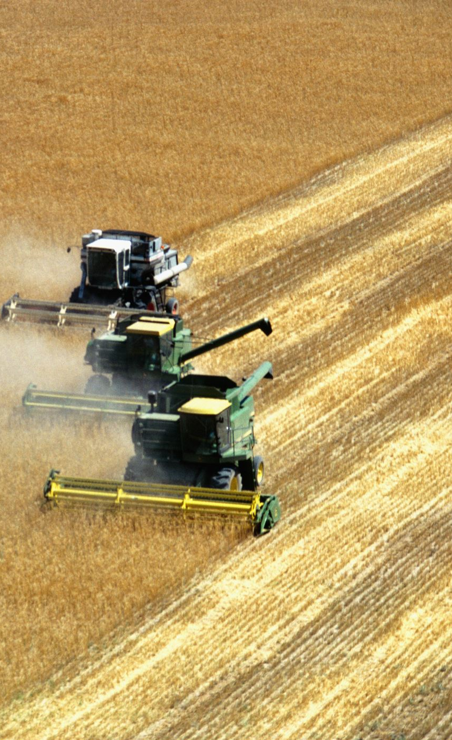
Canola Yield Clusters
Cluster 0: 21.06 Bu/ac
Cluster 1: 27.43 Bu/ac
Cluster 2: 28.37 Bu/ac
Cluster 3: 32.22 Bu/ac
Cluster 4: 34.18 Bu/ac

Slide 8
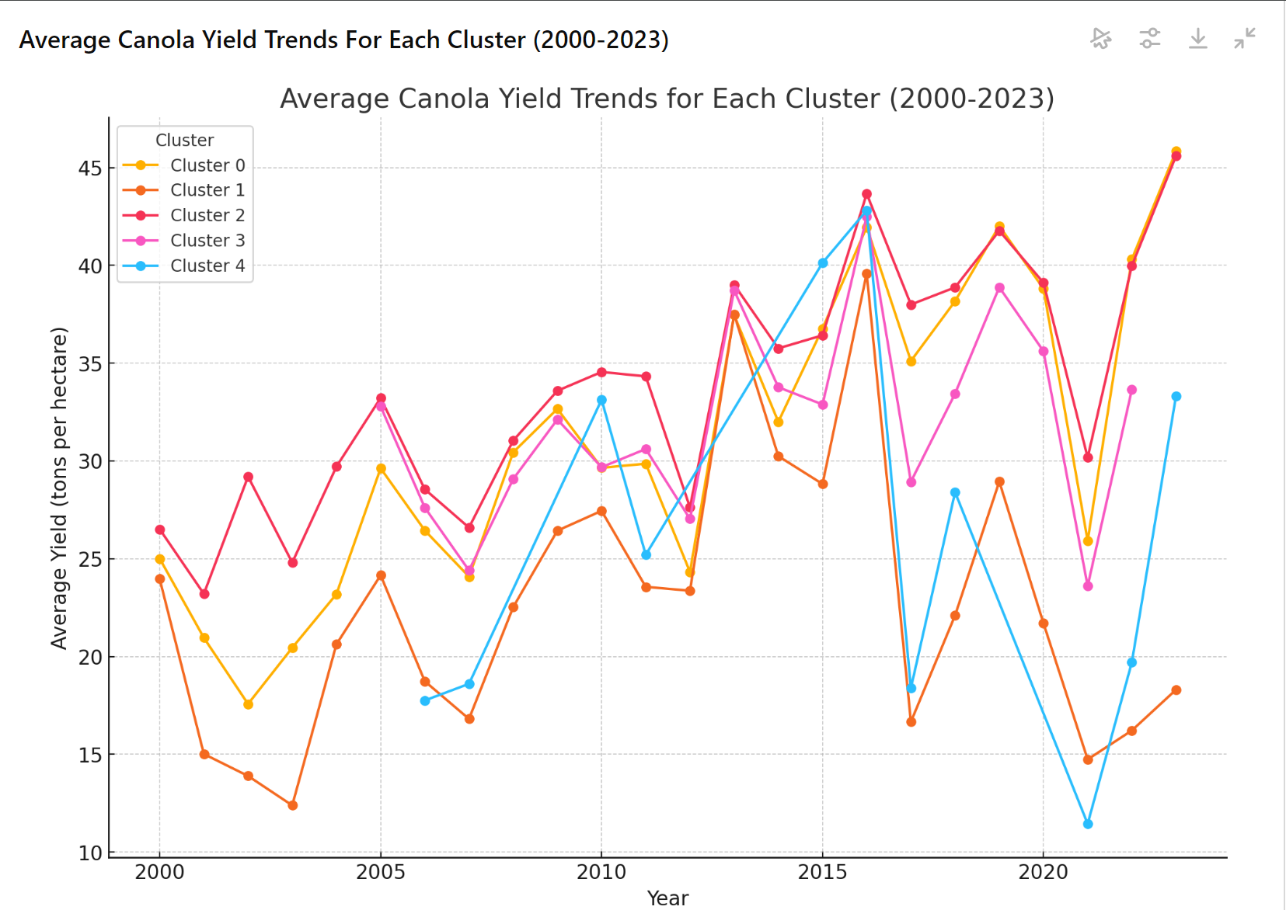
Average Yield Trend for Each Cluster
This chart shows the average yield trends for each identified cluster.

Slide 9

Thank You

