Slide 1
Climate change and electric cars

Slide 2
Today’s Agenda
1. Introduction
The effects of petrol cars on the environment
Past solutions of the climate change problem
2. Electric cars
The benefits of electric cars on the environment
Comparison between petrol and electric cars
3. Ample
What is ample.
Ample in comparison with other charging stations.
4. Conclusion
References

Slide 3
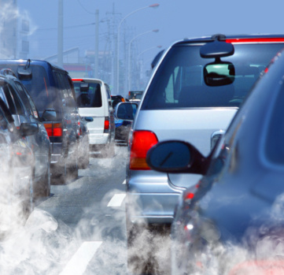
Introduction:
The effects of petrol cars on the environment
CARS
EMISSIONS
CLIMATE CHANGE
Highway vehicles release about 1.6 billion tons of greenhouse gases (GHGs) into the atmosphere each year—mostly in the form of carbon dioxide (CO₂)—contributing to global climate change. Each gallon of gasoline you burn creates 20 pounds of GHG. That's roughly 6 to 9 tons of GHG each year for a typical vehicle.

Slide 4
Electric cars
Electric cars are powered by electric batteries instead of conventional fuels such as gasoline and diesel. The emissions profile of these vehicles is much lower and pure electric cars produce no carbon dioxide emissions when driving. This reduces air pollution considerably.
Eco Friendly
Electric Energy
Cleaner Environment
Lower running cost
Maintenance Costs
zero carbon emission and reduction in air pollution
Cheaper to Charge than to
fill the tank
Lower costs especially with long battery warranties

Slide 5
Electric cars is better for the environment.
CO₂ emissions is harmful for the environment.
High emission
No emissions
The only repairs electric cars will need are brake pads, tyres and suspension.
Needs oil changes and other engine mechanical repairs.
Low maintenance
High maintenance
Upfront, the cost of an electric car is high, but in the long term it is cheaper.
since petrol is always on the rise, the overall cost of a petrol car is higher.
Cost
Cost

Slide 6
What’s New

Slide 7

A new way to deliver energy to any electric vehicle.
MODULAR BATTERY SWAPPING

Slide 8

Fastest to a full charge
Using modular battery swapping, Ample can deliver 100% charge to any EV in under 10 minutes. As battery density increases, Ample maintains the same delivery efficiency.

Slide 9

cheaper than gas.
An Ample station is 3-10 times cheaper than a fast-charging station. It’s cheaper to build and cheaper to install. So, Ample is able to deliver energy at a cost that is 10-20% cheaper than gas.

Slide 10
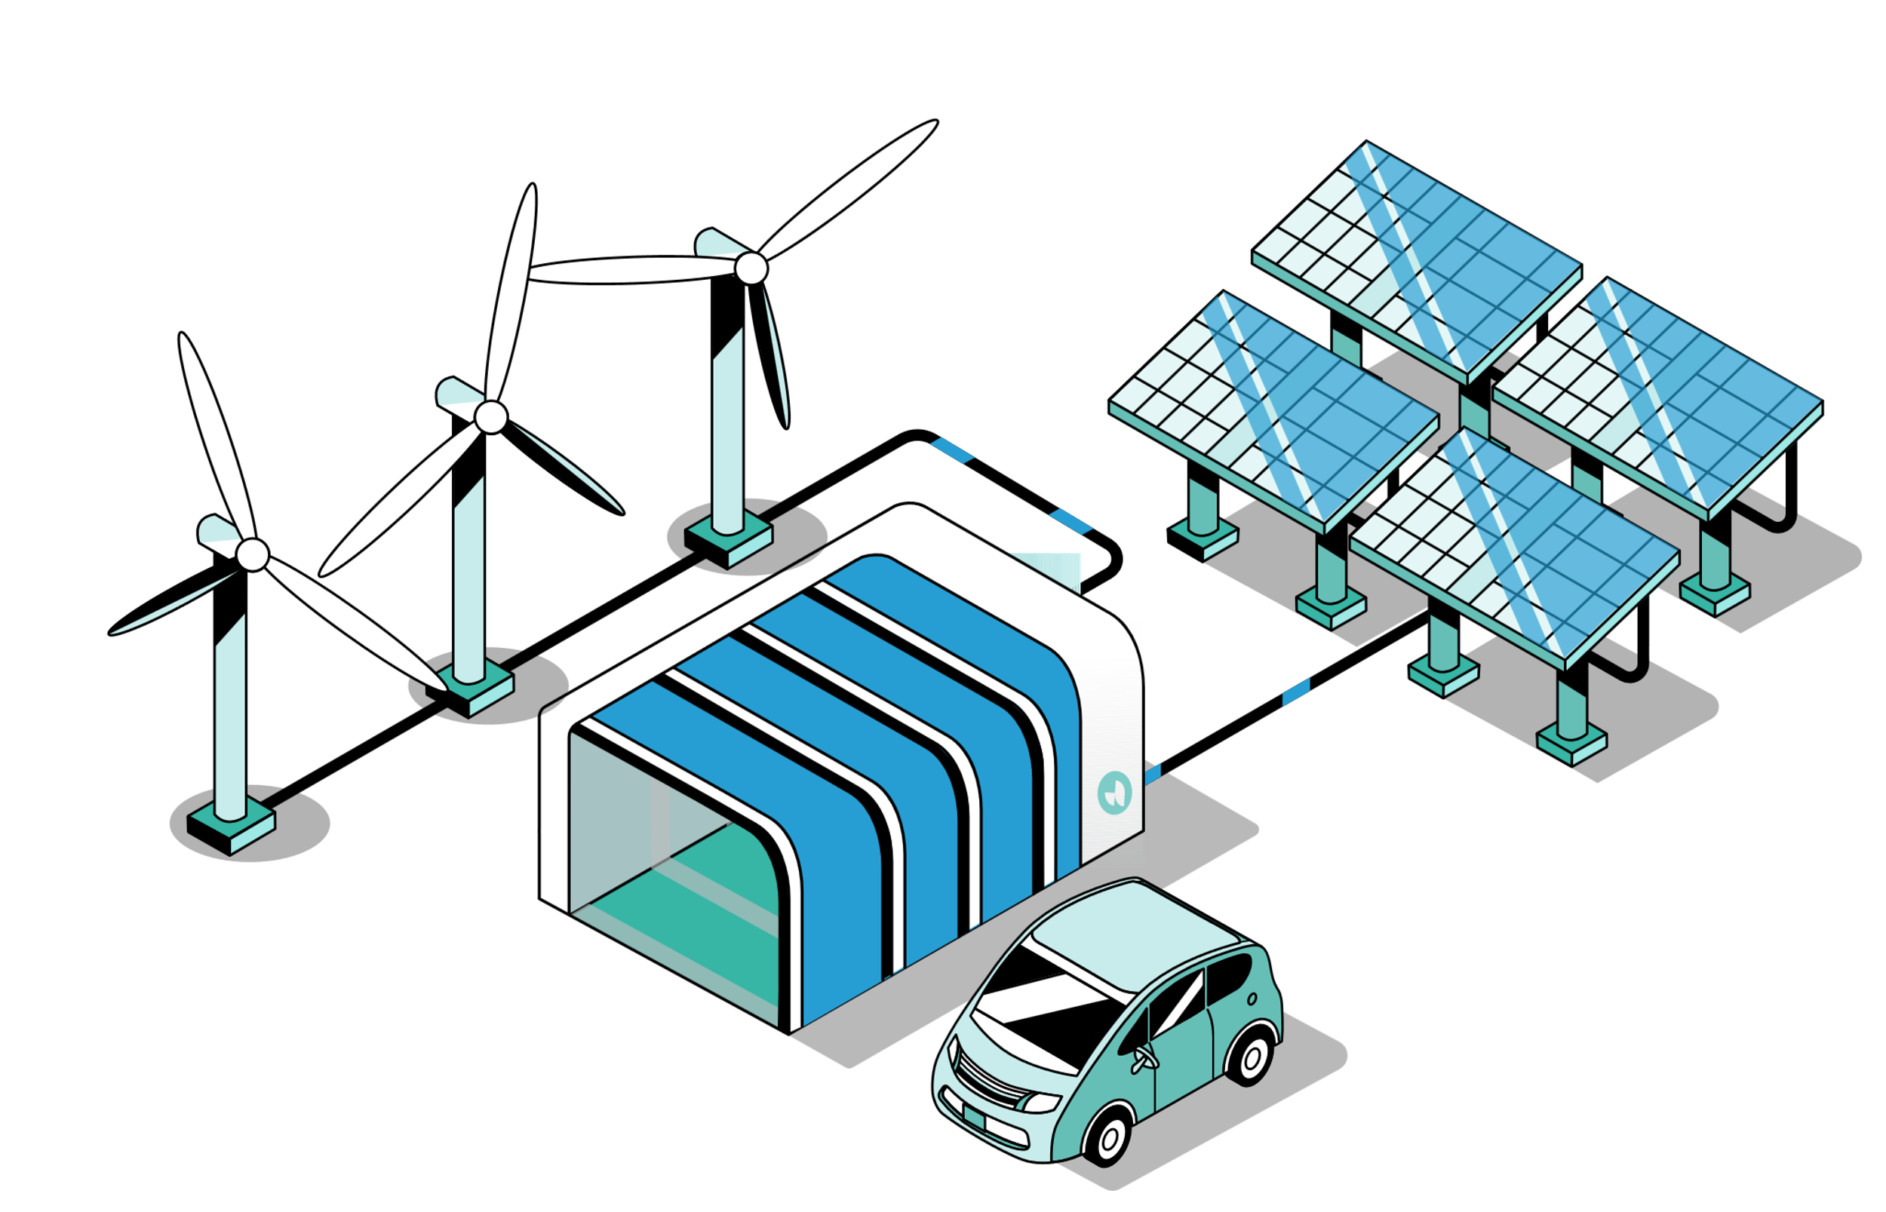
Not just electric, renewable.
Ample captures wind and solar energy when available and then delivers it to vehicles when drivers need it.

Slide 11
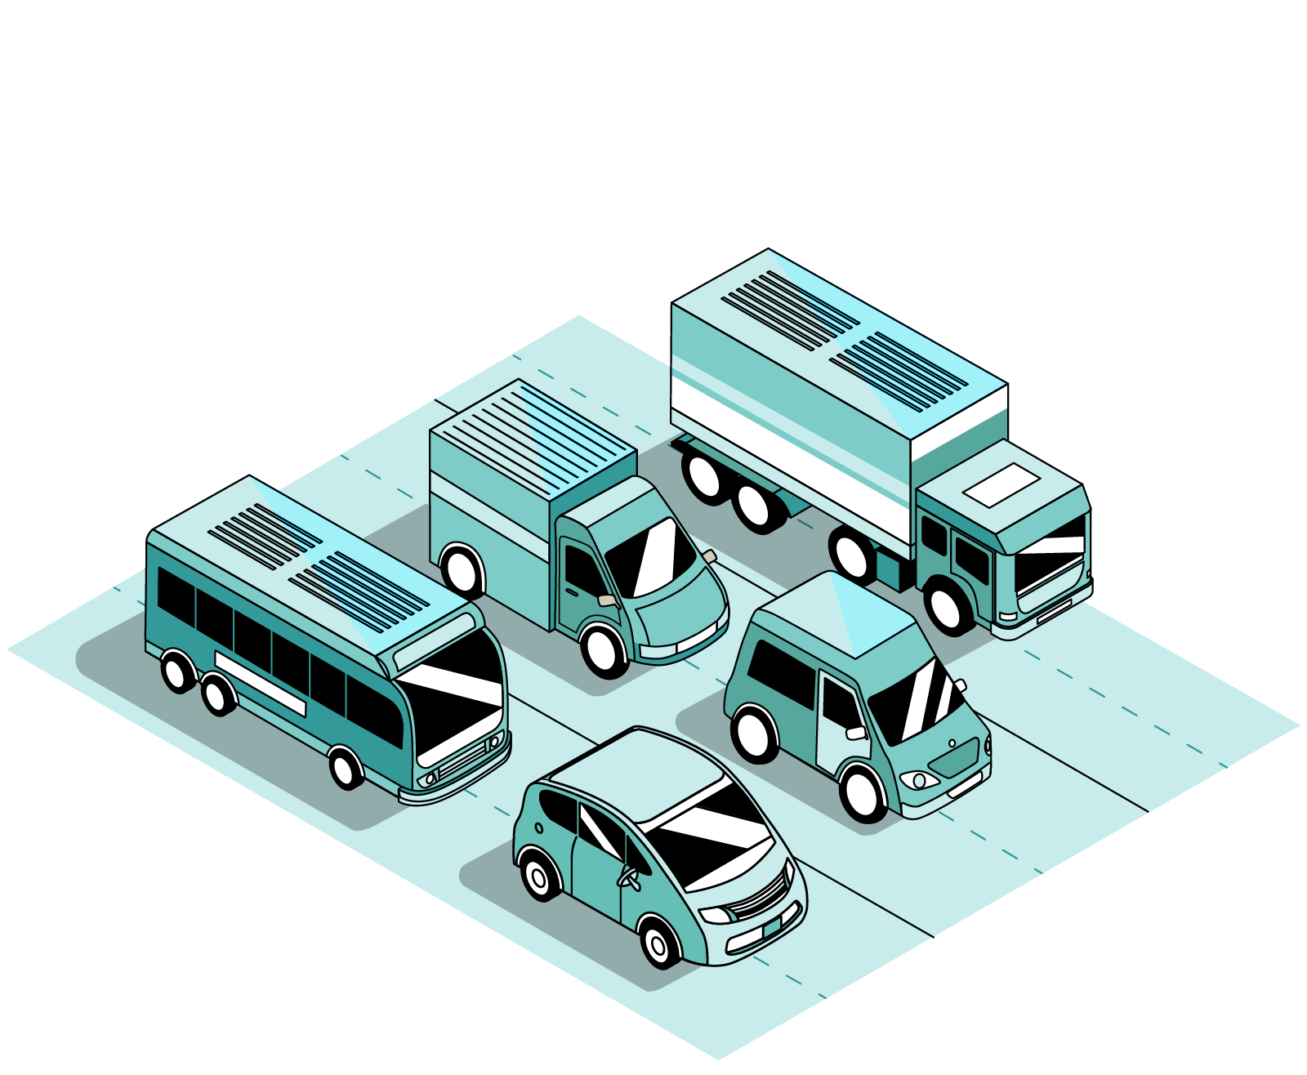
For any electric
vehicle.
At the core of Ample’s technology is our modular, swappable, battery architecture. Carmakers don’t need to redesign their cars to work with the Ample technology.

Slide 12
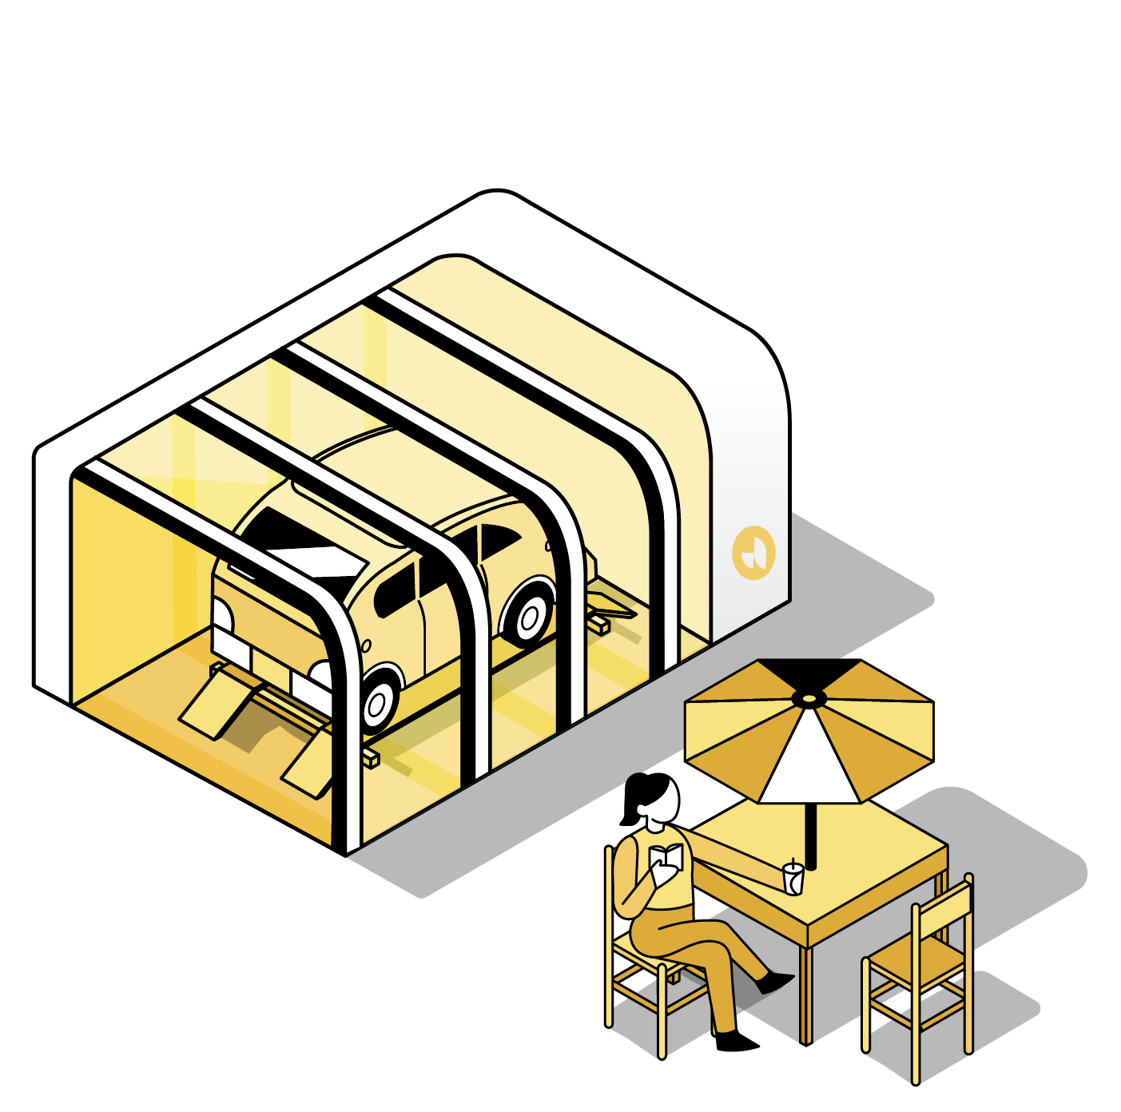
Fully automated.
Using a combination of computer vision and secure wireless communication with the vehicle, the Ample station can identify the exact location of each battery module to be swapped. Once discharged battery modules are removed from the car, they are placed on shelves so that they can be charged and ready for the next vehicle.

Slide 13
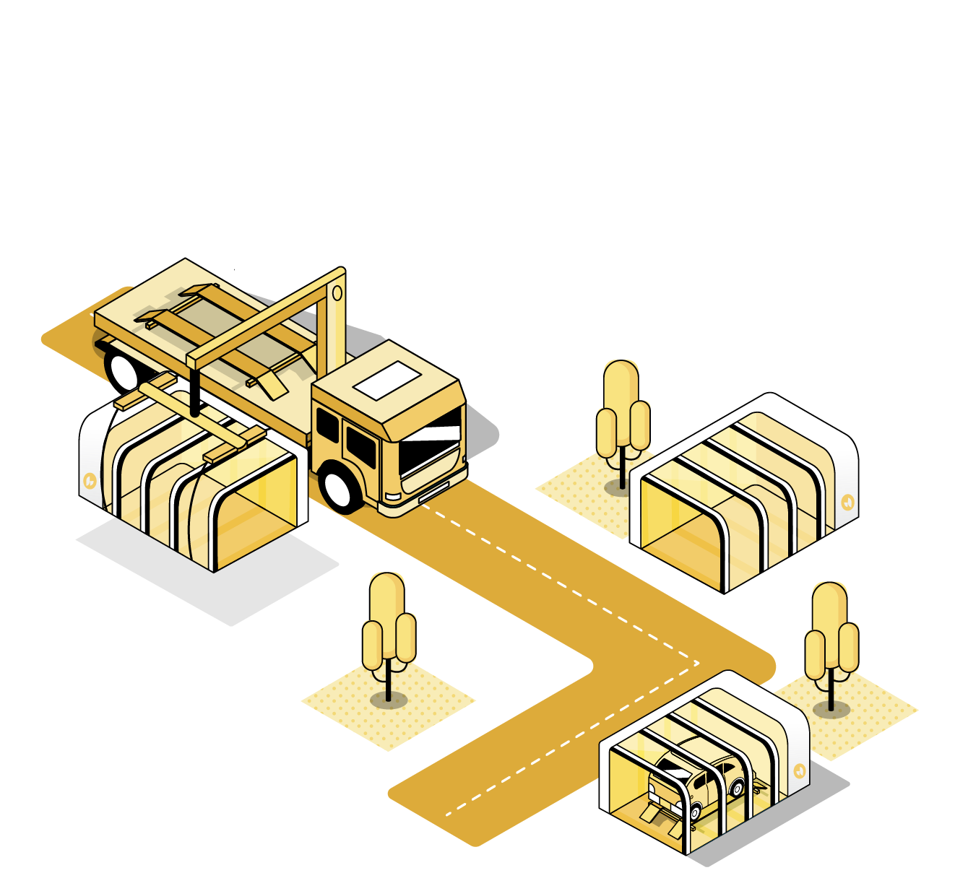
A whole city deployed in weeks.
Ample stations require no construction. With a small footprint equivalent to two parking spots, they can be located at gas stations, grocery stores, or the side of the road. With fast installation, a whole city can be ready for EVs in weeks when it used to take months or even years.

Slide 14
References
1
U.S. Environmental Protection Agency
https://www.epa.gov/transportation-air-pollution-and-climate-change/carbon-pollution-transportation
2
European Environment Agency
https://www.eea.europa.eu/articles/electric-vehicles-a-smart
3
Ample website
https://ample.com.
4
Ample demonstration video
https://www.youtube.com/watch?v=5hcCbg1Nf-c

Slide 15
THANK YOU
اعداد : عادل محمود شوشه
AIE

