Slide 1
Sales: [ 1, 12.5, 25., 37.5, 50., 62.5, 75., 87.5, 100., 87.5, 75., 62.5]
Rate of production: [100., 87.5, 75., 62.5, 50., 37.5, 25., 12.5, 1., 12.5, 25., 37.5]

Slide 2
100
80
60
40
20
10
30 60 90 110 140 170 200

Slide 3
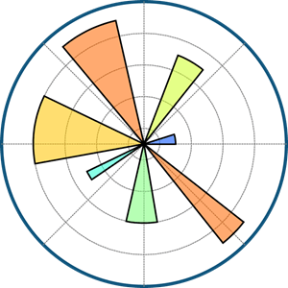

Slide 4


Slide 5
Why Data Visualization ?
- Simplifies complex data
- Reveals patterns and trends
- Data driven decisions

Slide 6
code.py
content.ppt
Can You Spot the Pattern?
write the following data randomly all over the side
[1: 31.1] [2: 27.5] [3: 30.1] [4: 35.3] [5: 36.3] [6: 31.0] [7: 41.5] [8: 44.7] [9: 53.0] [10: 63.7] [11: 72.1] [12: 84.2] [13: 88.6] [14: 91.4] [15: 95.6] [16: 97.4] [17: 100.0] [18: 98.0] [19: 100.0] [20: 96.9]

Slide 7
Tabulated Data: Any Clear Trends?
code.py
content.ppt
Hours Studied Test Score
1 31.1
2 27.5
3 30.1
4 35.3
5 36.3
6 31.0
7 41.5
8 44.7
9 53.0
10 63.7
11 72.1
12 84.2
13 88.6
14 91.4
15 95.6
16 97.4
17 100.0

Slide 8
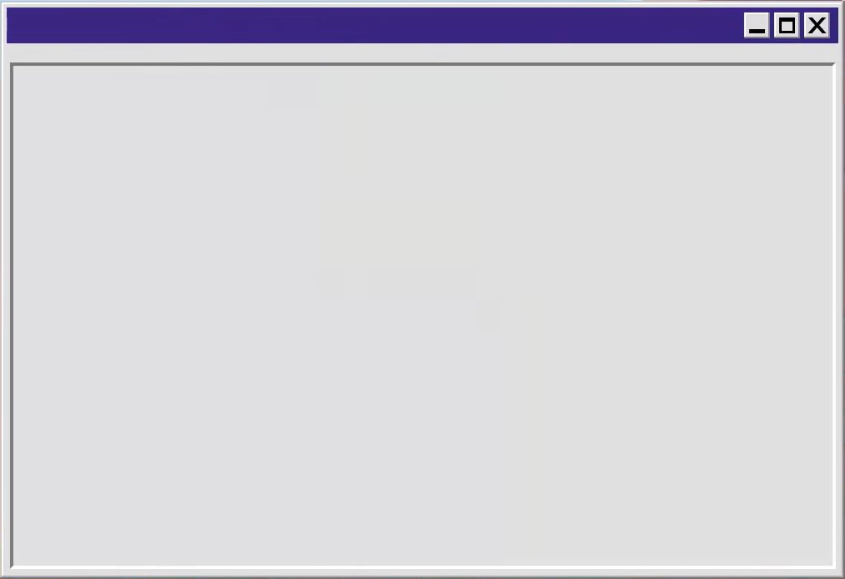
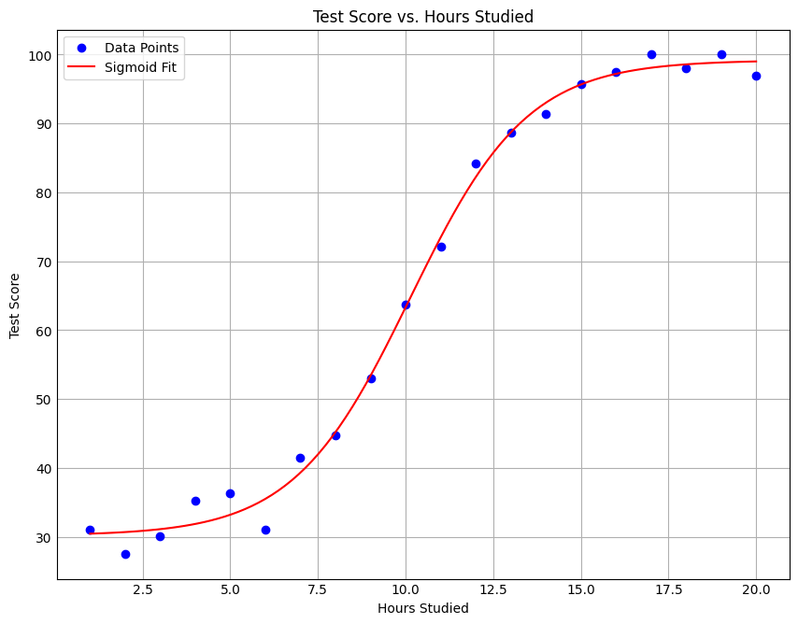
code.py
content.ppt
Revealing the
Hidden Pattern

Slide 9
code.py
content.ppt
code for creating the data
# Generate integer hours studied by students from 1 to 20 hours_studied = np.arange(1, 21) # Parameters for the sigmoid function max_score = 100 min_score = 25 k = 0.5 # Steepness of the curve midpoint = 10 # Hours at which score is halfway between min and max # Calculate test scores with a sigmoid relationship scores = min_score + (max_score - min_score) / (1 + np.exp(-k * (hours_studied - midpoint))) + np.random.normal(0, 3, size=hours_studied.size) # Round scores to the nearest digit after the decimal point rounded_scores = np.round(scores, 1) # Print the rounded scores along with hours studied print("Hours Studied:", hours_studied) print("Rounded Test Scores:", rounded_scores)
Matplotlib

Slide 10
code.py
content.ppt
code for creating the plot
# Define the modified sigmoid function
def sigmoid(x, L, x0, k, b):
return b + (L - b) / (1 + np.exp(-k * (x - x0)))
# Generate fitted scores
hours_fit = np.linspace(min(hours_studied), max(hours_studied), 100
scores_fit = sigmoid(hours_fit, max_score, midpoint, k, min_score)
# Plot the data
plt.scatter(hours_studied, scores, color='blue', label='Data Points')
plt.plot(hours_fit, scores_fit, color='red', label='Sigmoid Fit')
# Add labels and title
plt.xlabel('Hours Studied')
plt.ylabel('Test Score')
plt.title('Test Score vs. Hours Studied')
plt.legend()
plt.show()
Matplotlib

Slide 11
Types of Plots
code.py
content.ppt
line plot
scatter plot
bar chart
Heatmap
Histogram
Pie plot
box plot
stack plot

Slide 12
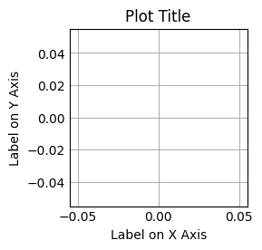
code.py
content.ppt
Important func
import matplotlib.pyplot as plt
plt.xlabel('Label on X Axis')
plt.ylabel('Label on Y Axis')
plt.title('Plot Title')
plt.show()
Matplotlib

Slide 13
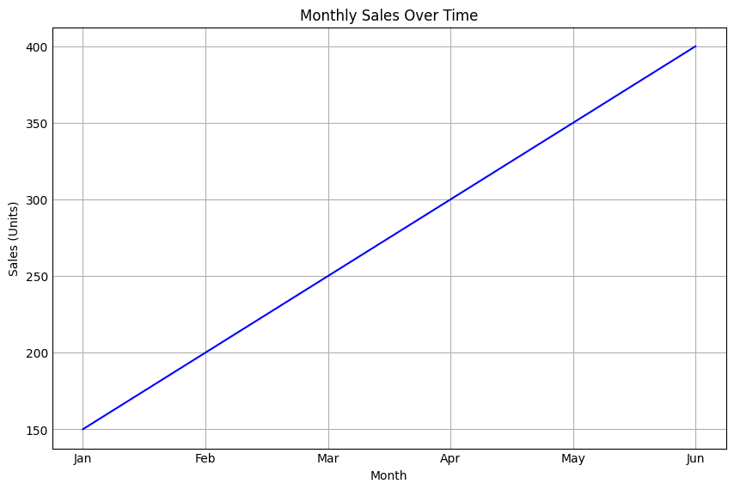
code.py
content.ppt
line plot - data over time
import matplotlib.pyplot as plt
# Sample data
months = ['Jan', 'Feb', 'Mar', 'Apr', 'May', 'Jun']
sales = [150, 200, 250, 300, 350, 400]
# Create line plot
plt.plot(months, sales)
plt.xlabel('Month')
plt.ylabel('Sales (Units)')
plt.title('Monthly Sales Over Time')
plt.show()
Matplotlib

Slide 14
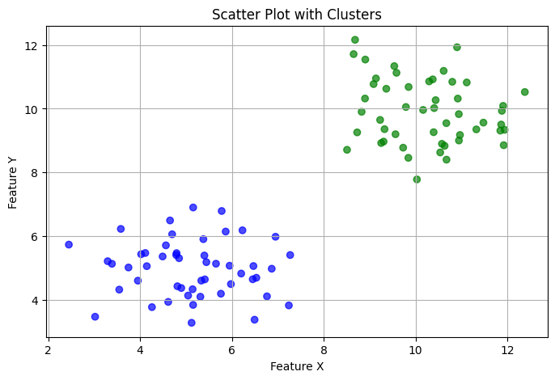
code.py
content.ppt
Scatter Plot - showing clusters
# Cluster 1
x1 = np.random.normal(5, 1, 50)
y1 = np.random.normal(5, 1, 50)
# Cluster 2
x2 = np.random.normal(10, 1, 50)
y2 = np.random.normal(10, 1, 50)
# Combine data
x = np.concatenate((x1, x2))
y = np.concatenate((y1, y2))
colors = ['blue'] * 50 + ['green'] * 50
# Create scatter plot
plt.scatter(x, y, c=colors)
# Add labels and title
plt.xlabel('Feature X')
plt.ylabel('Feature Y')
plt.title('Scatter Plot with Clusters')
plt.show()
Matplotlib

Slide 15
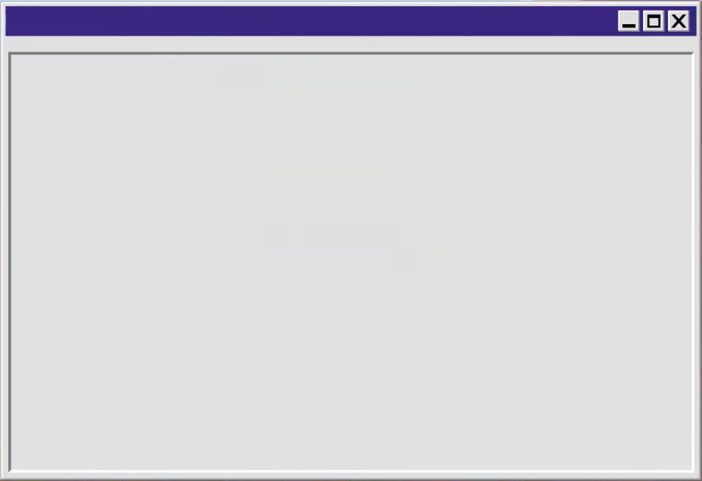
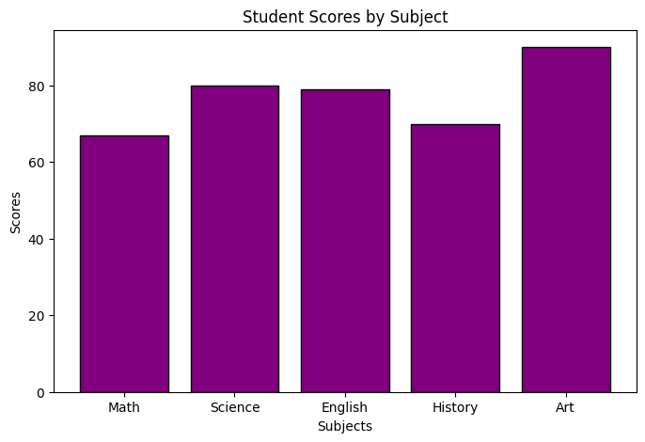
code.py
content.ppt
Bar Chart - Comparing Categorical Data
# Sample data
subjects = ['Math', 'Science', 'English', 'History', 'Art']
scores = [67, 80, 79, 70, 90]
# Create bar chart
plt.bar(subjects, scores)
# Add labels and title
plt.xlabel('Subjects')
plt.ylabel('Scores')
plt.title('Student Scores by Subject')
plt.show()
Matplotlib

Slide 16
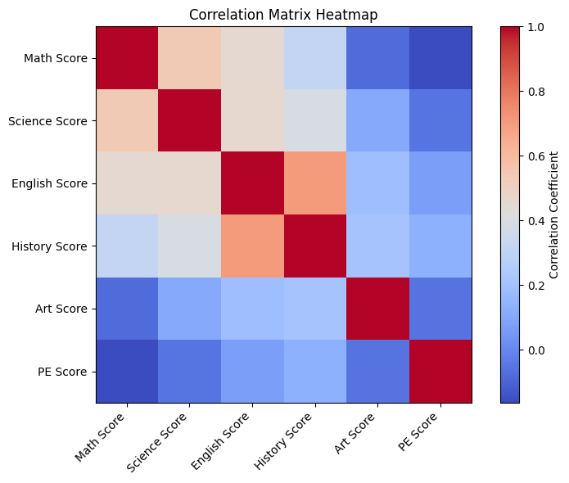
code.py
content.ppt
Heatmap - Visualizing Correlation Matrices
df = pd.read_csv('subject_scores_data.csv') # Compute the correlation matrix
corr_matrix = df.corr()
# Create heatmap
plt.imshow(corr_matrix, cmap='coolwarm’)
# Add colorbar
plt.colorbar(label='Correlation Coefficient’)
# Add labels
plt.xticks(ticks, corr_matrix.columns, rotation=45, ha='right’)
plt.yticks(ticks, corr_matrix.columns)
# Add title and adjust layout
plt.title('Correlation Matrix Heatmap')
plt.show()
Matplotlib

Slide 17
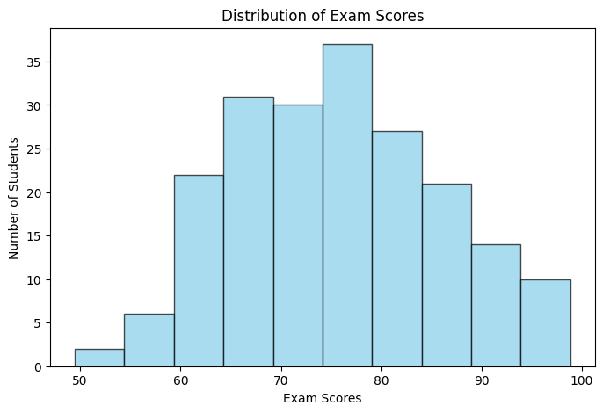
code.py
content.ppt
Histogram - Visualizing Data Distribution
import matplotlib.pyplot as plt
import numpy as np
# Sample data
exam_scores = np.random.normal(75, 10, 200)
# Create histogram
plt.hist(exam_scores, bins=10)
# Add labels and title
plt.xlabel('Exam Scores')
plt.ylabel('Number of Students')
plt.title('Distribution of Exam Scores')
plt.show()
Matplotlib

Slide 18
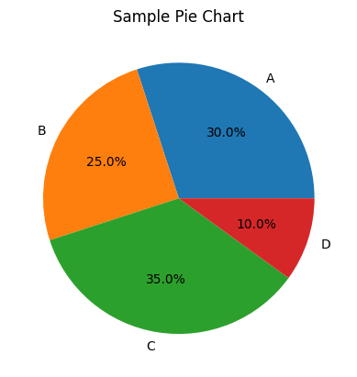
code.py
content.ppt
Pie Plot
import matplotlib.pyplot as plt
# Data to plot
labels = ['A', 'B', 'C', 'D']
sizes = [30, 25, 35, 10] # Percentage values
# Create Pie Chart
plt.pie(sizes, labels=labels, autopct='%1.1f%%',)
plt.title("Sample Pie Chart")
plt.show()
Matplotlib

Slide 19
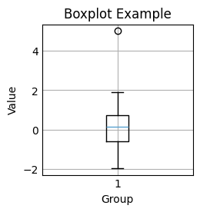
code.py
content.ppt
Boxplot - Visualizing Distribution of values
import matplotlib.pyplot as plt
import numpy as np
# Generate some sample data
data = np.random.normal(0, 1, 100) # Normal distribution with mean 0 and std deviation 1
# Create a boxplot
plt.boxplot(data)
# Add labels and title
plt.xlabel('Group')
plt.ylabel('Value')
plt.title('Boxplot Example')
# Display the plot
plt.show()
Matplotlib

Slide 20
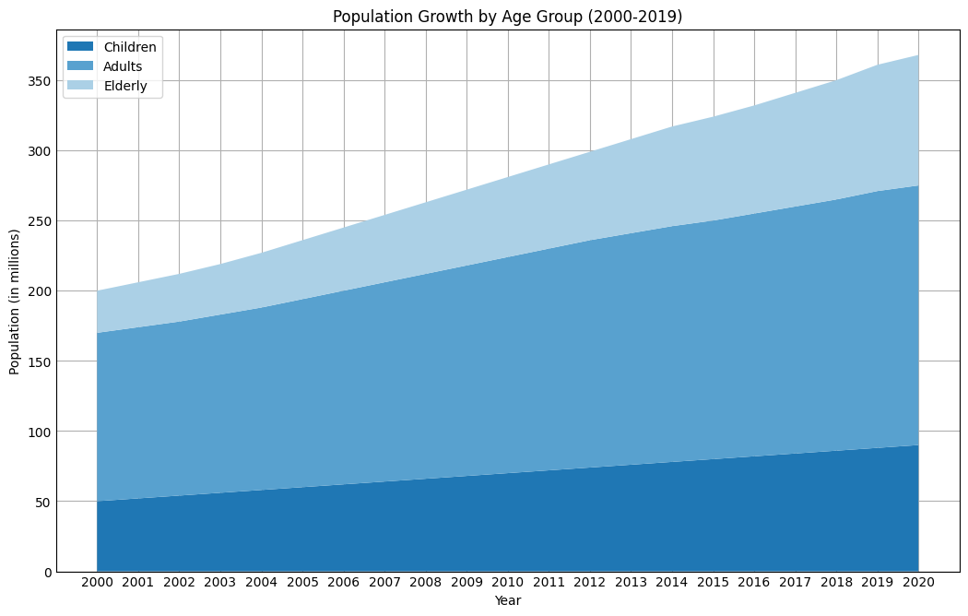
code.py
content.ppt
Stackplot - Groups Over Time
# Simulating Population Growth Data for 3 age groups over 20 years
years = np.arange(2000, 2021, dtype=int) # Years from 2000 to 2020
# Simulated population data for each age group (in millions)
children = np.array([50, 52,…]) # Children
adults = np.array([120, 122,…]) # Adults
elderly = np.array([30, 32,…]) # Elderly
# Create the stack plot
plt.stackplot(years, children, adults, elderly, labels=['Children', 'Adults', 'Elderly'])
# Add labels and title
plt.xlabel('Year')
plt.ylabel('Population (in millions)')
plt.title('Population Growth by Age Group (2000-2019)') # Display the plot
plt.show()
Matplotlib

Slide 21
# Thank you

Slide 22






# Team
image1 = cv2.imread(‘Adel Shousha.jpg')
image2 = cv2.imread(‘Mahmoud Sadeq.jpg')
image3 = cv2.imread(‘Mazen Ayman.jpg')
image4 = cv2.imread(‘Mazen Amir.jpg’)
image5 = cv2.imread(‘Youssef Elkotby.jpg’)
image6 = cv2.imread(‘Hassan ElAttar.jpg’)
plt.imshow(image1)
plt.imshow(image2)
plt.imshow(image3)
plt.imshow(image4)
plt.imshow(image5)
plt.imshow(image6)
plt.show()

