Slide 1
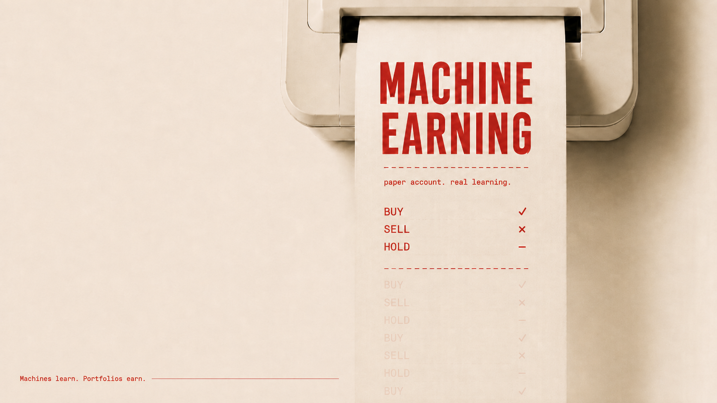
Notes:
[Sources]
- User-supplied title image: codex-clipboard-4759ce69-99a0-4b12-be9f-6ea023e67aa8.png
[/Sources]

Slide 2
The edge isn’t one signal. It’s disciplined combination.
Community attention reveals where interest is moving.
Expert shifts capture fresh ratings and target changes.
Technical evidence ranks volume, momentum and volatility.
Notes:
[Sources]
- README.md (community, expert and technical signal lanes)
[/Sources]

Slide 3
A three-stage loop turns information into accountable action.
01 · COLLECT
Validate Alpaca assets, snapshots and completed daily bars.
02 · RANK
Fuse deterministic screens with community and expert attention.
03 · ACT
Research, risk-check, then BUY, SELL or HOLD—paper only.
STAGE 0
STAGE 1
STAGE 2
Notes:
[Sources]
- README.md (Stage 0, Stage 1 and Stage 2 workflow)
[/Sources]

Slide 4
The funnel gets narrower—and more skeptical—at every step.
LATEST SCREEN · 02 SEP 2026
The same bars and configuration reproduce the same ranked shortlist.
13,476
197
36
US-listed symbols
screened
multi-signal
candidates
research-ready
shortlist
Notes:
[Sources]
- data/stage1_screen.json (13,476 universe; 197 candidates; as of 2026-09-02)
- data/stage1_shortlist.md (36 unique shortlist tickers; as of 2026-09-02)
[/Sources]

Slide 5
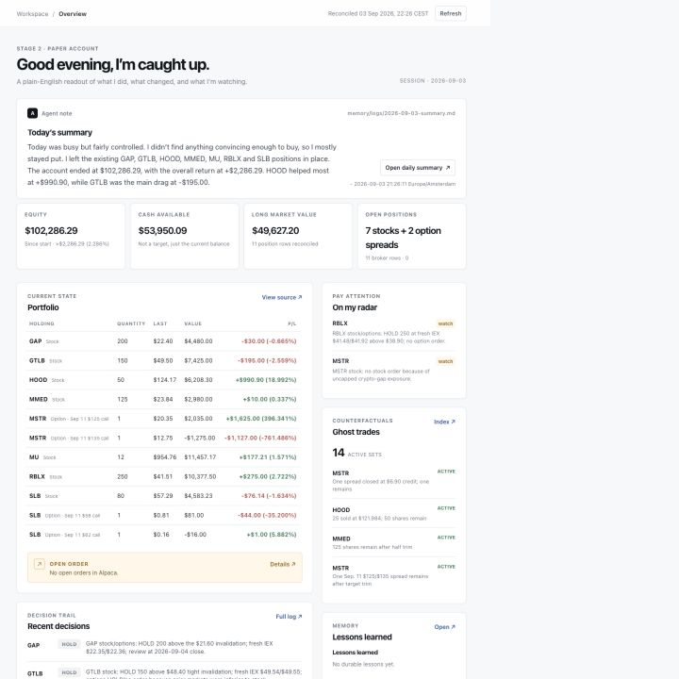
Autonomy stays inspectable.
One workspace, the whole decision trail.
Plain-English summaries, live paper state, research links, ghost trades and durable Markdown memory keep every action reviewable.
Notes:
[Sources]
- Local product screenshot captured from http://127.0.0.1:8765/
- README.md (dashboard and durable Markdown memory)
[/Sources]

Slide 6
Paper-first by design.
Learning by comparison.
MACHINE
No live trades
Defined-risk guardrails
Real vs. ghost memory
Notes:
[Sources]
- README.md (paper-only scope, risk policy and ghost-trade learning loop)
[/Sources]

