Slide 1
Secure Broadcast Update Scenario with an End-to-end Implementation

Slide 2
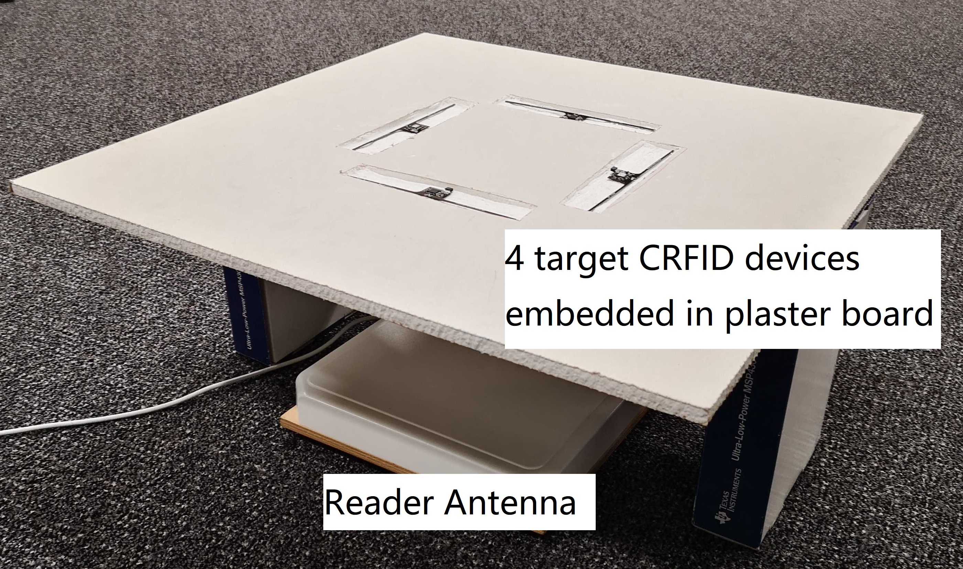

Slide 3
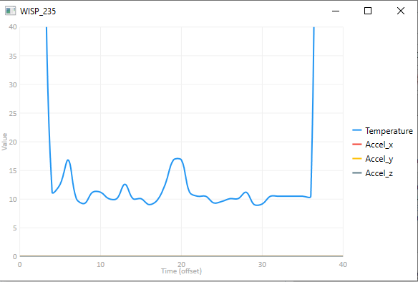

Slide 4
