Slide 1
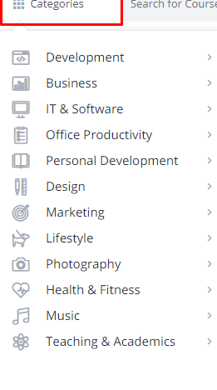
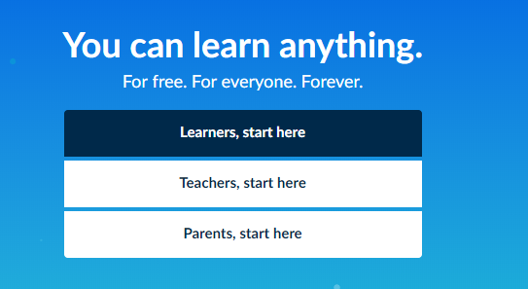
HOME

Slide 2
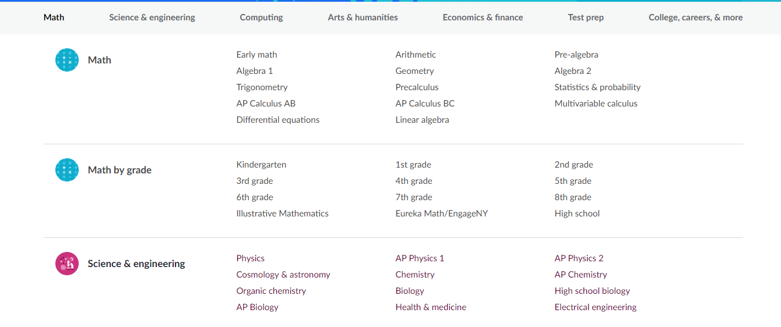
Beginning
intermediate
Advanced
Beginning
Advanced
Advanced
Beginning
intermediate
Advanced

Slide 3


Slide 4


Slide 5
