Slide 1
Pad 1 Side 2 Boundary
Pad 1 Width
Pad 1 Side 1 Boundary
Pad 1 Side 3 Boundary
Pad 1 Length
JJ Location[0]
JJ Stem Width
Pad 1 Side 4 Boundary
JJ Patch Width
JJ Location[1]
Pad Separation
JJ Patch
Length
Center X,
Center Y,
Point of rotation for Angle
JJ Stem Boundary
Pad 2 Side 4 Boundary
Pad 2 Width
Pad 2 Side 3 Boundary
Pad 2 Side 1 Boundary
Pad 2 Length
Pad 2 Side 2 Boundary

Slide 2
Pad 1 Side 2 Boundary
Pad 1 Width
Pad 1 Side 1 Boundary
Pad 1 Side 3 Boundary
Pad 1 Length
JJ Location
SQUID T Stem Width
Pad 1 Side 4 Boundary
SQUID Stem
Separation
Center X,
Center Y,
Point of rotation for Angle
Pad Separation
SQUID Stem Width
SQUID Stem Length
SQUID T Head Width
SQUID T Head Length
Pad 2 Side 4 Boundary
Pad 2 Width
Pad 2 Side 3 Boundary
Pad 2 Side 1 Boundary
Pad 2 Length
Pad 2 Side 2 Boundary

Slide 3
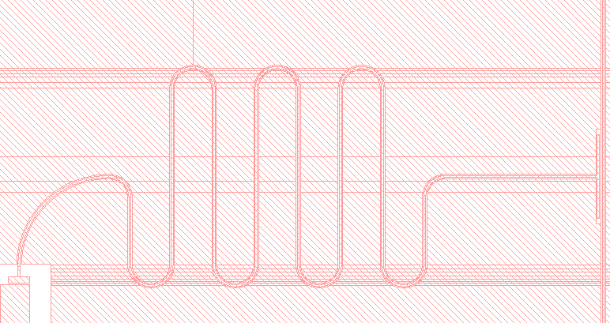
Pad separation (as if pad 2 were straight)
Pad 1
Pad curve angle
Meander to pad minimum distance
Meander turn radius
Pad 2

