Slide 1
Online Diabetes Diagnostic Web Application Developed and Designed by Minh CHU

Slide 2
How I came up with this idea
We often go to the hospital every six months to do a health check. That's the purpose of early detection of illnesses
However, there are times when we are too busy and unable to do health checks but We still want to know if we have any diseases
Or we have done the lab tests but the time sitting in the hospital and waiting for the result is too long.
Too many patients and too many test results for doctors
=> For Some non-fatal diseases, such as obesity, diabetes , we can use the prediction model instead of humans

Slide 3
All the things that patients needs to do
Go the website
Fill out the Patient ID
Press the check button
And wait for the results

Slide 4
What I’ve done
Web UI using Django Frame work
API using flask
Machine learning model with sklearn
Docker container

Slide 5
Web UI
Using Django Framework
2 html pages : about.html and showdata.html

Slide 6
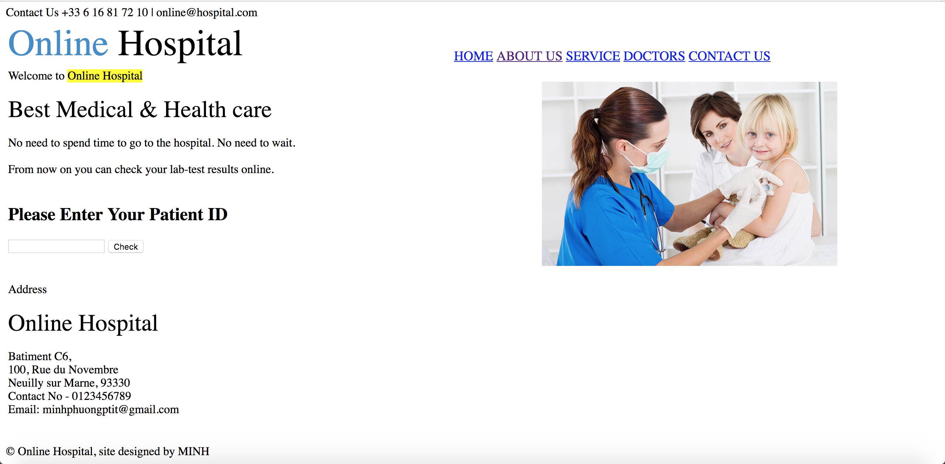
About.html page

Slide 7
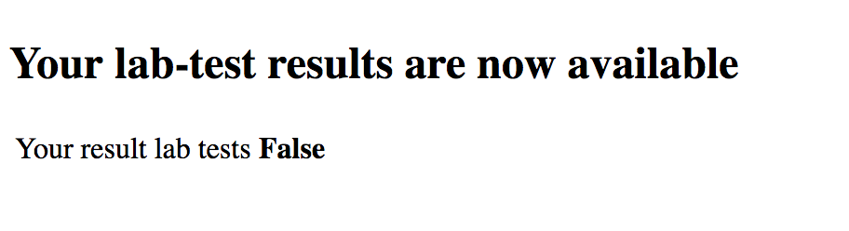
Showdata.html page

Slide 8
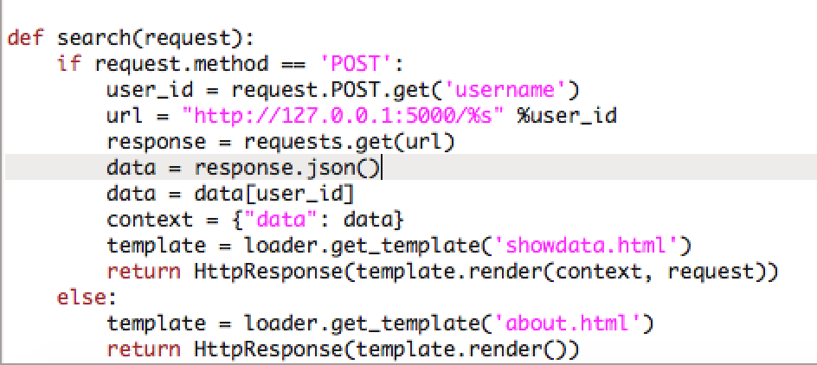
View.py view.search() is called when button Search is clicked

Slide 9
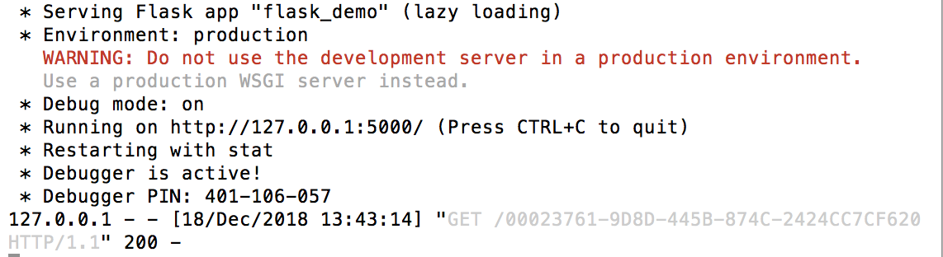
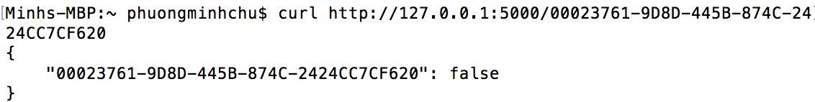
API
Flash
Run server

Slide 10
Machine learning Model
Predict whether or not a patient has diabetes based on their lab-tests history

Slide 11
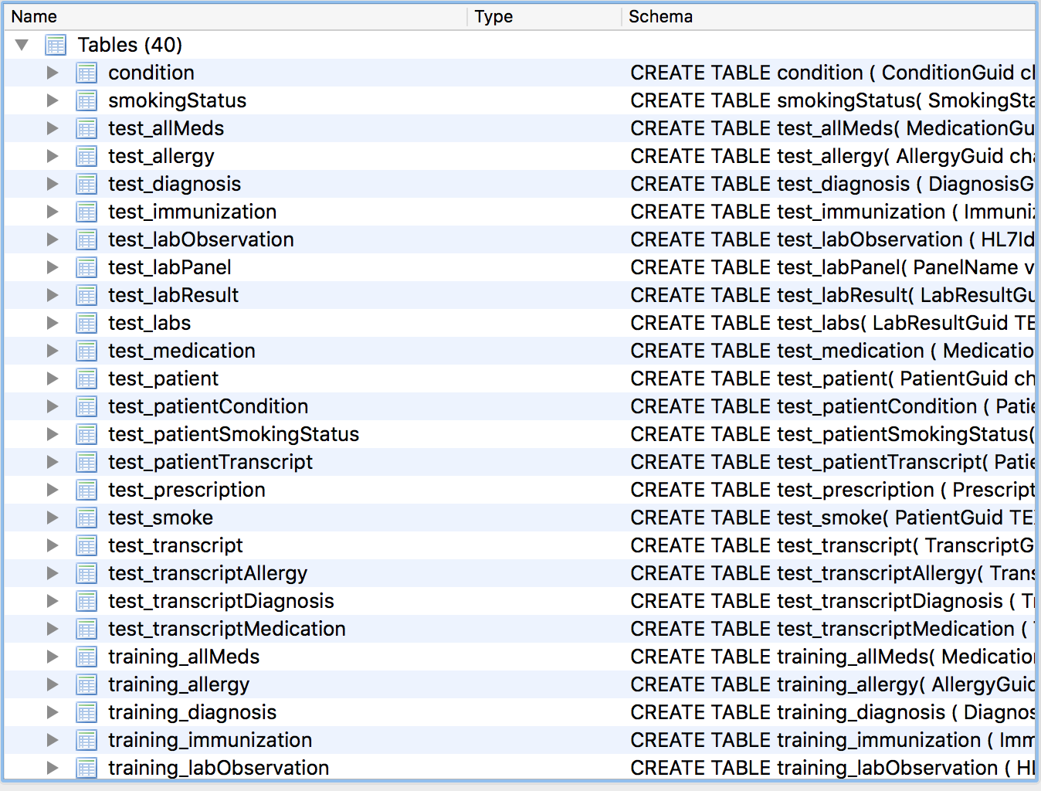
Data

Slide 12
Features selection
Common risk factors for diabetes
Medication that the patient was taking
Diagnoses of the patient
Lab tests that the patient received

Slide 13
Features selection Common risk factors for diabetes
SELECT BMI,Height,Weight,SystolicBP,DiastolicBP,RespiratoryRate,HeartRate,
Temperature
FROM training_transcript
WHERE PatientGuid= '%s’
Take the median of these features
SELECT Gender FROM training_patient WHERE PatientGuid= '%s’
SELECT YearOfBirth FROM training_patient WHERE PatientGuid= '%s'

Slide 14
Features selection Medication that the patient was taking
1522 Medication features (remove Medication features appear<10)
count of how many times a specific medication a patient took
SELECT DISTINCT MedicationName FROM training_allMeds
Def get_MedicationName(patient) : Return a number indicating how many of each type of Medication have been performed for this patient

Slide 15
Diagnoses of the patient
2336 features
SELECT DISTINCT DiagnosisDescription FROM training_diagnosis
def get_DiagnosisDescription(patient)

Slide 16
Lab tests that the patient received
239 features
SELECT DISTINCT HL7Text FROM training_labs
def get_HL7Text(patient)

Slide 17
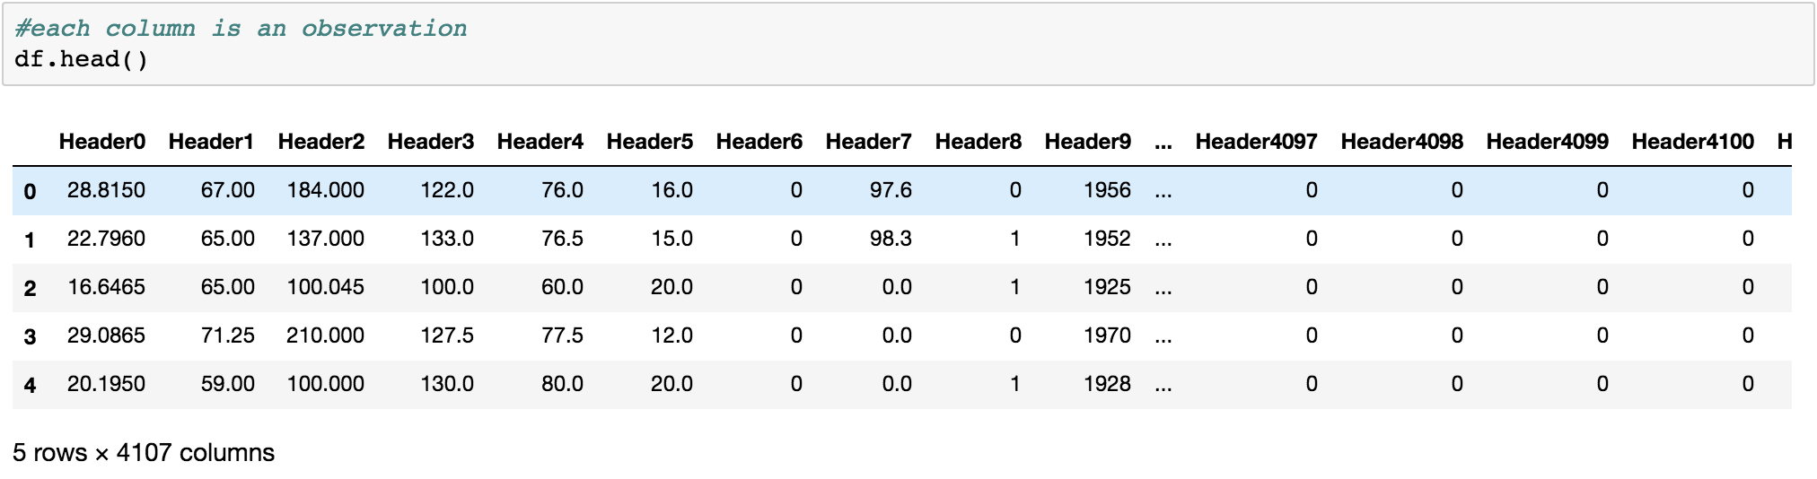
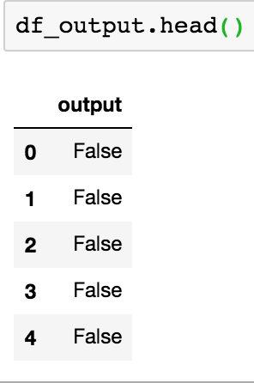
Data frame

Slide 18
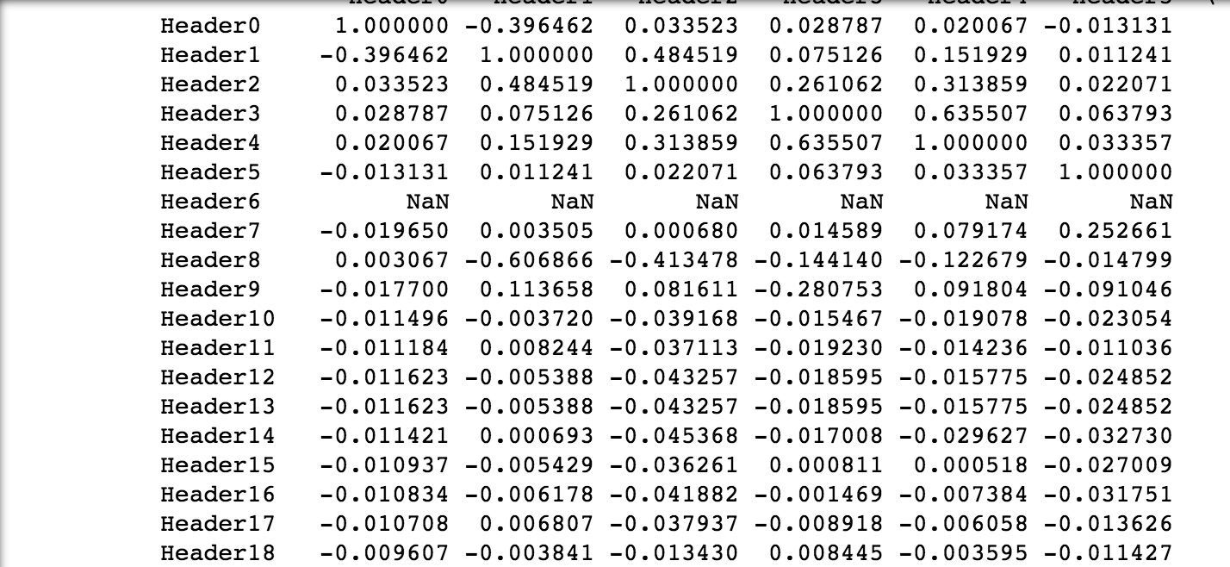
Features correlation Small => There is no dependency keep all features

Slide 19
Model trainning
from sklearn.ensemble import RandomForestClassifier
from sklearn.svm import SVC
from sklearn.naive_bayes import GaussianNB
20% data validation, 80% for training

Slide 20
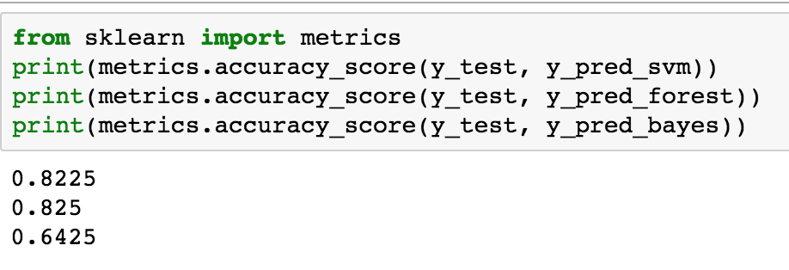
Accuracy

Slide 21
pickle.dump(forest_object,open("forest.pkl","wb"))

Slide 22
Docker Container
Docker-compose.yml
Dockerfile for api
Dockerfile for web application

Slide 23
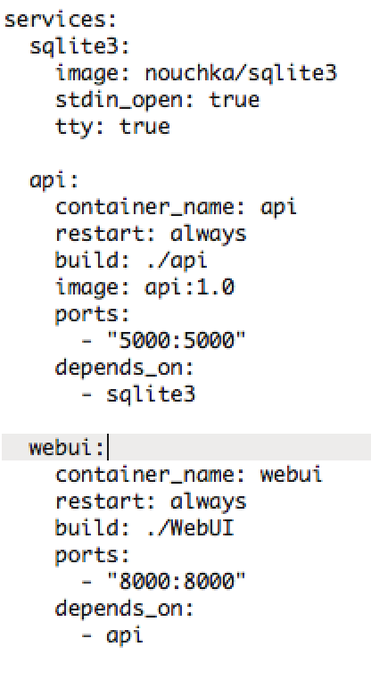
Docker-compose.yml

Slide 24
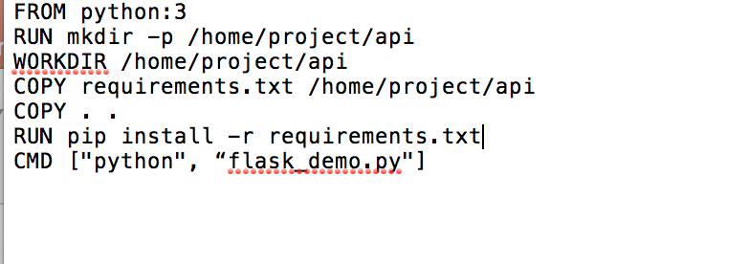
Dockerfile for api

Slide 25
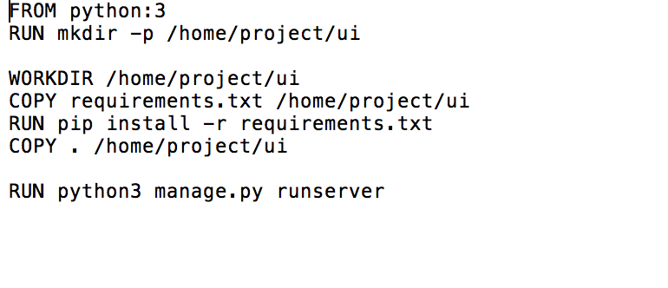
Dockerfile for WebUI

