Slide 1



Task 1:
Task 4:
Explain the problem and biological importance:
GC content is the percentage of Guanine and Cytosine nucleotides in part of a DNA. Between Guanine and Cytosine, there are three hydrogen bonds while Adenine-Thymine base pairs have only two. This means that Guanine-Cytosine base pairs contribute more to DNA stability than Adenine-Thymine base pairs. Therefore, the stability and melting temperature of DNA depend on the GC content. In polymerase chain reaction (PCR) experiments, GC content can also be used to predict annealing temperature of primers to the template DNA.
The approach you took:
1. We used a for loop to count the number of Guanine and Cytosine.
2. The number of Guanine and Cytosine was divided by the length of the DNA sequence to calculate the percentage.
The result:
The percentage of the GC content.
Explain the problem and biological importance:
Translation, one of the steps in Central Dogma converts sequences of bases in mRNA into chains of amino acids.
The approach you took
1. Request user input of mRNA sequence.
2. Continue the process if the input only contains the letters: A, U, G and C.
3. Return the index position of the first occurrence of AUG.
4. To loop through the mRNA sequence and access 3 elements at the same time, use for in range with step size of 3. The 3 elements will form a codon.
5. Retrieve the amino acid 1-letter code of the codon from a dictionary.
6. For each codon in mRNA, add its 1-letter code to a string variable.
The result:
Show the amino acids sequence in the string variable to the screen.
Task 2:
Task 5:
Explain the problem and biological importance:
DNA is a double helix of two complementary strands. In DNA replication, each strand of a DNA serves as a template to produce an identical replica of the original DNA. If we have one stand of DNA sequence, we can know what its complementary DNA strand looks like by the principle of complementary base pairing.
The approach you took:
1. Use a for loop to compute each base from the beginning of the given DNA sequence to find its complementary base.
2. Use all the complementary bases to form a new sequence.
3. Reverse the given sequence.
The result:
The complementary DNA strand for a DNA sequence (from 5' to 3') given by user.
Virus vectors such as AAV are commonly used for tissue-specific drug delivery in gene therapy. In order to screen the tissue specificity of different motif in proteins of the virus, a library with same length of amino acid sequence with a 1aa shifting sliding window is usually created. Based on the library, DNA molecules were synthesized, attached with primers as well as barcode sequence (UMI), underwent PCR and finally sequenced by next-generation sequencing (NGS). The process above is repeated Our code is used to analyze the result of NGS, dealing with the result of sequencing to find out effective domains for tissue penetration.
Step 1: delete the sequence with same UMI (decrease the error caused by PCR preference).
Step 2: Extract and align interested sequence segments by comparing to a reference sequence.
Step 3: Take count of the repeated times of certain sequence and create plots to detect functional motifs of proteins.
Task 3:
Explain the problem and biological importance:
The genetic information stored in DNA cannot be directly converted into proteins as the cellular protein factory – ribosomes only read instruction in the form of RNA. Therefore, a Central Dogma process known as transcription is important for converting the sequences of bases in DNA into RNA messages.
The approach you took:
1. Request user input of DNA sequence.
2. Compute complementary base-pairing: A to U, C to G, G to C and T to A.
3. For each deoxynucleotide in DNA, add its complimentary base to a string variable.
The result:
Print the mRNA sequence.
Conclusion:
Reference:

Slide 2
DNA sequence
For i in sequence
No more i
No
i = G or C
Yes
count += 1
Calculate percentage
DNA sequence
Print percentage
No more i
For i in sequence
i = A/T/G/C
DNA sequence
No more i
c = c + T/A/C/G
For i in sequence
i = A/T/G/C
Reverse c
Print c
s = s + U/A/C/G
Print s

Slide 3
mRNA sequence
PCR result
Start from AUG
For sequence i in
newlist
No more i
Stop codon?
Yes
Yes
No
i in newlist
S = S + amino acid
No
Add i to newlist
Print S
Remove primers and tags of the sequence in newlist
Calculate percentage of each sequence
Print percentage

Slide 4
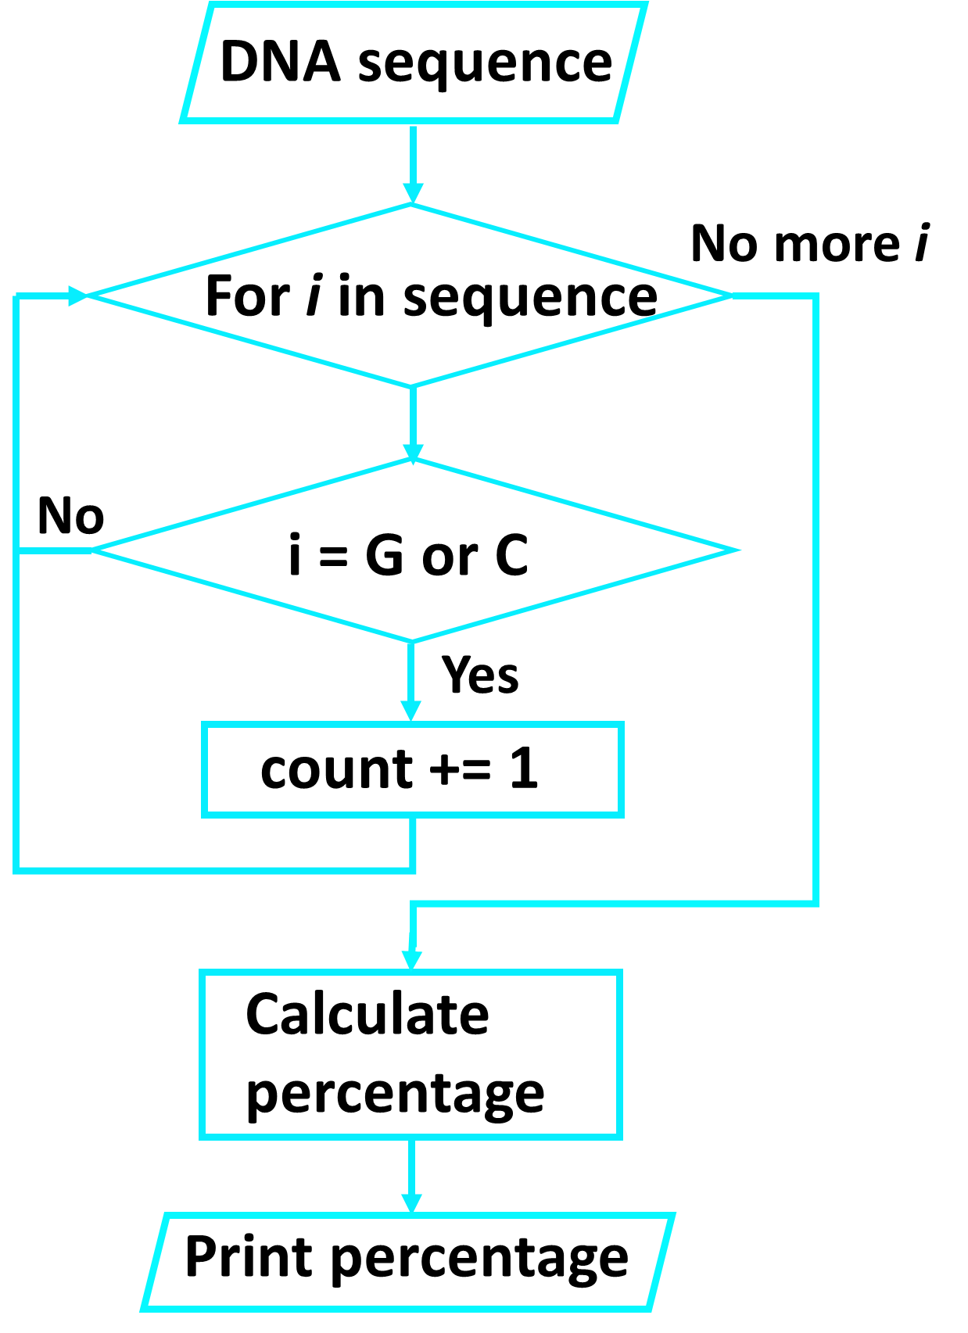
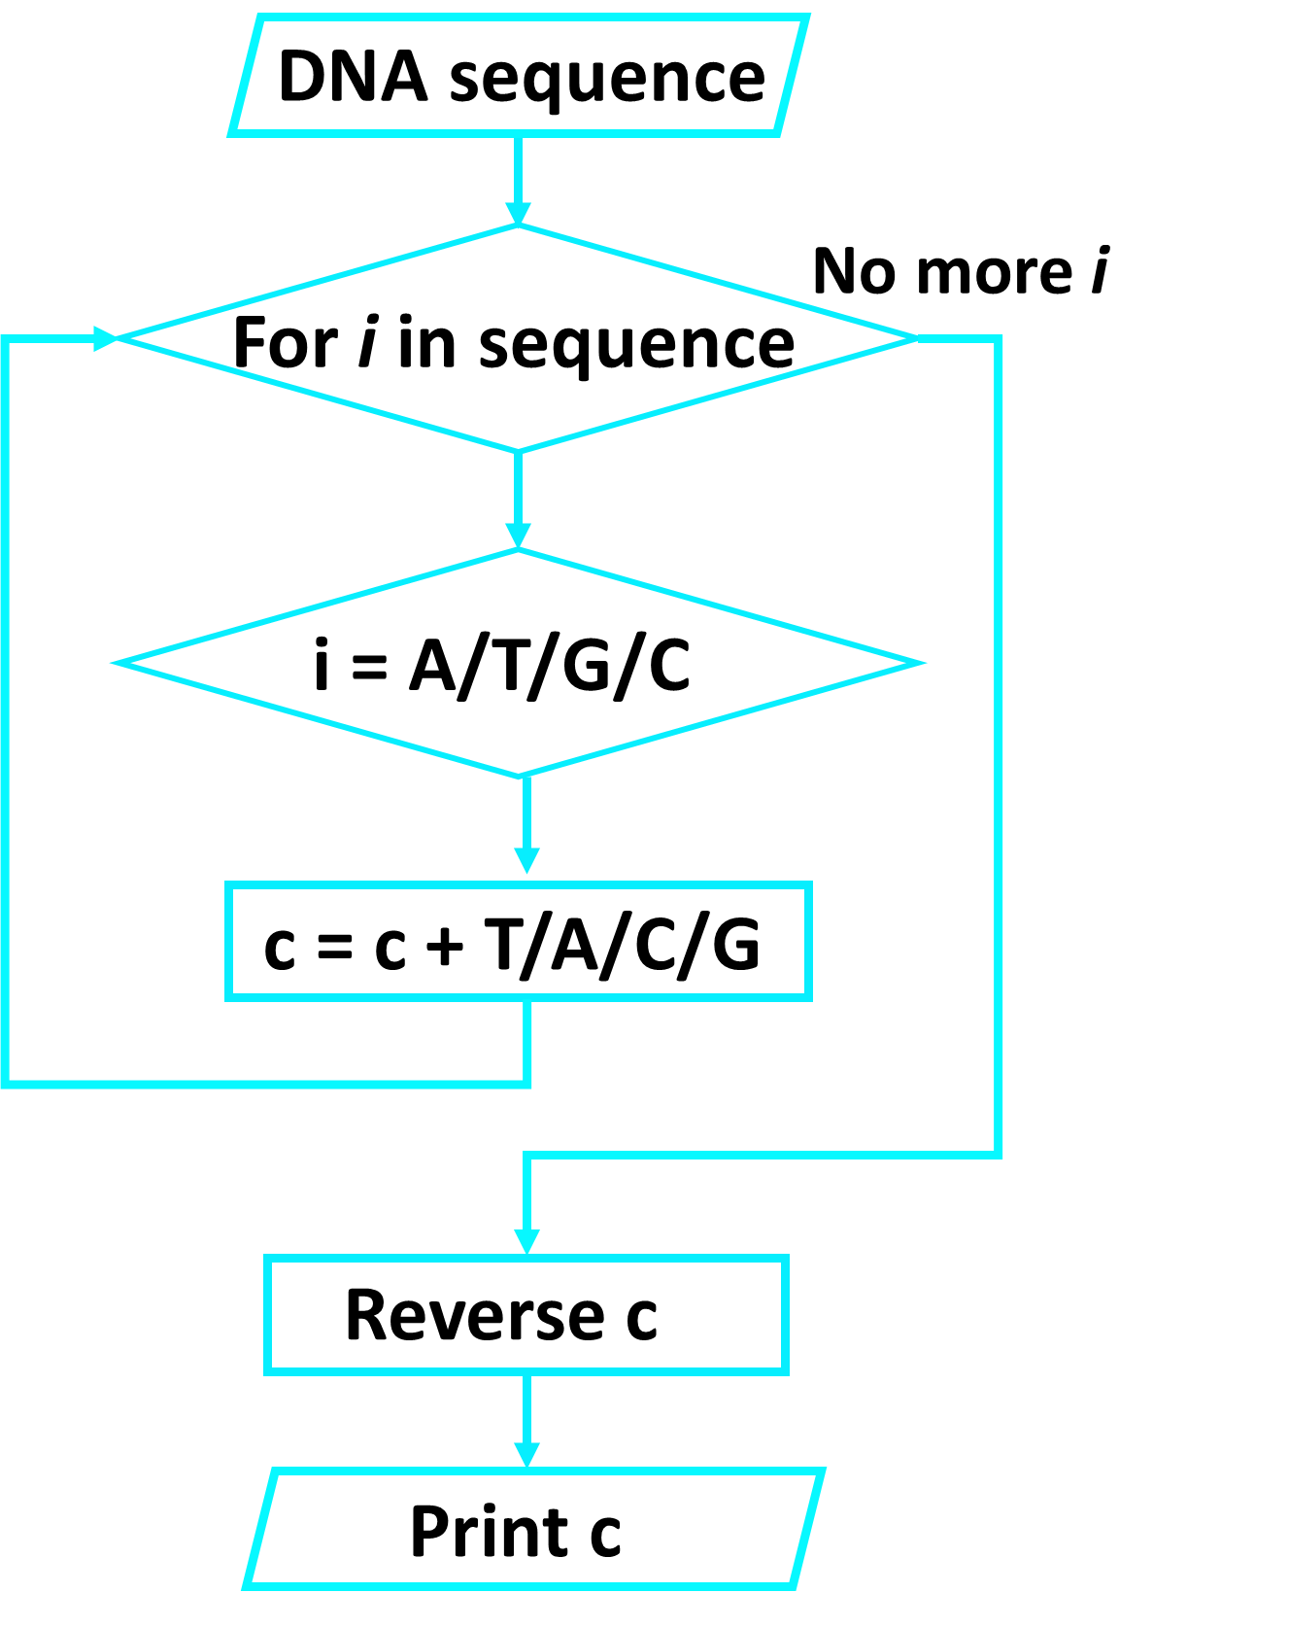
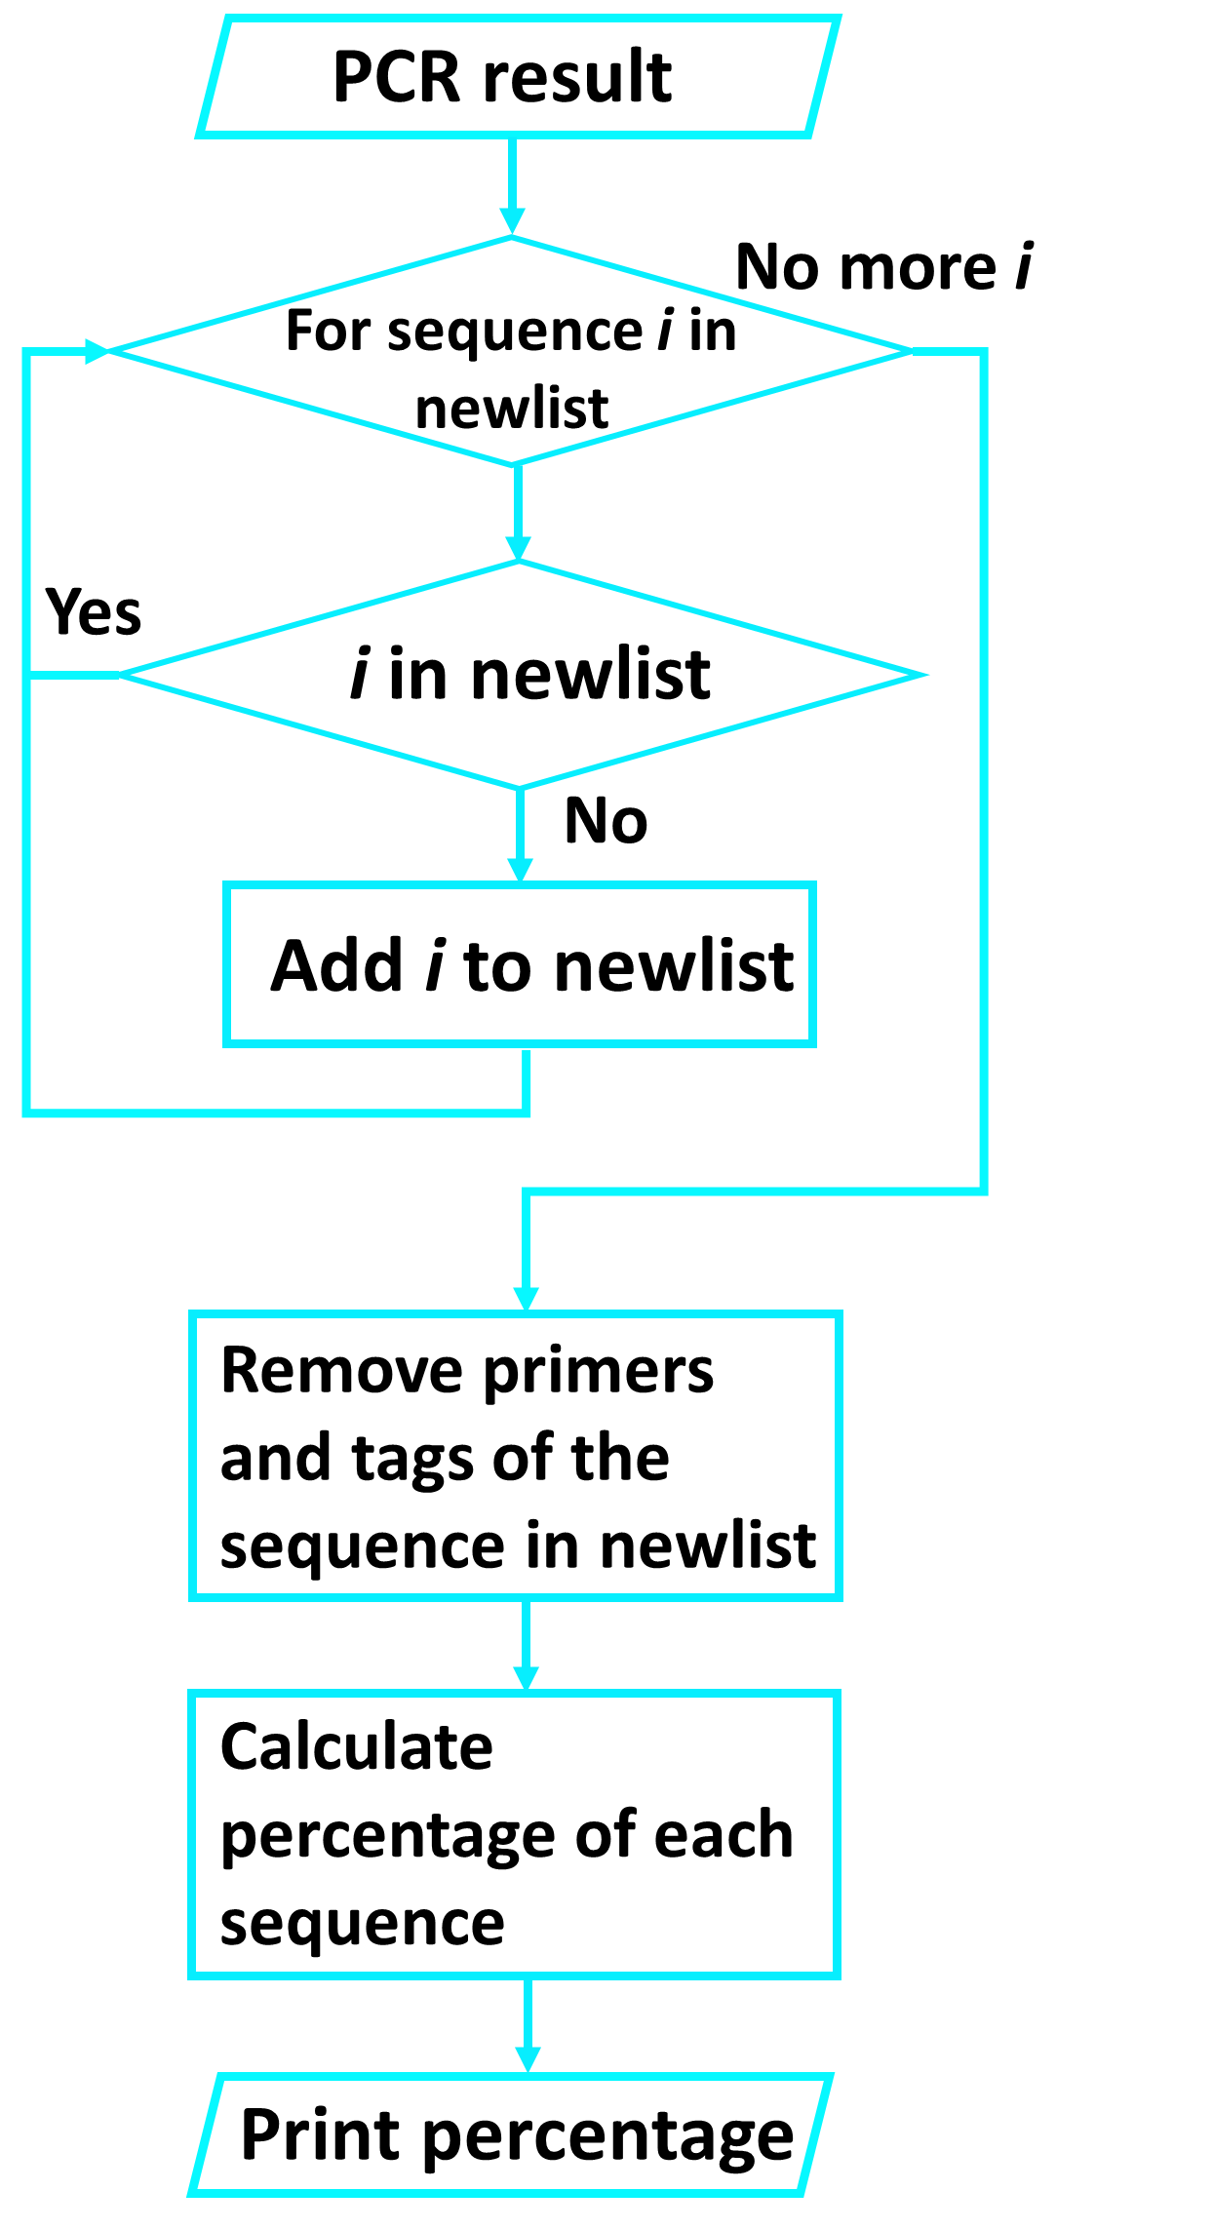
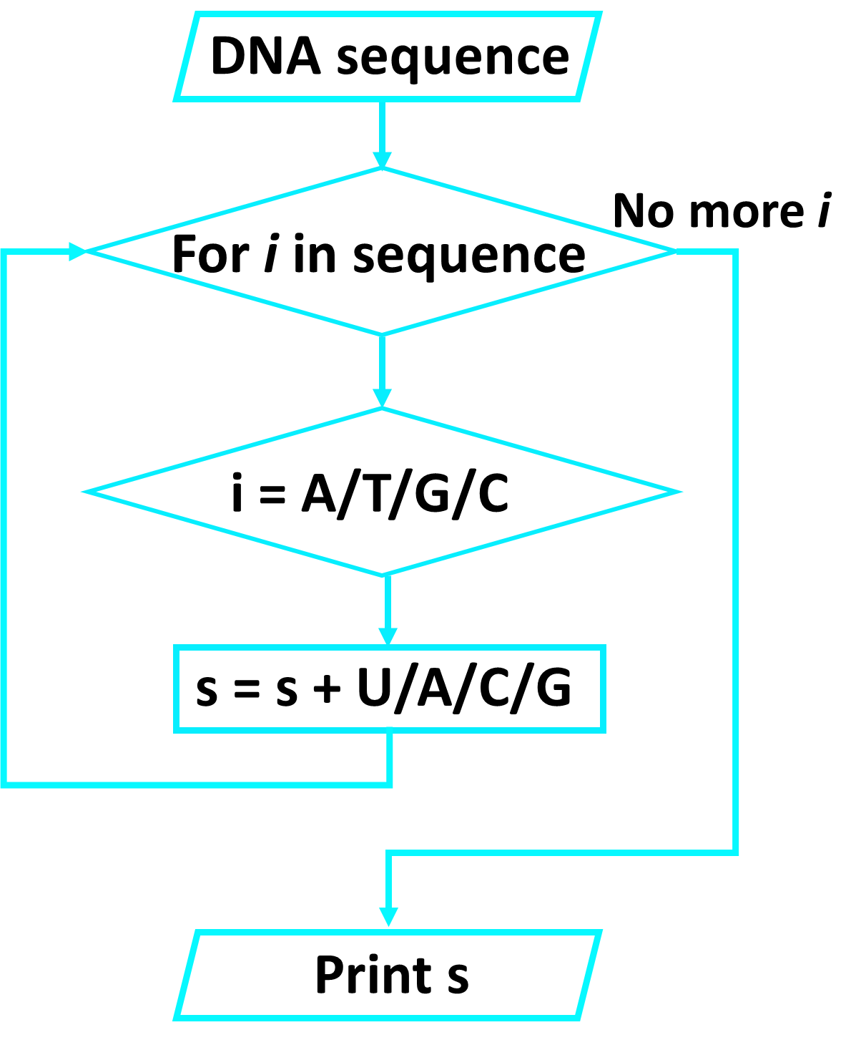
Task 1:
Explain the problem and biological importance:
GC content is the percentage of Guanine and Cytosine nucleotides in part of a DNA. Between Guanine and Cytosine, there are three hydrogen bonds while Adenine-Thymine base pairs have only two. This means that Guanine-Cytosine base pairs contribute more to DNA stability than Adenine-Thymine base pairs. Therefore, the stability and melting temperature of DNA depend on the GC content. In polymerase chain reaction (PCR) experiments, GC content can also be used to predict annealing temperature of primers to the template DNA.
Task 4:
Explain the problem and biological importance:
Translation, one of the steps in Central Dogma converts sequences of bases in mRNA into chains of amino acids.
The approach you took
1. Request user input of mRNA sequence.
2. Continue the process if the input only contains the letters: A, U, G and C.
3. Return the index position of the first occurrence of AUG.
4. To loop through the mRNA sequence and access 3 elements at the same time, use for in range with step size of 3. The 3 elements will form a codon.
5. Retrieve the amino acid 1-letter code of the codon from a dictionary.
6. For each codon in mRNA, add its 1-letter code to a string variable.
The result:
Show the amino acids sequence in the string variable to the screen.
Task 2:
Task 5:
Explain the problem and biological importance:
DNA is a double helix of two complementary strands. In DNA replication, each strand of a DNA serves as a template to produce an identical replica of the original DNA. If we have one stand of DNA sequence, we can know what its complementary DNA strand looks like by the principle of complementary base pairing.
Virus vectors such as AAV are commonly used for tissue-specific drug delivery in gene therapy. In order to screen the tissue specificity of different motif in proteins of the virus, a library with same length of amino acid sequence with a 1aa shifting sliding window is usually created. Based on the library, DNA molecules were synthesized, attached with primers as well as barcode sequence (UMI), underwent PCR and finally sequenced by next-generation sequencing (NGS). The process above is repeated Our code is used to analyze the result of NGS, dealing with the result of sequencing to find out effective domains for tissue penetration.
Step 1: delete the sequence with same UMI (decrease the error caused by PCR preference).
Step 2: Extract and align interested sequence segments by comparing to a reference sequence.
Step 3: Take count of the repeated times of certain sequence and create plots to detect functional motifs of proteins.
Task 3:
Explain the problem and biological importance:
The genetic information stored in DNA cannot be directly converted into proteins as the cellular protein factory – ribosomes only read instruction in the form of RNA. Therefore, a Central Dogma process known as transcription is important for converting the sequences of bases in DNA into RNA messages.
Conclusion:
Reference:

