Slide 1
DNA sequence
For i in sequence
No more i
No
i = G or C
Yes
count += 1
Calculate percentage
DNA sequence
Print percentage & pie chart
No more i
For i in sequence
i = A/T/G/C
DNA sequence
No more i
c += T/A/C/G
For i in sequence
i = A/T/G/C
Reverse c
Print c
mRNA += U/A/C/G
Print mRNA

Slide 2
mRNA sequence
PCR result
Start from AUG
For sequence i in
PCR result
No more i
Stop codon?
Yes
Yes
No
i in newlist
S += amino acid
No
Add i to newlist
Print S
Print newlist
experiments, GC content can also be used to predict annealing temperature of primers to the template DNA.
Remove primers and tags of the sequence in newlist
GC content is the percentage of Guanine and Cytosine nucleotides in part of a DNA. Between Guanine and Cytosine, there are three hydrogen bonds while Adenine-Thymine base pairs have only two. This means that Guanine-Cytosine base pairs contribute more to DNA stability than Adenine-Thymine base pairs. Therefore, the stability and melting temperature of DNA depend on the GC content. In polymerase chain reaction (PCR)
Calculate percentage of each sequence
Print percentage

Slide 3


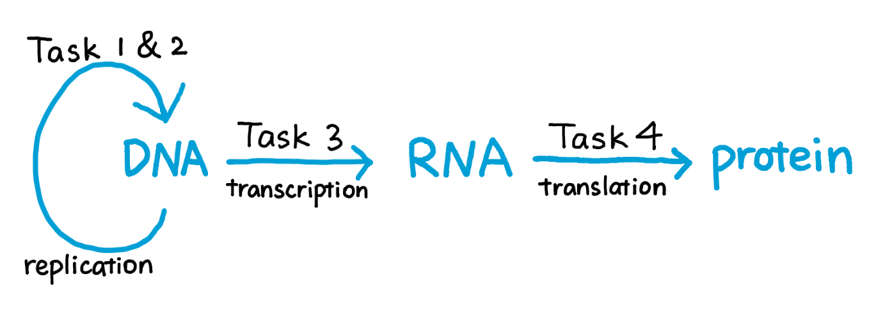
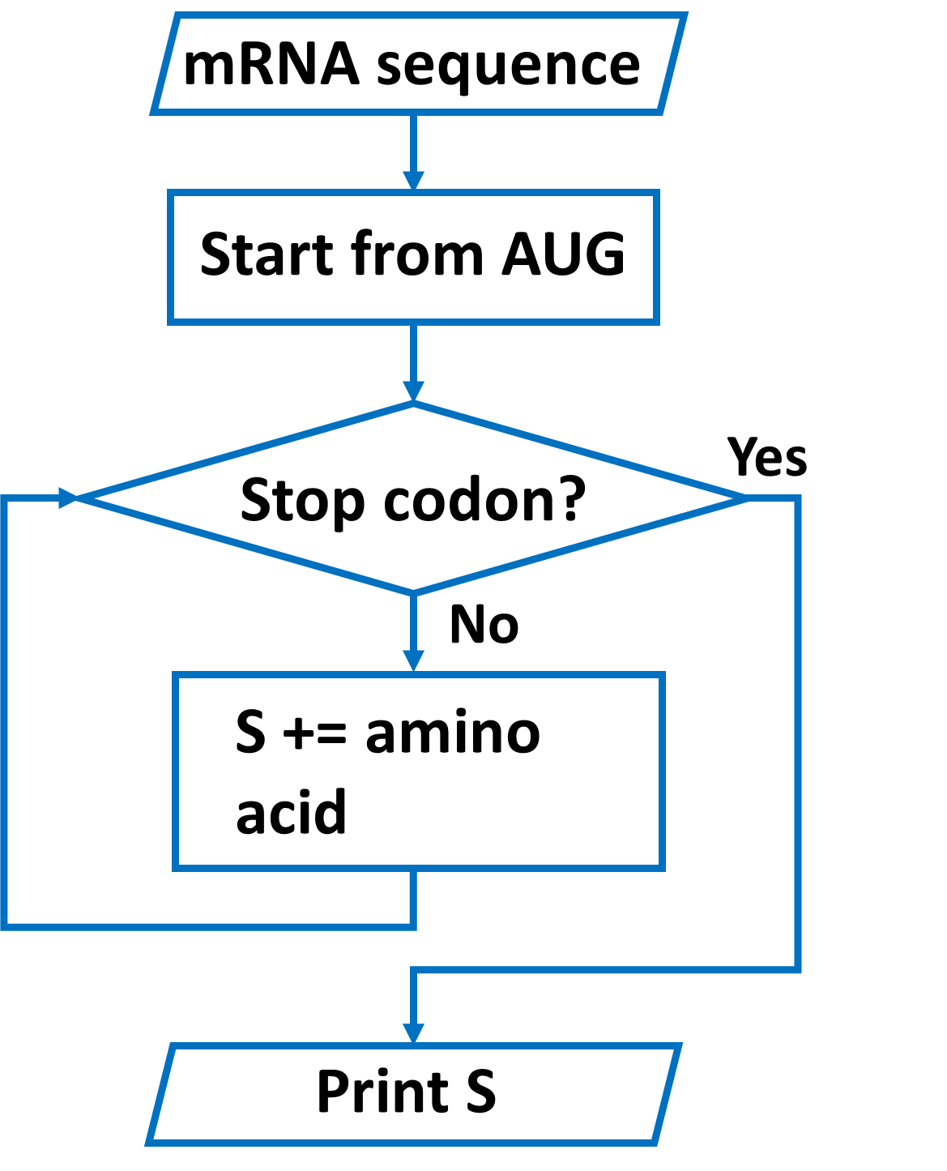
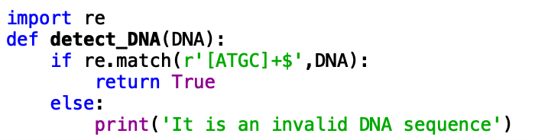
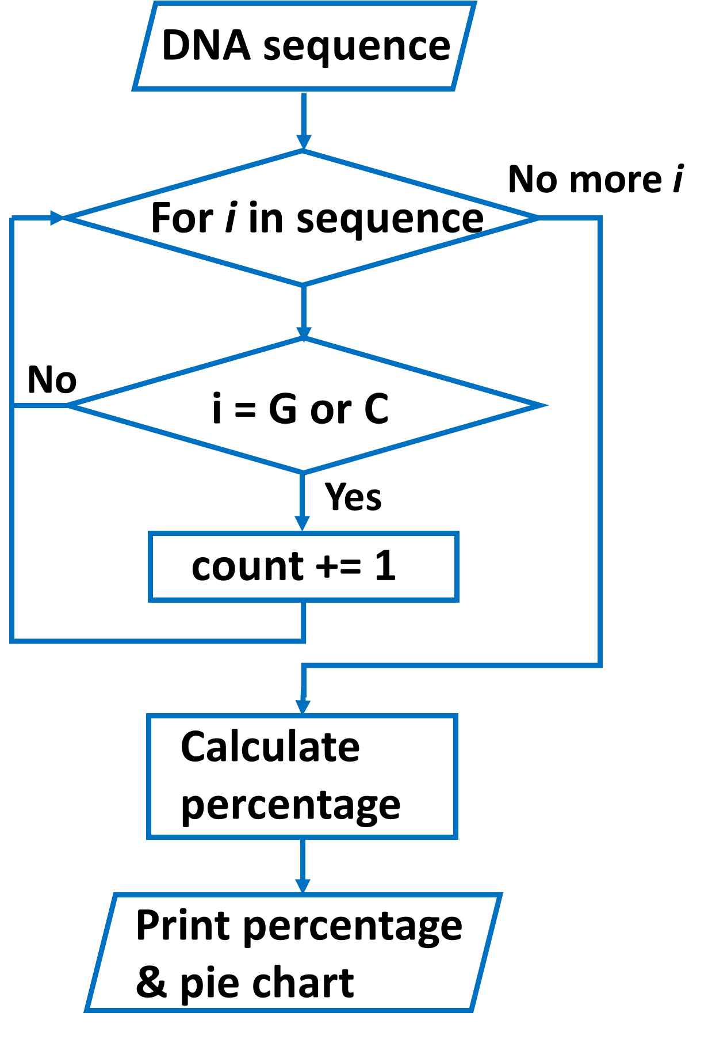
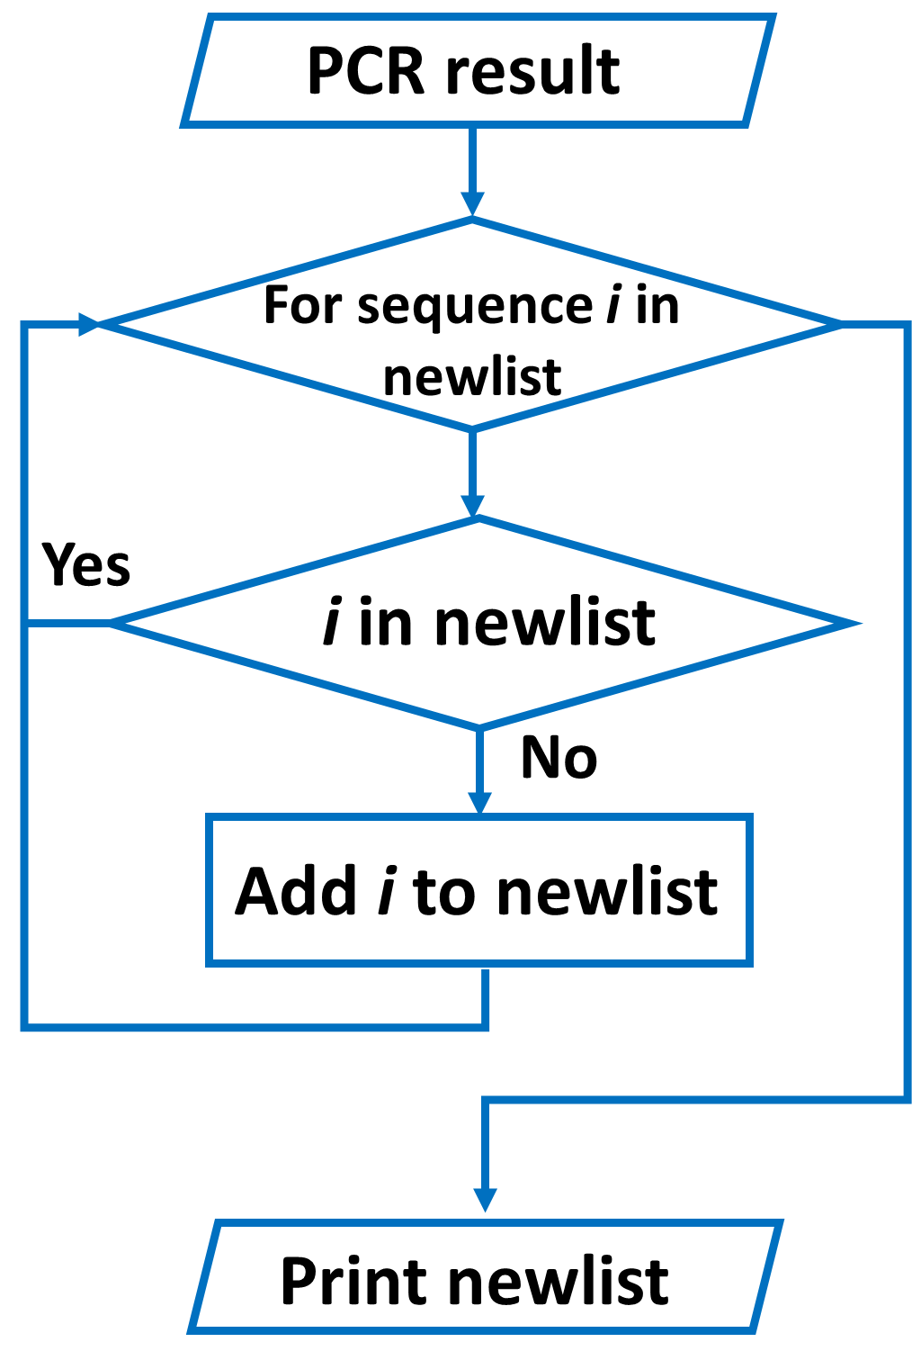
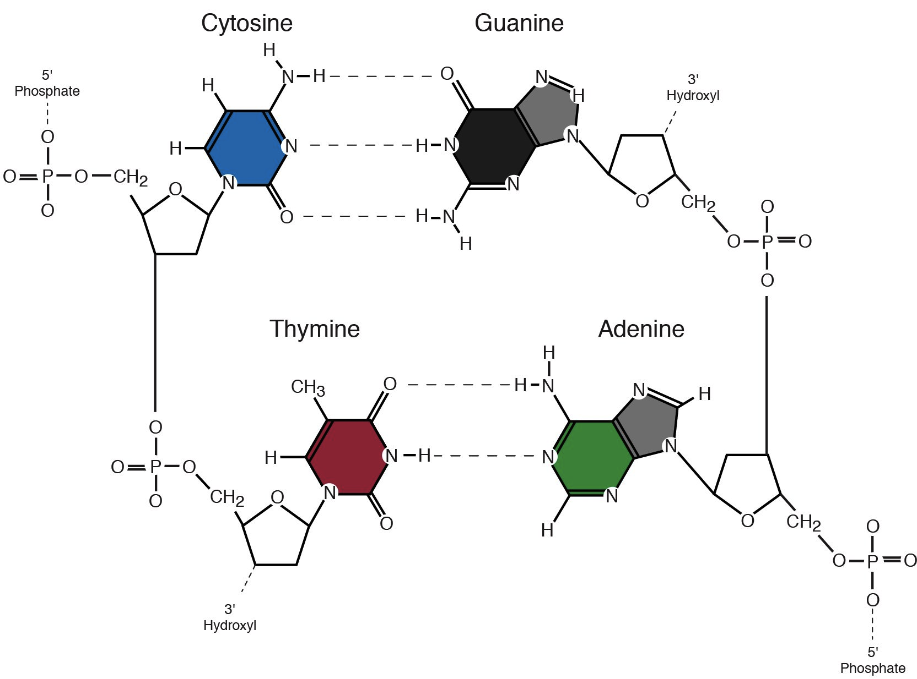
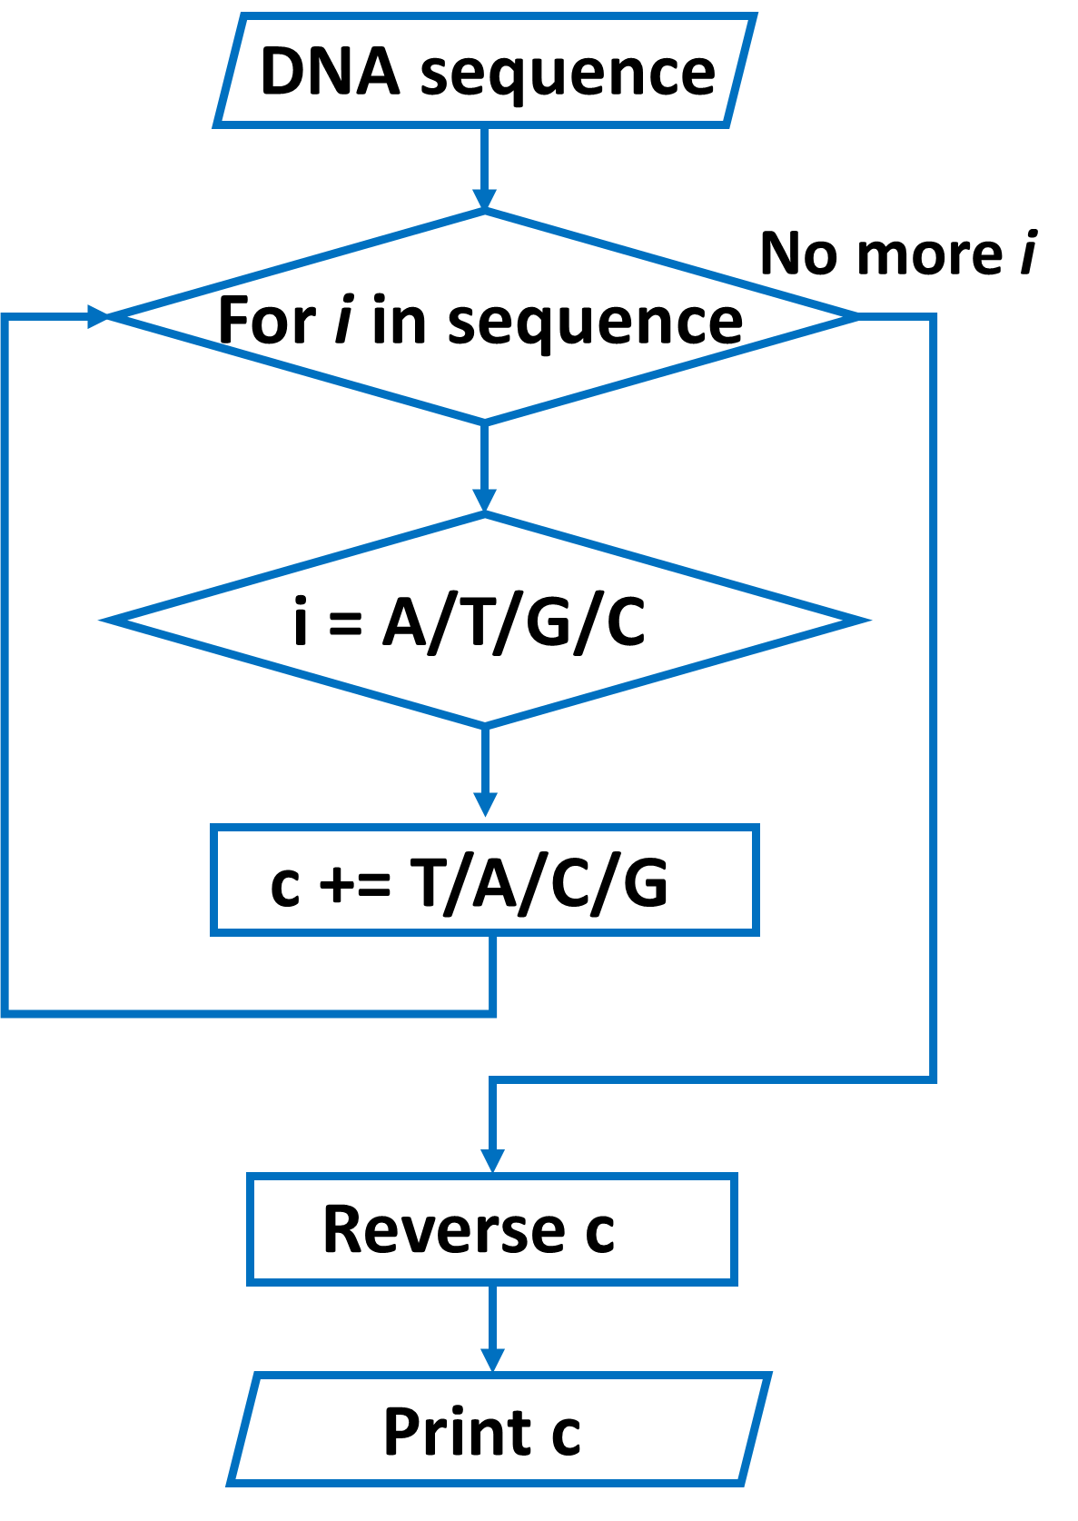
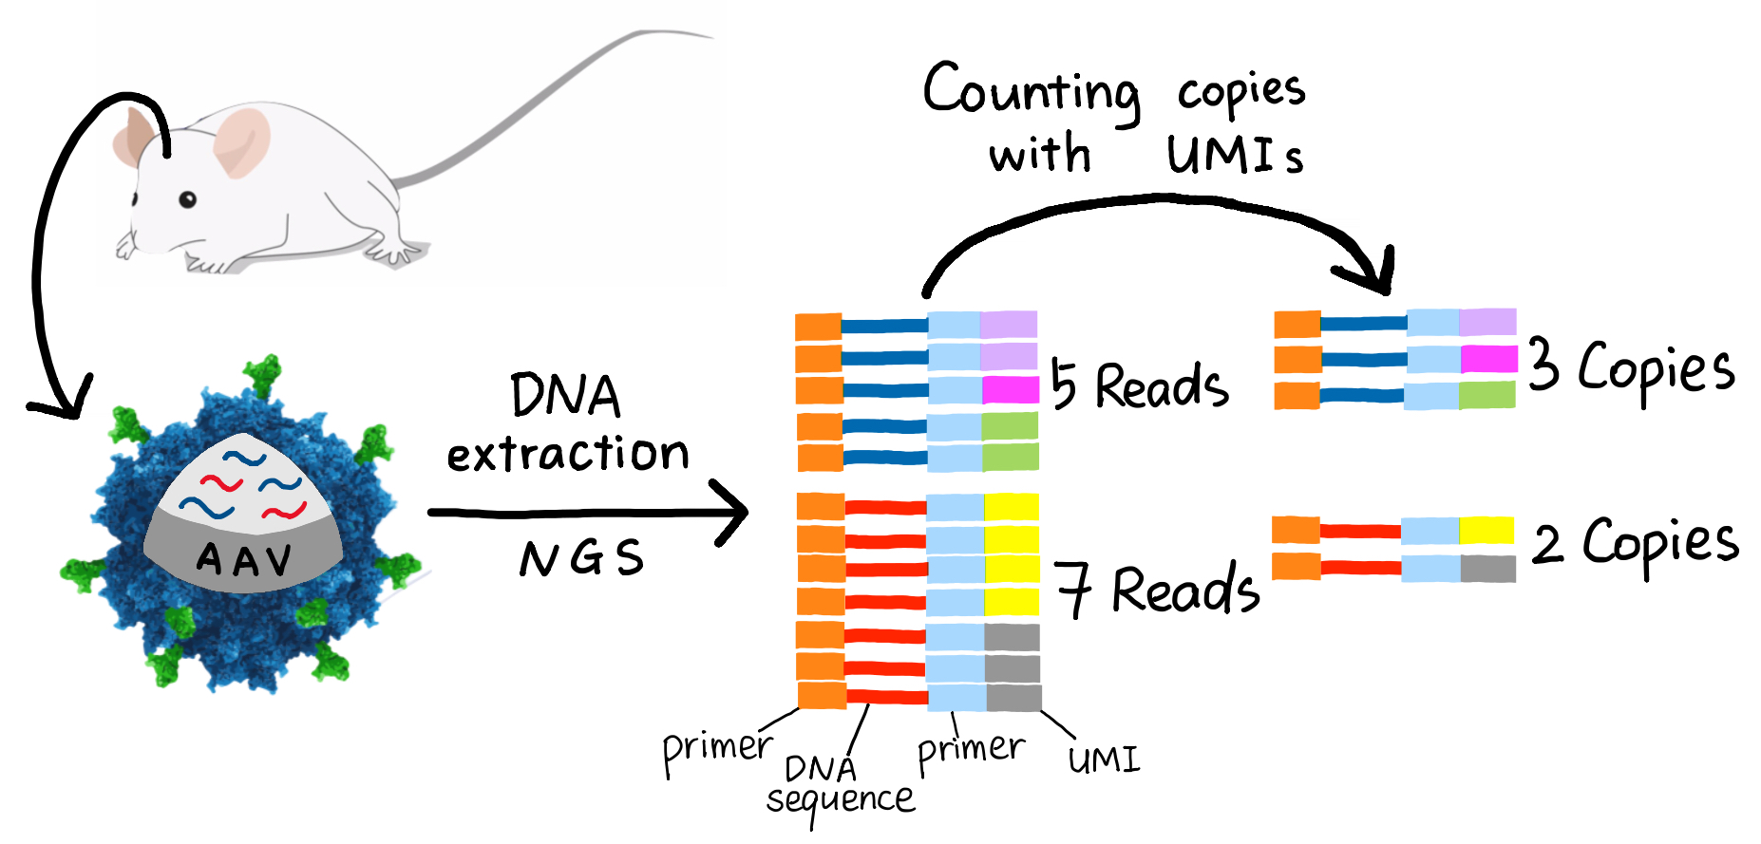
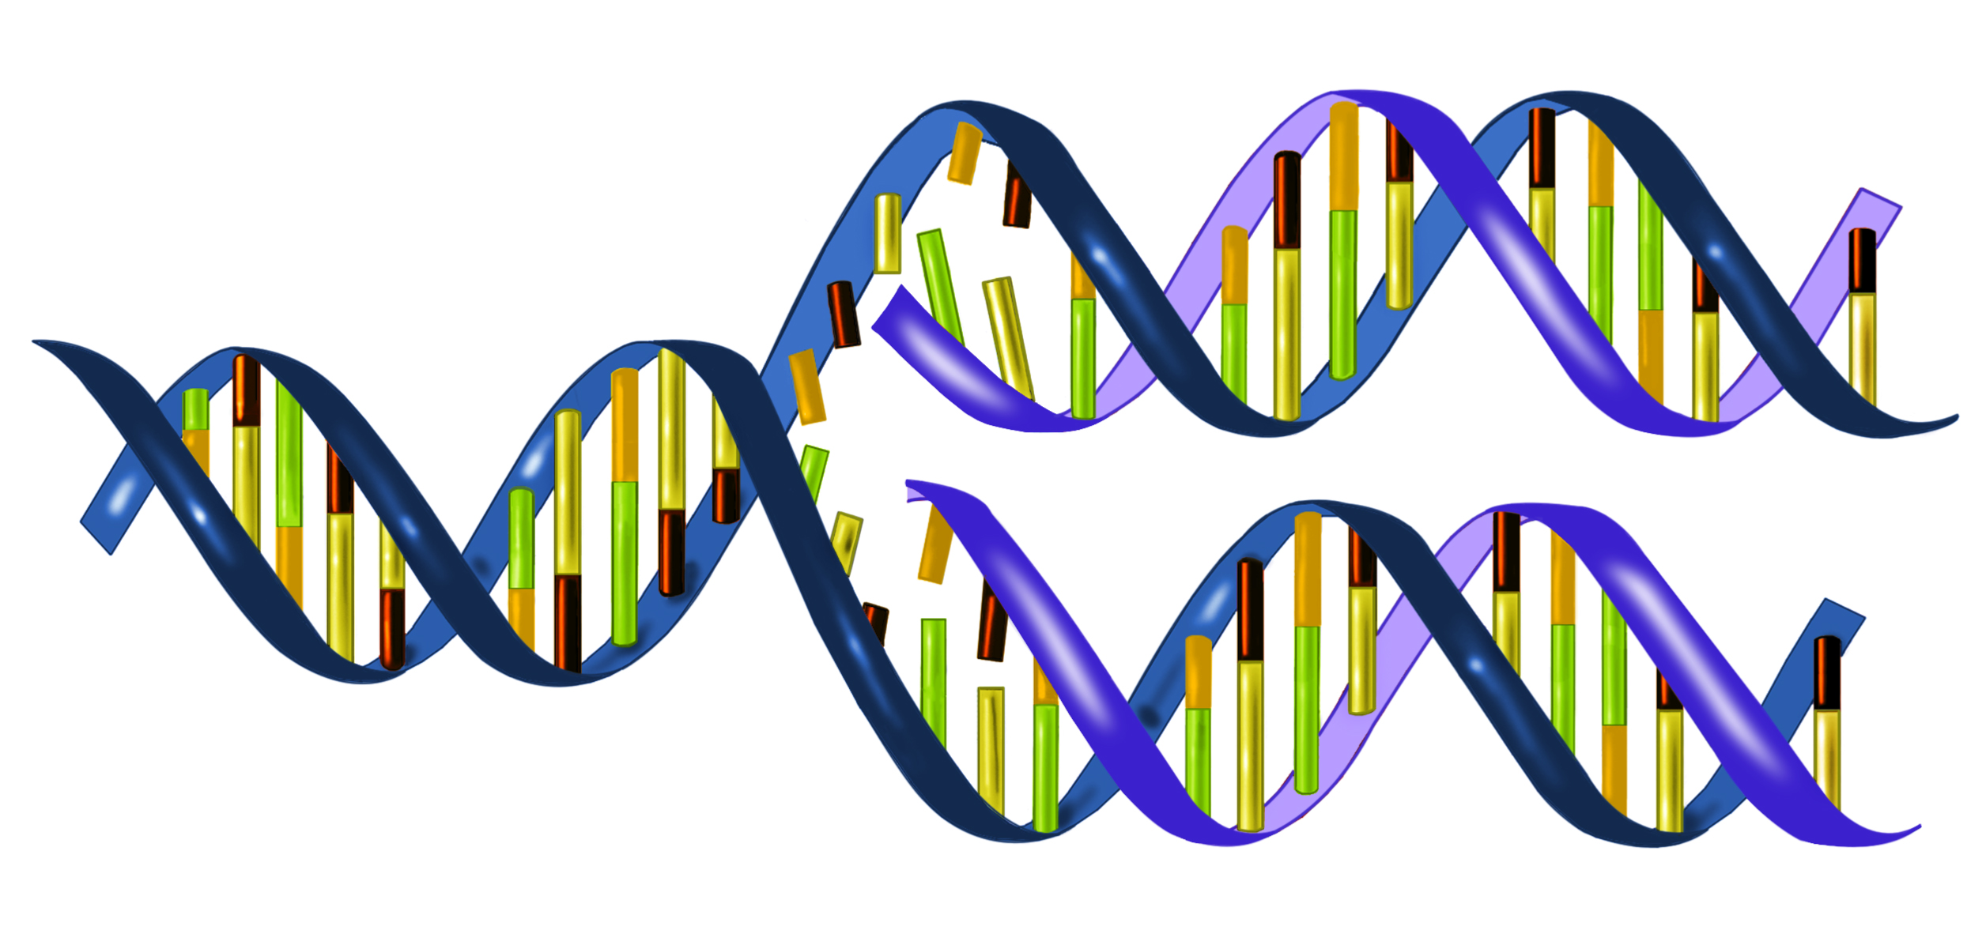
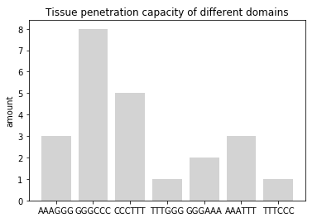
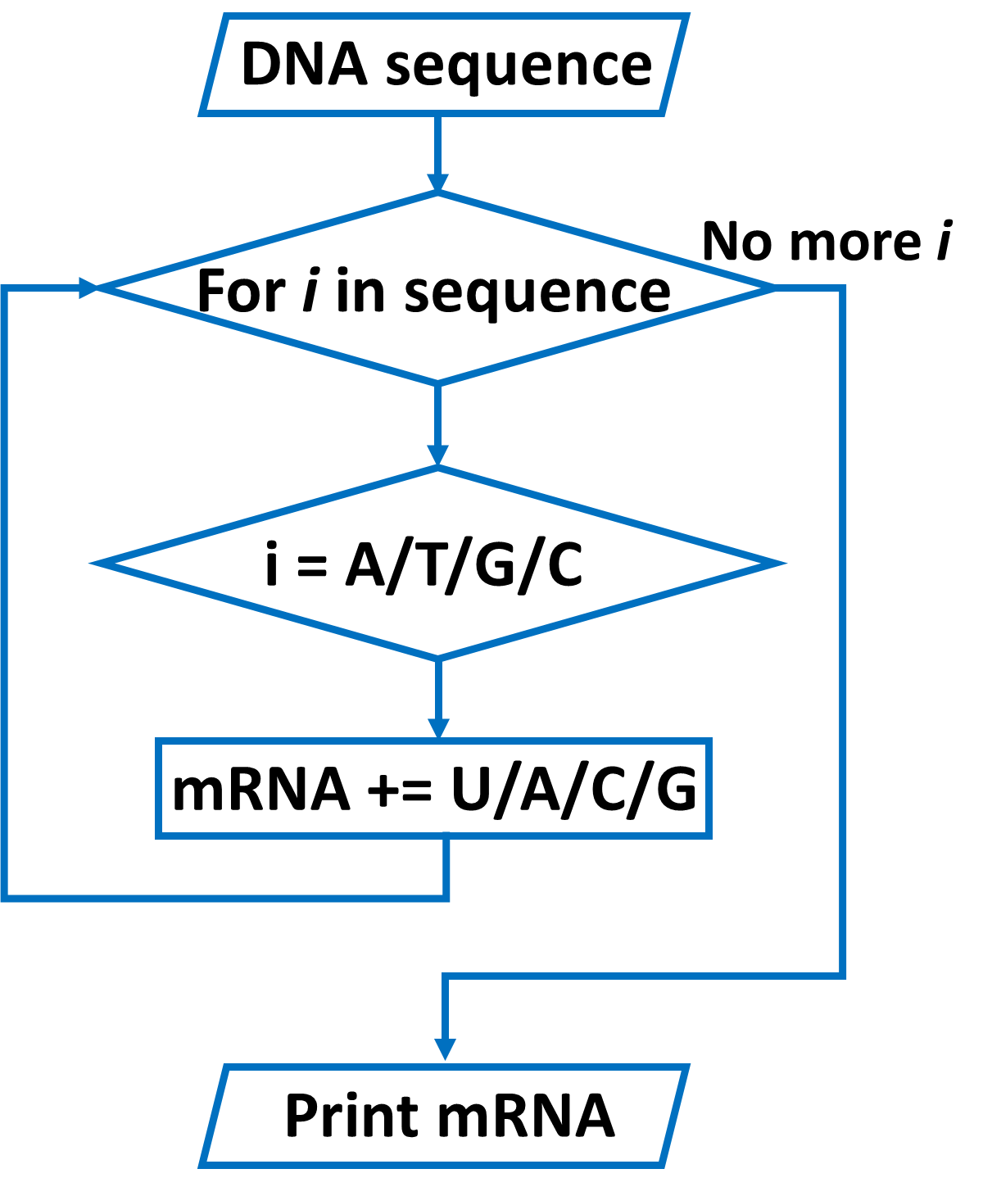
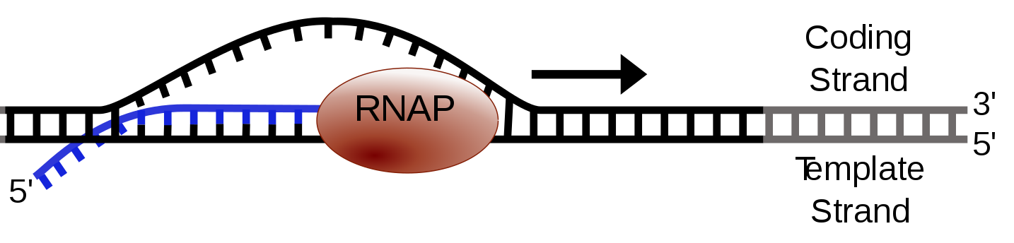
Nucleic Acid Analysis
Task 1 & 2: Hongbing PAN
Task 3 & 4: Adele VALERIA
Task 5: Yuchen CHENG & Jiayi SHEN
Poster: Hanqi XIE
All work has been
peer reviewed.
Introduction
Task 4
Translation, one of the steps in Central Dogma converts a sequence of mRNA bases into a chain of amino acids. A group of 3 mRNA bases called codon encodes for a specific amino acid. Codon can also signal the beginning (start codon) and end (stop codon) of the translation.
Coding:
Step 1: Return the index position to the first occurrence of AUG.
Step 2: Use a for-in-range loop with a step size of 3 to loop through the mRNA sequence and access 3 elements at the same time.
Step 3: If the codon encodes an amino acid, its 1-letter-code will be retrieved from the dictionary and used to form a new sequence of amino acids.
Step 5: If the codon signals stop, the loop will terminate and print out the sequence of amino acids.
Step 6: If there is no start and or stop codon, an error message will appear.
Figure 1. Relationship between Task 1, 2, 3 & 4
Detect the validity
Task 1
GC content is the percentage of Guanine and Cytosine nucleotides in a DNA sequence. In comparison with Adenine-Thymine (A-T) base pairs which contain only two hydrogen bonds, Guanine and Cytosine (G-C) form three bonds (Fig.2). Therefore, G-C pairs contribute greater DNA stability than A-T, making the stability and melting temperature of DNA depend on the GC content. In polymerase chain reaction (PCR), GC content can also be used to predict
Chart 4. Flow Chart of Task 4. ‘S’ refers to amino acid sequence.
Task 5
Viral vectors such as AAV are commonly used for tissue-specific therapeutic gene delivery in gene therapy. To screen the tissue-specific AAV variant, a tiling library harboring DNA sequence encoding with amino acid sequence was created and synthesized. The sequence was flanked by PCR primers as well as unique molecular identifiers (UMI) (Fig.5) for preparing next-generation sequencing (NGS). The AAV harboring the library was injected into mice for selection of tissues-specific variants. The aim of our code is to analyze the convergence of the library selection based on result of NGS, thus finding out the functional domains for better tissue penetration (Davidsson et al., 2018) (Grun and Oudenaarden, 2015)
annealing temperature of primers to the template DNA which is important to the efficiency and specificity of the experiments (Strien et al., 2013).
Chart 1. Flow Chart of Task 1. ‘count’ represents the number of Guanine and Cytosine.
Figure 2. Hydrogen Bonds between Base Pair.
http://knowgenetics.org/nucleotides-and-bases/
Task 2
Chart 5. Flow Chart of Step 1 in Task 5
DNA is a double helix made of two antiparallel strands and linked by complementary base pairing between A-T and C-G. In DNA replication, each strand serves as a template to produce an identical replica of the original DNA (Fig.3). If the sequence of bases in one strand of DNA is known, the principle of complementary base pairing can be used to determine the sequence of bases in the corresponding strand.
Figure 5. Quantification of the DNA extracted from Virus.
Coding:
Step 1: delete the sequence with same UMI (decrease the error caused by PCR preference).
Step 2: Extract and align the DNA fragments by comparing to a reference sequence.
Step 3: Take count of the repeated times of certain sequence and create plots to detect functional motifs of proteins (Fig.6).
Figure 3. Diagram of DNA Replication
https://www.thinglink.com/scene/878491570184126464
Chart 2. Flow Chart of Task 2. ‘c’ refers to the complementary DNA sequence (5’ to 3’).
Task 3
Figure 6. An Example of the Outcome of Task 5. The larger the amount of a piece of DNA, the better ability of this protein domain to penetrate tissue. In this example, the protein domain encoded by GGGCCC has the best tissue penetration capacity. (The DNA sequence used in the example is not real.)
The genetic information stored in DNA cannot be directly converted into proteins as the cellular protein factory (ribosomes) only read the instruction in the form of RNA. Although RNA is chemically similar to DNA, it contains Uracil instead of Thymine. A Central Dogma process known as transcription is important for converting the sequence of bases in DNA into RNA message.(Fig.4).
Further Improvement
To make our code more user-friendly, we created a user interface. We first give the user some functions to choose and a corresponding number. Then, the user can select the function they want to use by typing in one of these numbers.
Reference
Figure 4. Diagram of Transcription Elongation. RNAP, RNA polymerase. https://en.wikipedia.org/wiki/Transcription_(biology)#/media/File:Simple_transcription_elongation1.svg
DAVIDSSON, M., WANG, G., ALDRIN-KIRK, P., CARDOSO, T, NOLBRANt, S., Hartnor, M, Parmar, M & Björklund, T. (2018) Barcoded Rational AAV Vector Evolution enables systematic in vivo mapping of peptide binding motifs. BioRxiv
Grun, D. & Oudenaarden, V. (2015) Design and Analysis of Single-Cell Sequencing Experiments. Cell, 163, 799-810
Strien J., Sanft J. & Mall G. (2013) Enhancement of PCR amplification of moderate GC-containing and highly GC-rich DNA sequences. Mol Biotechnol, 54(3), 1048-1054
Chart 3. Flow Chart of Task 3.

