Slide 1
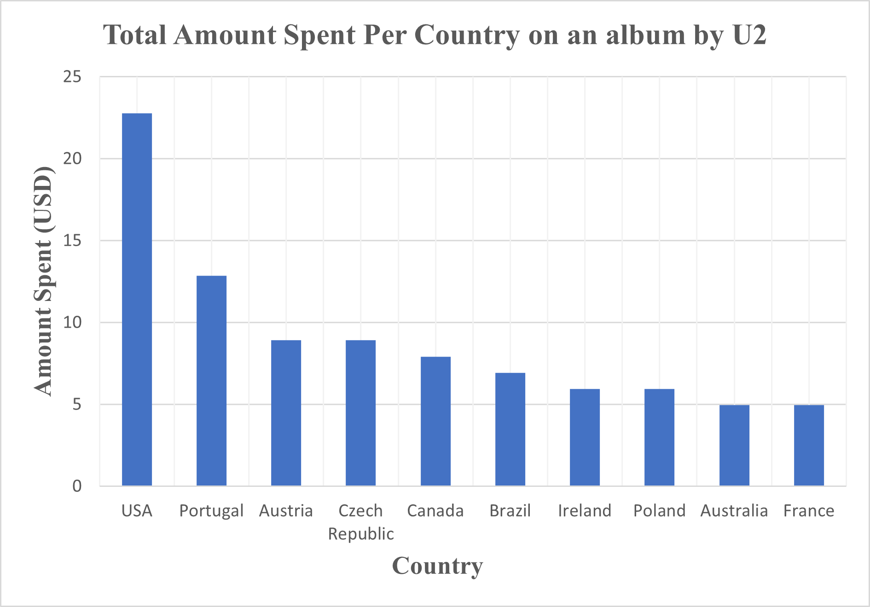
Amount Spent by Customers Per Country on any album by U2
On the albums by U2, customers from the USA spent the most of any country accounting for $22.77. It can also be seen that Customers from Australia and France spent the same amount for albums made by U2.
Notes:
SELECT c.Country, COUNT(il.Quantity)*il.UnitPrice AS Amount
FROM Artist ar
JOIN Album a
ON a.ArtistId = ar.ArtistId
JOIN Track t
ON a.AlbumId = t.AlbumId
JOIN InvoiceLine il
ON il.trackId = t.trackId
JOIN Invoice i
ON i.InvoiceId = il.InvoiceId
JOIN Customer c
ON c.CustomerId = i.CustomerId
WHERE ar.name= “U2”
GROUP By c.Country, ar.name
ORDER BY Amount DESC
LIMIT 10

Slide 2
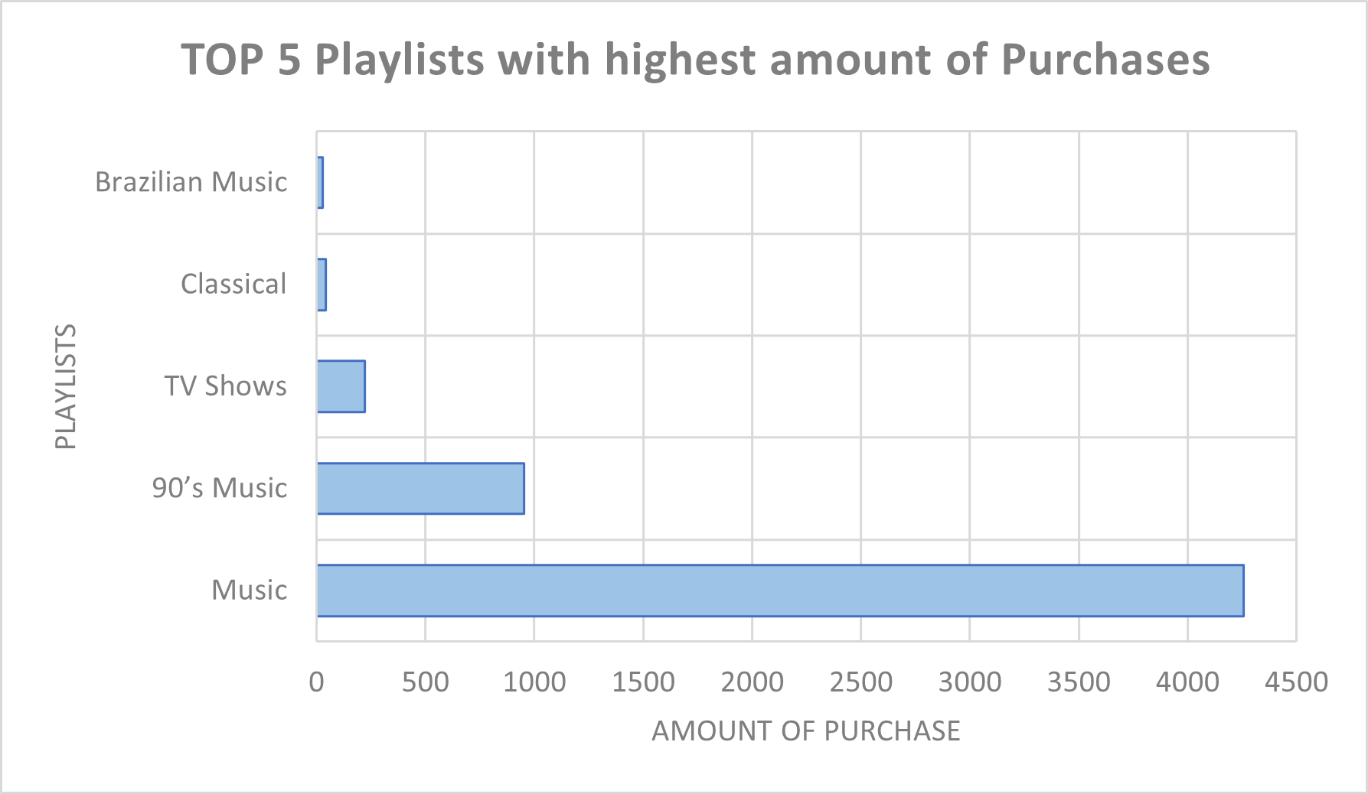
TOP 5 Playlists with highest amount of Purchase
Here is the bar chart for the top 5 playlists with high purchases in terms of invoice. Music generated 4258 purchases followed closely by playlist titled “90’s music”. Brazilian Music had the lowest amount of purchase.
Notes:
SELECT p.Name, COUNT(i.InvoiceId) AS Purchases
JOIN PlayListTrack pt
ON pt.PlaylistId = p.PlaylistId
JOIN Track t
ON t.TrackId = pt.TrackId
JOIN InvoiceLine il
ON il.TrackId = t.TrackId
JOIN Invoice i
ON i.InvoiceId = il. InvoiceId
JOIN Customer c
ON i.CustomerId = c.CustomerId
GROUP BY p.Name
ORDER BY Purchased DESC
LIMIT 5

Slide 3
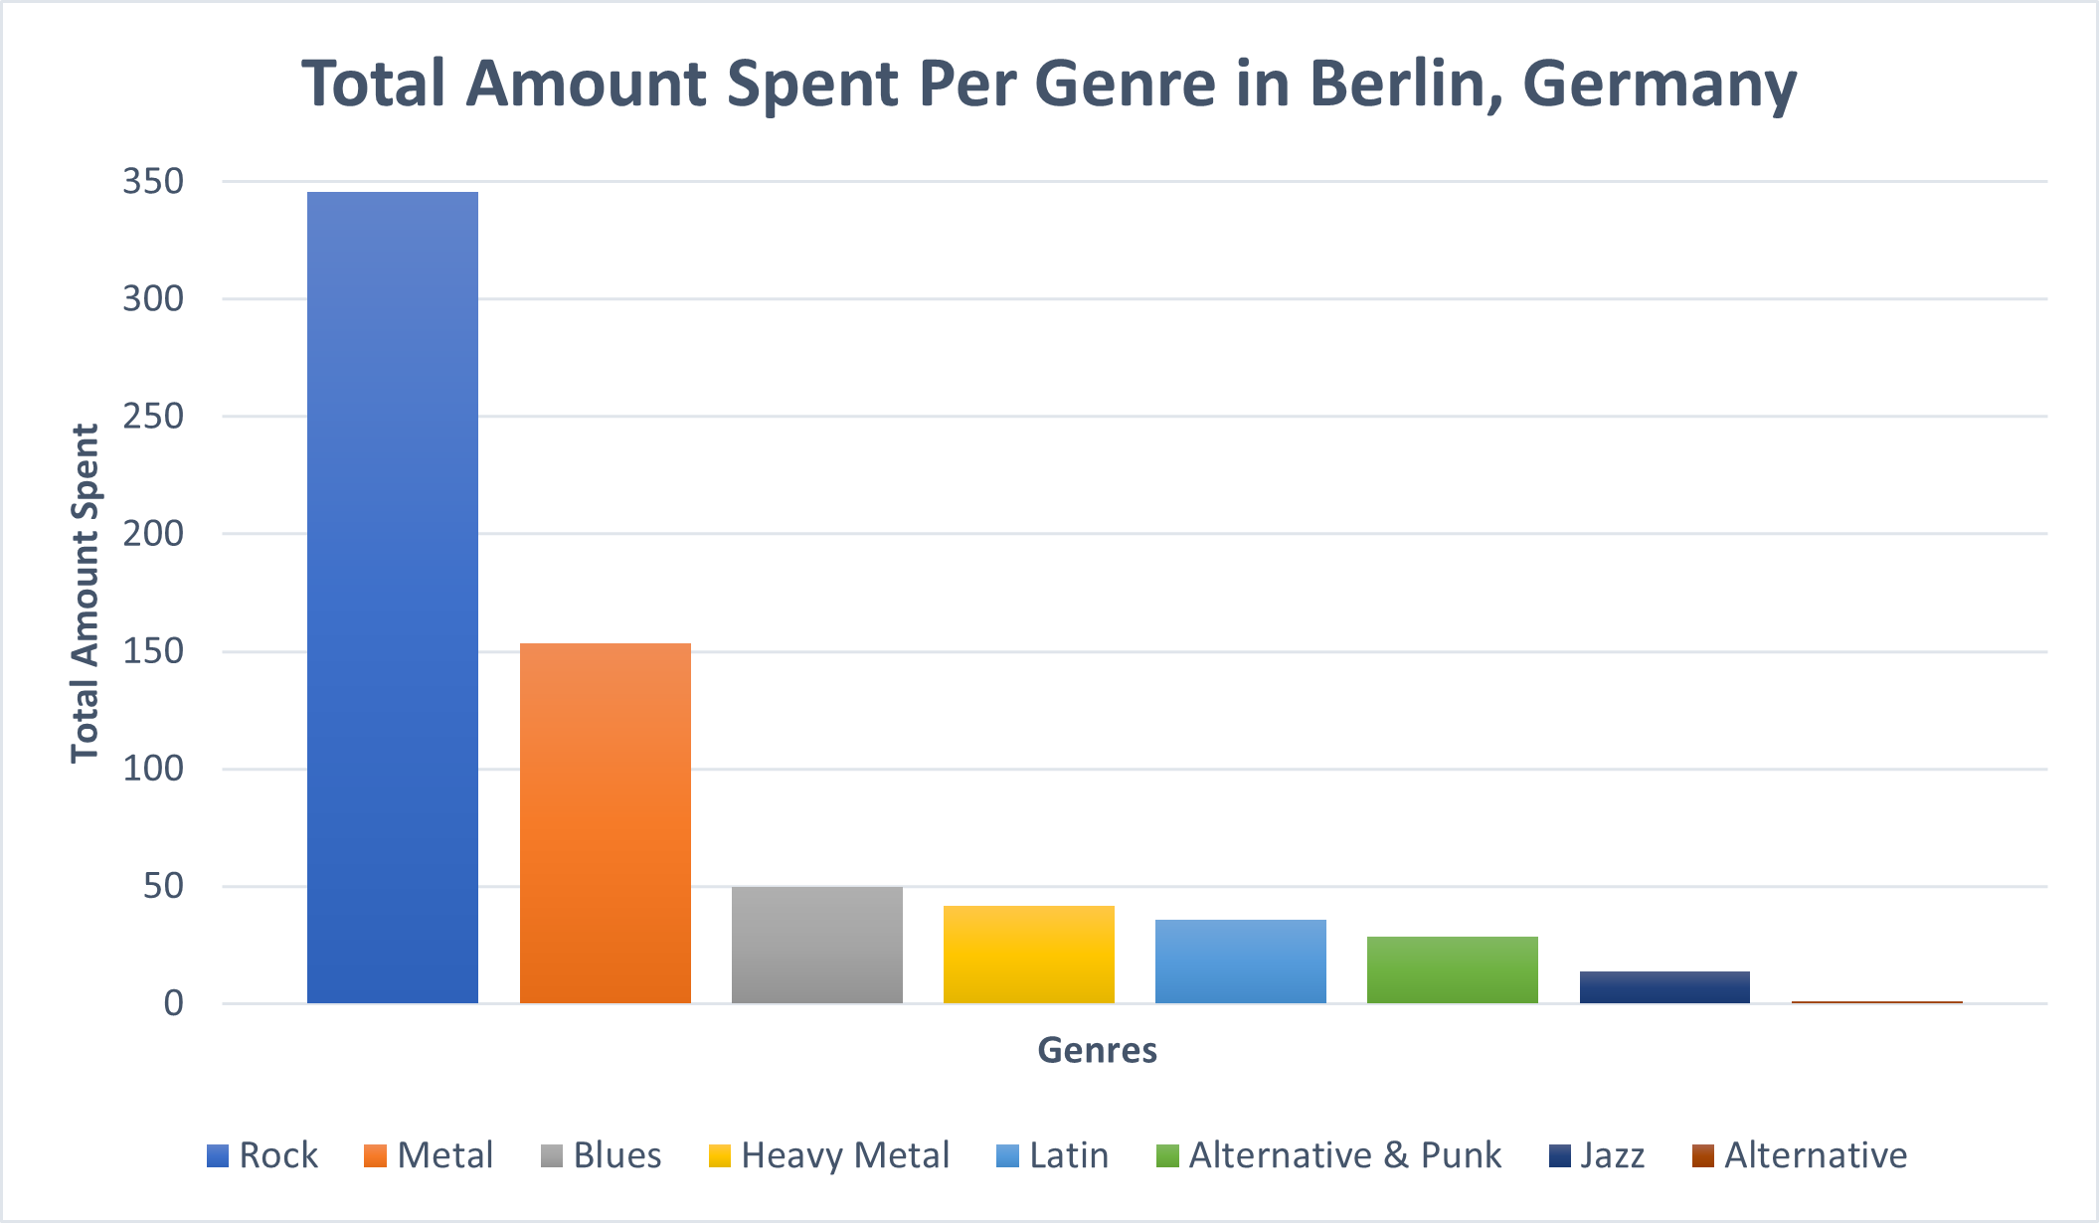
Total Amount Spent Per Genre in Berlin, Germany
It is visible that a lot of people spend a lot on rock music in berlin, Germany. Also, alternative is the least genre which customers are not likely to purchase in the city.
Notes:
SELECT g.name AS Genres, Sum(i.Total) Total_spent, c.city
FROM Customer c
JOIN Invoice i
ON i.CustomerId = c.CustomerId
JOIN InvoiceLine il
ON il.InvoiceId = i.InvoiceId
JOIN Track t
ON t.TrackId = il.TrackId
JOIN Genre g
ON g.GenreId = t.GenreId
WHERE c.Country = “Germany” and c.City =“Berlin”
GROUP BY Genres, c.City
ORDER BY c.City, Total_spent DESC
4.

Slide 4
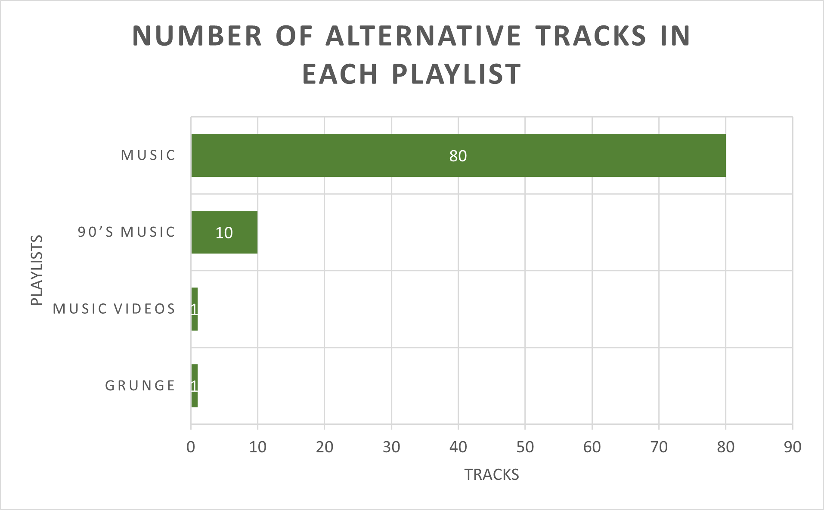
Alternative tracks in playlist
Alternative songs in each playlist are displayed. Playlist titled ‘Music’ has 80 alternative songs, followed closely by 90’s music with 10 songs. Only 1 alternative track can be found in both Music video and Grunge playlists.
Notes:
SELECT p.PlaylistId, g.Name, p.Name Playlists, Count(t.Name) AS Tracks
FROM Playlist p
JOIN PlaylistTrack pt
ON pt.PlaylistId = p.PlaylistId
JOIN Track t
ON pt.TrackId = t.TrackId
JOIN Genre g
ON t.GenreId = g.GenreId
WHERE g.name = “Alternative”
GROUP BY Playlists
ORDER BY Tracks

