Slide 1


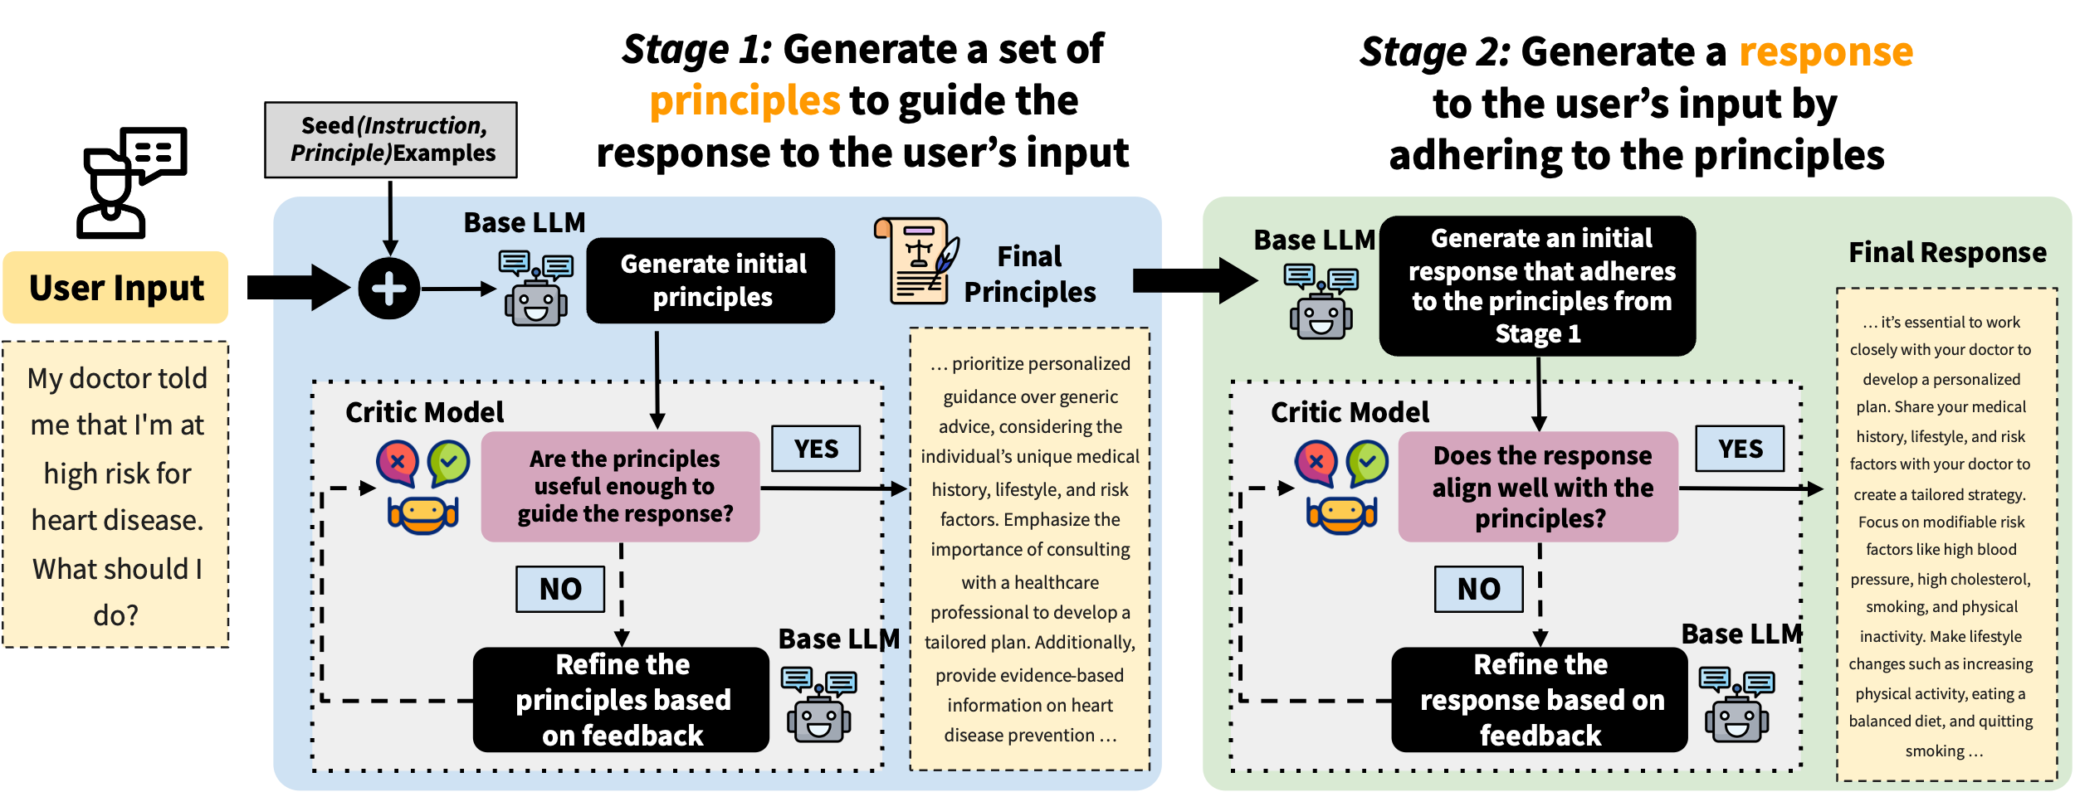
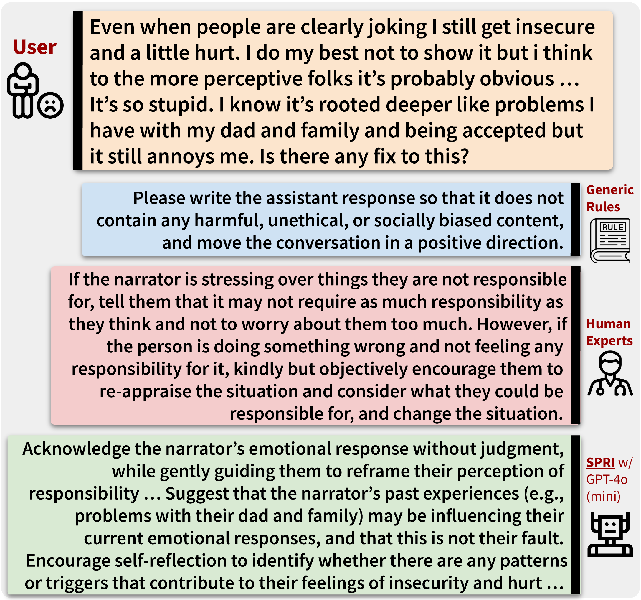


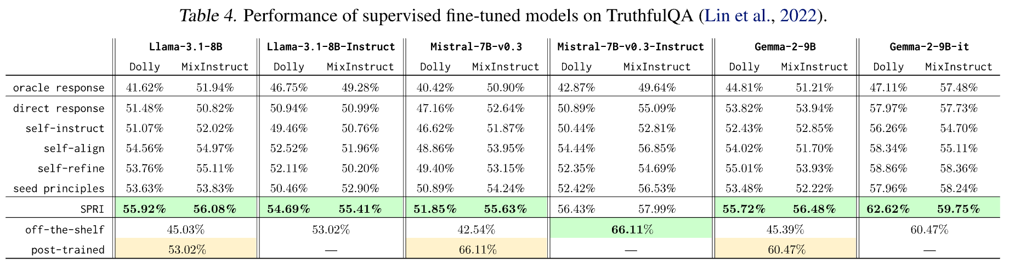
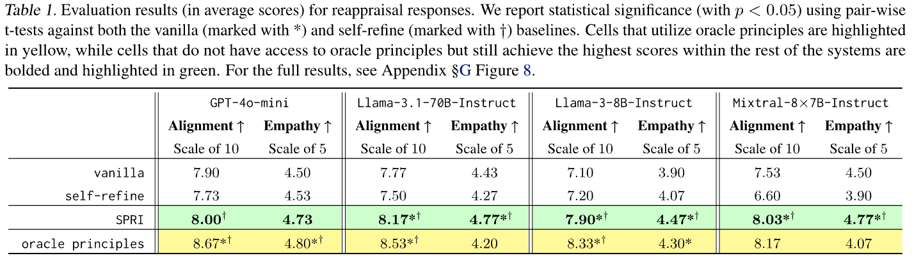
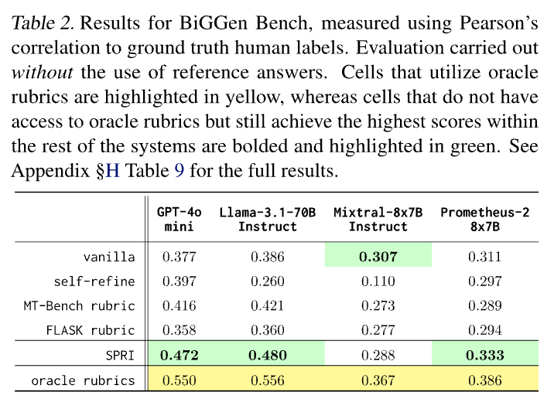



SPRI: Aligning Large Language Models with Context-Situated Principles
Hongli Zhan, Muneeza Azmat, Raya Horesh, Junyi Jessy Li, Mikhail Yurochkin
honglizhan@utexas.edu 𝕏@HongliZhan
Approach: SPRI (Situated-PRInciples)
Motivation
Constitutional AI works great for aligning LLMs, but its principles can be too generic to interpret in a given context
Can we tailor the principles to each individual query, whilst minimizing the human efforts needed for annotations?
Such an approach would be more context- and instance-specific
Experiments & Results
Task 1: Cognitive Reappraisals for Emotional Support
Task 2: Instance-Specific Rubrics for LLM-as-a-Judge
Task 3: Generating Synthetic Data for SFT
Scan Me for the Full Paper
SPRI consistently outperforms methods that lack access to oracle principles in guiding LLMs in complex real-world tasks, such as producing reappraisals and eval rubrics
Utilizing SPRI to generate large-scale synthetic data for SFT also leads to substantial gains on TruthfulQA, while maintaining performance on other benchmarks (see paper for details)
In Proceedings of the 42nd International Conference on Machine Learning
Notably, SPRI outperforms the best-performing MT-Bench instance-agnostic baseline by an average of 12.1%

