Slide 1


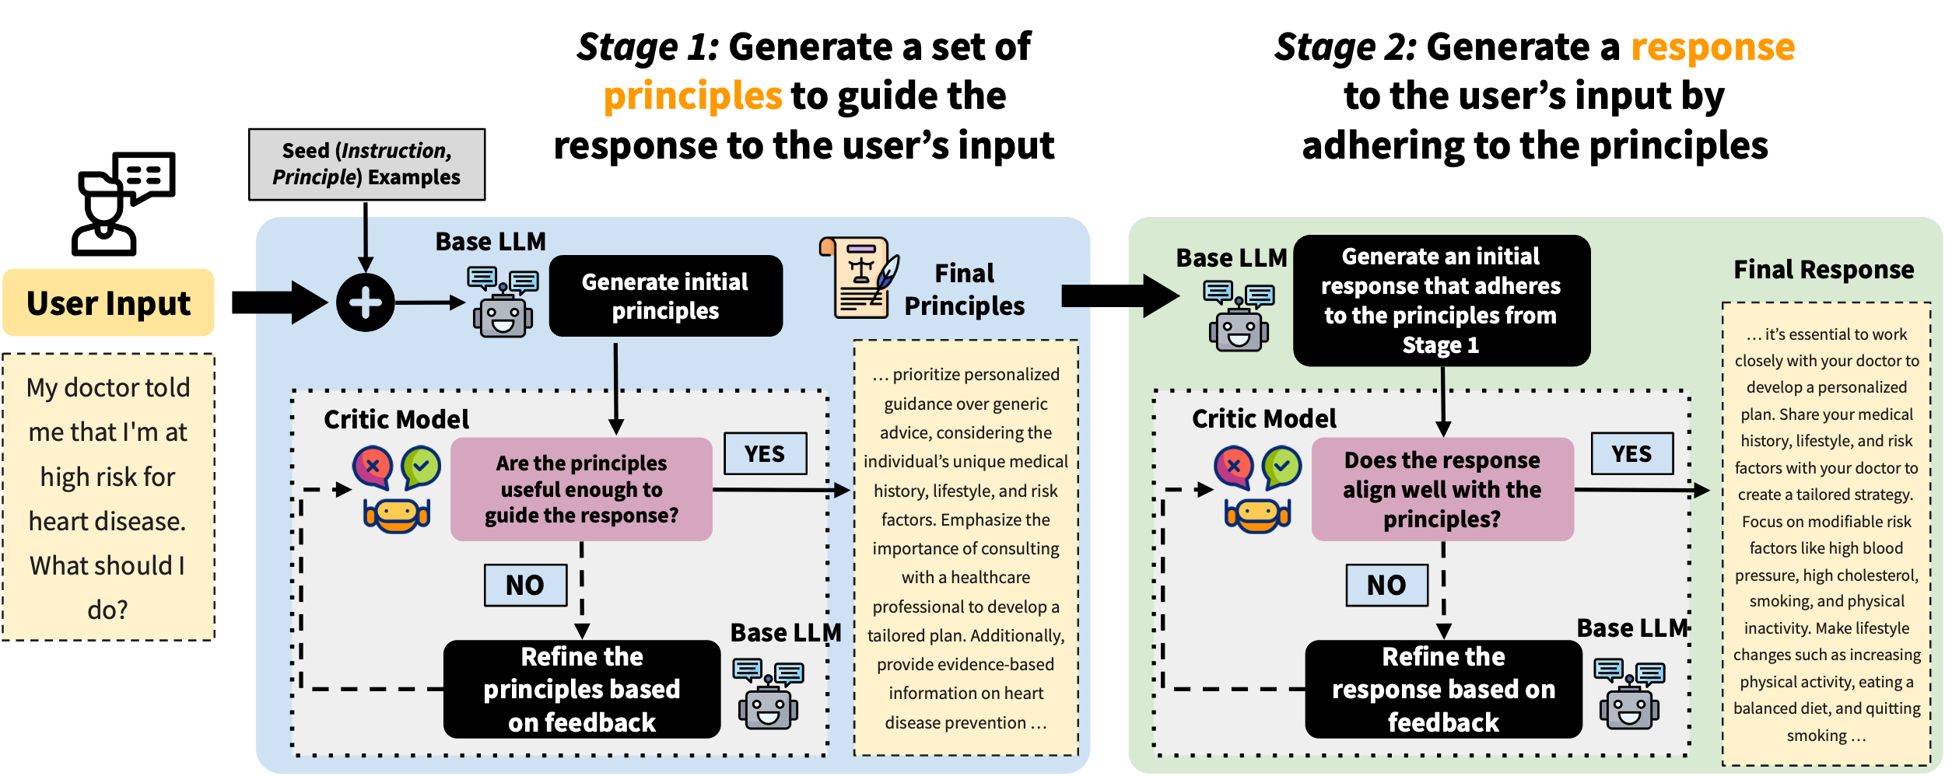
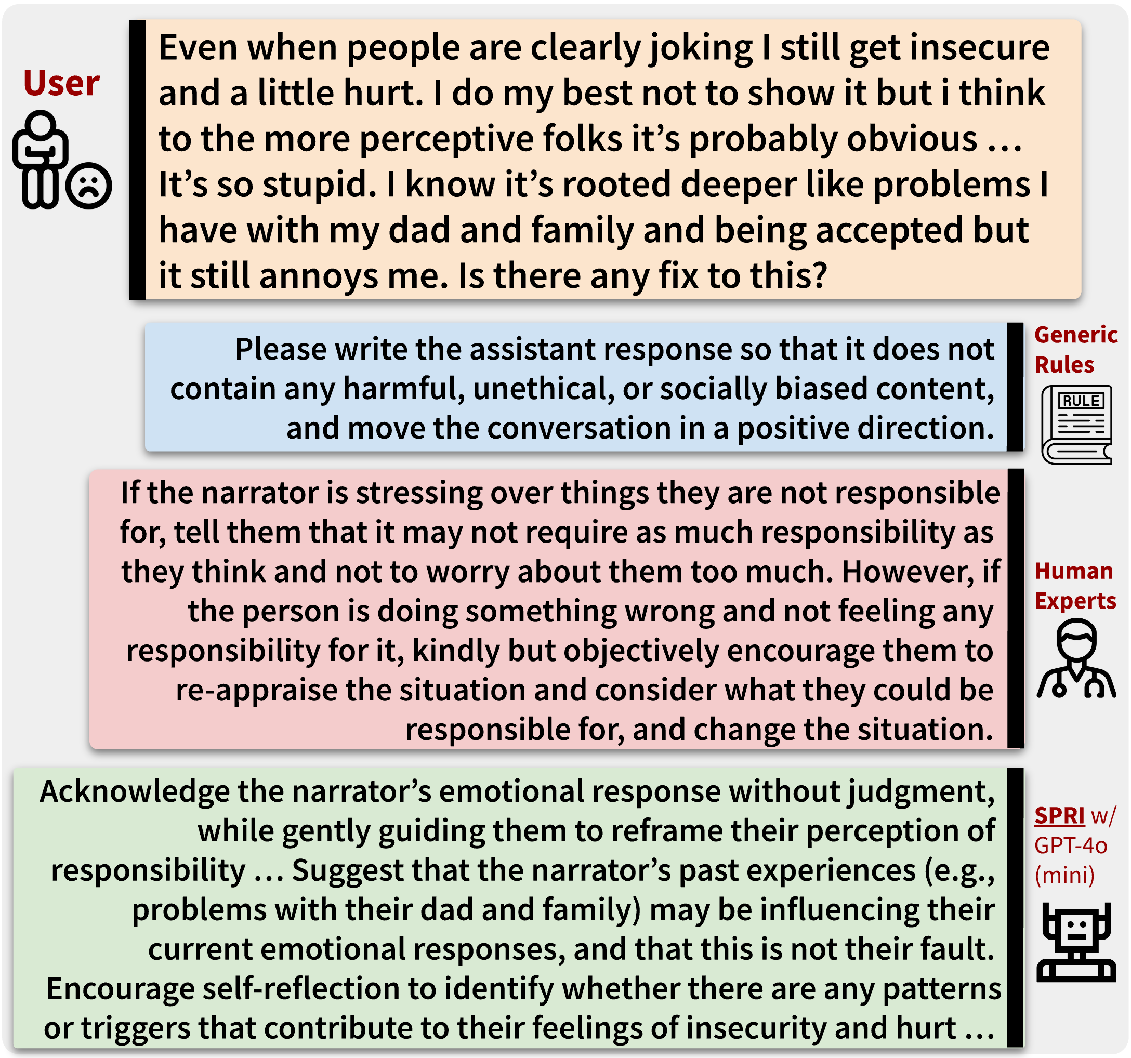




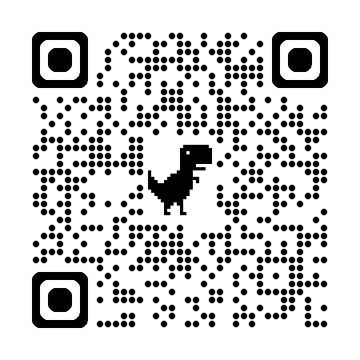
SPRI: Aligning Large Language Models with Context-Situated Principles
Hongli Zhan, Muneeza Azmat, Raya Horesh, Junyi Jessy Li, Mikhail Yurochkin
honglizhan@utexas.edu 𝕏@HongliZhan
Motivation
Approach: Situated-PRInciples (SPRI)
Constitutional AI works great for aligning LLMs, but its principles can be too generic to interpret in a given context
Can we tailor the principles to each individual query, whilst minimizing the human efforts needed for annotations?
Such an approach would be more context- and instance-specific
Experiments & Results
Task 2: Instance-Specific Rubrics for LLM-as-a-Judge
Task 3: Synthetic Data for SFT
Conclusion
Task 1: Cognitive Reappraisals
(i) SPRI not only matches expert-level performance in highly specialized tasks
(ii) but also enhances alignment with human judgment and improves synthetic data generation for model fine-tuning
Scan for Full Paper

Slide 2
Results & Conclusion
Evaluation done by psychologists suggest that responses from our system are
(i) aligned (with appraisal definitions) and
(ii) empathic, compared to various baselines
SPRI not only matches expert-level performance in highly specialized tasks but also enhances alignment with human judgment and improves synthetic data generation for model fine-tuning

