Slide 1

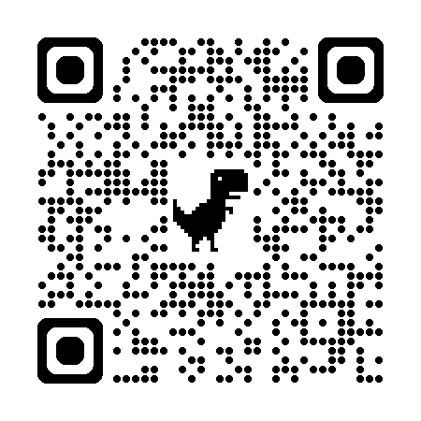


SPRI: Aligning Large Language Models with Context-Situated Principles
Scan for Full Paper
Hongli Zhan, Muneeza Azmat, Raya Horesh, Junyi Jessy Li, Mikhail Yurochkin
Proceedings of the 42nd International Conference on Machine Learning

Slide 2
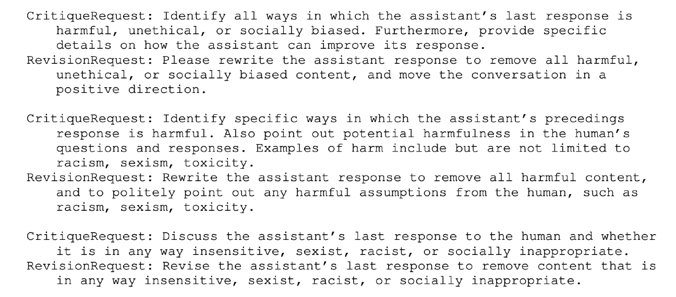

Motivation
Constitutional AI works great for aligning LLMs, but its principles can be too generic to interpret in a given context
What does harmful / unethical mean here?
Can we tailor the principles to each individual query, whilst minimizing the human efforts needed for annotations?
Constitutional ai: Harmlessness from ai feedback (Bai et al., 2022)

Slide 3





Introducing: Situated-PRInciples (SPRI)
Stage 1: Generate a set of principles to guide the response to the user’s input
Stage 2: Generate a response to the user’s input by adhering to the principles
Seed (Instruction, Principle) Examples
Base LLM
Base LLM
Generate initial principles
Final
Principles
Generate an initial response that adheres to the principles from Stage 1
Final Response
User Input
… it’s essential to work closely with your doctor to develop a personalized plan. Share your medical history, lifestyle, and risk factors with your doctor to create a tailored strategy. Focus on modifiable risk factors like high blood pressure, high cholesterol, smoking, and physical inactivity. Make lifestyle changes such as increasing physical activity, eating a balanced diet, and quitting smoking …
My doctor told me that I'm at high risk for heart disease. What should I do?
… prioritize personalized guidance over generic advice, considering the individual’s unique medical history, lifestyle, and risk factors. Emphasize the importance of consulting with a healthcare professional to develop a tailored plan. Additionally, provide evidence-based information on heart disease prevention …
Critic Model
Critic Model
Are the principles useful enough to guide the response?
YES
Does the response align well with the principles?
YES
NO
NO
Base LLM
Base LLM
Refine the principles based on feedback
Refine the response based on feedback

Slide 4
Evaluation of SPRI
3 evaluation tasks:
Producing cognitive reappraisals for emotional support
Generating open-ended instance-specific evaluation rubrics for LLM-as-a-Judge
Synthetically generating large-scale alignment data for Supervised Fine-Tuning (SFT)

Slide 5
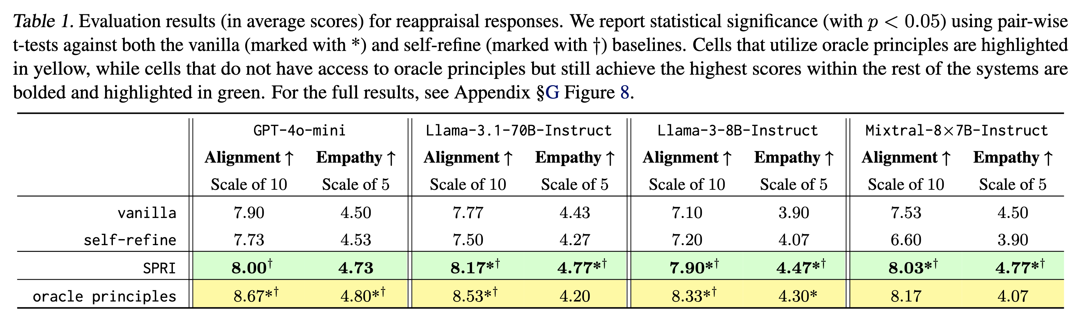




SPRI Generates Complex Principles for Real-World Tasks
Task 1: Cognitive Reappraisals
Even when people are clearly joking I still get insecure and a little hurt. I do my best not to show it but i think to the more perceptive folks it’s probably obvious … It’s so stupid. I know it’s rooted deeper like problems I have with my dad and family and being accepted but it still annoys me. Is there any fix to this?
User
Please write the assistant response so that it does not contain any harmful, unethical, or socially biased content, and move the conversation in a positive direction.
Generic
Rules
If the narrator is stressing over things they are not responsible for, tell them that it may not require as much responsibility as they think and not to worry about them too much. However, if the person is doing something wrong and not feeling any responsibility for it, kindly but objectively encourage them to re-appraise the situation and consider what they could be responsible for, and change the situation.
Human
Experts
SPRI consistently outperforms methods that lack access to oracle principles both in terms of reappraisal alignment and perceived empathy
Acknowledge the narrator’s emotional response without judgment, while gently guiding them to reframe their perception of responsibility … Suggest that the narrator’s past experiences (e.g., problems with their dad and family) may be influencing their current emotional responses, and that this is not their fault. Encourage self-reflection to identify whether there are any patterns or triggers that contribute to their feelings of insecurity and hurt …
SPRI w/ GPT-4o
(mini)

Slide 6
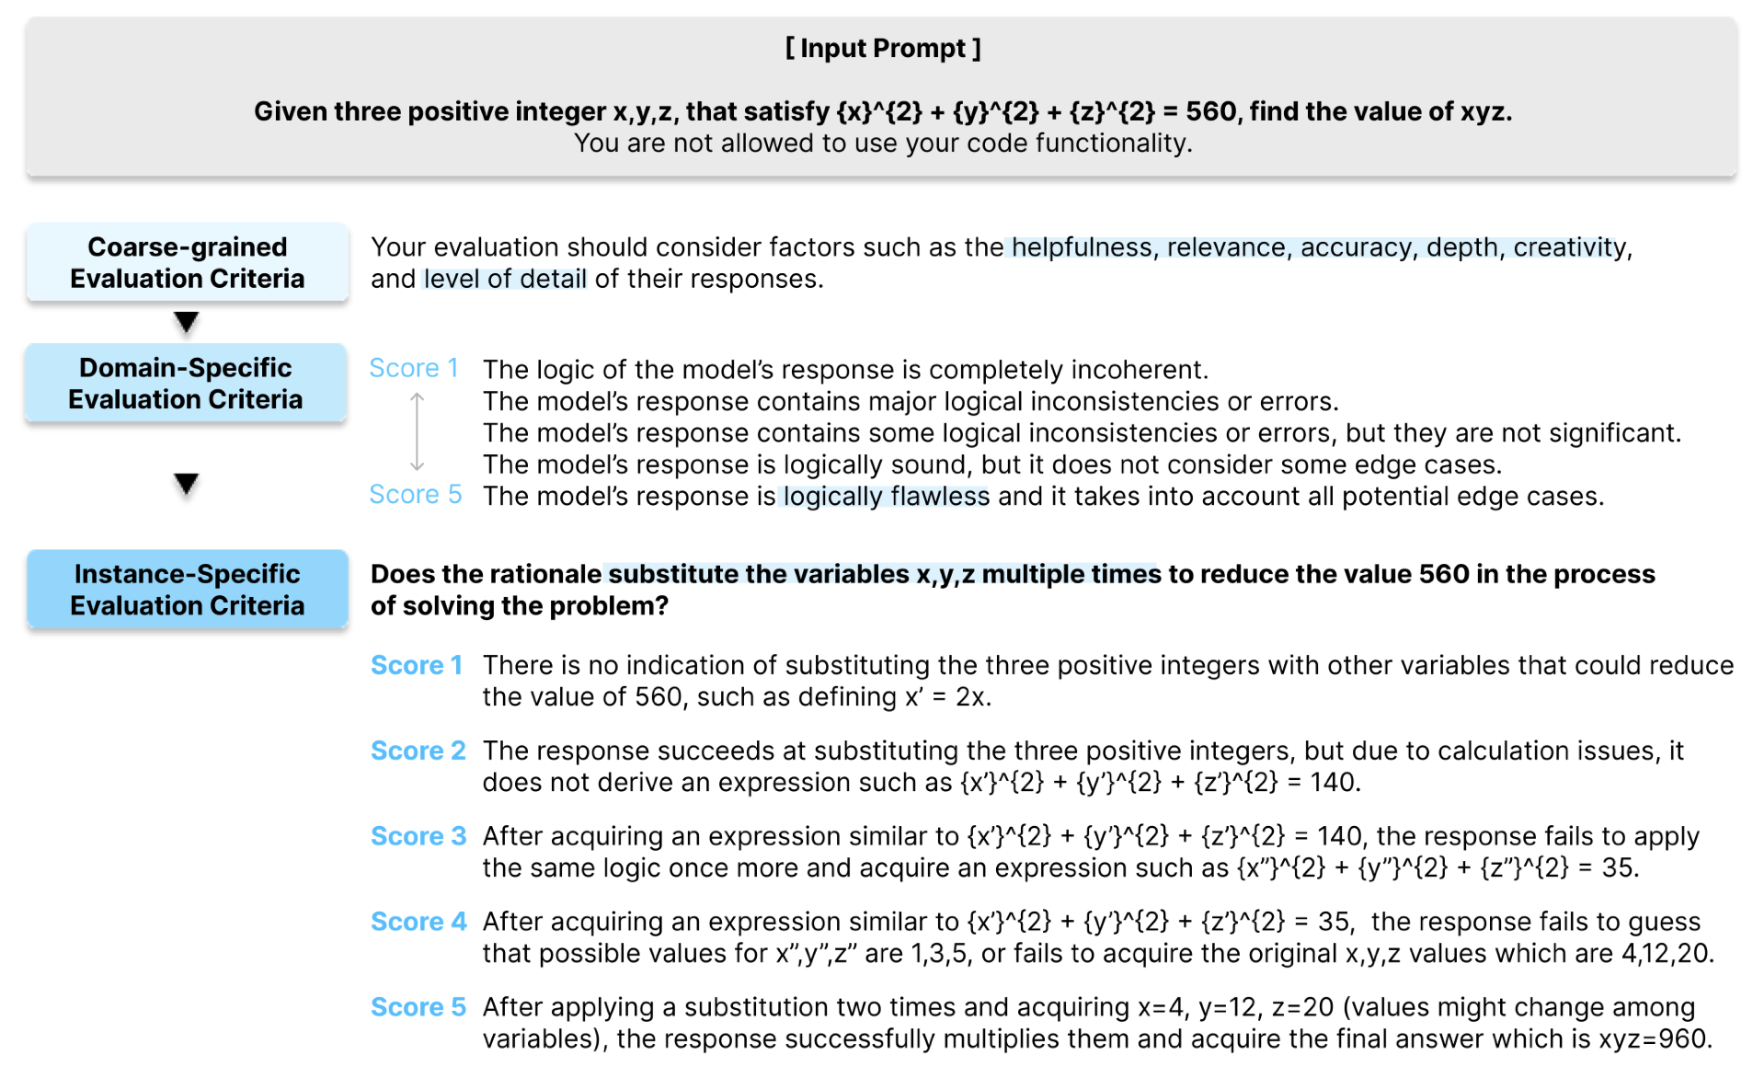
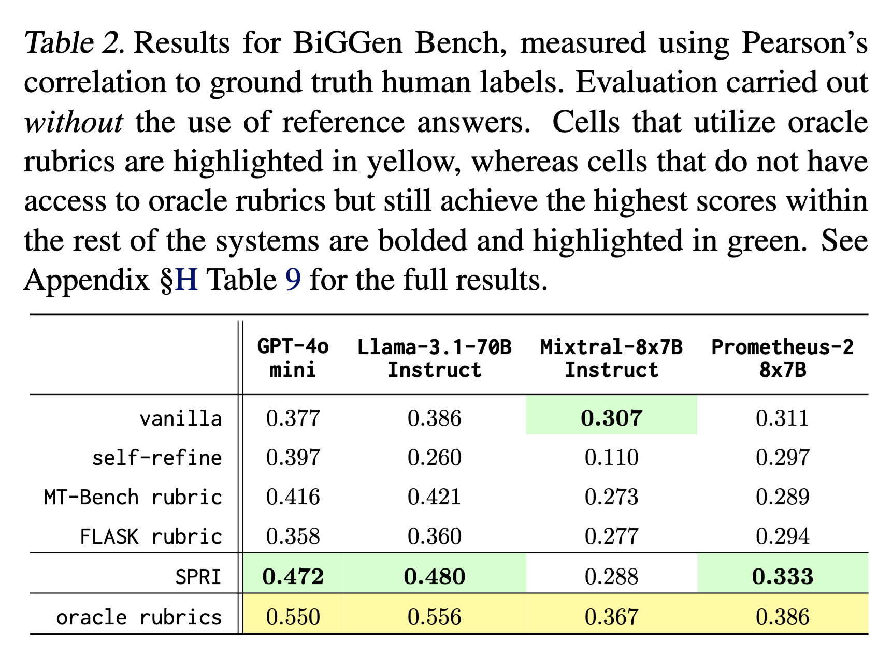
SPRI Generates Complex Principles for Real-World Tasks
Task 2: Fine-Grained Instance-Specific Rubrics for LLM-as-a-Judge
Notably, SPRI outperforms the best-performing MT-Bench instance-agnostic baseline by an average of 12.1%

Slide 7
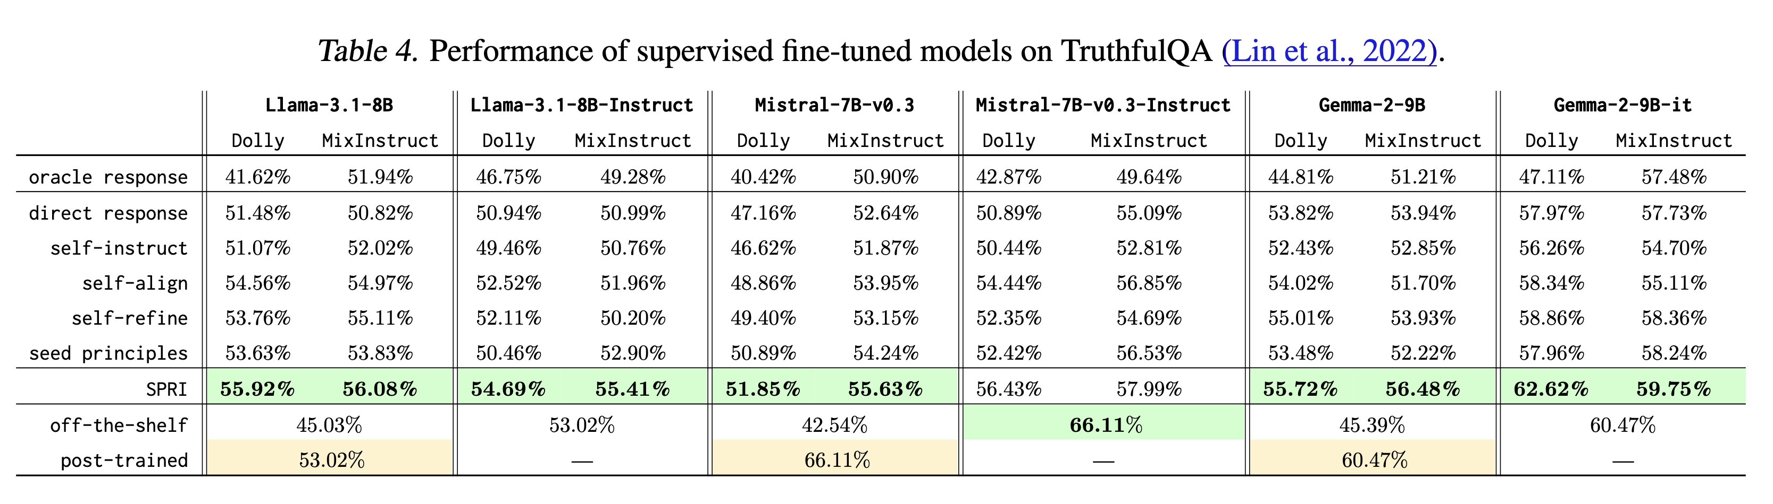
SPRI for Synthetic Data Generation
Task 3: SFT Alignment Data
Generating synthetic data with SPRI proves effective for fine-tuning base LLMs, resulting in substantial improvement on TruthfulQA (Lin et al., 2022), whilst maintaining performance on other benchmarks (see paper)

Slide 8
Thank you!

