Slide 1

An Analysis of Regional Hospital Emergency Department Waiting Times

Slide 2
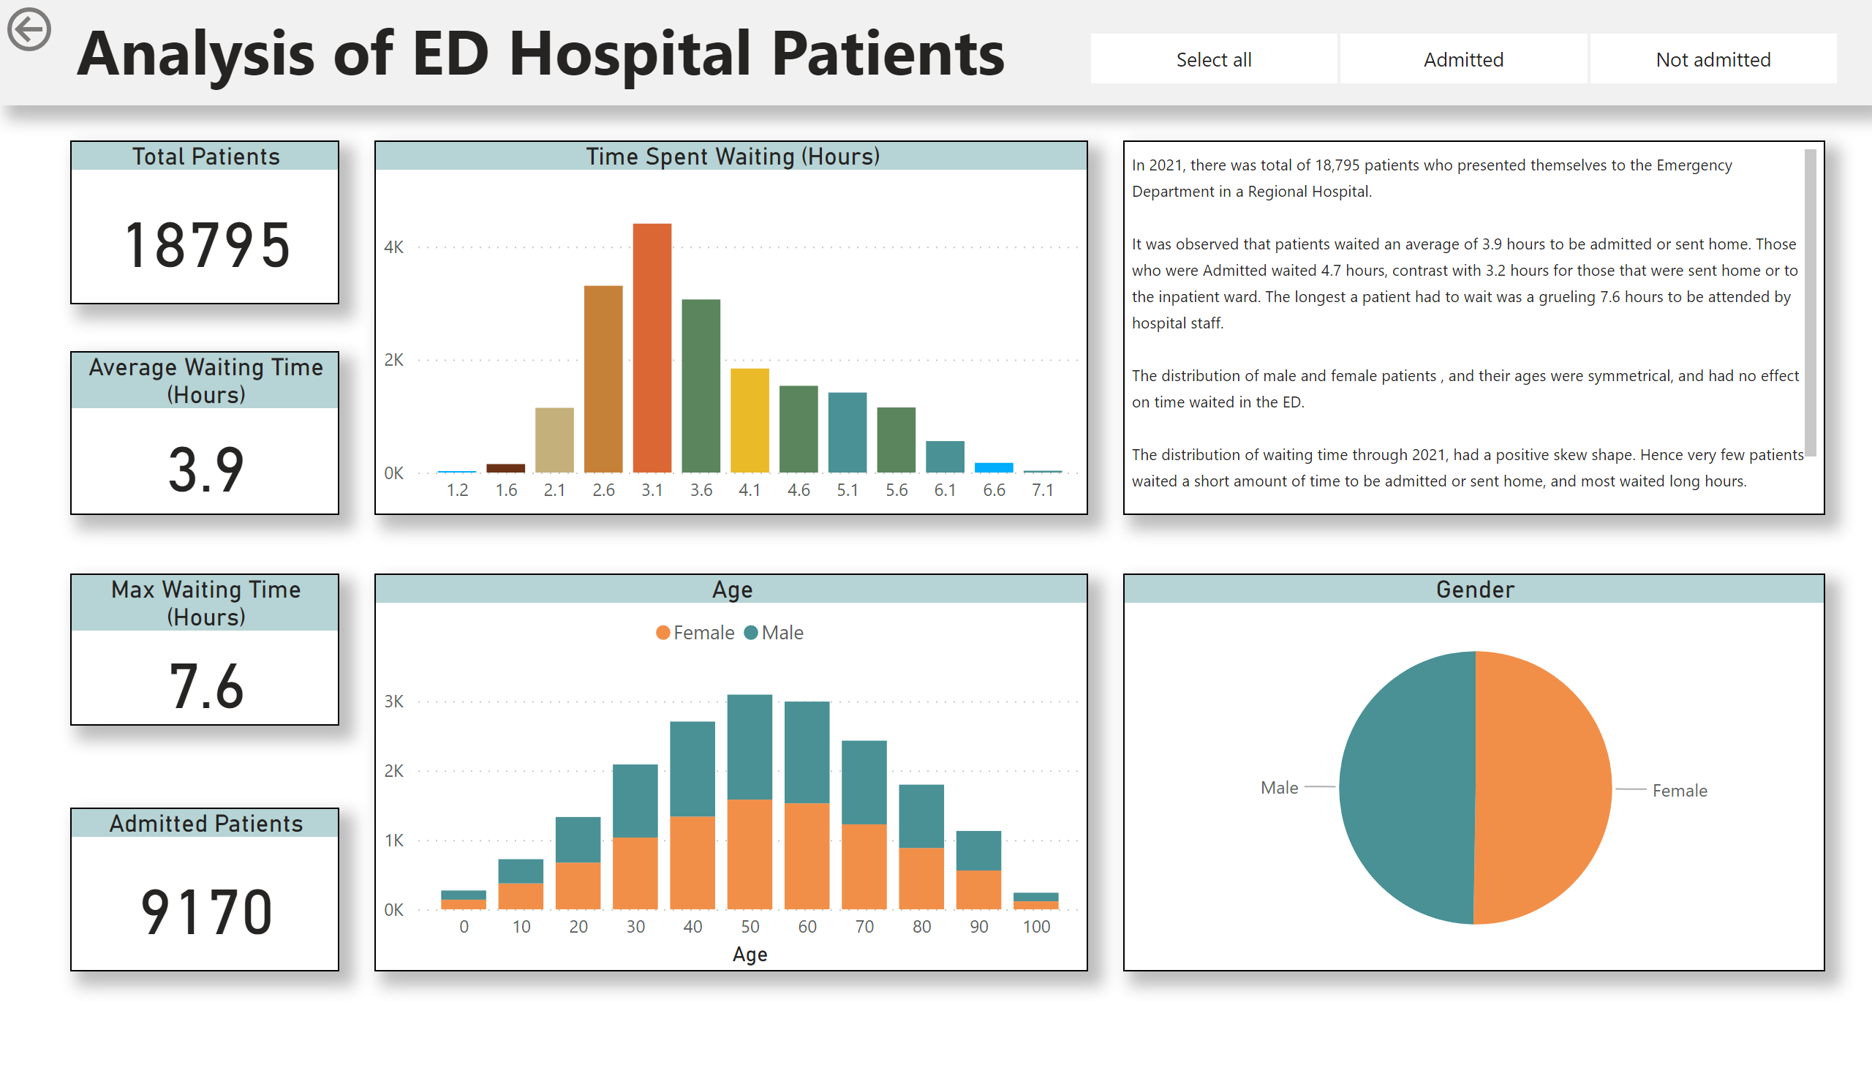
Page 2
Notes:
Cleaning and Preparing the Data:
Patient IDs
Removed Duplicates
Patient DOBs
Created a new column ‘Age’ from the given ‘DOB’ column to make graphs.
I also then grouped the ‘Age’ column to sections of 10 years, to make a final column ‘Age (Bins)’
Time in ED
Removed rows that had negative values, by using greater than >0 filter
Made a new column ‘Time in ED (Hours)’ which converted the minutes to hours by calculating minutes/60 on each row and rounded to 1 decimal place.
Arrival Time
Split this column to create ‘Quarter’ column into the 4 Quarters of 2021.
Overview of Patients who presented to the ED in 2021
Card values:
Total Patients
Used the count of ‘Patient ID’ column
Average Waiting Time
Used the new ‘Time in ED (hours)’ column to view the average value.
Max Waiting Time
Also Used the new ‘Time in ED (hours)’ column to calculate a static value of the max waiting time.
Admitted Patients
Created a quick measure for Admitted patients only with DAX
Slicer
Can easily view how each graph changes with admitted, not admitted patients
Time Spent Waiting Hours graph.
Grouped the ‘Time in ED (Hours)’ into 13 groups to create the graph by amount of patients
Age Graph
Used count of ‘Patient ID’ column on y-axis by ‘Age(bins)’ on x-axis. Finally including a second level by using ‘Gender’ as the legend.
Gender Pie chart
Used Gender as the legend and using ‘Patient ID’ as the values

Slide 3
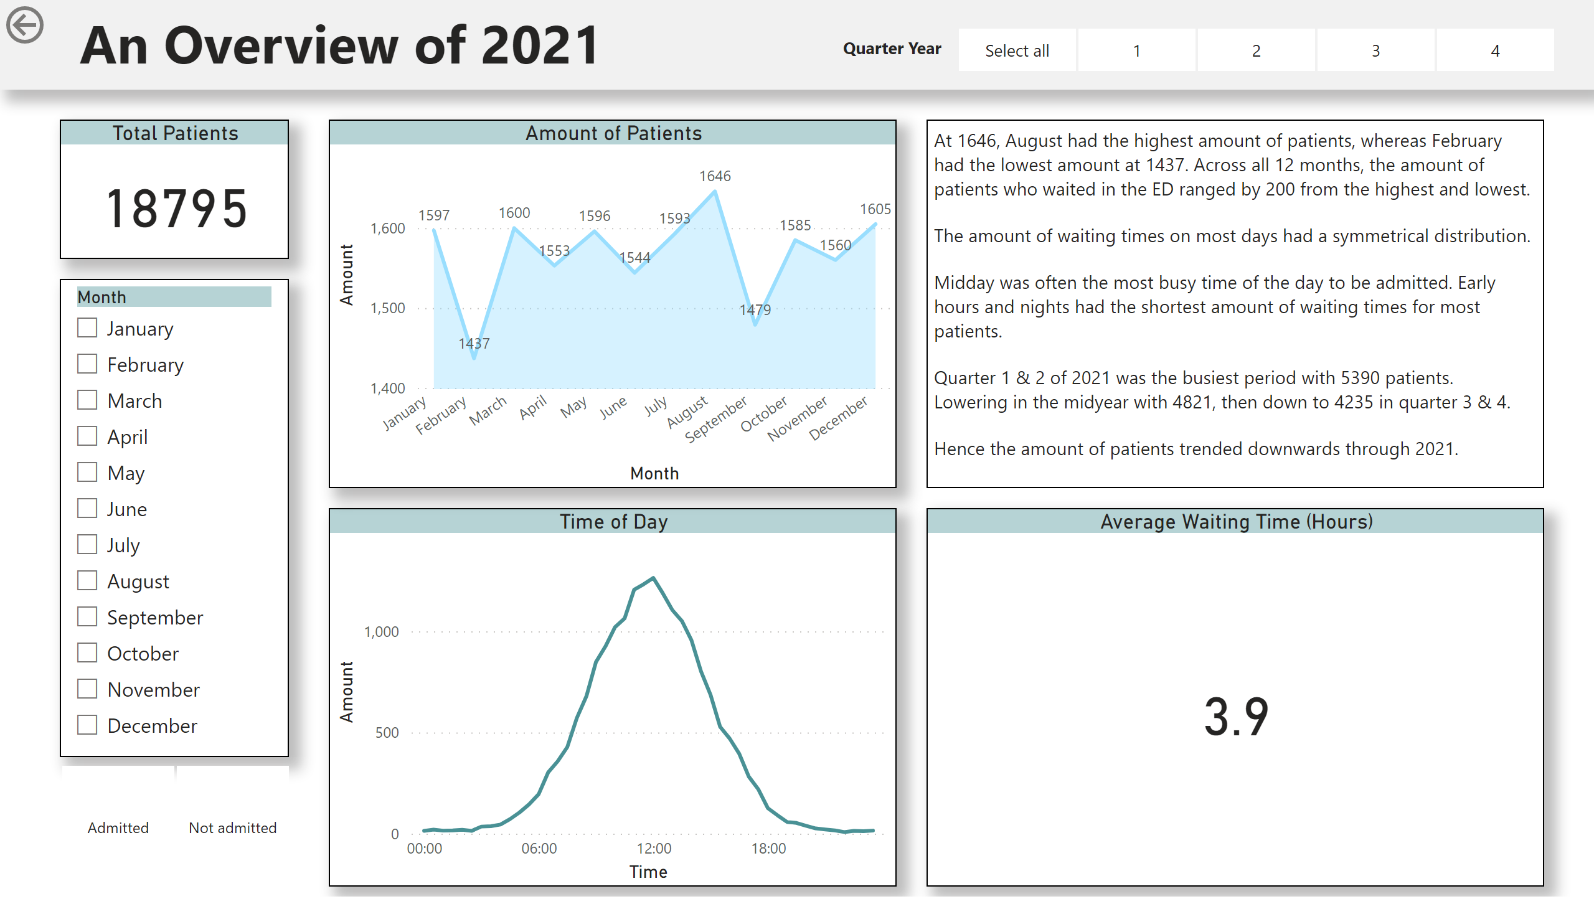
Notes:
Spotlight the year through quarters and individual months, and days.
Total Patients Card
Used the count of ‘Patient ID’ column
Month slicer
Choose any month and see amount of patients and time.
Admitted slicer
Created a slicer in bottom left corner to split groups of patients of Admitted, Not Admitted.
Quarter slicer
Used the new ‘Quarter’ column to create the slicer in top right corner to easily view each quarter of 2021
or click to view 2 or more at the same time.
Amount of Patients
X-axis: Month
Y-axis: Count of Patients
Time Graph by Amount of Patients
Used the new ‘ Time of Day’ column by splitting the ‘Arrival Time’ column into the time only.
Then group the times to a new column ‘Time of Day (bins)’ into 30 minute intervals.
Average Waiting Time
As mentioned before, used the new ‘Time in ED (hours)’ column to view the average time waiting value.

Slide 4
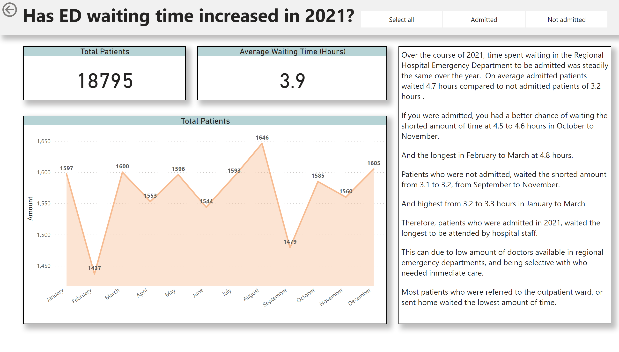
Page 3
Notes:
Spotlighting the year as a whole
Total Patients Card
As mentioned before, used the count of ‘Patient ID’ column
Average Waiting Time
As mentioned before, used the new ‘Time in ED (hours)’ column to view the average time waiting value.
Total of Patients
X-axis: Month
Y-axis: Count of Patients

