Slide 1


PROTOTYPE
DESIGN PATTERN

Slide 2
CONTENT
1
Idea
2
Usage
3
Advantages
4
Practical Example

Slide 3

IDEA
MAIN IDEA
Specify the kinds of objects to create using a prototypical instance, and create new objects by copying this prototype.
Co-opt one instance of a class for use as a breeder of all future instances.

Slide 4
USAGE
1
When the classes are instantiated at runtime.
2
When the cost of creating an object is expensive or complicated.
3
When the client application needs to be unaware of object creation and representation.

Slide 5
ADVANTAGES
1
2
3
4
It eliminates the (potentially expensive) overhead of initializing an object
It simplifies and can optimize the use case where multiple objects of the same type will have mostly the same data.
It hides complexities of creating objects.
It reduces the need of sub-classing
Notes:
Pillars slide

Slide 6
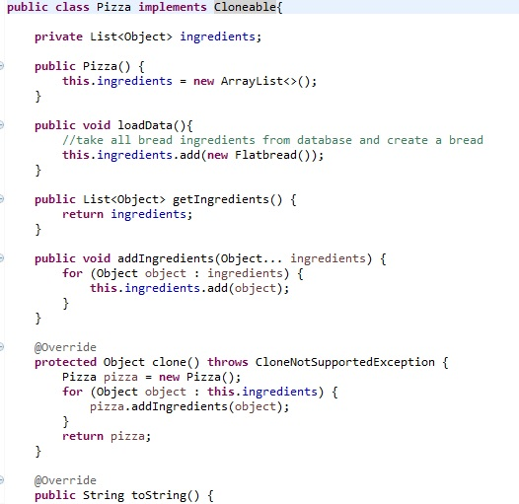
IMPLEMENTATION
Notes:
P37 – divide into 2 slides

Slide 7
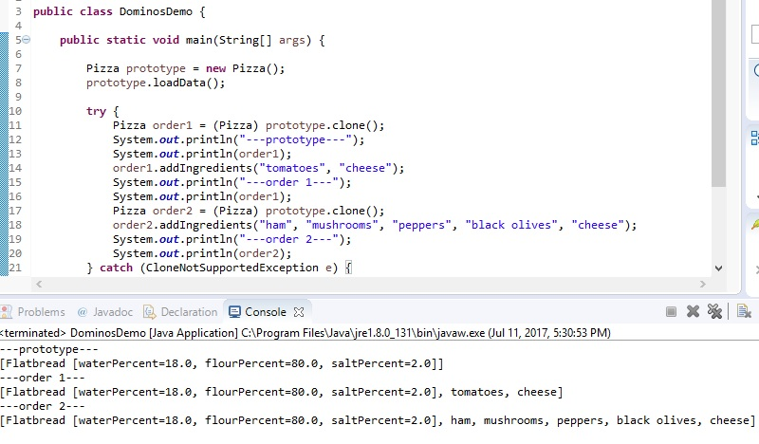
PRACTICAL EXAMPLE
Notes:
P37 – divide into 2 slides

