Slide 1
Vanilla Policy Gradient
Aditya Dhavala
Aaditya
Arpit Chandrakar
Shravan Nermati
Vineeth

Slide 2
Introduction
Vanilla Policy Gradient (VPG) is a fundamental reinforcement learning algorithm used to train agents in a trial-and-error manner.
At a high level, VPG focuses on improving an agent's behavior over time to maximize the total rewards it can earn in an environment.
It achieves this by directly adjusting the agent's policy, which is like its strategy, to increase the likelihood of taking actions that lead to higher rewards.
VPG is a simple and intuitive approach to reinforcement learning that forms the basis for more advanced algorithms, making it an important concept in the field.

Slide 3
Working
VPG trains a stochastic policy in an on-policy way. This means that it explores by sampling actions according to the latest version of its stochastic policy. The amount of randomness in action selection depends on both initial conditions and the training procedure. Over the course of training, the policy typically becomes progressively less random, as the update rule encourages it to exploit rewards that it has already found. This may cause the policy to get trapped in local optima.
PPO is an advancement over VPG and addresses its high variance issue by using a surrogate objective. PPO generally outperforms VPG in terms of stability, sample efficiency, and convergence speed.

Slide 4
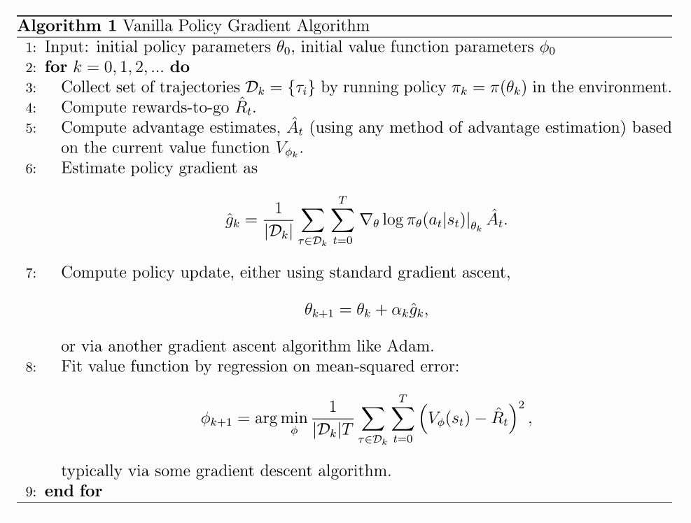
Implementation

Slide 5
Working
Initialization (Lines 1-2):
Initialize the policy parameters ( θ ​ ) and the value function parameters ( ɸ ).
Main Loop (Lines 2-9):
The algorithm iterates over episodes or iterations, indexed by k.
Data Collection (Line 3):
Collect a set of trajectories ( D ​ ) by running the current policy ( θₖ ​ ) in the environment. Trajectories consist of state-action pairs and rewards.

Slide 6
Working
Compute Rewards-to-Go (Line 4):
Compute the rewards-to-go ( R ​ ) for each time step t in the trajectories. The rewards-to-go is the total discounted reward from time step t onwards till termination for that state.
Compute Advantage Estimates (Line 5):
Using any method of advantage estimation (e.g., subtracting a value function estimate from the Q Value), compute advantage estimates ( A_{t} ​ ) based on the current value function ( V = θ ​ ).
Compute Policy Gradient (Line 6):
Estimate the policy gradient ( ∇θ ​ J(θ)) using the advantage estimates ( A_{t} ​ ) and the log probabilities of actions ( logπ θ ​ (a∣s)) according to the current policy. This step calculates how policy parameters should be adjusted to maximize expected return.

Slide 7
Working
Policy Update (Line 7):
Update the policy parameters using gradient ascent, typically following the standard gradient ascent rule (θ k+1 ​ =θ k ​ +α k ​ ∇ θ ​ J(θ)), where α k ​ is the learning rate. Alternatively, another gradient ascent algorithm like Adam can be used for the update.
Value Function Update (Line 8):
Fit value function by regression on mean-squared error: typically via some gradient descent algorithm
Iteration (Line 9):
The algorithm proceeds by iteratively collecting data, computing rewards-to-go and advantage estimates, estimating policy gradients, updating the policy parameters, and updating the value function. This process continues until convergence or a predefined stopping criterion is met, improving the policy to maximize the expected return.

Slide 8
Pros and cons
Pros
simple to understand and implement, making it a good starting point for those new to RL.
VPG is an on-policy algorithm that can be used for environments with either discrete or continuous action spaces
VPG directly optimizes the expected return by maximizing the objective function, making it suitable for applications where optimizing the policy is the primary goal.
Cons
VPG often suffers from high variance in the policy gradients, which can lead to slow convergence and instability during training.
Can be stuck in local optima
Unlike value-based methods, VPG does not explicitly learn a value function, which can limit its ability to generalize and estimate the value of states.

Slide 9

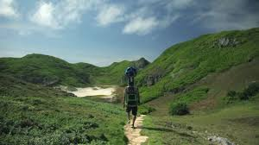

Slide 10
Applications
VPG is an on-policy algorithm.
VPG can be used for environments with either discrete or continuous action spaces.
The Spinning Up implementation of VPG supports parallelization with MPI.
Vanilla Policy Gradient (VPG) and its variants find applications across a wide range of domains due to their capability to directly learn policy parameterizations and handle continuous action spaces. Here are some notable applications of VPG in various fields:
Robotics
Game playing
NLPs
Healthcare
Finance
Autonomous vehicles

Slide 11
References
https://spinningup.openai.com/en/latest/algorithms/vpg.html
https://medium.com/analytics-vidhya/a-deep-dive-into-vanilla-policy-gradients-3a79a95f3334
https://medium.com/@alancooney/vanilla-policy-gradient-from-scratch-3c9ebb4de441

Slide 12
Thank you!

